Slide 1
What’s Going On In Canada After World War I?
A lot...Socially, Economically, and Politically

Slide 2
Heritage Minute Video
https://www.youtube.com/watch?v=0stBqPP5VaA-

Slide 3

Background Survey
P-rior knowledge of the strike?
T-hink-Pair
What is happening in 1919? (War is over in 1918).
S-hare
D-iscuss
Notes:
Who were the main participants in the strike? What are the causes of strikes? Are there long-term consequences of strikes? What is a union? How does the formation of unions change the workplace?

Slide 4

Essential Questions:
What was Canada like after the war?
How were Canadians feeling during this time?

Slide 5
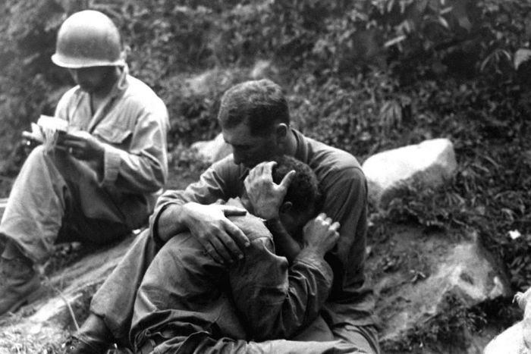
Notes:
https://www.abc.net.au/radionational/programs/archived/hindsight/the-history-of-forgetting/5744242

Slide 6
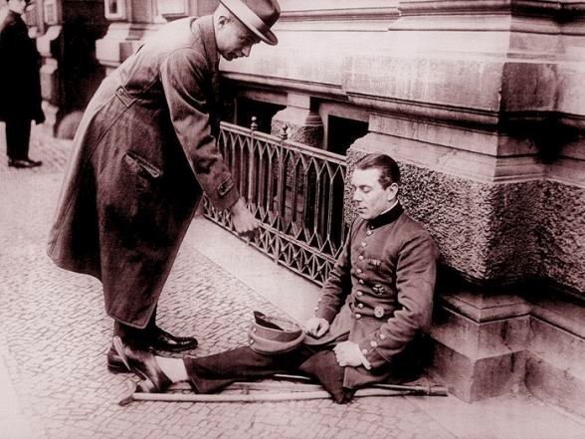
Notes:
https://live.warthunder.com/post/247001/en/?comment=987370

Slide 7
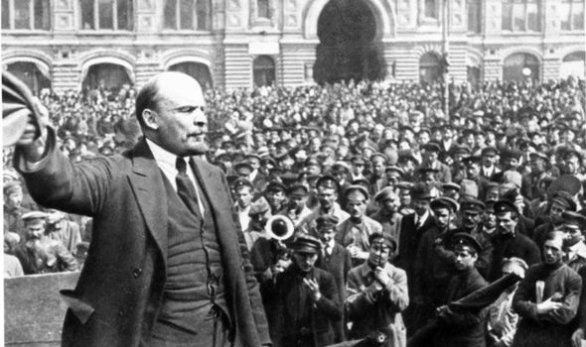
Notes:
https://www.express.co.uk/comment/expresscomment/872638/Russian-Revolution-100-years-communism

Slide 8

Scavenger Hunt
1 Answer=1 Point
What is the prohibition and Spanish Flu? How were Canadians affected?
What were the demands of women? Veterans? And workers after the war?
Why did the strikes happen and why was the Canadian government/employers alarmed to the strikes?

Slide 9
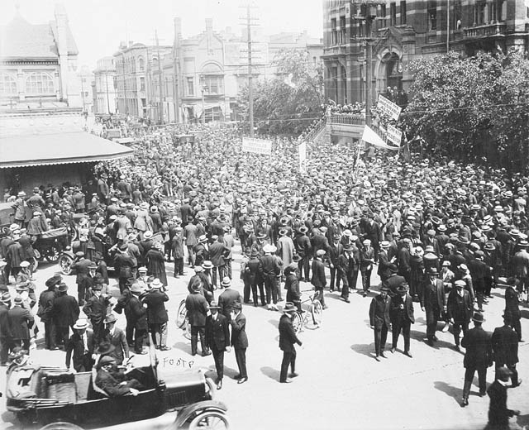

Slide 10
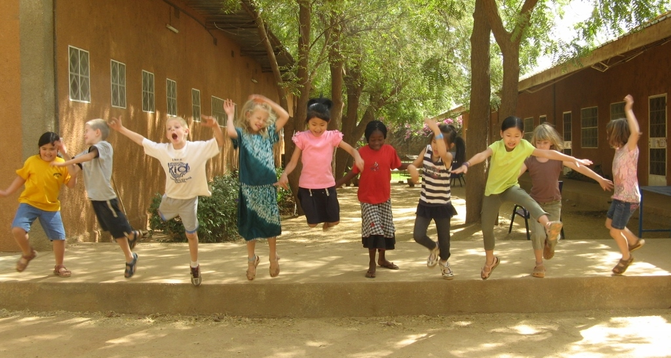
Let's Take A Break!

Slide 11
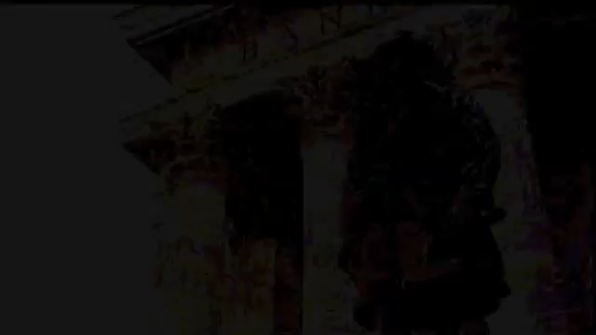

Slide 12

Video-Why did the strike happen?
-Who were the participants?
-What were the consequences of the strike?

Slide 13
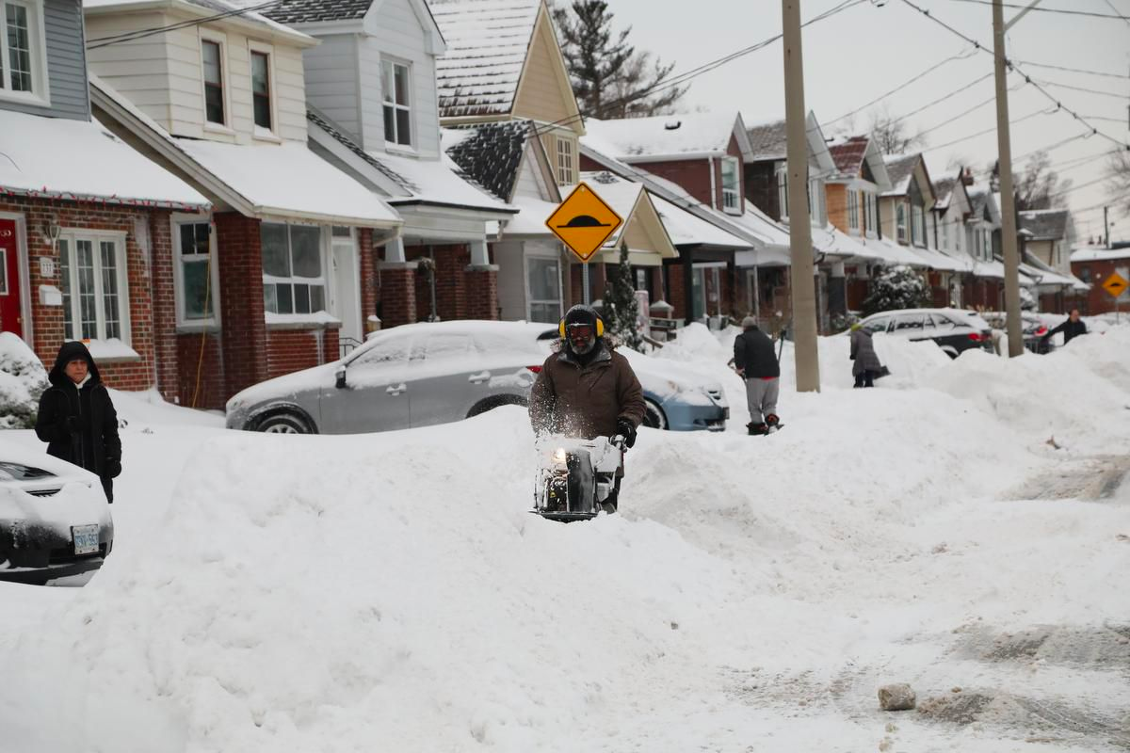
Historical Significance/Cause and Consequences
Snowstorm!!!

Slide 14
Extra Readings/Resources
https://www.cbc.ca/news/canada/manitoba/winnipeg-general-strike-legacy-1.5137684

