Slide 1
INTRO TO HUMAN
GEOGRAPHY

Slide 2
HUMAN GEOGRAPHY: FIVE THEMES
Location – the space that is occupied in the universe (absolute/relative).
Place – physical and human characteristics: space after humans.
Human/Environment Interactions – how humans depend, modify, and adapt to their environments.
Movement – how humans interact on earth, the diffusion of religion or trade patterns through connections of peoples.
Regions – an area with one or more shared characteristics.

Slide 3
SPACE/LOCATION
Distribution – the arrangement of a feature in space.
  Three properties
  Density – the frequency with which something occurs.
  Concentration – the extent of a feature’s spread over space. Used to describe changes in distribution.
    Clustered
    Dispersed
  Pattern – geometric arrangement of objects in space.

Slide 4
EVOLUTION OF MAPMAKING
Babylonians – 2300 BC earliest surviving maps written on clay tablets.
Aristotle – 384-322 BC demonstrated earth was spherical through maps.
Eratosthenes – 276-194 BC first person to use the word geography. Also the first person to correctly divide earth into 5 climatic regions.
Ptolemy – 100-170 AD Guide to Geography
Age of Exploration – by the 17th century, most continents and oceans were accurately displayed.

Slide 5
HOW TO LIE WITH MAPS
A map is a generalization or representation of the real world.
Cartography – the science of mapmaking.
Contemporary Mapping –
  Remote Sensing Satellites
  GIS (geographic information systems)
  GPS (global positioning system)
All maps lie. They contain distortions. You cannot represent the three-dimensional earth on a flat surface without distorting reality.
Any useful map is selective in what is put in and left out. Example: road or subway map.

Slide 6
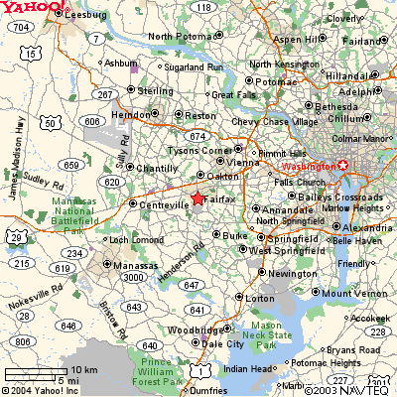

Slide 7
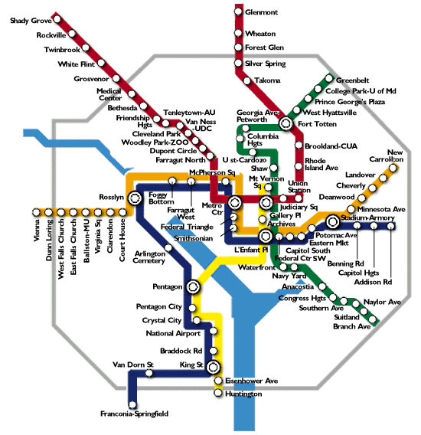

Slide 8
Any single map is but one of an indefinitely large number of maps that might be produced for the same situation from the same data.

Slide 9
THREE SOURCES OF MAP DISTORTION
Map scale – most maps are smaller than the reality they represent. Map scales tell us how much smaller.
Map projection – this occurs because you must transform the curved surface of the earth on a flat plan.
Map type – you can display the same information on different types of maps.

Slide 10
MAP SCALE – TELLS US RELATIONSHIP BETWEEN DISTANCE ON MAP AND DISTANCE ON EARTH’S SURFACE
Ratio scale = ratio of map distance to earth distance.
  1:10,000 means that one inch on the map equals 10,000 inches earth’s surface; one centimeter represents 10,000 centimeters; or one foot equals 10,000 feet.
  Recall a small fraction has a large denominator so that 1:100,000 is a smaller scale than 1:25,000.
  A large-scale map depicts a small area with great detail.
  A small-scale map depicts a larger area with little detail. Distortion is especially severe here.

Slide 11
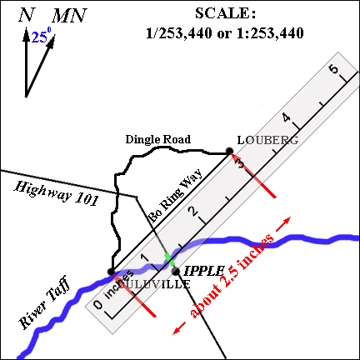
RATIO SCALE

Slide 12
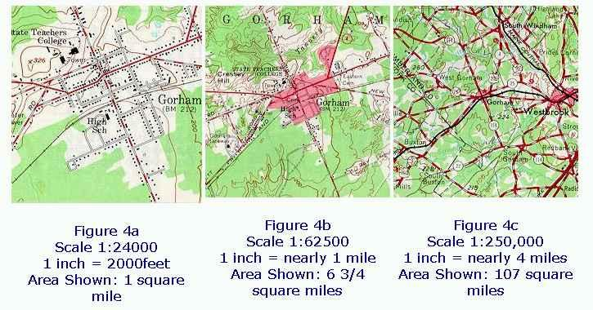
WHICH IS THE LARGE-SCALE MAP?

Slide 13
MAP SCALE CONTINUED
Verbal scale – translates the representative fraction into words.
  One inch represents one mile conveys more meaning than 1:63,630.
  Used little in places where people use metric system. People familiar with centimeters and kilometers have little need for verbal scales to tell them that 1:100,000 means that one centimeter equals 1 kilometer or that 1:250,000 means that four centimeter represent one kilometer.

Slide 14
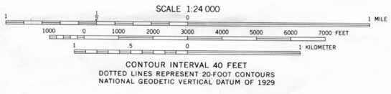
MAP SCALE CONTINUED
Graphic scale – is a simple bar scale that portrays distance on the map.

Slide 15
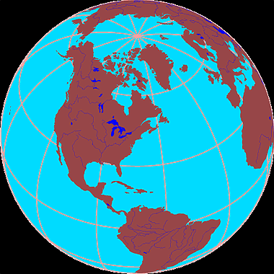
MAP PROJECTION IS THE WAY WE FIT EARTH’S THREE-DIMENSIONAL SURFACE ONTO FLAT PAPER OR A SCREEN

Slide 16
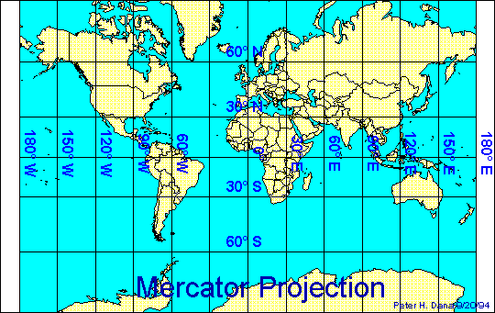
MERCATOR PROJECTION

Slide 17
MERCATOR PROJECTION
Stretches the poles from one length to the size of the equator. The north-south scale is constant, but east-west scale increases to twice the north-south scale at 60 degrees N and infinitely at the poles.
Shapes are correct for all areas, and map has correct directional relationships.
Look at the size of Greenland and Antarctica.
Map exaggerates the distance between Chicago and Stockholm, both in northern latitudes.

Slide 18
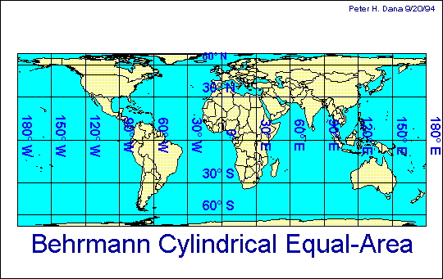
EQUAL AREA PROJECTION

Slide 19
EQUAL AREA PROJECTION
Represents areas correctly, but distorts shapes.
If South America is 8 times larger than Greenland on the globe, it will be 8 times bigger on the map.

Slide 20
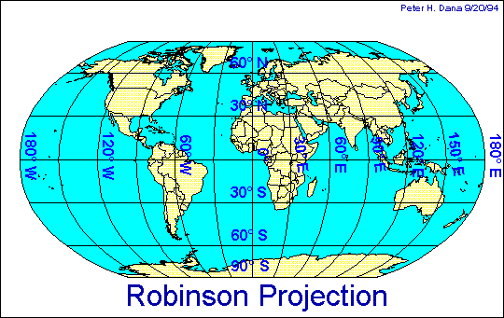
ROBINSON PROJECTION

Slide 21
ROBINSON PROJECTION
Frequently used.
Distorts both size and shape, but not too much.

Slide 22
MAP TYPE – YOU CAN DISPLAY THE SAME INFORMATION ON DIFFERENT MAPS
A thematic map depicts a single feature, for example: climate, population, landform or land use.
Types of thematic maps:
  Isoline – connects points of equal value
  Choropleth – puts features into classes and then maps classes for each region
  Proportional symbol – size of the symbol corresponds to the magnitude of the mapped feature
  Dot – each dot represents some frequency

Slide 23
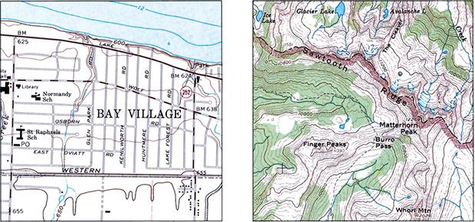
CONTOUR MAPS
reveal the nature of the local topography;
contour lines at given intervals indicate slope of a territory;
isolines can indicate lines of atmospheric pressure (isobars) or temperature (isotherms).

Slide 24
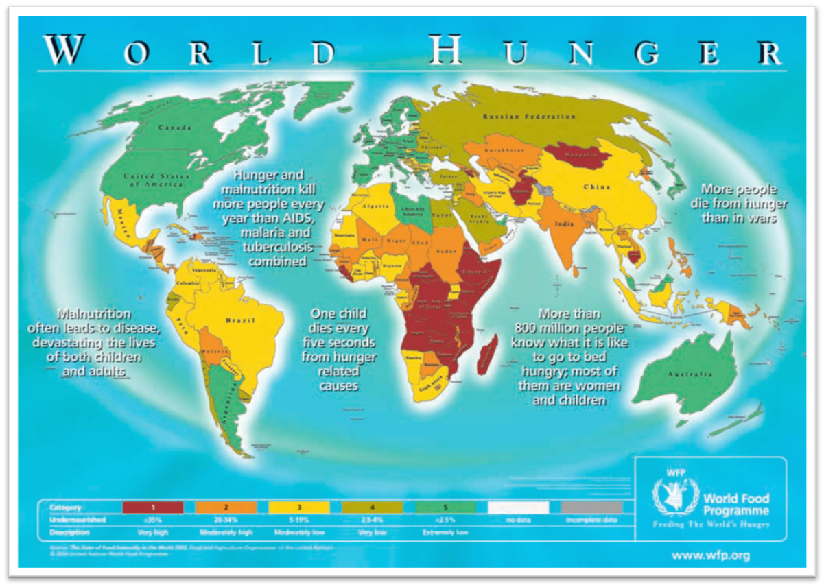
CHLOROPLETHIC MAP : GLOBAL HUNGER

Slide 25
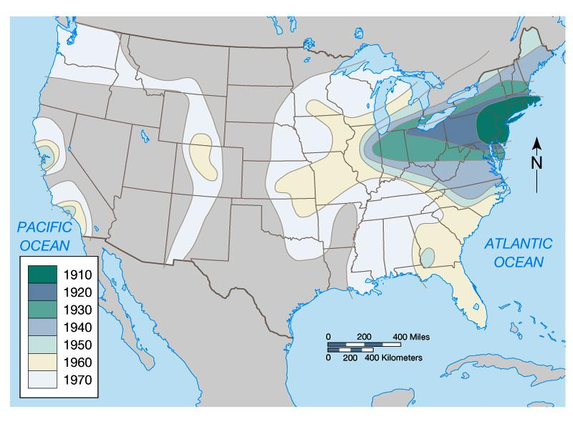
ISOMETRIC MAP :
SPATIAL DIFFUSION OF COLLEGE SOCCER

Slide 26
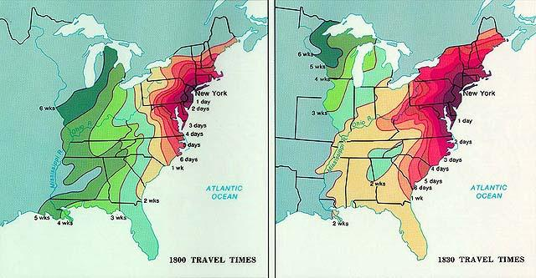
ISOMETRIC MAP:
TIME-SPACE COMPRESSION

Slide 27
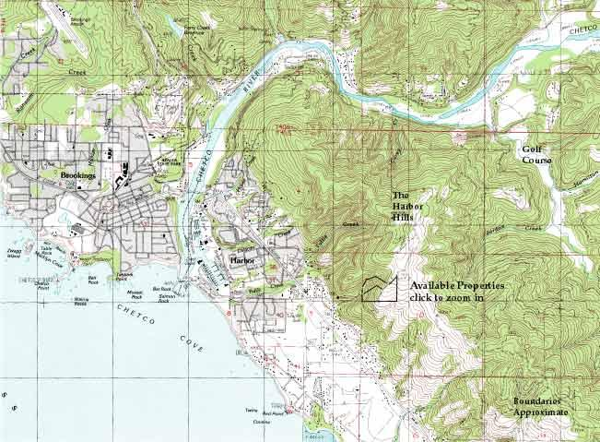
TOPOGRAPHIC MAP
(USING ELEVATION CONTOUR ISOLINES)

Slide 28
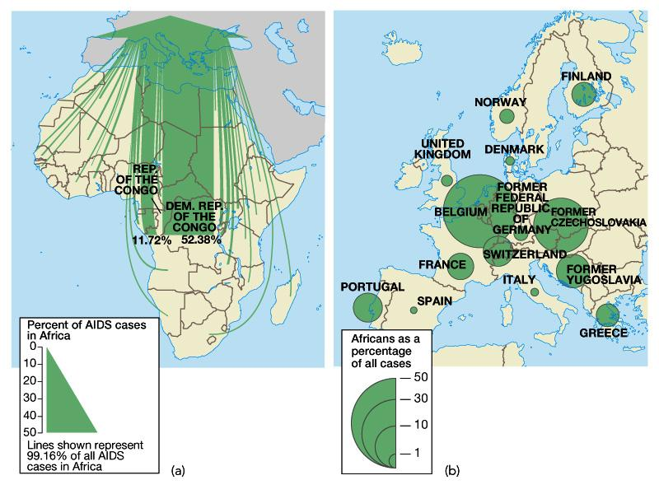
PROPORTIONAL SYMBOLS MAP :
AIDS VICTIMS

Slide 29
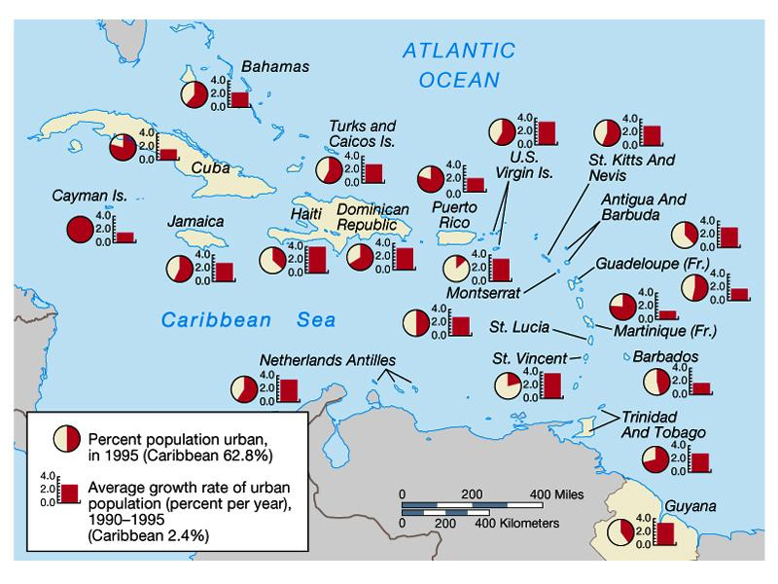
LOCATED CHART MAP: POPULATION INCREASE

Slide 30
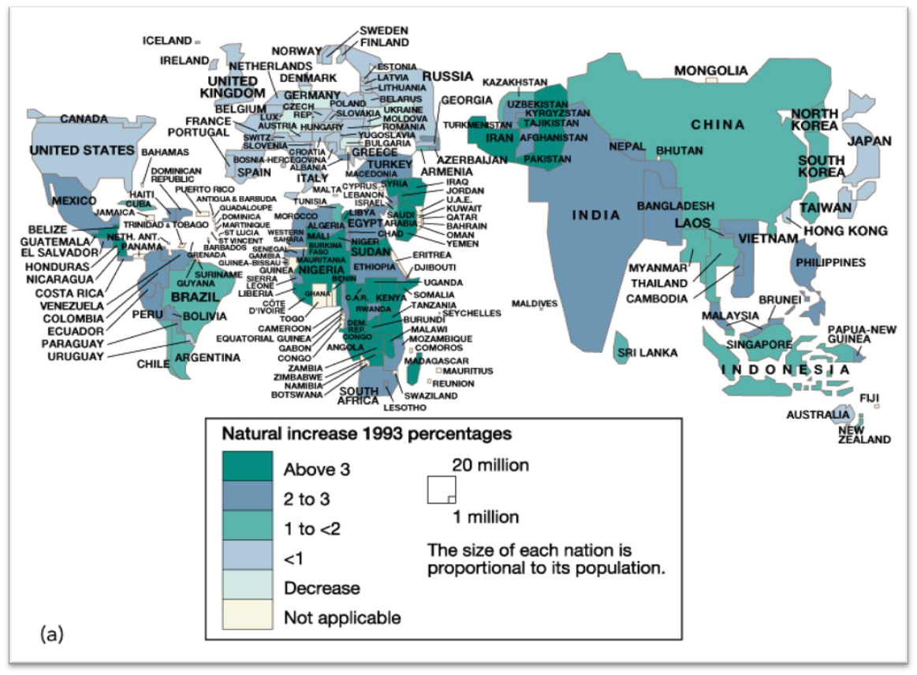
CARTOGRAM: POPULATION GROWTH RATES

Slide 31
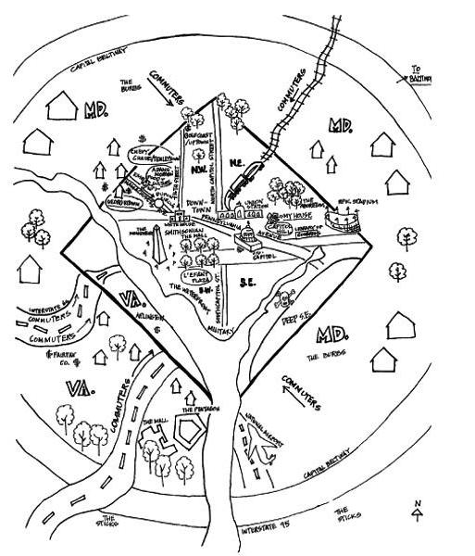
MENTAL
(COGNITIVE)
MAPS OF OUR GEOGRAPHICAL PERCEPTIONS

Slide 32
MENTAL MAP INTERPRETATION
Selection of information, details, labels
Omission is as important as inclusion
Proportions of sizes, scales, shapes
Choice of physical or cultural features
Relative placement of features
Influence of personal experience
Influence of media and world events
Effect of core, periphery, semi-periphery

Slide 33
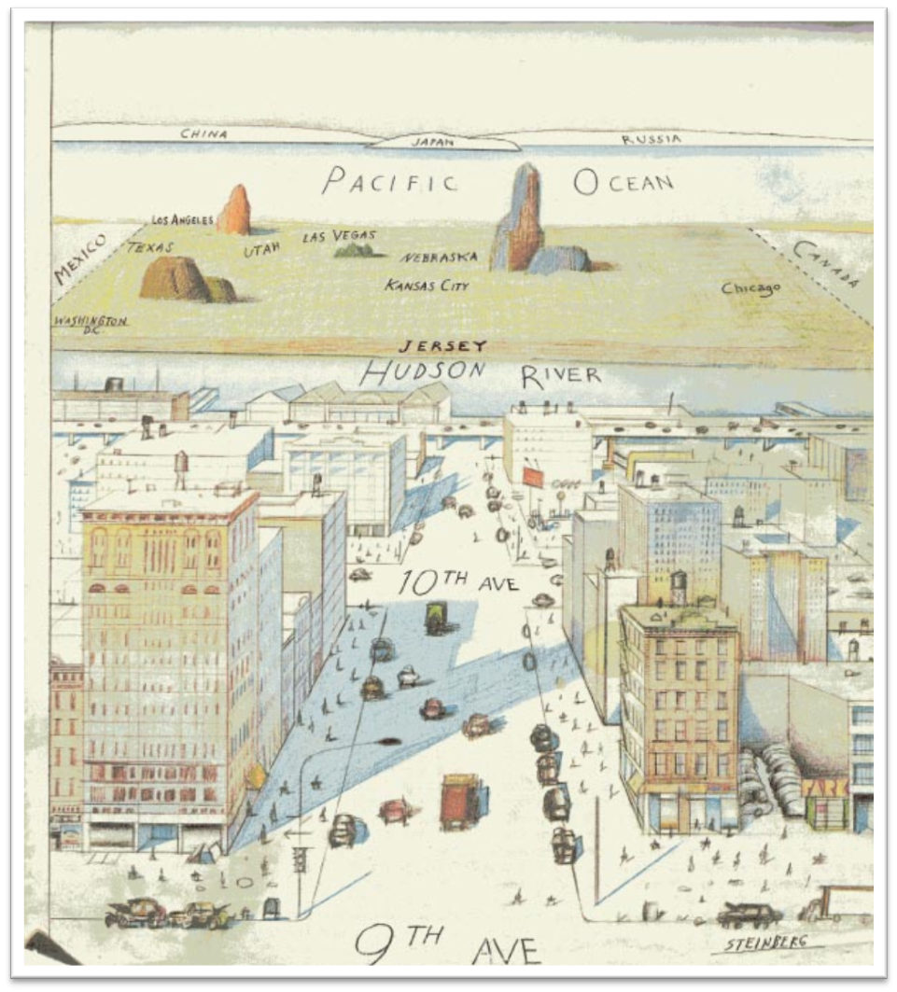
NEW YORKER’S VIEW OF
THE WORLD

Slide 34
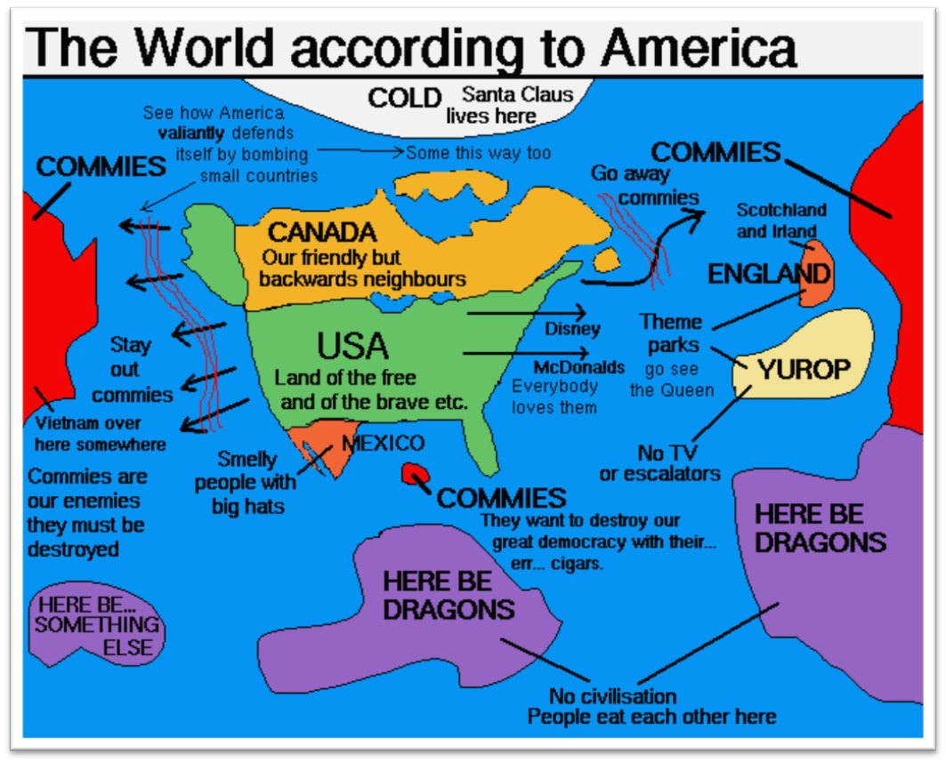
THE WORLD AS SEEN FROM THE U.S.

Slide 35
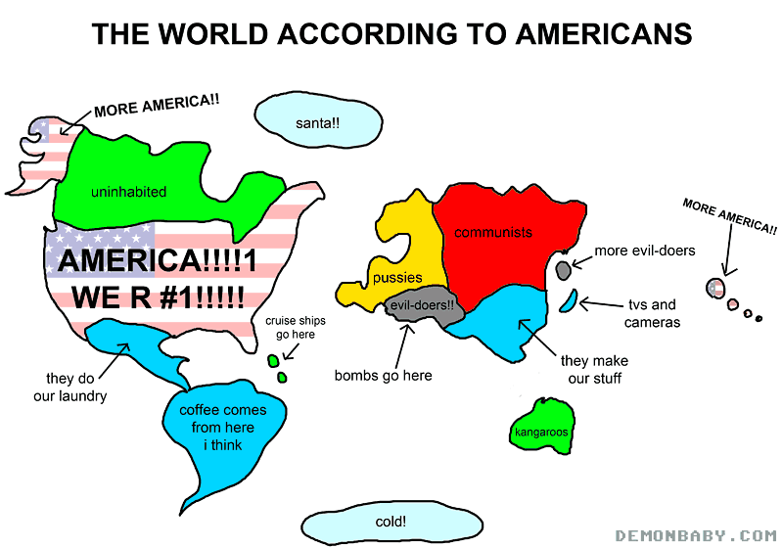

Slide 36
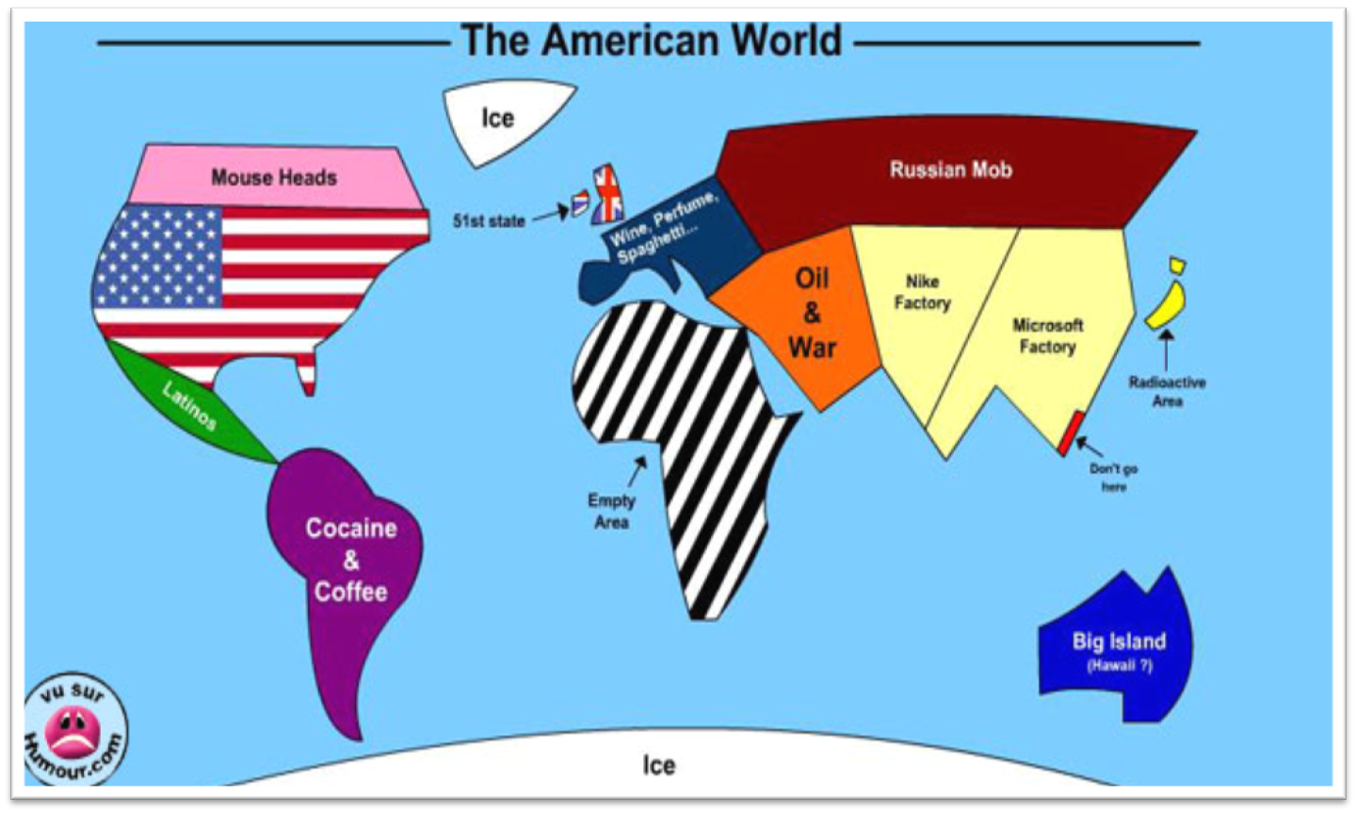

Slide 37
OTHER TYPES OF VISUAL IMAGES:
Create a mental map of your home:

Slide 38
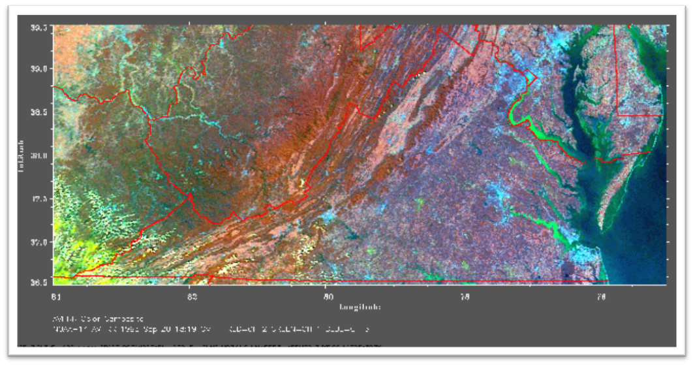
THE ACQUISITION OF DATA ABOUT EARTH’S SURFACE FROM A SATELLITE ORBITING THE PLANET IS CALLED REMOTE SENSING.

Slide 39
BOTTOM LINE: HUNDREDS OF DECISIONS ARE MADE IN THE MAKING OF A MAP, INCLUDING SCALE, PROJECTION, AND TYPE. THESE DECISION ULTIMATELY DETERMINE THE MAP’S MESSAGE.

