Slide 1
Unit 5
Canada In the Post-War World
Social changes impacting Canadian society in the post war era

Slide 2
2 filters
Autonomy
Nationalism
noun, plural au·ton·o·mies.
1. independence or freedom, as of the will or one's actions: the autonomy of the individual.
2. the condition of being autonomous. self-government, or the right of self-government; independence: The rebels demanded autonomy from Spain.
3. a self-governing community.
noun
1. National spirit or aspirations.
2. devotion and loyalty to one's own nation; patriotism.
3. excessive patriotism; chauvinism.
4. the desire for national advancement or independence.
5. the policy or doctrine of asserting the interests of one's own nation viewed as separate from the interests of other nations or the common interests of all nations.
Notes:
As we go through today’s lesson, I want you to consider the numbered points from the lens of two filters- autonomy and nationalism.

Slide 3
Imagine this
The year is 1950. You are in a plane flying over Kelowna. You see the lake, the mountains, the city below. The cars look like tiny ants scurrying up and down the streets. As the plane gets lower, you see more details, there are buildings, houses, people.
What did you see? Draw it.
Notes:
THINK PAIR SHARE: You have 5 minutes to do this task. No talking please. Just draw what you think you might see if you had a birds eye view of Kelowna in 1950. When you are finished, share with your partner.

Slide 4
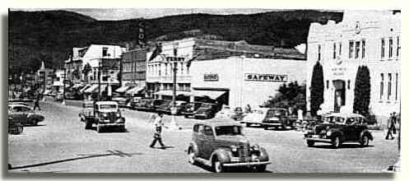
Notes:
Bernard Avenue, 1950. The population of the city was just over 8,000 people.

Slide 5
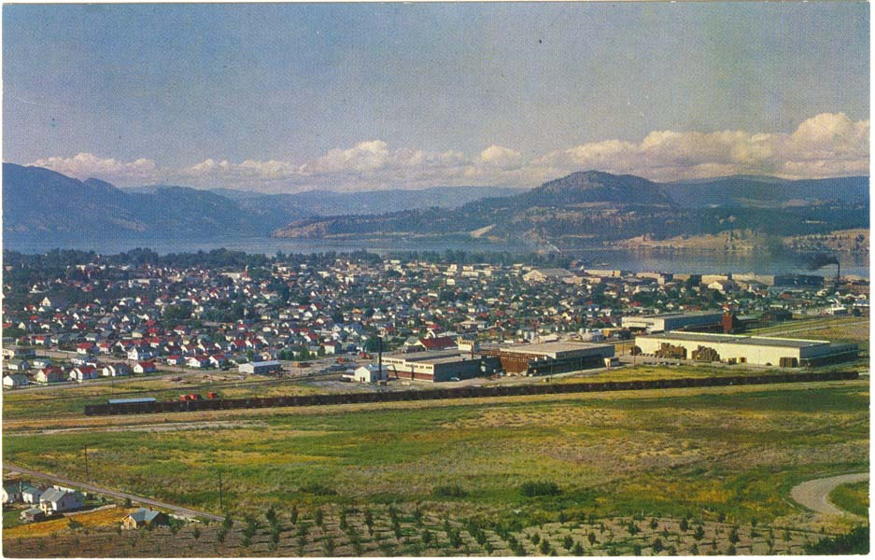

Slide 6
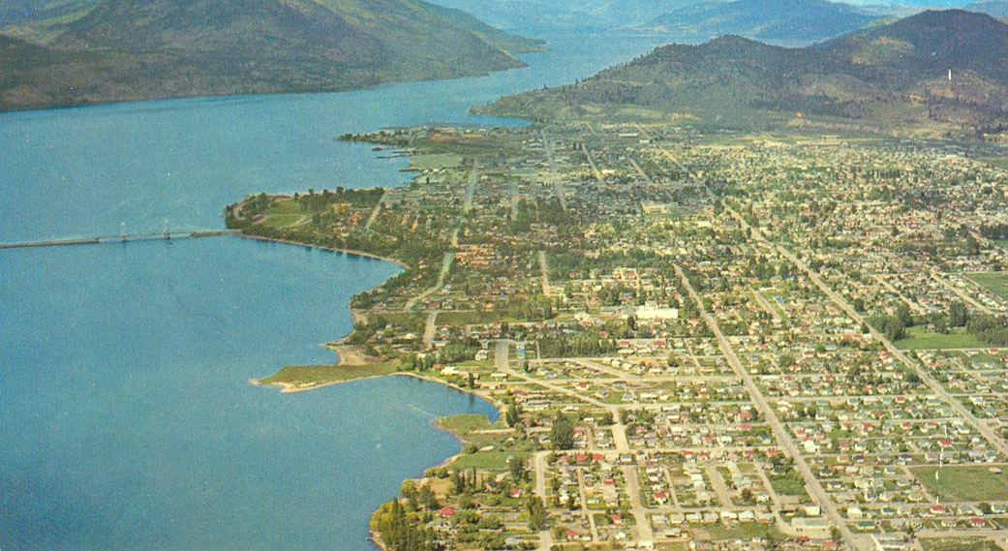
Notes:
Kelowna 1959 looking north from the Mission. And just as Kelowna has changed significantly….so did the rest of the country!

Slide 7
Social Events and Changes
Top Ten
Notes:
These events/changes are not in order of importance and are merely numbered as a method o

Slide 8
#1. The Baby Boom

Slide 9
Baby Boom= the substantial increase in birth rate after WW2. (1946-64)
The end of WW 2 marked the beginning of a population boom in Canada, but the actual “boom” in Canada started later, because our soldiers were repatriated later than other Allied countries, and lasted longer because of a later adoption of birth control pill.
Baby Boom in Canada 1947-66
Families-3 or 4 children was the average.
In Canada, between 1946 and 1961 6.7 million children were born.
Notes:
Those who had postponed marriage because of the war, began to start families which were generally larger than they are today. This dramatic increase in the birthrate is known as a “baby boom” and also occurred in the US and Australia. There have been subsequent “booms”.
The “Baby Boom” started later in Canada because our soldiers were often repatriated later than other Allied countries. I

Slide 10
#2. Rise of the Suburbs

Slide 11
The Burbs!
Soon suburbs emerged and the “commute” began.
Supported by a booming economy.
Less than 6% unemployed throughout the decade.
Notes:
Gradually “bedroom communities” emerged. Subdivisions with their own schools, parks, churches, etc. Commuters travelled to work in the cities and returned home at the end of the day. Increased economic development supported the suburban lifestyle. Both business and manufacturing were booming and fewer than 6 percent of Canadians were unemployed.

Slide 12
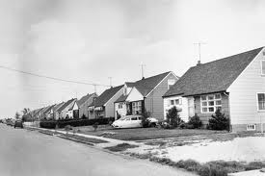
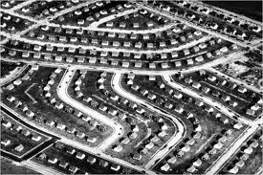
Notes:
Because many of these communities emerged quickly, and were products of people who had lived through a depression (and feared another), homes built in the first decade or so lacked imagination. They were very boxy. I would argue that you could be dropped in any North American city that had significant post war building boom, and find neighbourhoods that looked the same as the ones in the city you left. These neighbourhoods became such a cliché that songs were written about them most notably the Pete Seeger tune “Little Boxes” but I am going to share a more recent version of the tune with you. Please actually listen to the words and what it is saying about “Suburbia”.
Ticky tacky is slang for shoddy materials.
https://www.youtube.com/watch?v=LM8JhvfoqdA

Slide 13
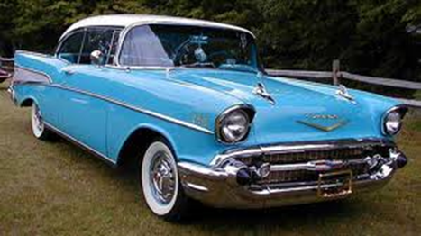
Cars became a necessity for many Canadians.
And Canadians fell in love with cars.
During the 1950’s. 3.5 million automobiles were purchased in Canada.
Notes:
The post war years were also a time of tremendous technological innovation…and one that was particularly embraced was the car. Although suburban homes were often plain and functional, cars grew steadily fancier with lots of chrome, fins and fancy tail lights. The auto industry boomed….in part to increased American investment in branch plants.

Slide 14
#3. The “Traditional” Family

Slide 15
In previous generations, it had been common to live as extended family. During years following WWII, a “traditional family” is considered:
a father whose primary role is that of economic provider or “breadwinner”
A mother, whose role is to stay home and care for the family.
And children. (Average 4 in the early post war years
Notes:
Average number of children in the early post war years 4. Decreased to 2.7 by 1961- Further decreases in the 1960s due, in part, to legalization of birth control, no fault divorce, changing women’s roles..etc

Slide 16
The Birth of Teen Culture
Baby boomers began to influence all aspects of Canadian culture and economy…(and still do.)
Youth organizations flourish.
Government built thousands of new schools, arenas and playgrounds.
Manufacturers developed and made new products.
Notes:
Because the “boomer” generation is the largest age group in Canada it influenced Canadian culture and the economy for decades to come.

Slide 17
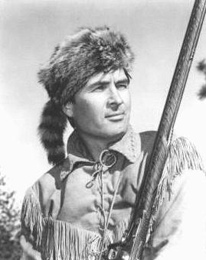
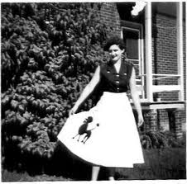
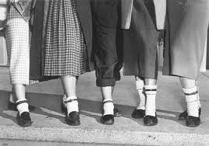
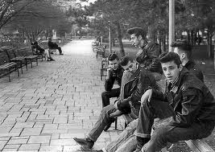

Slide 18
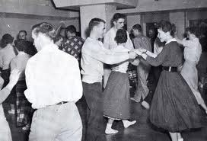
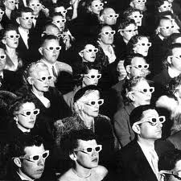
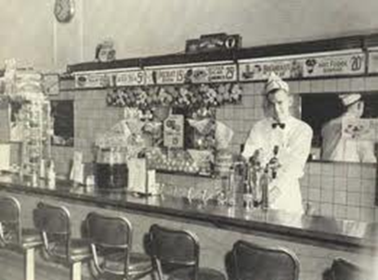
Notes:
Sock hops. 3-D movies. Hanging out at drive ins and soda fountains.

Slide 19
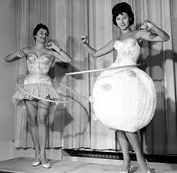



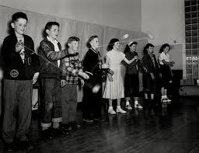


Slide 20
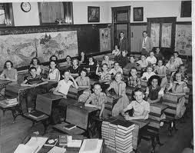
Boomers spent more time in school.
Before the war: average=8 years.
1 in 10 finished high school.
Now no war or economic hardships to force the boomer generation out of school and into the adult world.
Notes:
Boomers spent more time in school than any other generation. Before WW2 the average Cdn. Child received 8 years of education. And one in 10 finished high school. During their adolescence, boomers did not face the adult hardships of previous generations, so most stayed in school. A result of this was the “invention” of the teenager. And how did they express themselves???

Slide 21
Rock and Roll
Developed in the mid-1950s.
Roots in African-American music from the southern United States.
Strong rhythms and sometimes rebellious teen lyrics shocked the older generation.
Banned in many places.

Slide 22

Elvis!
Notes:
On August 31, 1957, Elvis Presley arrived in Vancouver to perform at Empire Stadium. With 8 number one singles in 2 years, he was one of the hottest rock’ n’ roll performers of the 1950s and epitomized the energy and attitude of that era. As soon as he began performing, screaming fans ran onto the field. The show was stopped. Fans were ordered to return to their seats. The teenagers refused and eventually the show went on anyways.
The next day, John Kirkwood who was a reporter for the Vancouver Sun described the concert this way: “It was like watching a demented army swarm down the hillside to do battle when those frenzied teenagers stormed the field…..Vancouver teenagers were transformed into writhing, frenzied idiots of delight by the savage jungle beat of the music…..It was the most disgusting exhibition of mass hysteria and lunacy this city has ever witnessed…..
As you will learn, the 1950s brought new lifestyles, new products and new values to Canadian society. At the same time, the economy boomed and consumerism grew in importance-factors that favoured the growth of youth culture. Cities grew, suburbs emerged new immigrants arrived.
Canada sought a middle path, maintaining good relations with Britain and the Commonwealth, as well as maintaining good, but independent relations with the US. Carving out a foreign policy was a challenge as the Canadian government sought to maintain the nations independence.

Slide 23
“In the 1950s kids lost their innocence.
They were liberated from their parents by well-paying jobs, cars, and lyrics in music that gave rise to a new term ---the generation gap.”

Slide 24
TV and consumer society
Price of a TV cost =20% of an average annual income.
People would gather to watch TV at the homes of those who could afford to own one.
First shows were in black and white.
Colour TV in Canada - 1966.
What were Canadians watching????
Notes:
In the early 1950s a TV cost about 20% of an average annual income. Television contributed significantly to a increasingly “consumer society”. Because they were so expensive, not everyone could afford a TV so people would gather at the homes of those who did. First shows were in black and white. What were Cdns watching?

Slide 25
American Programming!
Canadians, were watching American TV shows.
Notes:
Howdy Doody, Lassie, Ed Sullivan show

Slide 26
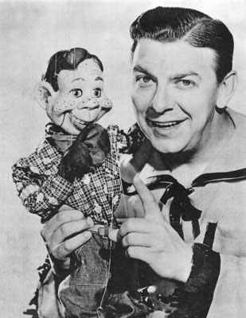
Howdy Doody

Slide 27

Ed Sullivan Show
Notes:
As you saw in the earlier clips, TV shows were sponsored by countries in a much more obvious way than they might be today. Advertisers realized that TV could send the powerful message that “Consumption was the road to happiness”. Companies were selling the good life, everything was new and improved. (ex. Tide…….perpetually new and improved)

Slide 28
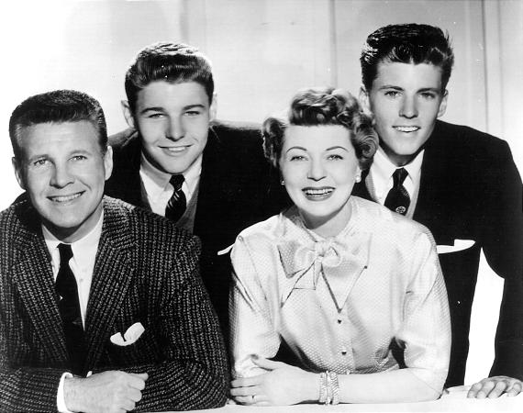
Ozzie and Harriet
Notes:
“Ozzie and Harriett”
The Nelsons were a real life entertainment family that had one of the number one shows.

Slide 29
And now a word from our sponsors.
TV shows were usually sponsored by companies.
Advertisers were now selling the good life: everything was “new” and “improved”..
Advertising =one of the biggest areas of economic growth.
Harriet Nelson
Notes:
As you saw in the earlier clips, TV shows were sponsored by countries in a much more obvious way than they might be today. Advertisers realized that TV could send the powerful message that “Consumption was the road to happiness”. Companies were selling the good life, everything was new and improved. (ex. Tide…….perpetually new and improved) as part of the programming their would be obvious product placement or the star of the show might actually endorse the product during the show.
http://www.youtube.com/watch?v=WjgI9172FRY

Slide 30
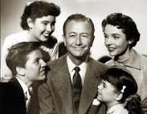
TV=Values!?!
Television shaped the values.
TV shows promoted the ideal of a traditional, wholesome, family centered lifestyle.
In Canada, concern about the influence of American programming.
Notes:
Father knows best.

Slide 31
It wasn’t all lighthearted
The Cold War led to a significant fear in society. A fear of nuclear attack!
Bomb shelters were built by governments, companies.
Diefenbunker
Greenbrier
Notes:
Bomb shelters weren’t just for government officials and rich CEOs

Slide 32
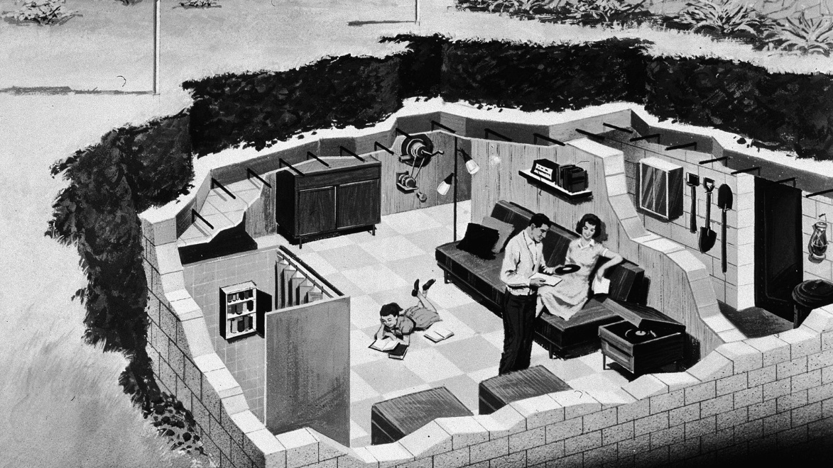
Notes:
Many were so afraid of the possibility of nuclear attack, that they built bomb shelters in their backyard.

Slide 33


Slide 34
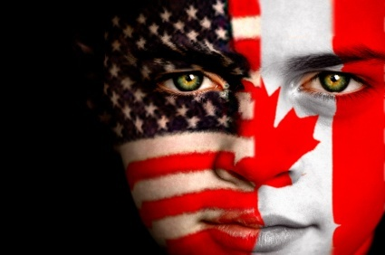
#4 Social Influence of the United States

Slide 35
The Canadian government felt that the “Canadian Identity” was in jeopardy.
What measures do you think the Canadian government put into place to protect Canadian Culture?
Notes:
Imagine that measures had never been put in place to protect Canadian culture. To what extent do you think that our choices in books, music, movies and tv shows might be different today?

Slide 36
The Massey Commission
Established in 1951 by St. Laurent’s Liberal government.
Charged with “investigating the state of Canadian culture.”
Reported in 1951 that Canadian culture needed to be protected from U.S. influences.
Notes:
Many recognized that television was a powerful cultural influence. And in the post war years, Canadians saw world events unfolding through an American lens as they watched popular newscasts from the states. Children of the 1950s grew up identifying more with American culture and values than any generation before them. In 1949, the Liberal government of Louis St. Laurent established the Massey Commission to investigate the state of Canadian culture. When the commission reported back two years later, it suggested that Canadian culture needed to be protected form U.S. influences. Measure taken as a result included……

Slide 37
Recommendations….
Canadian television would be used to promote national communication and for cultural education in drama and music.
The CBC -development of television.
First two stations:
Toronto and Montreal-1952
By 1960, 90% of Canadian homes had a television and access to the CBC
Notes:
Canadian television would be used to promote national communication and for cultural education in drama and music. The CBC, which already had a national radio network, was put in charge of the development of TV.

Slide 38
Further recommendations…
The National Film Board (NFB) - strengthened.
CDN Gov. would fund universities and the arts.
The Canada Council for the Arts was created which awarded grants to writers, artists and theatres.
Creation of the Canadian Radio-television and Telecommunications Commission (CRTC) in 1968.
Notes:
Canadian content requirements for Popular Music (Category 2)
Commercial, community, campus and native radio
English-language and French-language stations must ensure that at least 35% of the Popular Music they broadcast each week is Canadian content.

Slide 39
The C.R.T.C
Regulates the amount of foreign material broadcast over Canadian airwaves and imposes rules regarding Canadian content.
Canadian content requirements for Popular Music (Category 2) 35 % each week.
Notes:
Canadian content requirements for Popular Music (Category 2)
Commercial, community, campus and native radio
English-language and French-language stations must ensure that at least 35% of the Popular Music they broadcast each week is Canadian content.
Which is why you might hear the same few “Canadian” songs over………and over……………….and over again!
Canadian content requirements for Popular Music (Category 2)
Commercial, community, campus and native radio
English-language and French-language stations must ensure that at least 35% of the Popular Music they broadcast each week is Canadian content.
Each of these recommended measures encouraged the growth of arts and culture in Canada and had a profound effect on Canadian identity in the post-war years.

Slide 40
#5 Immigration
How did Immigration change in the Post War era?
Notes:
What was Canadian Immigration policy like prior to WW2?
Significant events?

Slide 41
Post-War Immigration
Pre 1960 Canada had a restrictive immigration policy; British/Northern Europeans were preferred.
Gov. limited the numbers of immigrants from other areas.
War brides and displaced persons.
Canada accepted 165 000 displaced persons after WW2.
Notes:
War brides, refugees, concentration camp survivors and others uprooted by war formed part of the new wave of immigrants.

Slide 42
More on immigration
Attracted by new possibilities.
Wanted to escape war torn Europe.
More than 2 million immigrants arrived between 1945-60.
settled in cities in Central Canada. (Unlike after WW1)
After 1956 the government relaxed entry requirements.
Notes:
In addition to being uprooted by war, new immigrants were attracted to Canada by the new possibilities. Unable to practise their former trades or professions in Canada, some of these newcomers had a hard time. Nevertheless refugee children often absorbed English quickly at school and their parents. Older areas of larger cities, vacated as veterans and their families moved to the suburbs, became home to vibrant new communities. In 1956 a violent revolution broke out in Hungary, and federal and provincial governments relaxed entry requirements in order to allow Hungarians wanting to escape communism to immigrate to Canada. More than 37000 Hungarians emigrated to canada. In 1968-69 many Czechs and Slovaks came under similar circumstances.

Slide 43
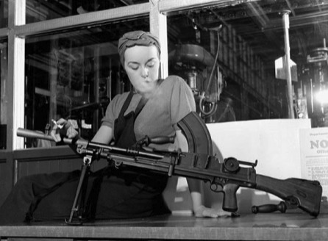
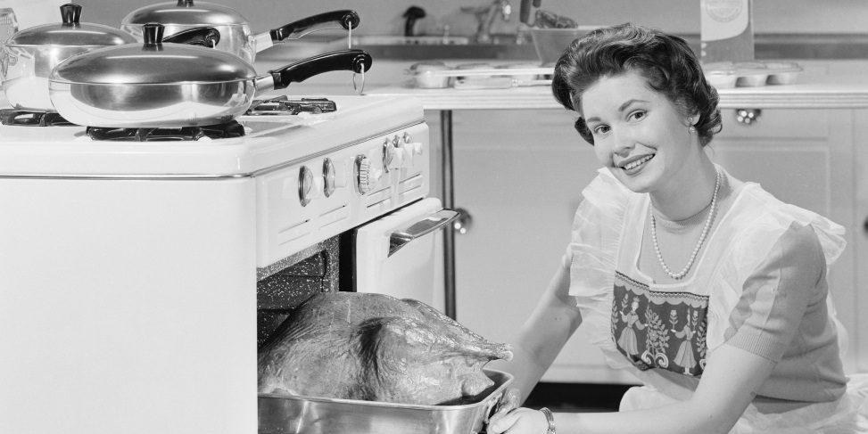
#6 Women: Redefining Roles

Slide 44
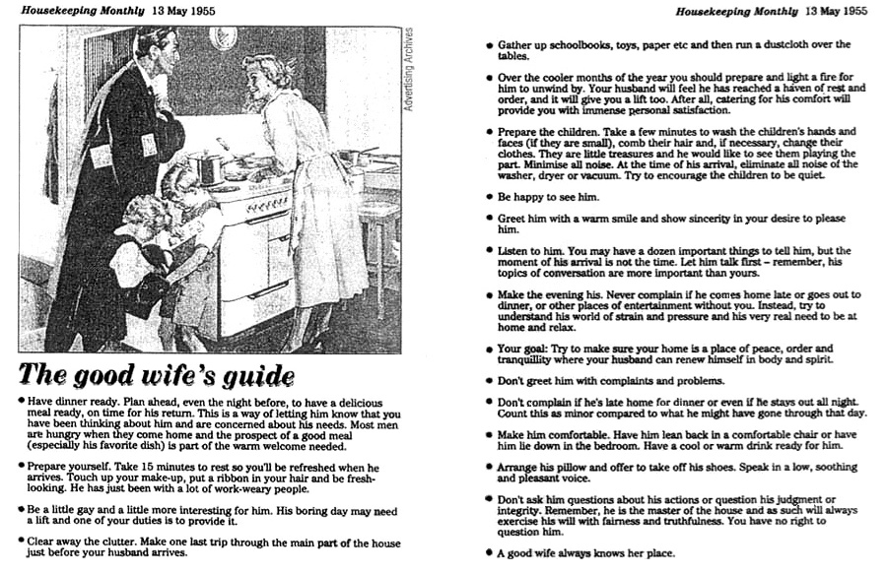
A Guide for the 1950s Housewife

Slide 45
Women in the 1950s
“A woman’s place is in the home.”
Media supported that notion.
Society had little patience for women who did not fit the “norm”
Notes:
Suburban life was centered on a traditional middle-class family with a stay-at-home mother at its heart. A father’s role was that of breadwinner, supporting the family. The media supported this idea. The popular magazines of the day announced that working mothers were the cause of delinquent children. All this was a far cry from the propaganda during the war that urged women to work outside the home. Fashions emphasized femininity-long full skirts, narrow waists, high heels.

Slide 46
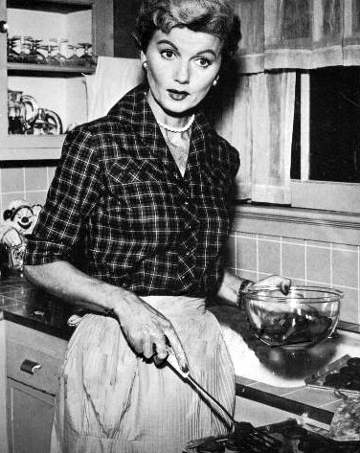
June Cleaver
Notes:
The quintessential 1950s housewife. She set the standard of perfection that many women sought to attain. But that was TV perfection, no average woman could meet that standard of excellence.

Slide 47

Not idyllic for all…
Notes:
Many women came to resent suburban life. They may have moved to the suburbs from a close knit community in the city, and they often felt trapped in a role that did not allow them to develop their potential. Some were particularly resentful of this in the wake of the contribution they had made during the war years. By the 60’s many women were looking for a different way of life

Slide 48
By the 1960s many women wanted more and were looking for a different way of life!

Slide 49
#7 Aboriginal People
What was the purpose of the Indian Act?
In what ways was it exemplified?

Slide 50
Aboriginal Communities
Also in transition.
Aboriginal soldiers were denied the benefits other returning veterans received.
Education was always a concern.
Residential schools had been utilized for the assimilation of Aboriginal children into mainstream Canadian culture.
Notes:
Aboriginal communities were also in transition. Aboriginal soldiers were denied the same benefits as other returning veterans.
Education was always a concern. For decades Abroginal children were forced to leave home to attend residential schools where they were isolated from their own culture.

Slide 51
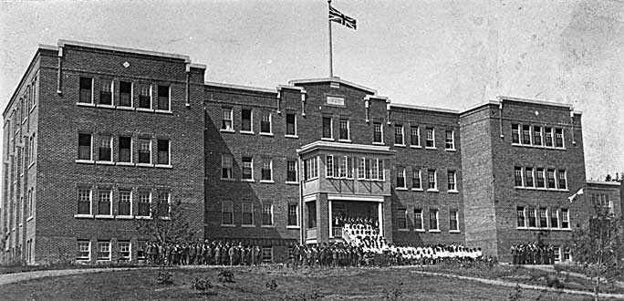
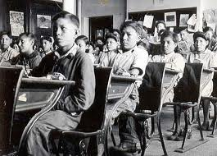
Residential Schools
Notes:
Residential school in Alert Bay, B.C.

Slide 52
Residential Schools
Compulsory attendance ended in 1948, but many remained in operation throughout the 1950s.
As a result of the baby boom residential school system hit its peak years in the 1950s.
The last residential school closed in 1996.
Often underfunded and relied a student labour force.
In response to the parental demands, the federal government began to fund off-reserve education.
Notes:
By 1960, thousands of Aboriginal youth were attending provincial schools with certified teachers and modern equipment. However teachers were not trained to meet the needs of Aboriginal students. This wnad the fact that many had to commute long distances by bus or bard far from home, worked against their academic success.

Slide 53
Changes to the Indian Act
In 1951, changes were made to the Indian Act:
-women = right to vote in
band elections.
-potlatches/ wearing traditional regalia
=no longer illegal.
Notes:
The Indian Act maintained the federal government’s power to define Indian status and band membership and continued to control the political and economic lives of Aboriginal people.

Slide 54
However…..
Gov. still had the power to define Indian status and how band membership was maintained.
It continued to control the political and economic lives of Aboriginal people.
Notes:
So keep in mind the government did not revoke the Indian Act….or replace the Indian Act….it was just changed.

Slide 55
High Arctic Relocation
In the summer of 1953, the Canadian government relocated several Inuit families to the High Arctic almost 2000 km away.
Though families had volunteered, they were not told about the conditions they would face or how difficult it would be to return to their former homes.
In the 1980’s legal action against the federal government arguing that the relocation was a tactic to assert Canadian sovereignty in the Far North.
In 1989, the government created a program to help those who wished to return south; cash compensation; no apology.
Notes:
****Pg. 179 in textbook.
Occasionally, governments around the world have arbitrarily relocated their Aboriginal people with little consideration of their rights. I believe that the resettlement in 1953-1955 of Inuit families is one of those situations. In the summer of 1953, the Canadian government relocated several Inuit families from Inukjuak, former’ly known as Port Harrison, in Northern Quebec and Pond Inlet, in the NWT, to the High Arctic, about 2000 km from their former homes. A second group of families moved two years later.
These families volunteered for the move, because the hunting conditions in their home areas was so poor, However they were not told about how difficult life would be nor the harsh conditions they would face. They were dropped off without firewood or housing at the onset of the Arctic’s four month winter darkness. Survivors today still talk about their struggles, the hunger, defending themselves against polar bears, and living in igloos until they could get wood to build houses. In the 1980’s, a suit was launched against the federal government arguing that the relocation was done to assert Canadian sovereignty in the Far North rather than for the benefit of the Inuit. In 1989, the federal government created a program to help those who wished to return south. And in 1996 the government offered a cash compensation to survivors but did not offer any sort of apology.

Slide 56
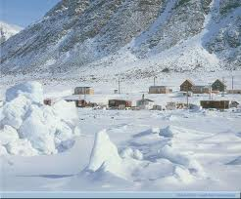
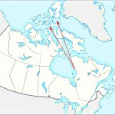

Slide 57
Under the Diefenbaker government:
1958: James Gladstone, a Blackfoot from the Northwest Territories was appointed as Canada’s first Aboriginal senator.
1960: win right to vote in federal elections.

Slide 58
#9 French Canadians
How was Quebec nationalism expressed in the Post War era?

Slide 59
Union Nationale
For almost 25 years Quebec had been controlled by Premier Duplessis and the Union Nationale.
They promoted the idea of a “distinct society”.
Opposed the growing power of the federal government.

Slide 60
Roman Catholic Church: main defender of Quebec culture;
“farm, faith, family”
Ran hospitals and schools.
Religion controlled curriculum.
Elite few attended highschool/univerisity. Many lawyers, priests, politicians. Few scientists.
Bribery and corruption trademarks. For many this time era was known as “the Great Darkness”

Slide 61


One of the most visible symbols of rising Quebec nationalism was the introduction of a new flag.
Old New

Slide 62
The Challenge
List as many events as you can that effected or represented changes in Canadian Autonomy from 1945-60.

Slide 63
Times of Turmoil
Canada in the 1960s and 1970s

Slide 64
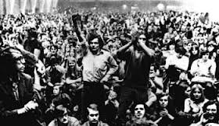
Notes:
Concert or Protest.

Slide 65
Think. Pair. Share.
What if there was a terrorist threat in your community and the government imposed the War Measure Act. What civil rights would you be prepared to give up? What rights do you think are too important to give up even in an emergency?

Slide 66
By the early 1960s, Canadians were beginning to accept the teen culture that had evolved after WW2.
Times marked by turbulence and change:
British Invasion.
“Youthquake”
HippiePhenomenon
“Make love, not war.”
Notes:
Counterculture: a subculture, especially of young people, with values or lifestyles that are in opposition to those of the dominant established culture.

Slide 67
#10 Protest Movements
Many Canadian youth were involved in political protests.
Anti Vietnam
Women’s Rights
Civil Rights
Protest music= popular music of the day that protested against social injustice and war.

Slide 68
Government response..
Politicians began making an effort to appeal to them by increasing spending on employment and activities for youth.
In 1972 the voting age for federal elections was lowered from 21 to 18.

Slide 69
Immigration Again
In the 1960s and 70s more open attitude towards immigrants.
1962: new regs. eliminate most of the racial discrimination in immigration policy.
1967: immigration policy becomes “colour blind”. A points system is introduced.
1971: official policy of multiculturalism.

Slide 70
Think. Pair. Share.
What is multiculturalism?
What ways is multiculturalism promoted in Canadian society today?
Notes:
What is multiculturalism?
What ways is multiculturalism promoted in Canadian society today?

Slide 71
#11 Multiculturalism
Multiculturalism-A policy of encouraging the expression of the cultures of many ethnic groups that make up a country’s population.
Notes:
Unlike the US……………Canada is not a “melting pot”!

Slide 72
#12 Social Welfare
1966: Pearson Gov. introduced-
CPP (Canada Pension Plan)
Canada Assistance Plan
Medical Care Act.(universal health care)

Slide 73
Women in the 1960s and 70s
Many felt trapped by their roles.
Continued to hold low-paying jobs.
Employers could legally discriminate.
University educated women still expected to be teachers or nurses.
Much was as it had been in the past….but there was an increasing sense of frustration.

Slide 74
1963. The Feminine Mystque by Betty Friedan, urged women to liberate themselves from traditional roles and fulfill themselves as human beings.
Feminists joined together to fight for women’s rights.

Slide 75
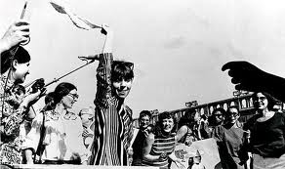
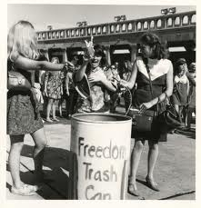
Notes:
Any idea what these women are doing???? Deconstruct this picture.

Slide 76
Government response
Royal Commission on the Status of Women:
Examined how women were treated and problems they faced.
Recommendations:
Women have the right to work outside the home.
Society in general should take some responsibility for children=daycare.
Paid maternity leave.
Fed. Gov. -work to eliminate discrimination against women.

Slide 77
NAC
National Action Committee on the Status of Women (NAC) 1971. A pressure group that lobbied the government to work quickly on the recommendations.
In 1982: important inclusion of a clause guaranteeing the equality in the Charter of Rights and Freedoms.
Throughout the 1970s. Provinces across Canada work to change family law to gradually eliminate gender bias.

Slide 78
#13 Challenging Social Values.
Dramatic increase in activism for social change in the 1960s.
Organizations: Human Rights Watch, the Canadian Civil Liberties Association, Amnesty International the National Indian Brotherhood.
Many unions joined fight for civil rights: Postal workers first to win paid maternity leave.
1960s gay rights activists began to organize.

Slide 79
Government response…
The Canadian Bill of Rights. 1960. A federal document that set out the rights and freedoms of Canadians.
ex: freedom of life, liberty, security of
person; right to equality before the law.
freedom of speech, religion, assembly,
association.
Many of the rights protected in this Bill, were later included in the Charter of Rights and Freedoms.

Slide 80
The Omnibus Bill
1969: Bill C-150 (The Omnibus Bill) made major changes in social legislation.
Recognizing the right of women to have access to contraception.
Recognizing the right to abortion (with certain limitations.)
And legalizing homosexuality between consenting adults.
Notes:
Trudeau was criticized for his progressive social policies but refused to back down, saying “There’s no place for the state in the bedrooms of the nation”

Slide 81
Other significant legal changes
1968: Divorce. made more freely available.
1976: Bill C-84 ended the death penalty.
Notes:
Trudeau also changed Canada’s divorce laws in 1968, making divorce more freely available.
Bill C-84 did not have widespread support and passed by a narrow margin, but Tru deauand his Cabinet were determined that Canada should join other progressive nations and abolish capital punishment.

Slide 82
First Nation people in the 1960s and 70s
Aboriginal people continued to suffer from poverty, health issues, inadequate housing and education
The White Paper: government proposed changes for Aboriginal peoples, including eliminating the Indian Act; would end special status for Aboriginal peoples.
The intent was to encourage further assimilation.

Slide 83
Aboriginal people were furious.
Responded the “Red Paper”- a demand for self government and control over their own affairs.
Notes:
Aboriginal people were furious. Saw it as an attack on their right to maintain their unique identity.
Trudeau’s government abandoned the White Paper.

Slide 84
More on Aboriginal life.
Residential schools began to wind down. “Band schools emerged”
Aboriginals took environmental action.
ex: lobbied to halt construction of oil and
natural gas pipeline in the Mackenzie
Valley.

Slide 85
Quebec in the 1960s and 70s-
“Time For Change”
After Duplessis’ death in 1959, Jean Lesage and the Liberals came into power.
Prov. Gov. modernized the province-The Quiet Revolution. (Ex. Hydro company monopoly.)
Church influence declined.
Québec nationalism and the separatist movement grew.
1967 Parti Québécois formed by René Lésvesque- believed that Québec and Canada would do better to “divorce”

Slide 86
Back in 1963, Pearson was convinced that Canada would face a grave crisis unless French Canadians felt more at home in Canada.
The Royal Commission on Bilingualism and Biculturalism
Notes:
Established the Royal Commission on Bilingualism and Biculturalism (“Bi and Bi Commission”) to recommend ways of enhancing an promoting the historically bilingual nature of Canada.

Slide 87
The commission’s report called for Canada to become bilingual with French and English its two official languages.
This was done by Pearson’s successor Trudeau with the Official Languages Act:-French and English Canada’s official languages; all federal institutions must provide services in both languages.
Notes:
This act received mixed reviews. Some people embraced the idea of bilingualism with enthusiasm, many enrolled their children in French immersion classes. Others, especially many in Western Canada, felt that the federal government was forcing french on them and that too much attention was being paid to Quebec. Francophones were also unimpressed. They wanted special status, but the federal government insisted they were a province like any other.

Slide 88
Rising political action
PM Trudeau disliked the idea of separatism and took a forceful stand against Québec nationalism.
From 1963 to 1970 members of a Quebec Nationalist group, the FLQ (Front de libération du Québec) had detonated over 95 bombs.
They also stole several tons of dynamite, and the organization was financed by multiple bank robberies.
Notes:
From 1963 to 1970 the Quebec nationalist group Front de libération du Québec had detonated over 95 bombs.^{[6]} While mailboxes—particularly in the affluent and predominantly Anglophone city of Westmount—were common targets, the largest single bombing was of the Montreal Stock Exchange on February 13, 1969, which caused extensive damage and injured 27 people. Other targets included Montreal City Hall, Royal Canadian Mounted Police recruitment offices, railway tracks, and army installations. FLQ members, in a strategic move, had stolen several tons of dynamite from military and industrial sites, and, financed by bank robberies, they threatened through their official communication organ, known as La Cognée, that more attacks were to come.
By 1970, 23 members of the FLQ were in prison, including four members convicted of murder.

Slide 89
By 1970-23 members of the FLQ were in prison for various crimes including murder.
There was also evidence that the FLQ was planning kidnapping of government officials and foreign dignitaries.

Slide 90
#14 The October Crisis
On Oct. 5. British Trade Commissioner James Cross is kidnapped from his home by the FLQ.
FLQ demands a reading of their manifesto on the CBC, as well as release of all the FLQ members serving prison sentences; “political prisoners”
Premier Bourassa agrees to most of the demands. The FLQ Manifesto is aired all over Quebec in both French and English, but Bourassa refuses to release the prisoners.
Notes:
October 5: Montreal, Quebec: Two members of the "Liberation Cell" of the FLQ kidnap British Trade Commissioner James Cross from his home. The kidnappers are disguised as delivery men bringing a package for his recent birthday. Once the maid lets them in, they pull out a rifle and a revolver and kidnapped Cross. This is followed by a communique to the authorities containing the kidnappers' demands, which include the exchange of Cross for "political prisoners", a number of convicted or detained FLQ members, and the CBC broadcast of the FLQ Manifesto. The terms of the ransom note are the same as those found in June for the planned kidnapping of the U.S. consul. At this time, the police do not connect the two

Slide 91
FLQ then kidnaps Québec Labour Minister Pierre Laporte.
Alarmed by the deteriorating situation, and at the urging of Montreal’s Mayor Drapeau and Premier Bourassa, PM Trudeau takes drastic measures.

Slide 92
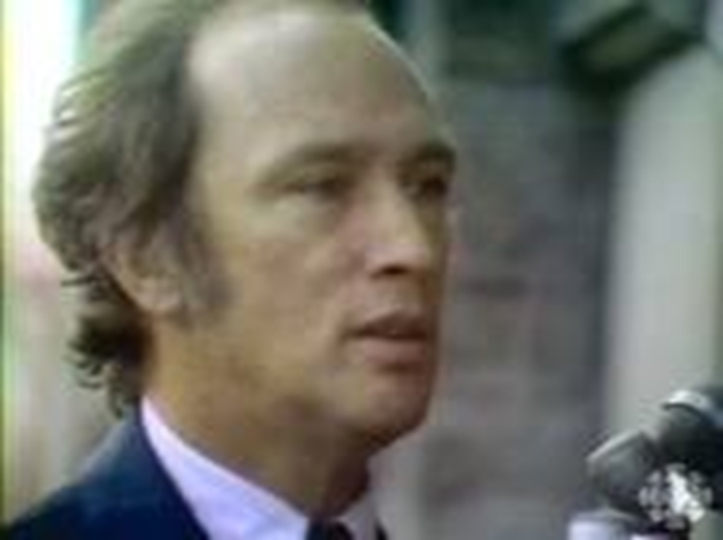

Slide 93
War Measures Act!
Oct 16, 1970- Prime Minister Trudeau
announces the imposition of the War Measures Act.
Notes:
Premier Bourassa formally requests that the federal government grant the government of Quebec "emergency powers".
This results in the implementation of the War Measures Act which come into effect at 4:00 a.m.
Prime Minister Trudeau makes a broadcast announcing the imposition of the War Measures Act.

Slide 94
Why is this a big deal?
Notes:
It was peacetime. Suspended people’s civil liberties. etc

Slide 95
Many were shocked by Trudeau’s hardline approach.
One day later, the body of Pierre Laporte was found dead in the trunk of a car.
Police located the remaining hostage, James Cross after being held for 60 days.
His kidnappers negotiated safe passage to Cuba in exchange for his release.
Of the 450 detained under the Act, most were released and few charged.

Slide 96
Bill 22
Many in Quebec felt that the Official Languages Act had not gone far enough.
Bill 22 was the first provincial legislation passed in Quebec aimed at protecting the status of French; made French the SOLE official language in Québec.
Many felt that Bourassa and his government had not gone far enough.
Notes:
Bill 22 forced hundreds of thousands of businesses and professional people in Quebec who were not fully proficient in Fernch to move out of the province, eventually allowing Toronto to surpass Montreal as Canada’s business capital.

Slide 97
#15 The PQ in Power
In 1976 the Parti Québécois won the provincial election.
Introduced Bill 101: called the Charter of the French language. Bill 101 strengthened the position of the French language in Quebec.
Gov. employees: work in French.
Commercial outdoor signs: only in French
Children of immigrants: attend French schools

Slide 98
Exit Ticket.
1. How did the role of women change from 1950-70?
2. What was the name of the “paper” that proposed to make changes to the lives of Aboriginals? What was their response called?
3. In what ways did Canada’s immigration policy change?
4. What year was the new Canadian flag introduced?
5. Summarize the October Crisis.

