Slide 1


Slide 2
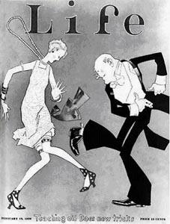
Canada in the 1920s:
The Roaring Twenties
Life Magazine cover page celebrating the 1920s, http://theroaringtwentieshistory.blogspot.ca/p/events-of-twenties.html

Slide 3
The Roaring Twenties
Music | Jazz, fast, happy, fun
Fashion | Women: dresses (sometimes showing knees and shoulders), Hats, short hair Men: nice suits
Technology | Cars, train, camera, record players
Social behaviours | Fast, crazy dancing, parties
Mood/Atmosphere | Happy, joyful, relaxing, cheerful
Other?

Slide 4
The Roaring Twenties:
Vocabulary (p. 83)
Economic boom (noun): Time of high economic growth
Prosperity (noun): Success, usually by making a lot of money
Adjective: A person is prosperous
Verb: To prosper
Income/wage (noun): Money received for work
Leisure (noun): Freedom from duties and responsibilities such as working; Free time

Slide 5
The Roaring Twenties:
Vocabulary (p. 83)
Rebel (verb): resisting authority, control or tradition
Noun: A person is a rebel
Adjective: He is rebellious
Strict (noun): demanding that people obey rules and behave in a certain way
Carefree (adjective): free from stress or responsibility
“Hard times” (idiom): to lose your money and start to have a difficult life

Slide 6
The Roaring Twenties:
Vocabulary (p. 110)
Modern (adjective): belonging to the present day, instead of the past
Wealthy (adjective): having a lot of money or resources
Appliance (noun): equipment designed to perform a specific task, usually around the house
ex: washer (laundry), blender, toaster
“Live up to” (idiom): meet expectations

Slide 7
The Roaring Twenties:
Vocabulary (p. 111)
Discourage (verb): cause someone to lose confidence or enthusiasm
Minimum-wage (noun): the lowest wage allowed by law
Feminine (adjective): qualities traditionally associated with women (delicate, pretty, etc)
Exclusive (adjective): restricting or limiting to certain people or groups
“Bottom rung” (idiom): at the lowest level of pay and status
“Hard to come by” (idiom): difficult to find

Slide 8
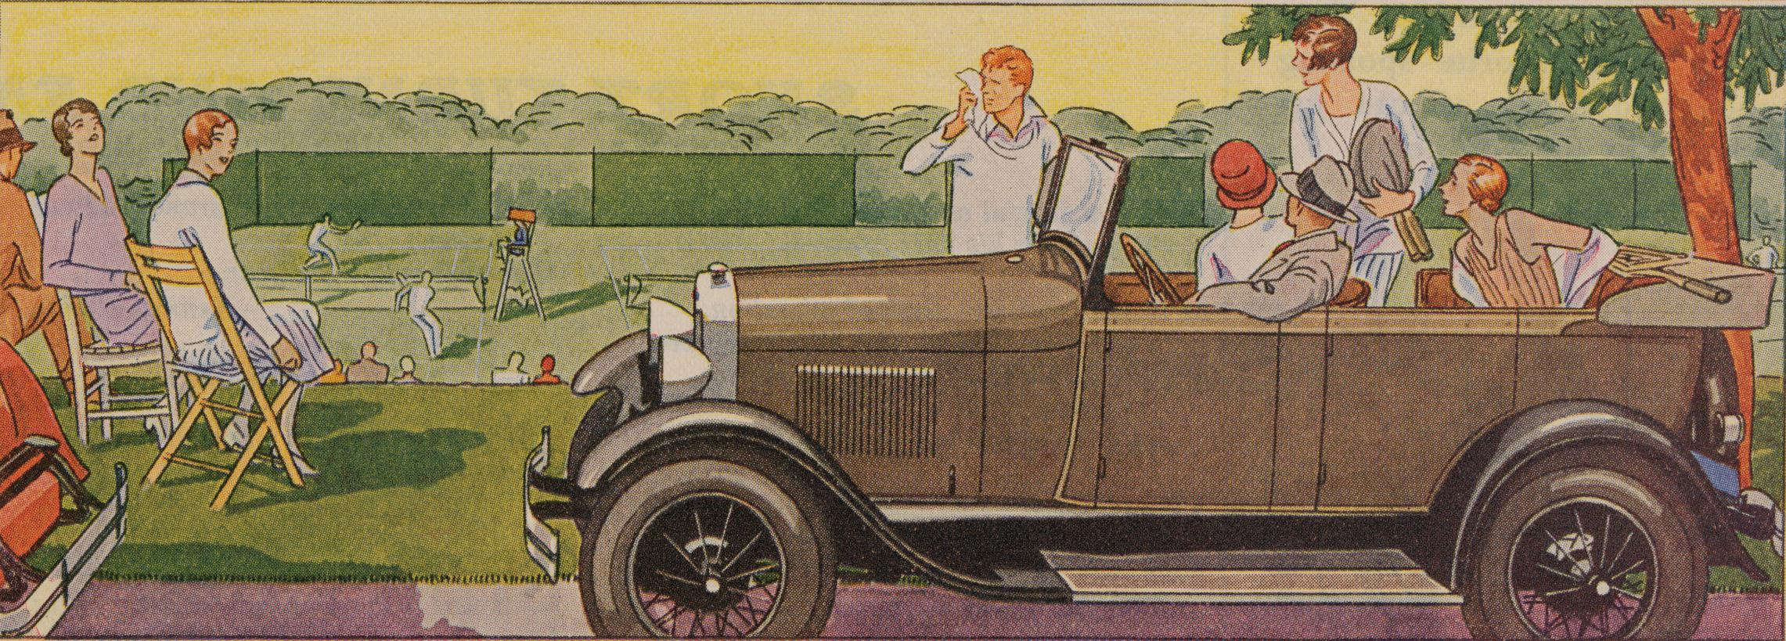
The Roaring Twenties: Cars
During the boom years of the 1920s, advertisements tried to persuade Canadians to buy cars such as this 1928 Model A Ford
Notes:
Ask students: describe the ad: what are these people doing? is this work or leisure? do they look like they are having fun? are they stressed or carefree? are they wealthy or is this “hard times”?

Slide 9
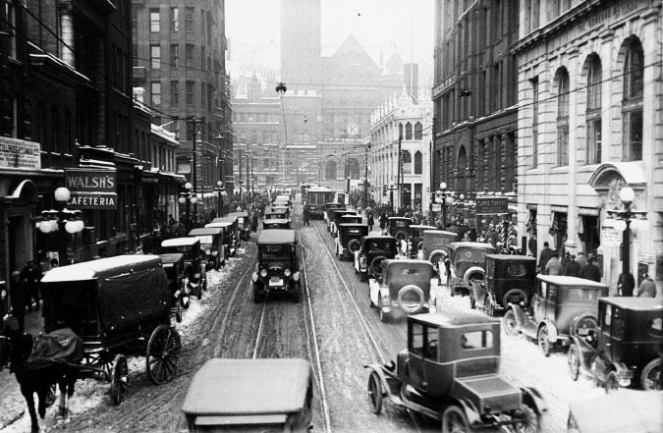
The Roaring Twenties: Cars
By 1924, downtown Toronto was full of cars

Slide 10
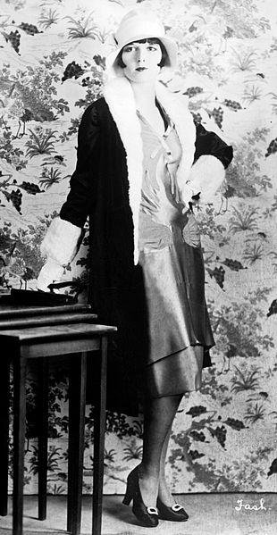
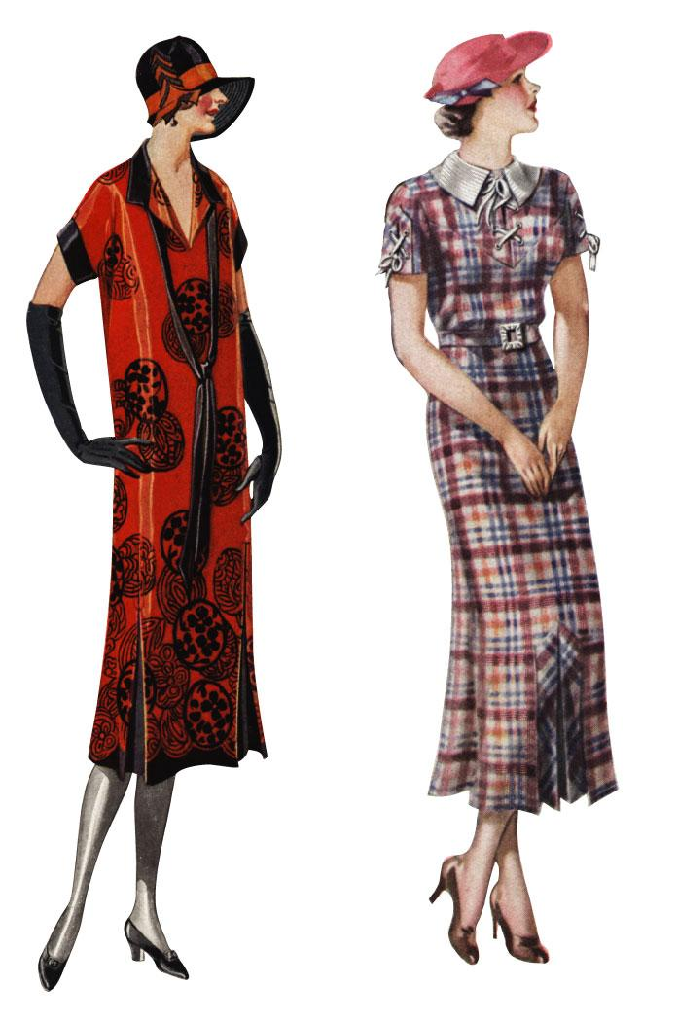
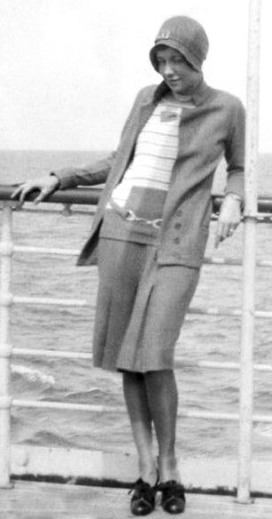
The Roaring Twenties: Flappers
In the prosperity of the 1920s, the hemlines of women’s dresses crept above the knee

Slide 11
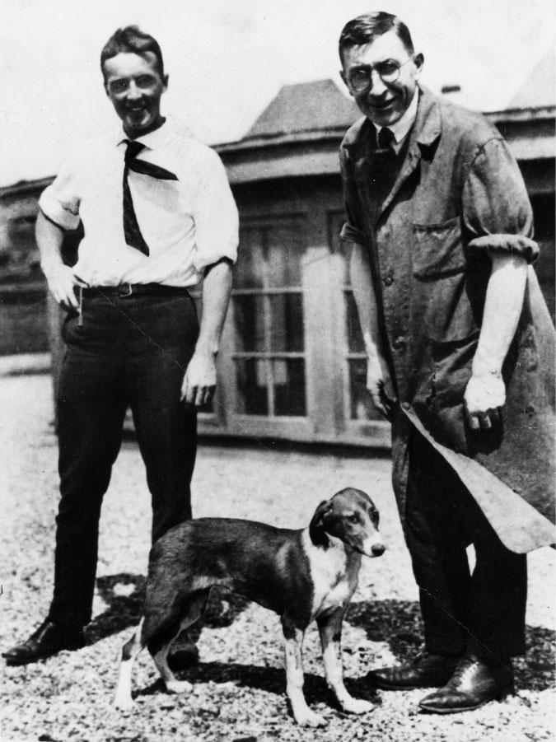
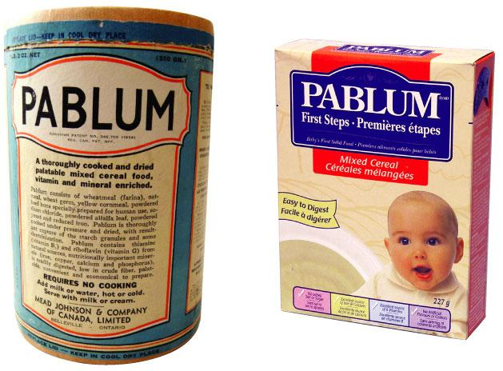
The Roaring Twenties:
Medicine and Nutrition
Charles Best (left) and Frederick Banting pose with one of the dogs used in their groundbreaking research that found a treatment for diabetes
Pablum: the first ready-to-use, pre-cooked cereal for babies. It was enriched with vitamins and minerals, and was the first solid food eaten by millions of babies

Slide 12
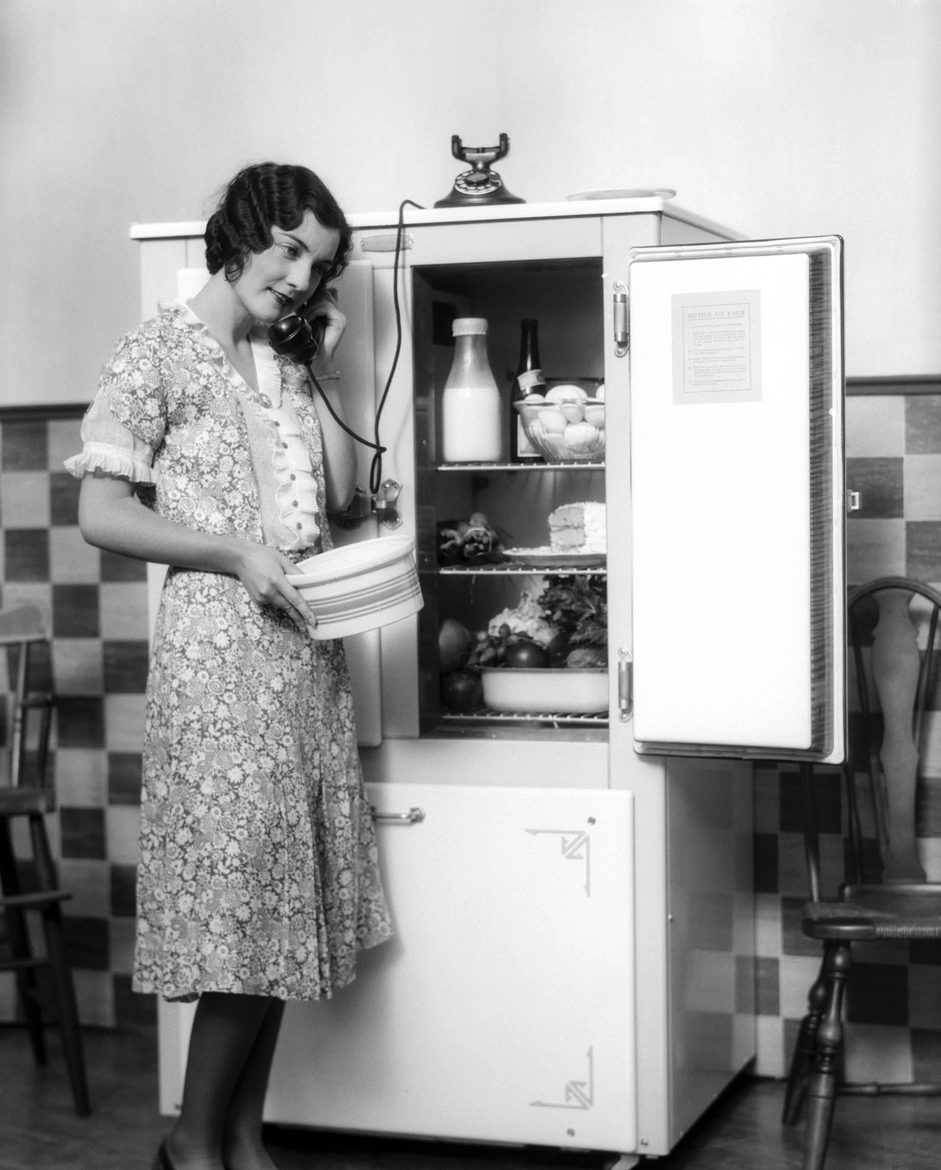
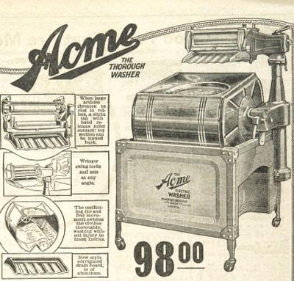
The Roaring Twenties:
Household Appliances
Acme electric wringer washer from 1926 Eaton’s catalogue
Notes:
Refrigerators, telephones, washing machines (also, electric lights, running water and indoor flush toilets becoming more popular

Slide 13
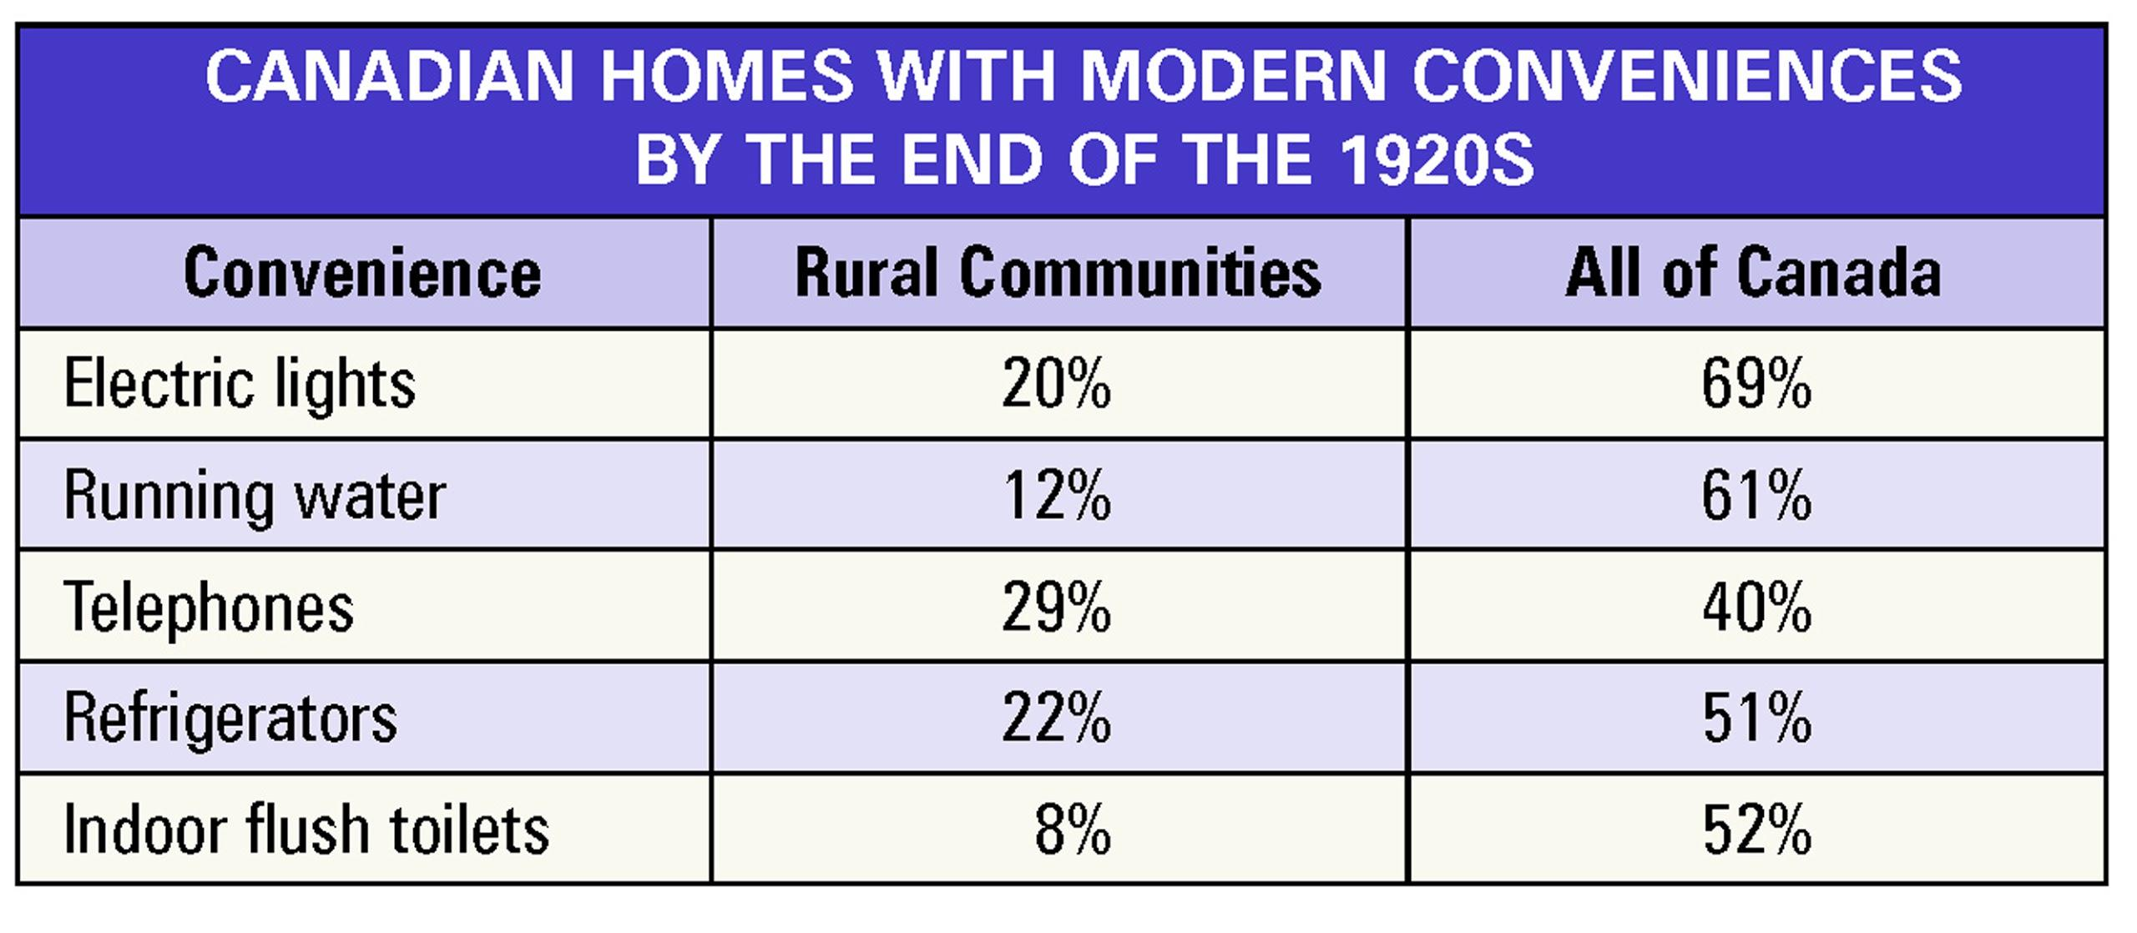
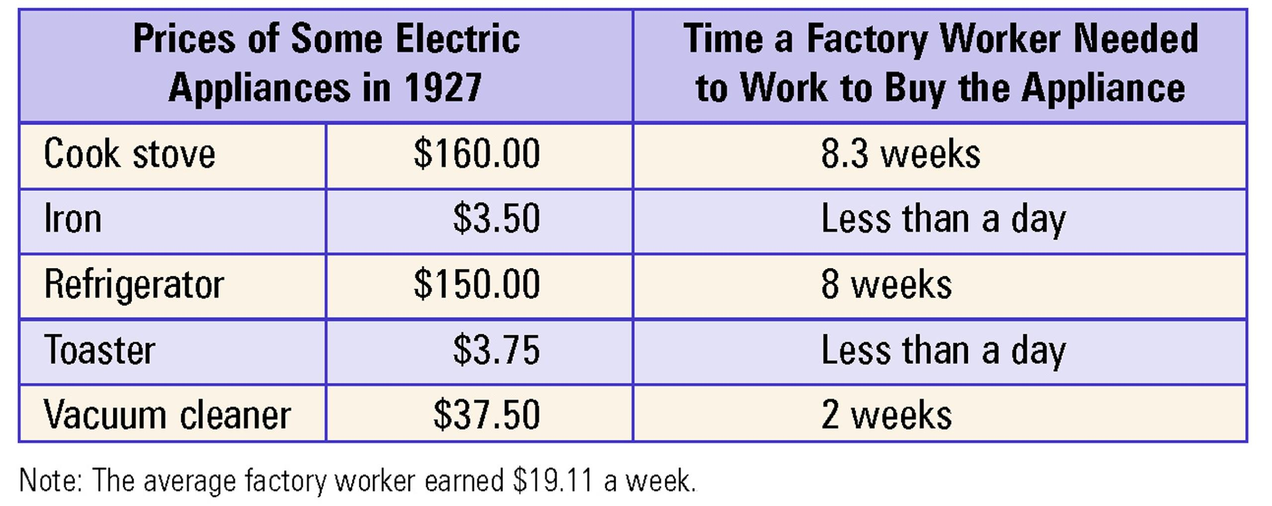
The Roaring Twenties:
Hard times for factory workers?

Slide 14
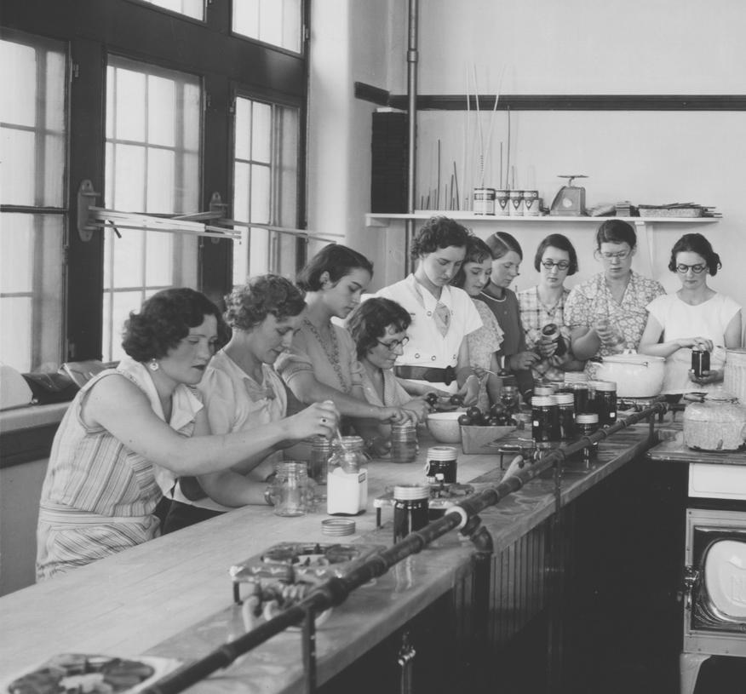
The Roaring Twenties:
Hard times for women?
These young women are making preserves as part of a course in “community leadership and domestic and leisure time activities” at the University of Saskatchewan.
In the 1920s and 1930s, less than 25% of university students were women - and they usually were steered into courses such as domestic science and the arts.

Slide 15
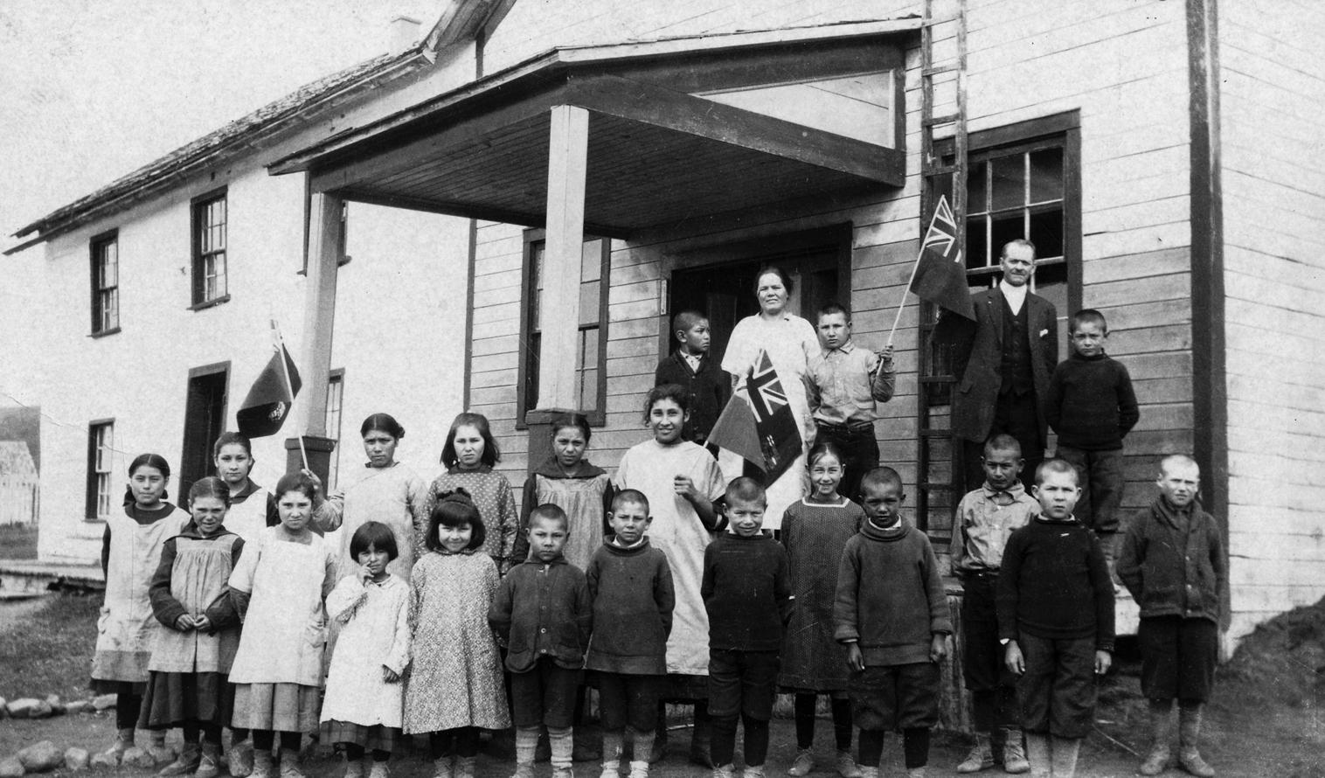
The Roaring Twenties:
Hard times for Aboriginal people?
Residential Schools in the 1920s
The Canadian government forced Aboriginal children to live, work and study at residential schools
The government wanted to assimilate Aboriginals - make them forget their own culture and be more like British Canadians
Discipline at school was often harsh. Children were forced to speak English - and punished for speaking their own language. They were told that their history and culture were not valuable.
These schools were very unhealthy and many children died of disease. Many other children were badly abused and mistreated by the teachers.
The last residential school in Canada was closed in 1996. In 2008, the government of Canada apologized to Aboriginal people for the treatment they received in residential schools.
These children attended a residential school in Alberta during the 1920s
Notes:
Explain who Aboriginals are, what they are doing at this school, what assimilation is and why the Canadian government wanted to assimilate these people, and the harmful effects of these schools on Aboriginal children and families

Slide 16
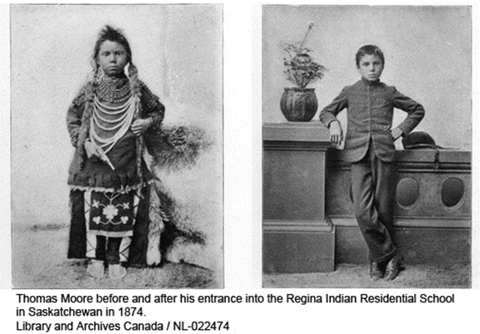
The Roaring Twenties:
Hard times for Aboriginal people?
Assimilation
This is an Aboriginal boy who spent time in a residential school. The Canadian government wanted to make him more like a British Canadian.
Did the government succeed in assimilating this boy?
What differences do you notice?

Slide 17
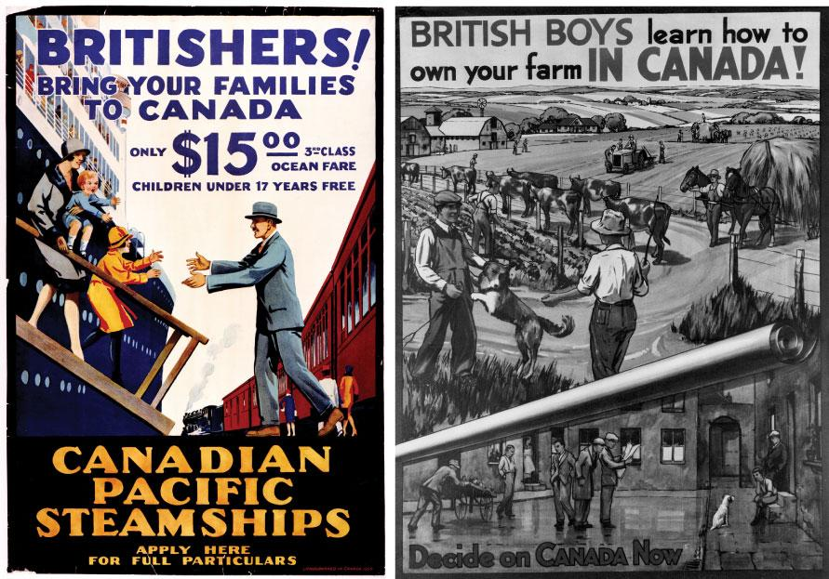
The Roaring Twenties:
Hard times for Immigrants?
In 1922, the Canadian government passed the Empire Settlement Act.
This law made it easier for British and other white immigrants to settle in Canada.
For example, the government helped pay their costs and offered other kinds of supports
These posters from the 1920s were used to recruit British immigrants to Canada

Slide 18
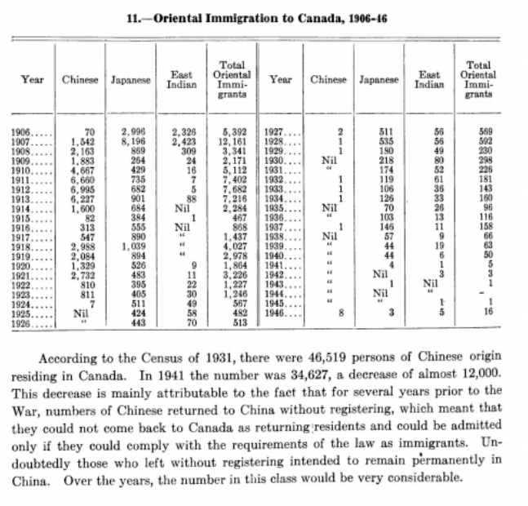
The Roaring Twenties:
Hard times for Immigrants?
In 1923, the Canadian government passed the Chinese Immigration Act, which banned Chinese people from immigrating to Canada.
Chinese Canadians remember July 1, 1923 - the day the Chinese Immigration Act came into force - as “Humiliation Day.”
The ban on Chinese immigration lasted until 1947.

Slide 19



How “roaring” were the 1920s?

