Slide 1
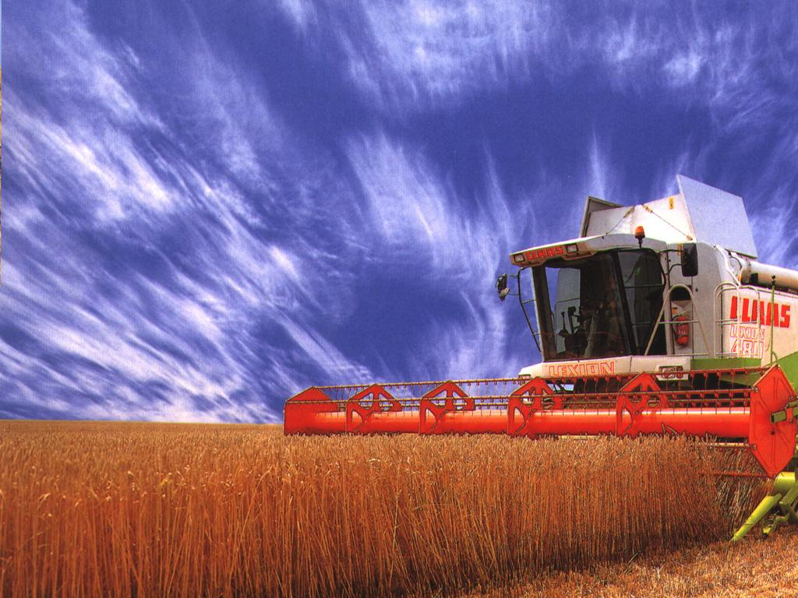
Globalization of Agriculture and Food
Globalization of Agriculture and Food
Notes:
http://www.miw.it/Agriculture.html

Slide 2
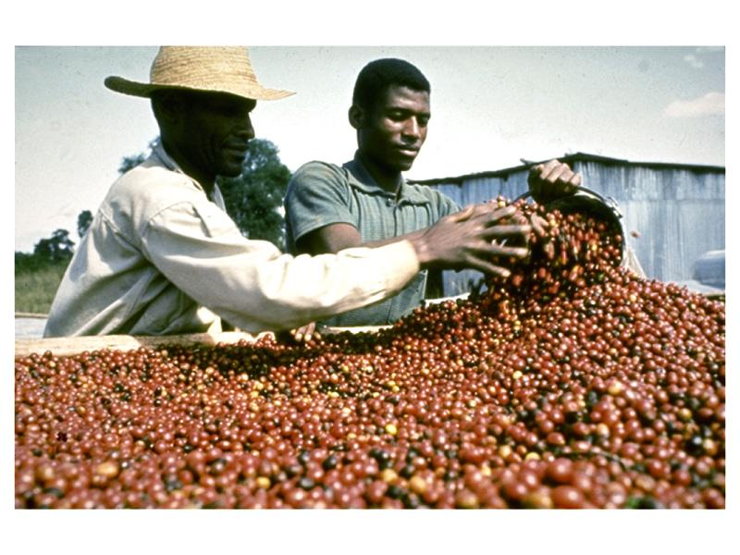

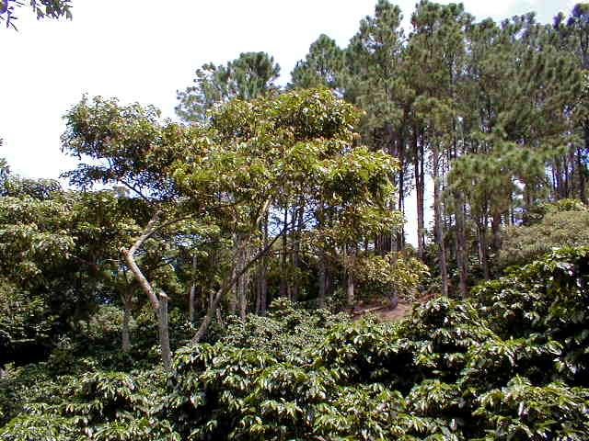

Slide 3
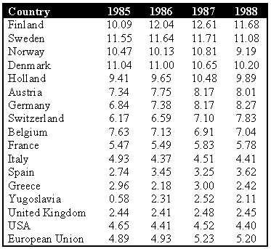
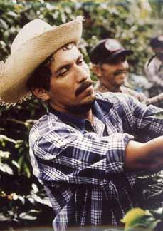
Worldwide Coffee Consumption
Kg/person from 1985-1988
In video, note
The linkages
The different types of
farms
Still
the
case
Average US Consumption – 1.9 cups (♂)
1.4 cups (♀)
Avg US coffee drinker drinks – 3.1 cups
Spending $165 per year on coffee (1999)
Notes:
http://www.der.org/photos/java-jive-2.jpg
http://www.coffeeresearch.org/market/consumption.htm
In 1999 there were 108,000,000 coffee consumers in the United States spending an approximated 9.2 billion dollars in the retail sector and 8.7 billion dollars in the foodservice sector every year (SCAA 1999 Market Report). It can be inferred, therefore, that coffee drinkers spend on average $164.71 per year on coffee. The National Coffee Association found in 2000 that 54% of the adult population of the United States drinks coffee daily (NCA Coffee Drinking Trends Survey, 2000). They also reported that 18.12% of the coffee drinkers in the United States drink gourmet coffee beverages daily (NCA). In addition to the 54% who drink coffee everyday, 25% of Americans drink coffee occasionally (NCA).
The average consumption per capita in the United States is around 4.4 Kg. Among coffee drinkers (i.e. not per capita) the average consumption in the United States is 3.1 cups of coffee per day (NCA). Per capita men drink approximately 1.9 cups per day, whereas women drink an average of 1.4 cups of coffee a day (NCA).

Slide 4
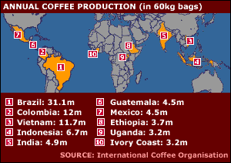
Notes:
http://www.harmonize.com/swdroundup/singer2.htm

Slide 5
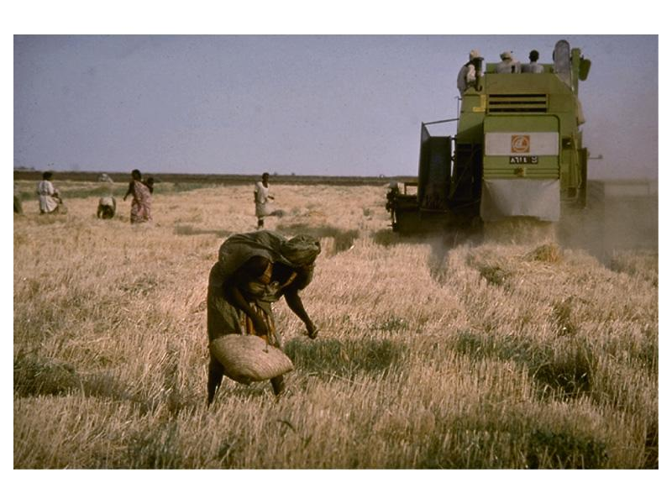
Agrarian
  the land or its cultivation
  farming practices or rural culture
  Land tenure: system of land ownership
Notes:
http://www.agrarianartefacts.co.uk/artefacts_at_arley.html
http://www.toprak.org.tr/isd/can_06.htm

Slide 6
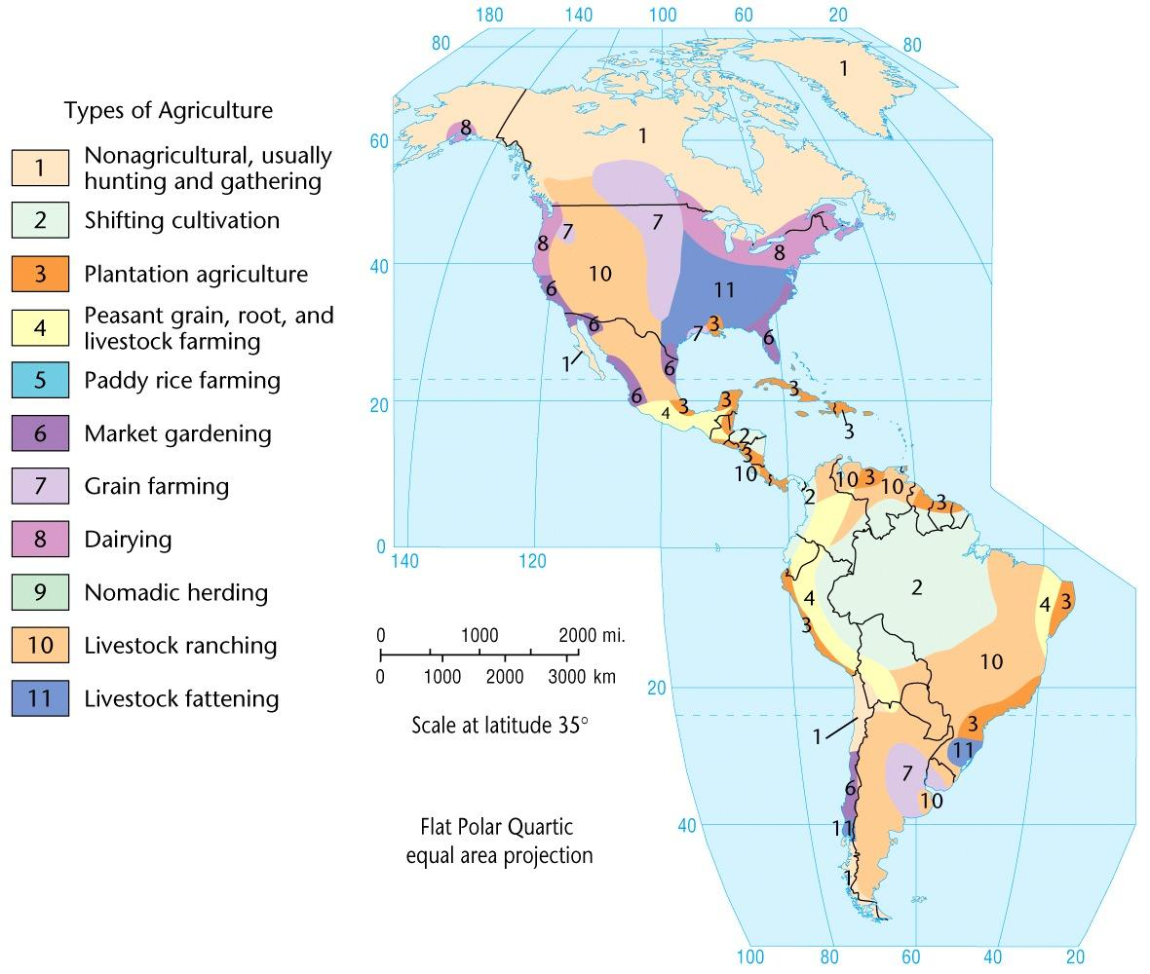
Subsistence agriculture
Commercial agriculture
Subsistence agriculture
Commercial agriculture

Slide 7
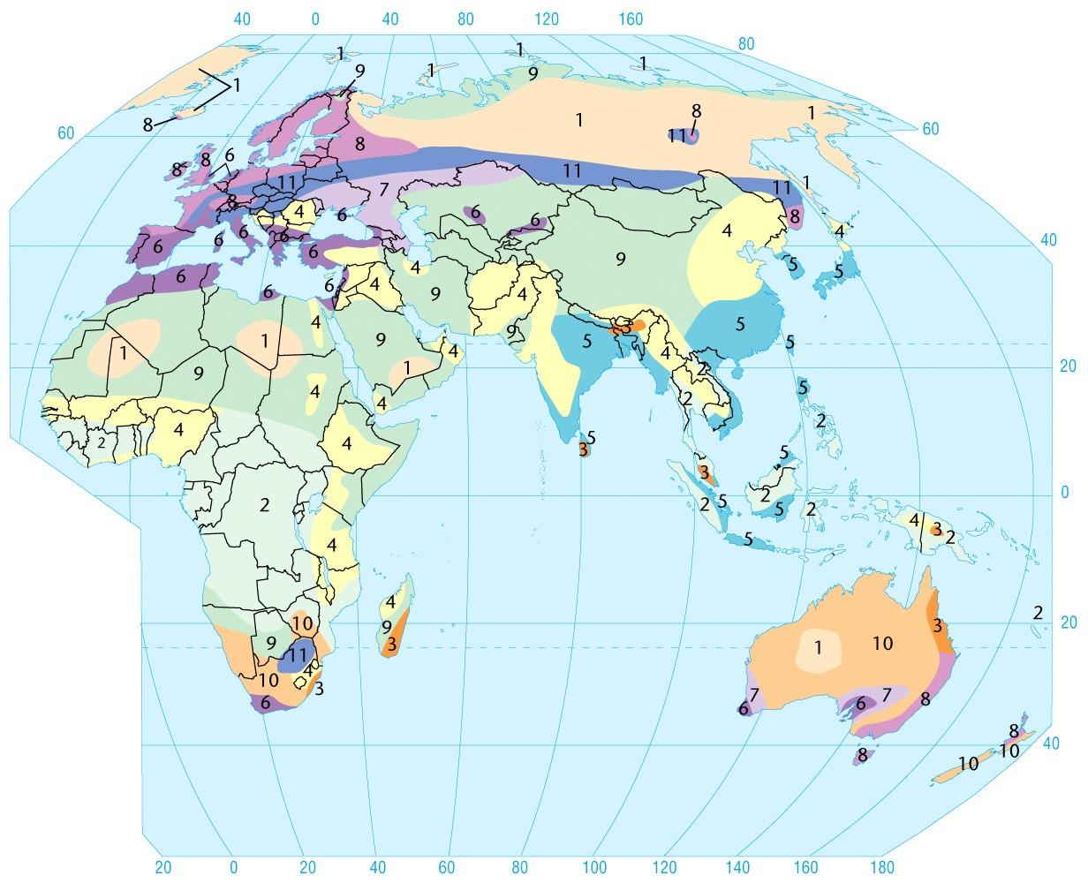
See Figure 8.3 in your text for a better map
Subsistence agriculture
Commercial agriculture
See Figure 8.3 in your text for a better map

Slide 8
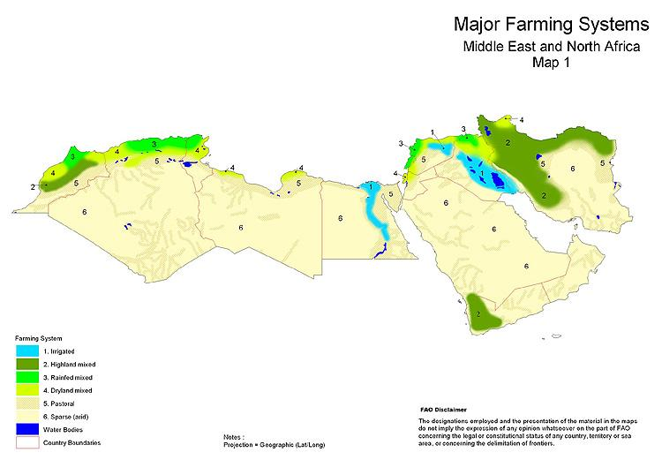
Notes:
http://www.fao.org/farmingsystems/mapstheme_01_en.htm

Slide 9
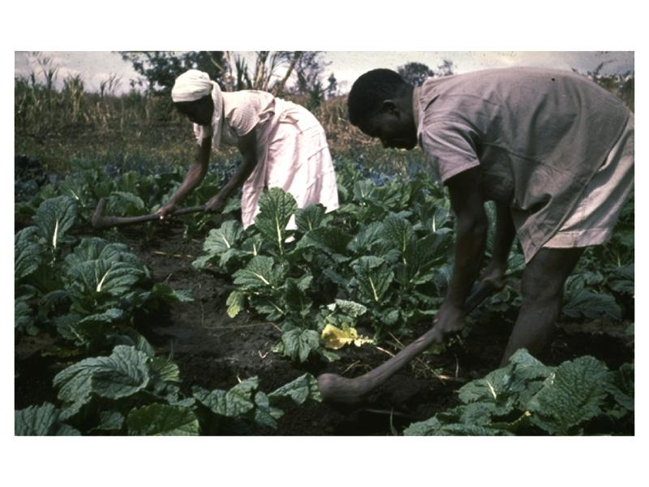
Subsistence Agricultural Systems
  Basic
    Hunting & gathering
    Shifting cultivation
    Pastoral nomadism
  Intensive
    Grain agriculture

Slide 10
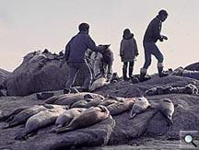
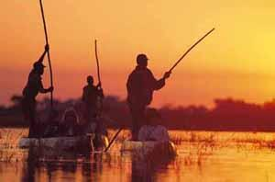
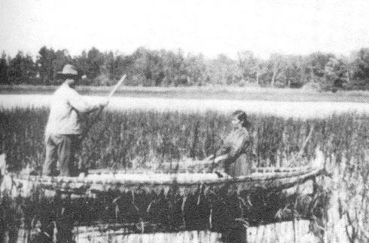
Hunting and Gathering Systems
Still practiced by
indigenous peoples;
now mixed with
other systems

Slide 11
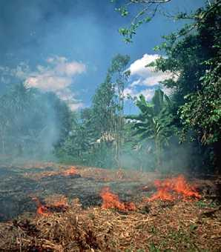
Shifting Cultivations:
Slash and Burn (swidden)

Slide 12
Since “Columbian Exchange”
Product Origin Main production today
Cacao Mexico West Africa
Potato Andes Europe
Banana SE Asia Central/S. America
Rubber S. America SE Asia
Notes:
See State of Food And Agriculture 2002
http://www.fao.org/WAICENT/FAOINFO/ECONOMIC/ESA/sofa.htm

Slide 13
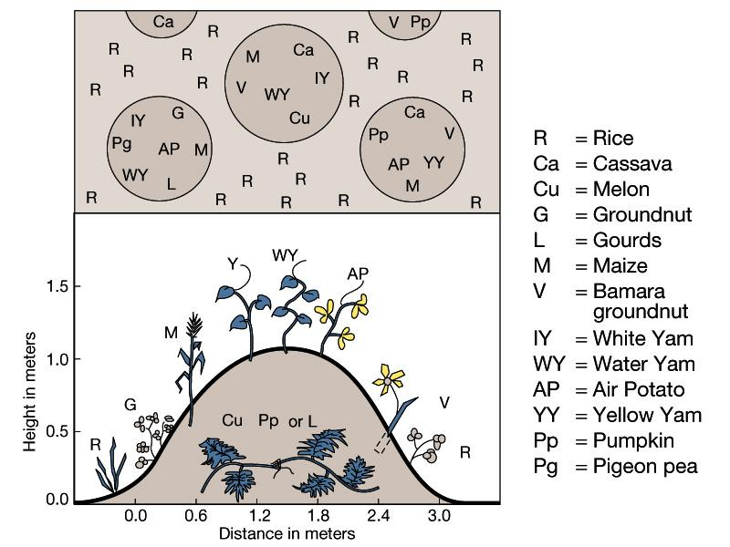
Intertillage

Slide 14
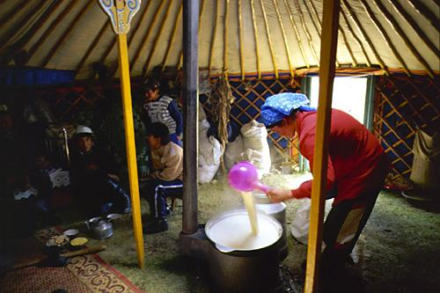
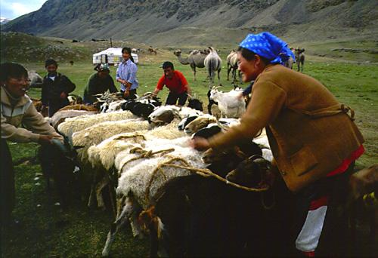
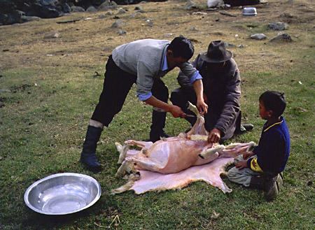
Pastoralism
(animal herding)
Notes:
http://home.planet.nl/~sanderva/mongolia/living/index4.htm

Slide 15
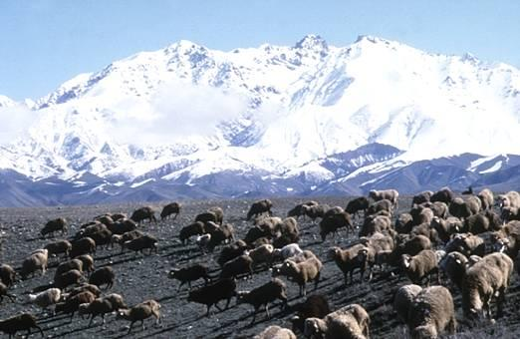
Nomadic Herding

Slide 16
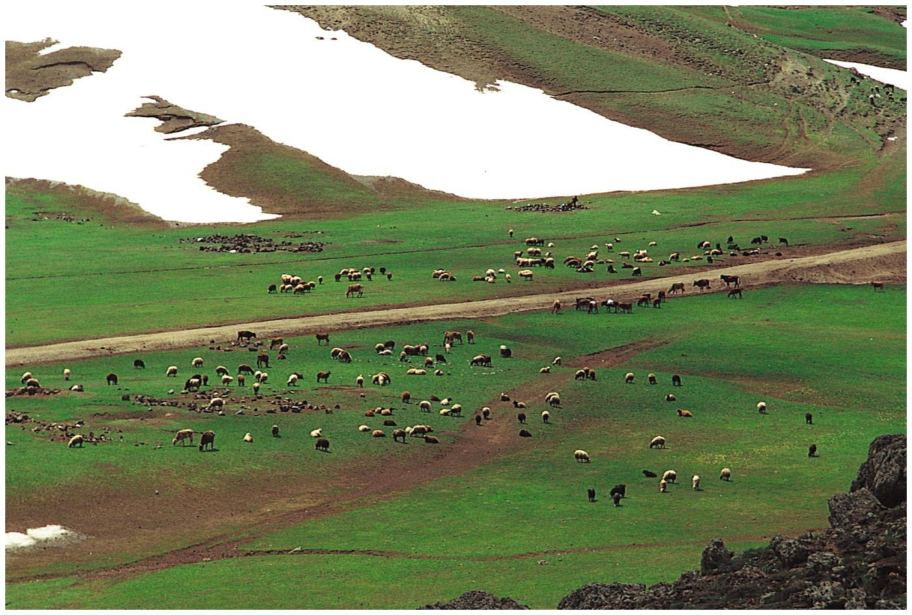
Transhumance: Movement of herds

Slide 17
Subsistence problems
Need lots of land to feed few
Poor soils
Lack of technology
Yields have not increased for generations
No capital
No land ownership
Poorest agriculturalists

Slide 18
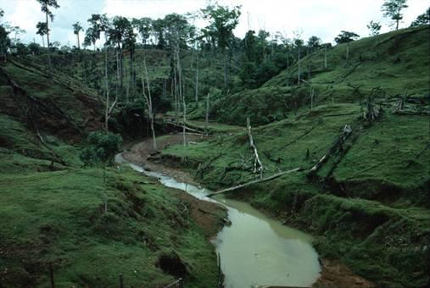
Deforestation and erosion

Slide 19
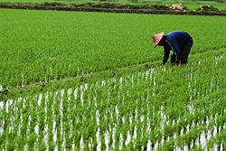
Intensive subsistence agriculture

Slide 20
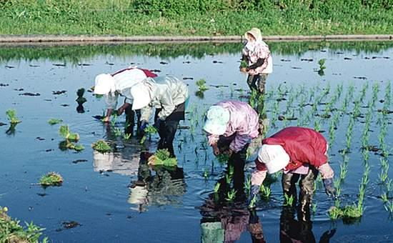
Rice Paddy Farming

Slide 21
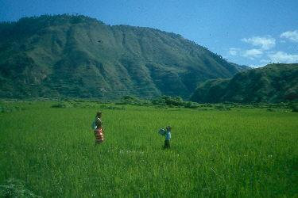
Philippine tribal rice culture

Slide 22
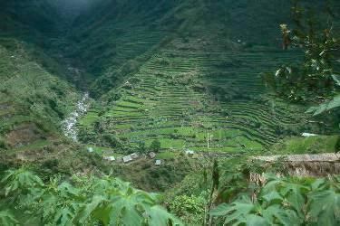
Rice terrace farming

Slide 23
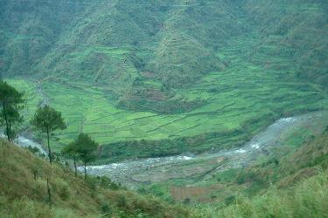
Chico River in the Philippines

Slide 24
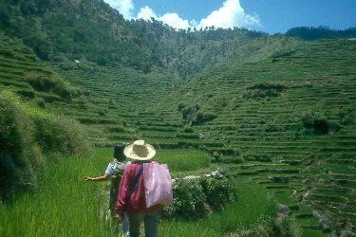
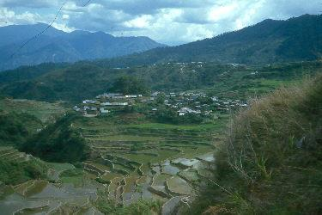
Rice terraces

Slide 25
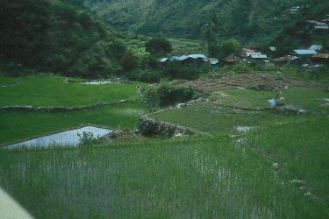
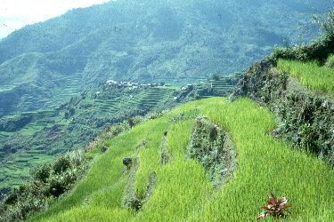
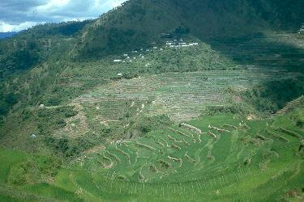
Rice terraces near Chico River

Slide 26
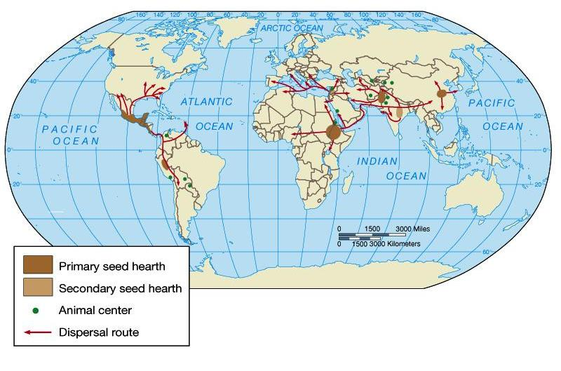
First Agricultural Revolution
Seed agriculture
Domestication of plow animals

Slide 27
Second Agricultural Revolution
Improvements
Inputs
  Fertilizers
  Irrigation
Outputs
  Crop yields
  Livestock yields
Technical innovations
  Horses, yokes

Slide 28
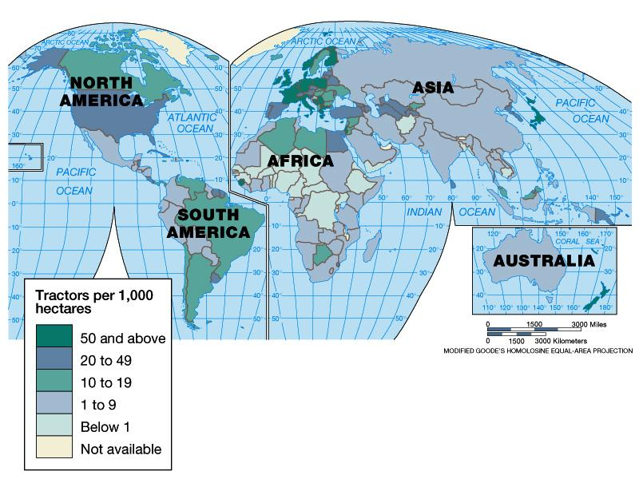
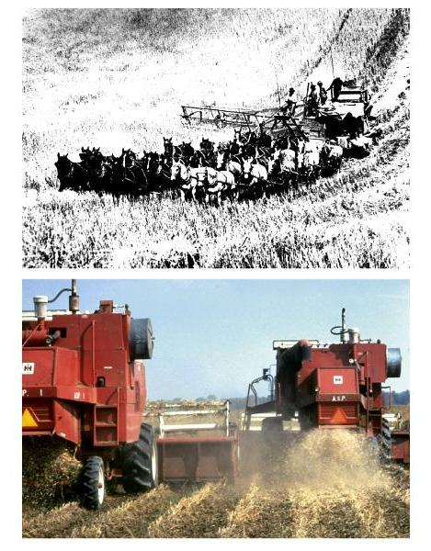
Third Agricultural
Revolution :
Mechanization

Slide 29
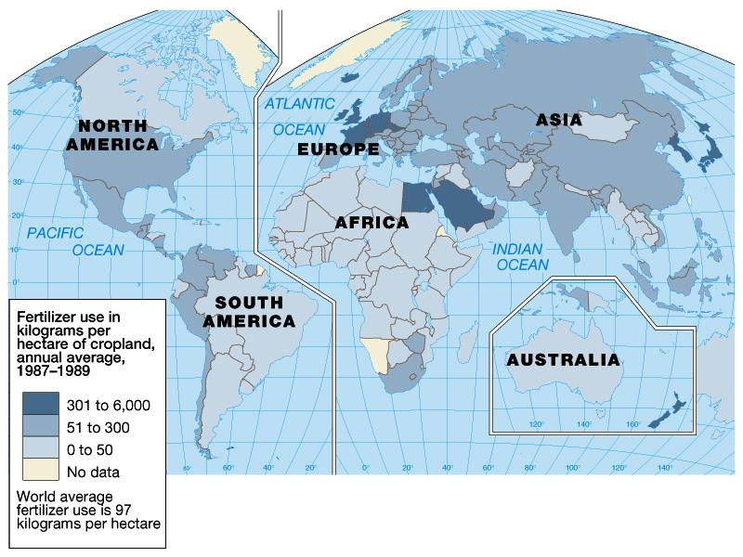
Third Agricultural Revolution:
Chemical inputs

Slide 30
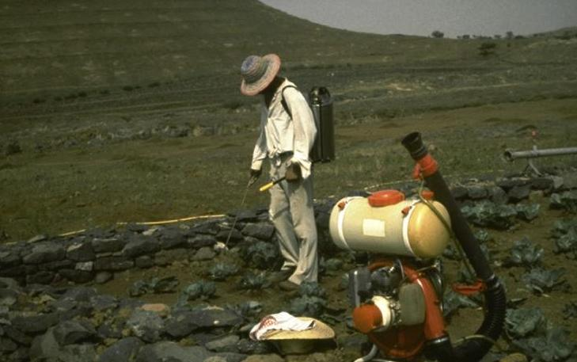
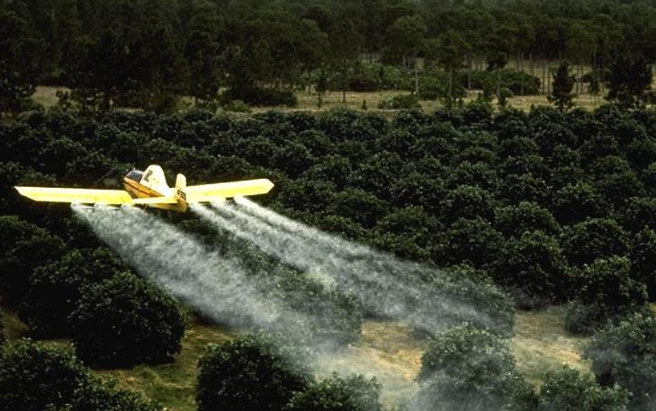
Agricultural
industrialization
Chemical inputs
Fertilizers
Pesticides
Fungicides
Herbicides
(weed killers)

Slide 31
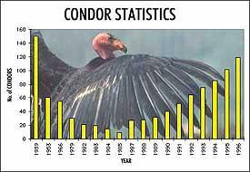
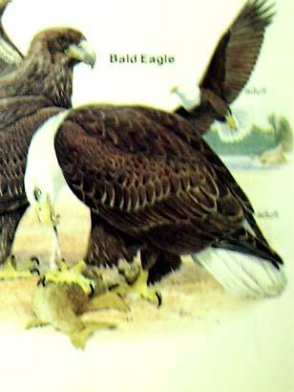
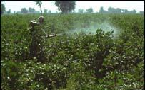
DDT pesticide effect on birds;
U.S. recovery since ban
Still exported to Periphery

Slide 32
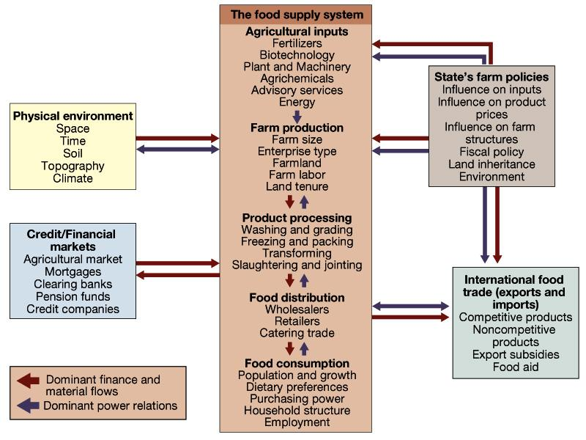

Slide 33
Commercial Agricultural Systems
  Trade oriented (cash crops)
  Surplus production
  Specialization and division of labor
  Input intensive
  Sustainability questionable

Slide 34
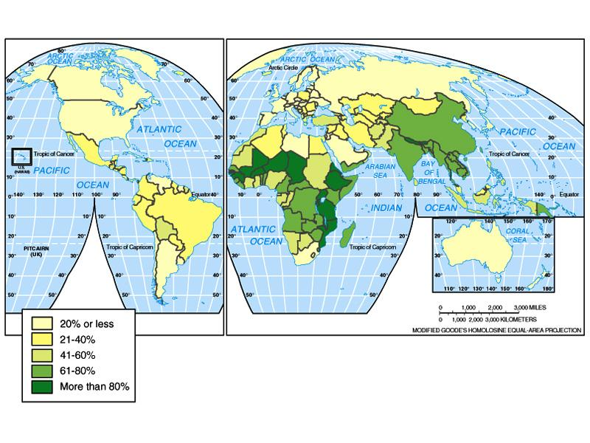
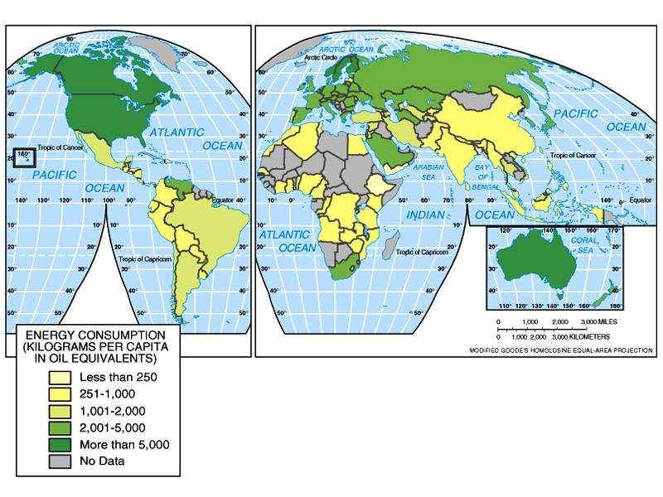
Percent of the Labor Force Engaged in Agriculture

Slide 35
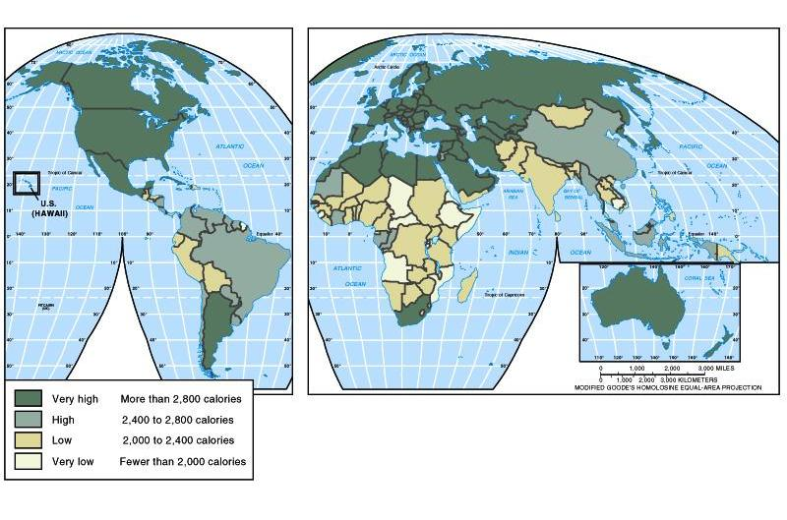
World Daily Per Capita Food Supply
(Average Calorie Intake)

Slide 36
Intensive/Extensive Agriculture
Intensive
  High inputs and production per unit of area
Extensive
  Cover wide areas
  Low inputs & production per unit of area

Slide 37
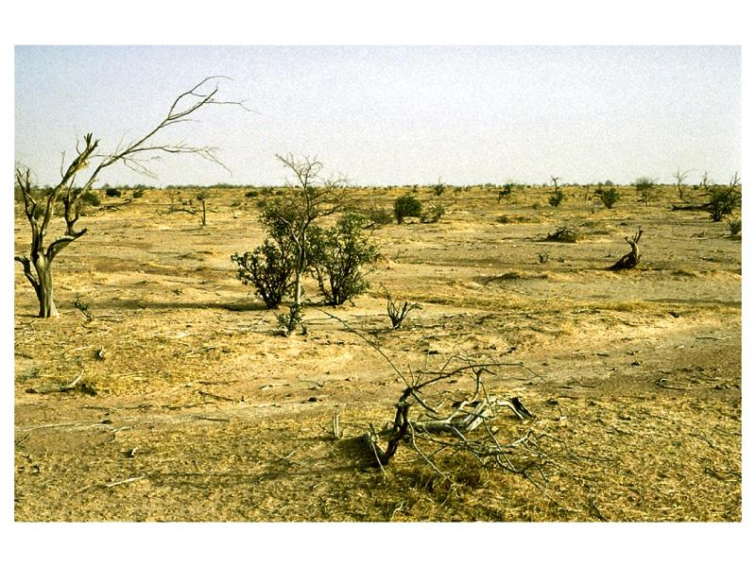
Desertification and erosion

Slide 38
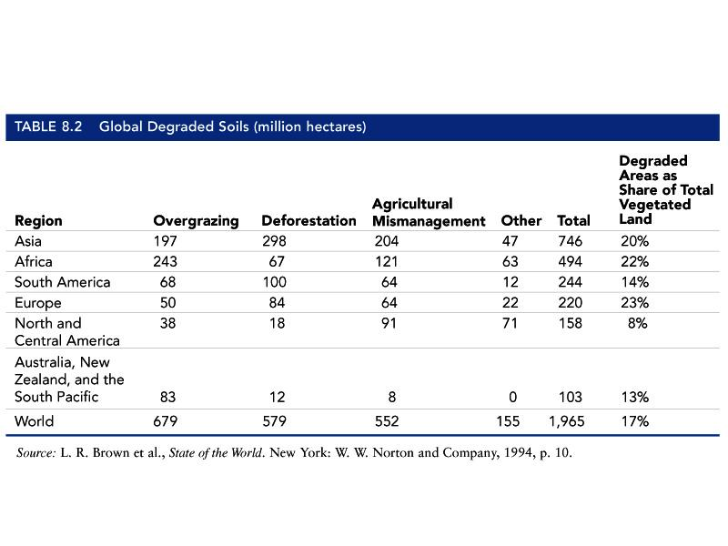

Slide 39
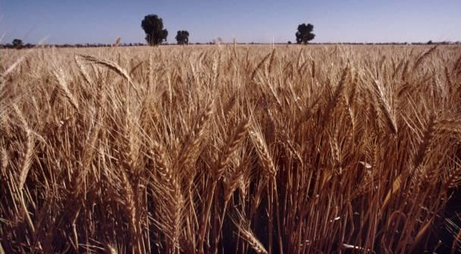
Commercial Grain Farming

Slide 40
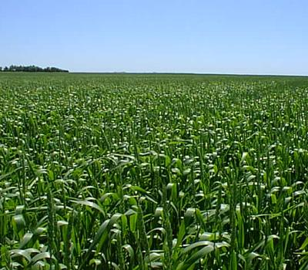
Corn (maize) from Mexico,
U.S. now top grower

Slide 41
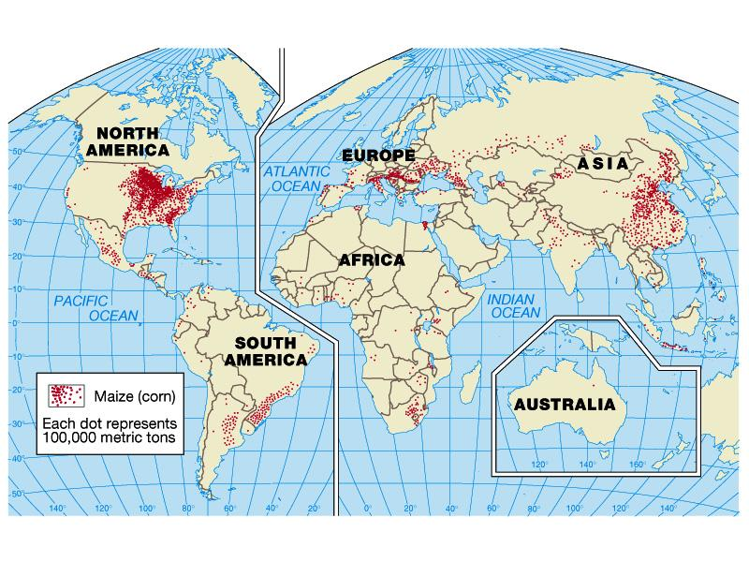

Slide 42


Wisconsin wheat, 1860-1920

Slide 43


Wisconsin Crops and Agricultural
Regions

Slide 44

Commercial Dairying

Slide 45



Wisconsin dairy industry,
1932

Slide 46




Wisconsin rural changes, early 1900s
Church
School
Creamery

Slide 47


Wisconsin Milk Strike of 1933

Slide 48



Wisconsin soil conservation, 1930s
Dust Bowl

Slide 49

Wisconsin rural electrification, 1930s

Slide 50


Slide 51


Intensive Ag: California Milk
2,157 dairies with average of 721 cows
Notes:
http://www.cdfa.ca.gov/dairy/pubs/Annual/2001/stats2001annual.pdf

Slide 52

Western Feedlots

Slide 53


Animal Fattening:
Chickens, Pigs, etc.

Slide 54

Livestock Ranching

Slide 55

Plantation Agriculture
Monocrops (Coffee, cocoa, rubber, etc.)

Slide 56




Ilicit
Agriculture
Coca
(for cocaine)
Opium poppy
(for heroin)
Marijuana

Slide 57


Slide 58


Slide 59


Slide 60



AGRIBUSINESS
Factory
hog farm
in North
Carolina

Slide 61

Notes:
http://www.illinoisatlas.com/us/agriculture/agriculture.htm

Slide 62
U.S. farm crisis started 1980s
Less revenue from product
Soaring land prices
Higher input prices
Bankruptcies and foreclosures

Slide 63

Wisconsin family farm auction

Slide 64
“Green Revolution”
benefits
Core exports high-yield “miracle” seeds
Needed oil-based fertilizers, pesticides
Asian rice crop up 66% in 1965-85
Favored areas with good soil, weather

Slide 65

“Green Revolution”

Slide 66

Green Revolution

Slide 67
“Green Revolution”
drawbacks
Favored farmers who could afford seeds,
inputs, machines, irrigation
Indebted farmers lost land, moved to cities
New “monocrops” lacked resistance to disease/pests
Environmental contamination, erosion
Oriented to export “cash crops,” not domestic food

Slide 68
Biotechnology:
Using organisms to…
Make or modify products
Improve plants or animals
Develop new microorganisms
Crossing natural divides between species
  Not just crossbreeding

Slide 69

Genetic Engineering

Slide 70


Genetically Modified Organisms (GMO)
Consumer concerns
began in Europe,
now in U.S. too

Slide 71

Genetic Engineering

Slide 72
Biotechnology benefits in agriculture
Increase yields
Increase pest resistance
Grow crops in new areas

Slide 73
Biotechnology drawbacks in agriculture
High costs (available to few)
Monocrops have less tolerance to disease
Possible health effects
Contamination of wild crops (“superweeds”)
Corporate patents on life forms

Slide 74



Bovine Growth
Hormone (BGH)

Slide 75




Starlink corn

Slide 76




Monarch butterflies and corn pollen
Possible
effects of
Bt-modified
corn pollen

Slide 77



Cloning
First calf cloned in
Wisconsin, 1997.
Many clones die
of complications.
Ethical and
economic conflicts

Slide 78


Slide 79


San Francisco
Farmers’ Market

Slide 80

Chinatown ginseng shop

Slide 81


Slide 82

Minneapolis airport
flower stand

