Slide 1
Chapter 7
Ethnicity

Slide 2
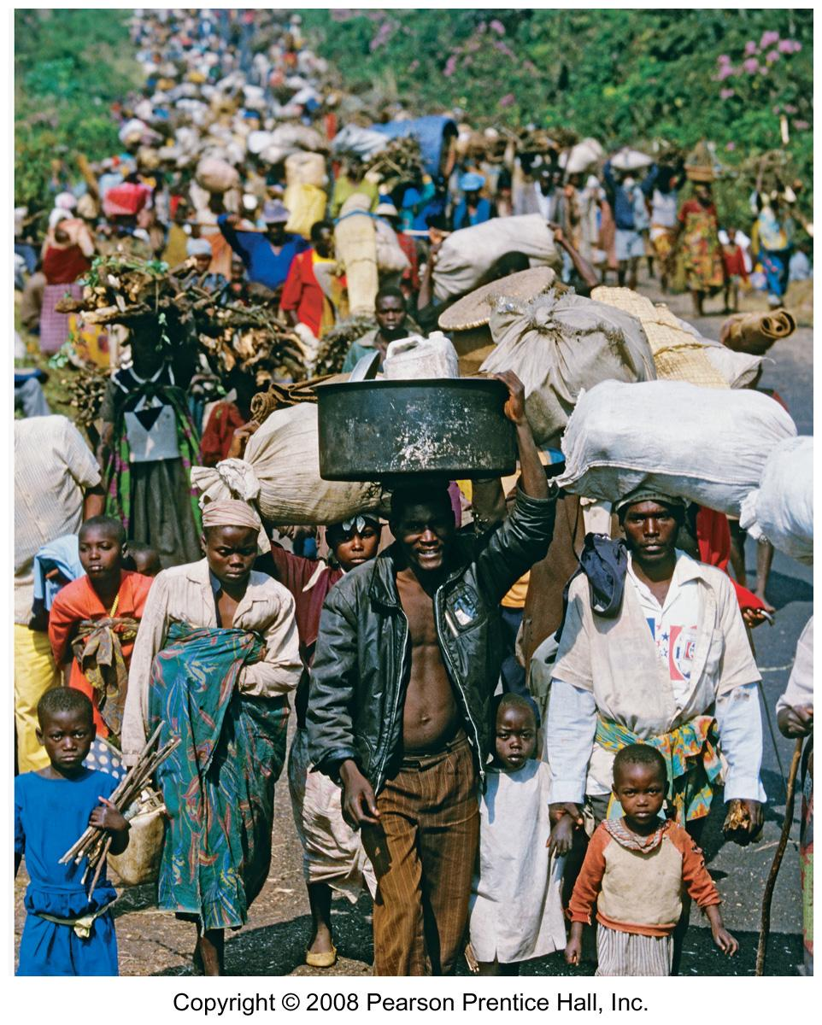
Refugees fleeing Rwanda
1994

Slide 3
Distribution of Ethnicities
Ethnicities in the United States
  Clustering of ethnicities
  African American migration patterns
Differentiating ethnicity and race
  Race in the United States
  Division by race in South Africa

Slide 4
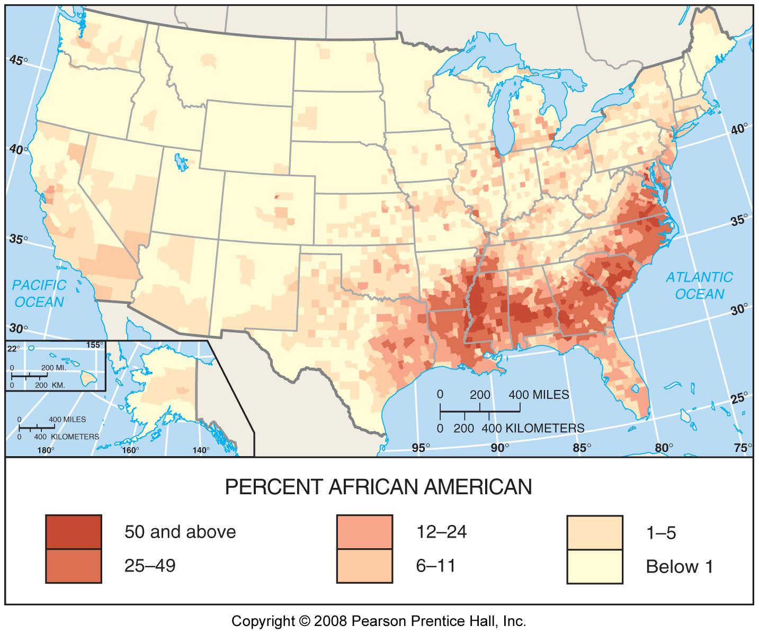
African-Americans in the U.S.
Fig. 7-1: The highest percentages of African Americans are in the rural South and in northern cities.

Slide 5
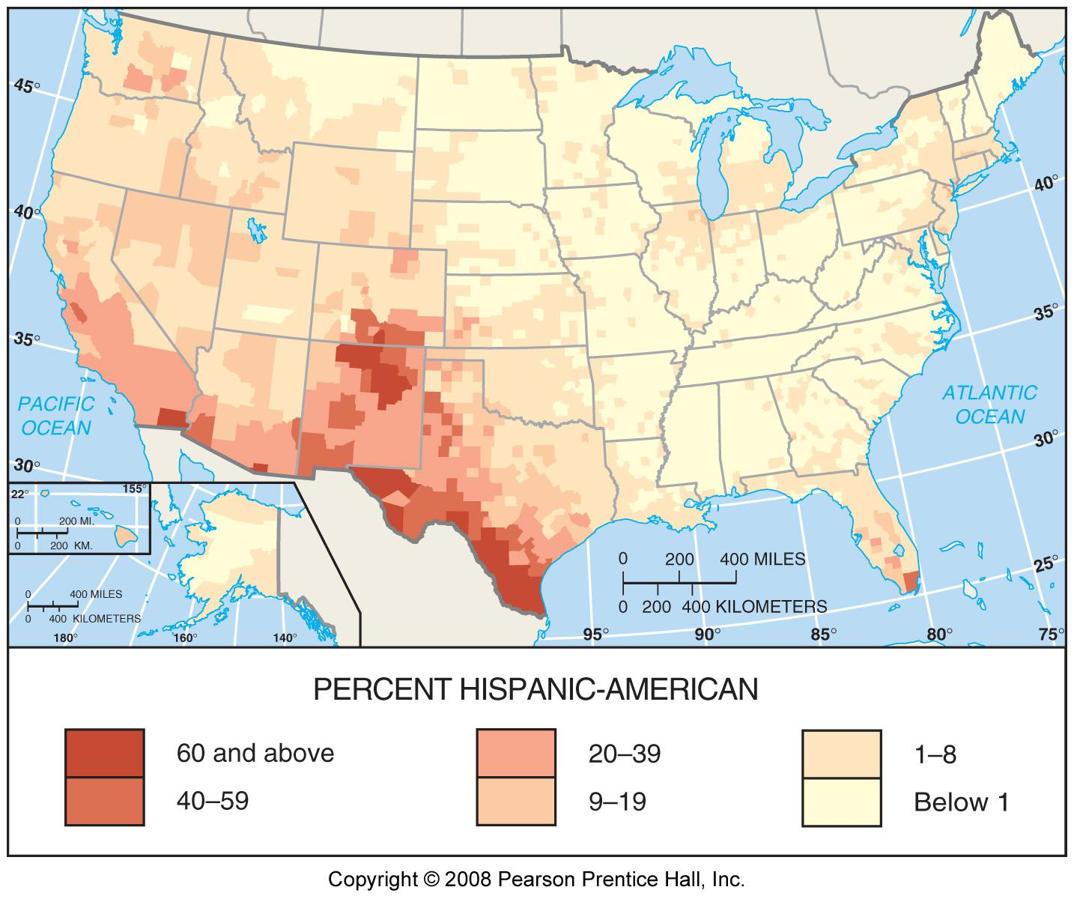
Hispanic Americans in the U.S.
Fig. 7-2: The highest percentages of Hispanic Americans are in the southwest and in northern cities.

Slide 6
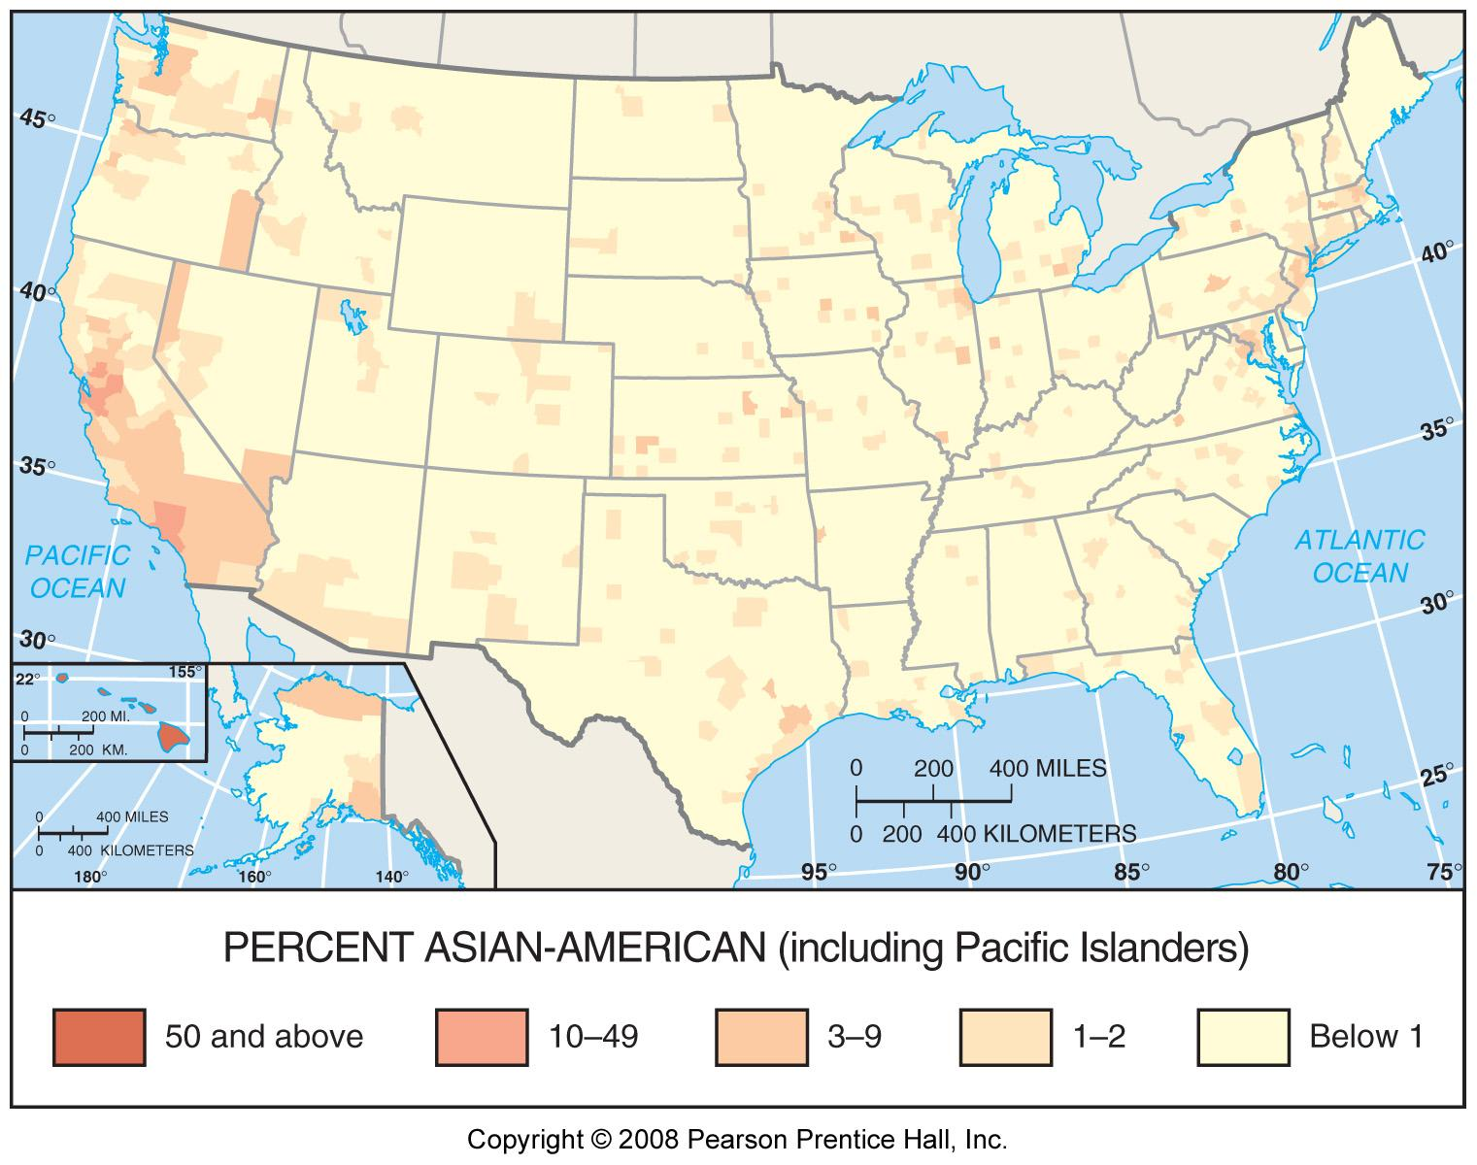
Asian Americans in the U.S.
Fig. 7-3: The highest percentages of Asian Americans are in Hawaii and California.

Slide 7
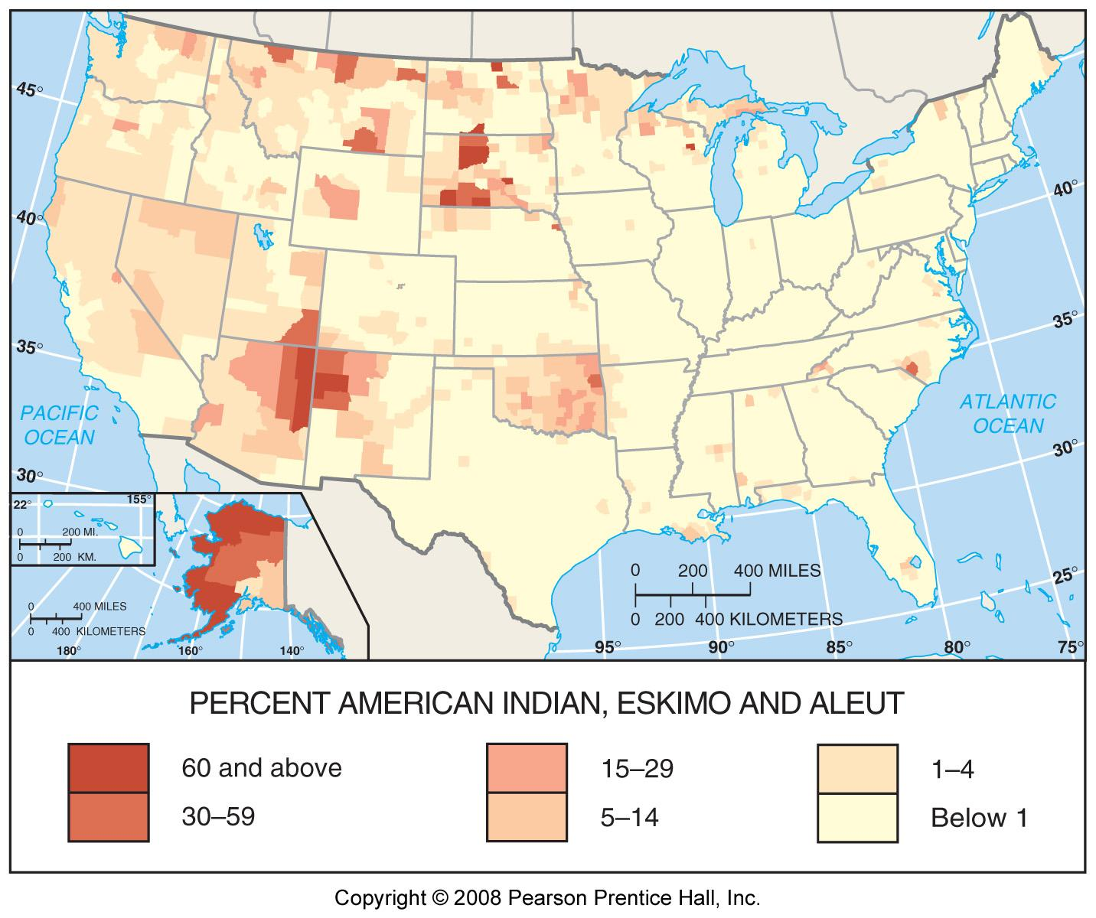
Native Americans in the U.S.
Fig. 7-4: The highest percentages of Native Americans are in parts of the plains, the southwest, and Alaska.

Slide 8
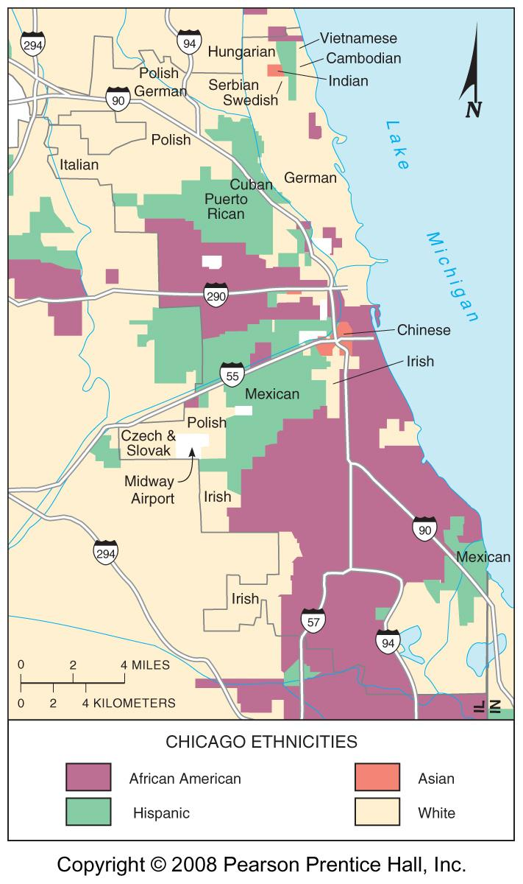
Ethnicities in Chicago
Fig. 7-5: African Americans, Hispanic Americans, Asian Americans, and European Americans are clustered in different areas of the city.

Slide 9
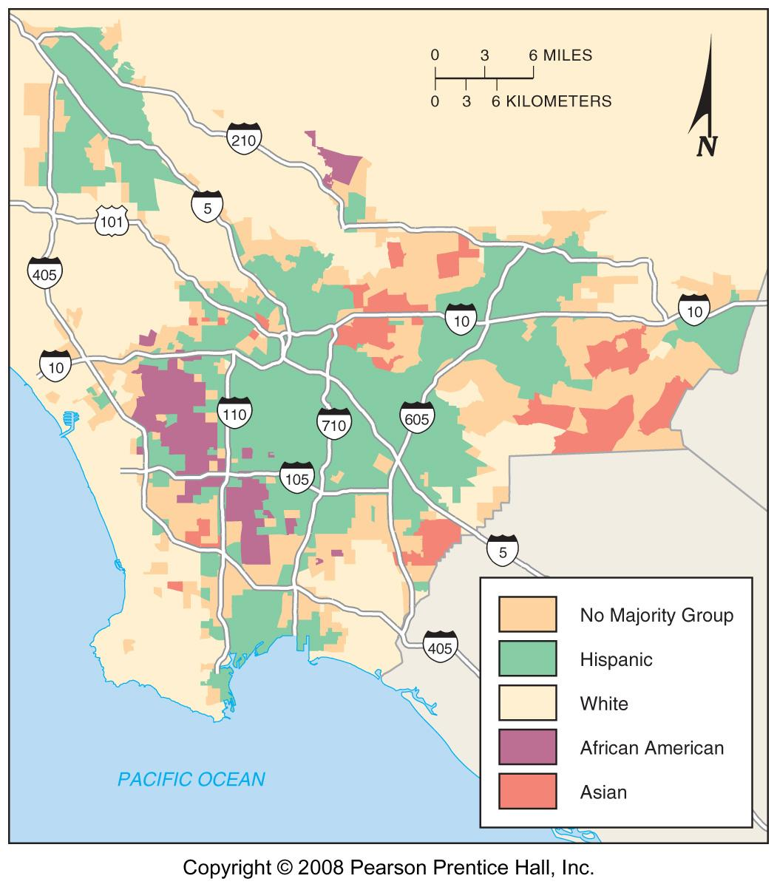
Ethnicities in Los Angeles
Fig. 7-6: Hispanic, white, African American, and Asian areas in and around Los Angeles.

Slide 10
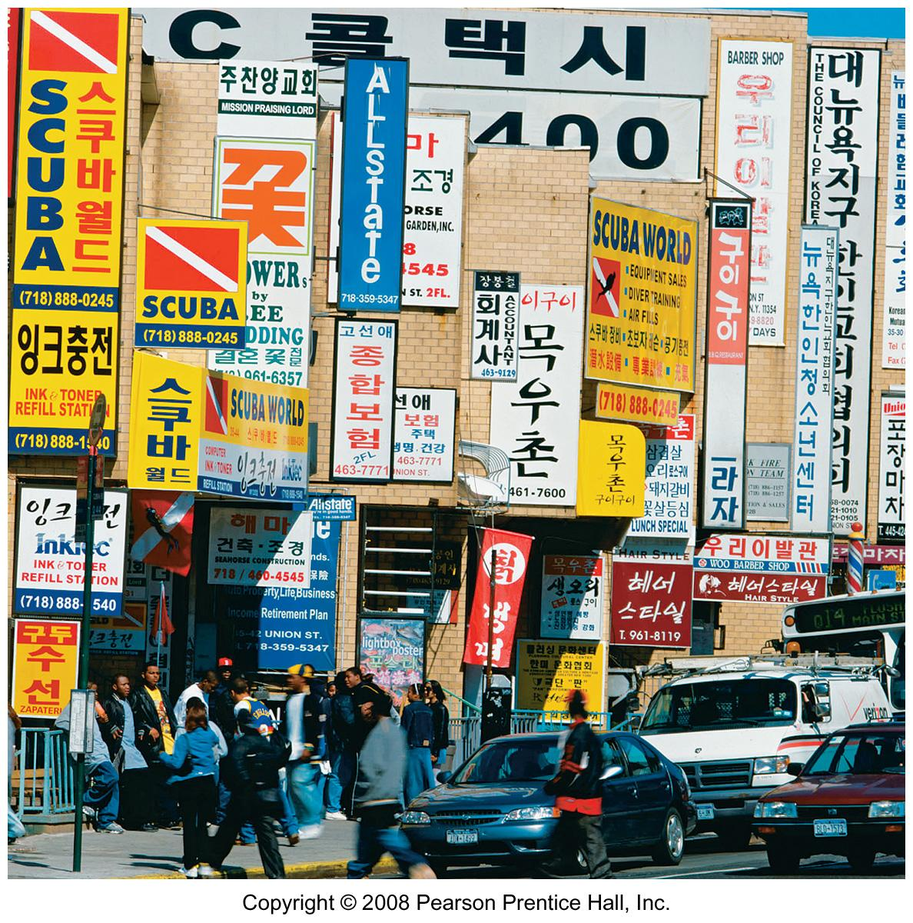
Ethnic Diversity, New York City

Slide 11
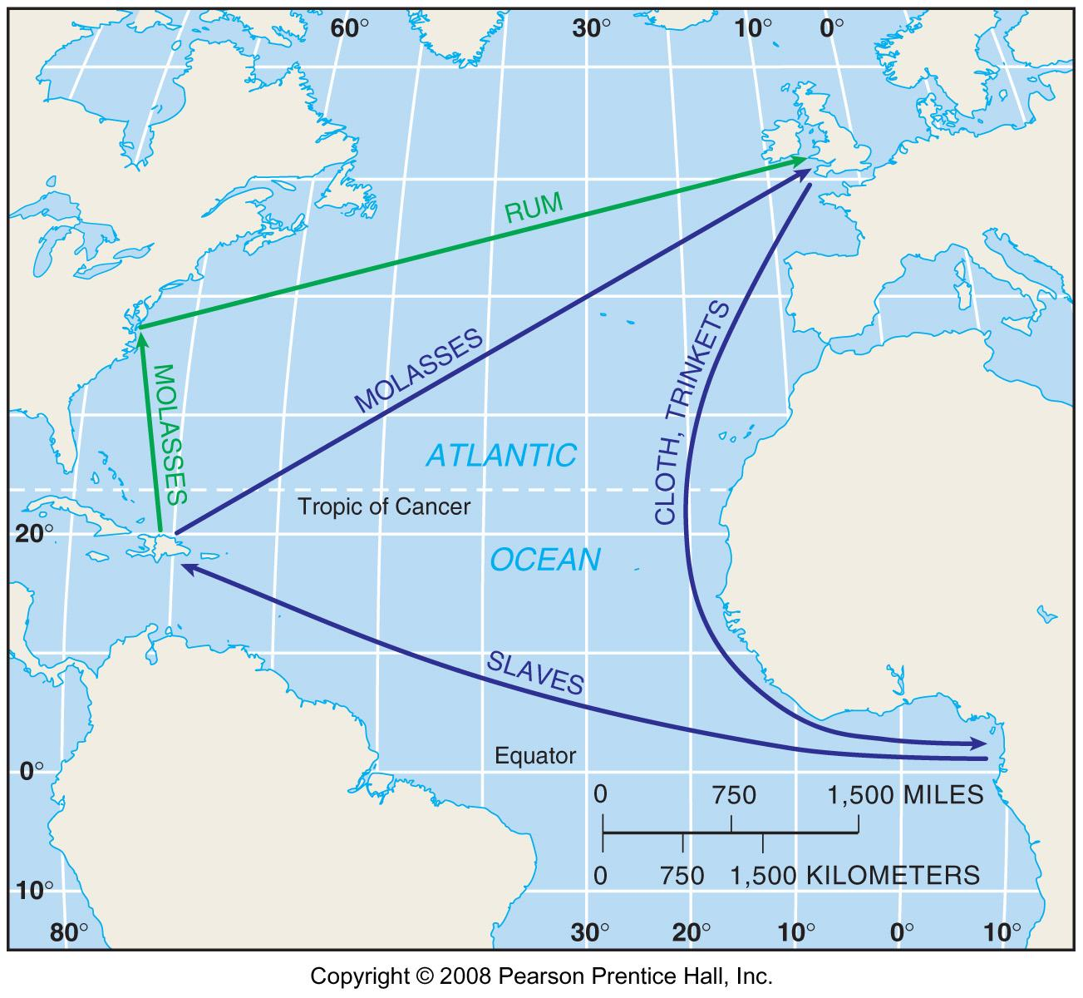
Triangular Slave Trade
Fig. 7-7: The British triangular slave trading system operated among Britain, Africa, and the Caribbean and North America.

Slide 12
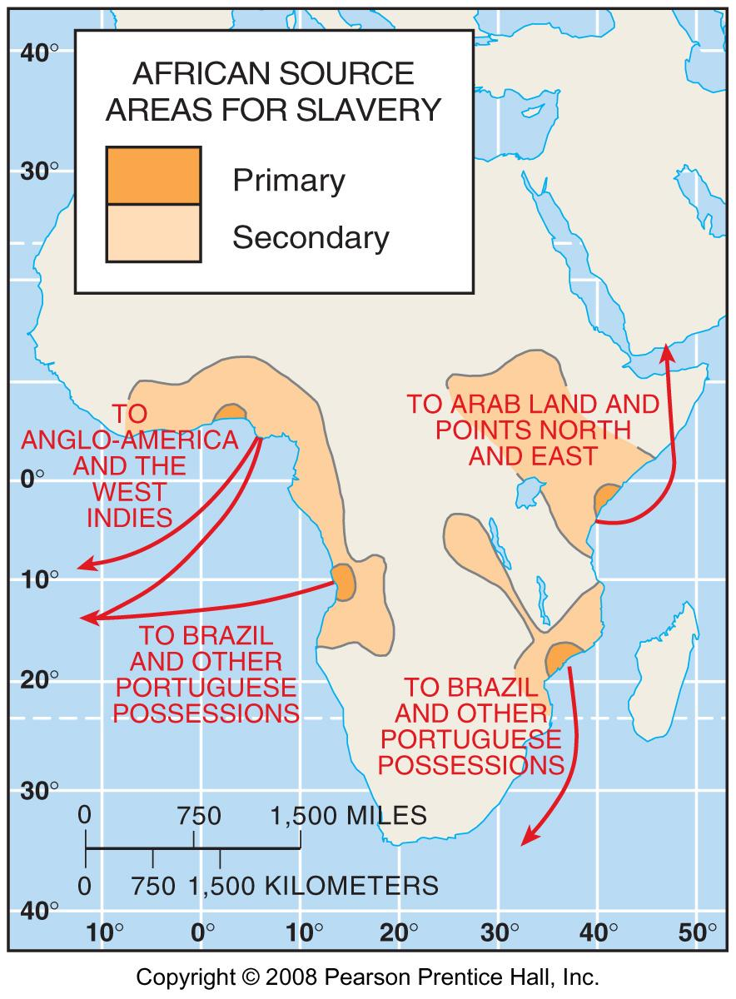
African Source Areas for Slavery
Fig. 7.7: Europeans obtained African slaves mainly from the western coast of Africa. Arabs and others also obtained slaves from Eastern Africa.

Slide 13
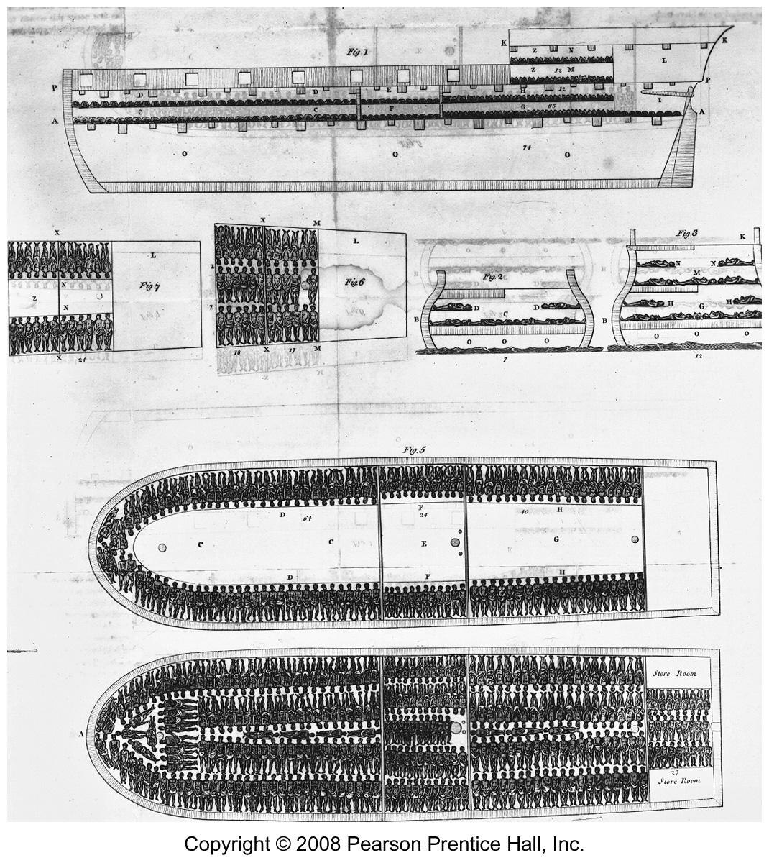
Diagram of a Slave Ship

Slide 14
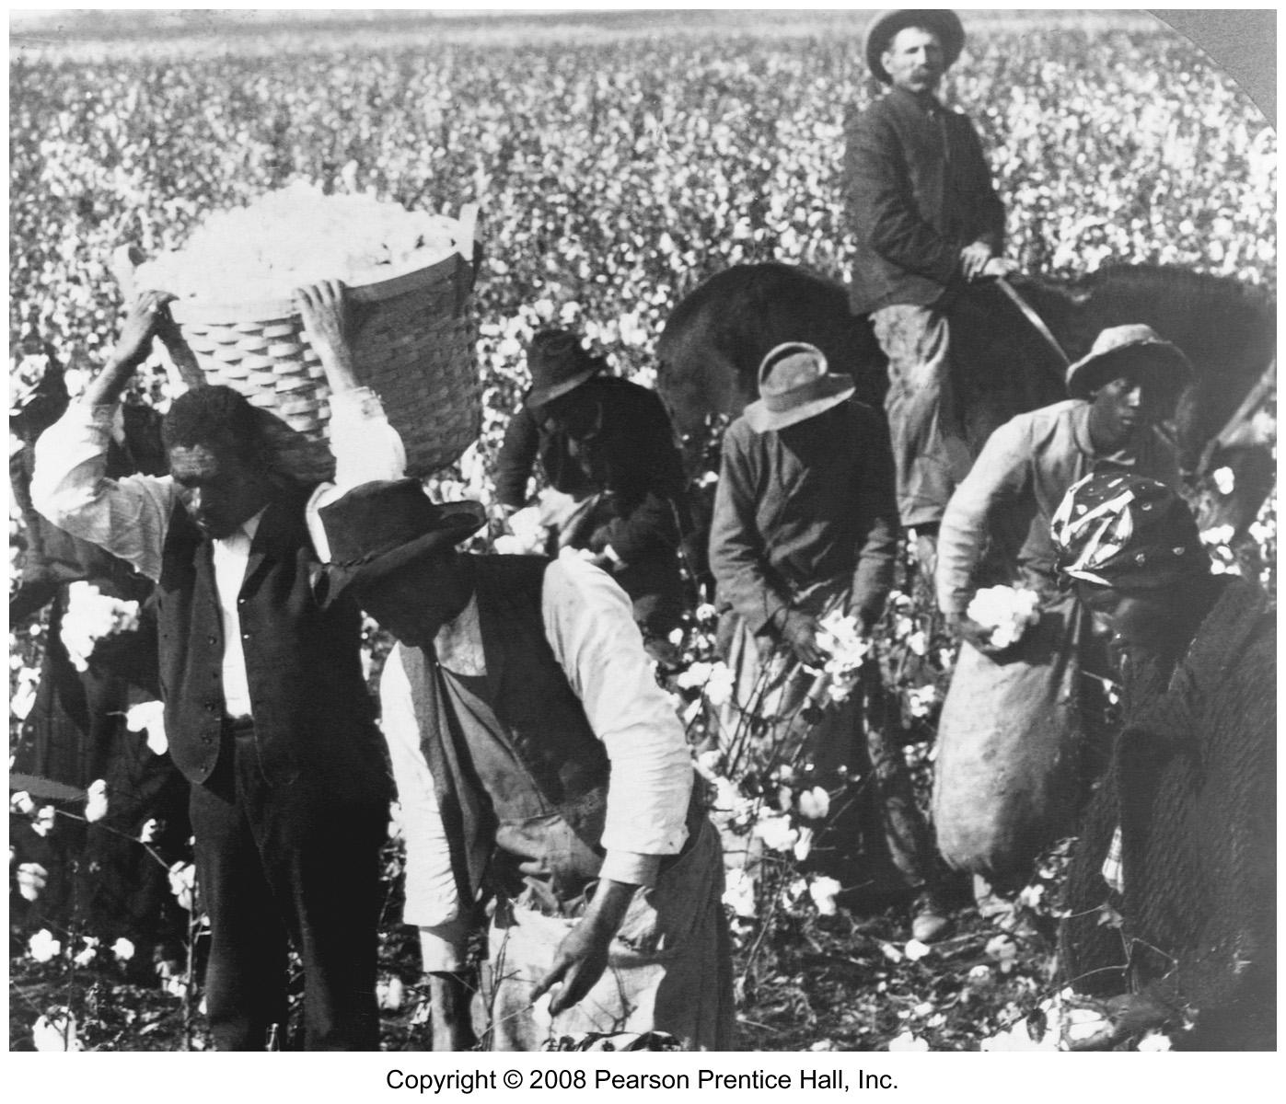
Cotton Sharecroppers in U.S.

Slide 15
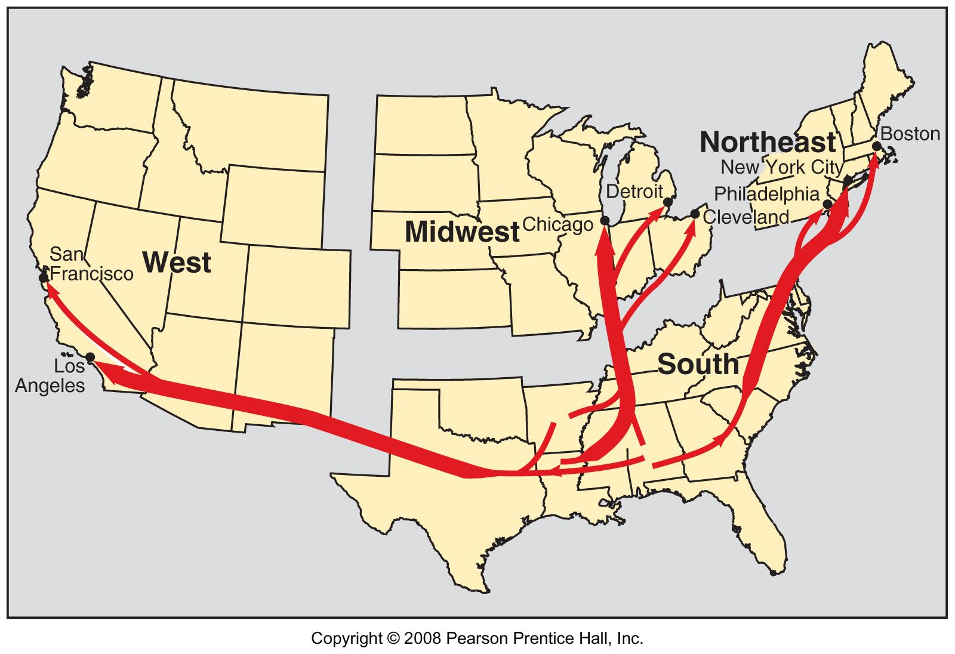
African American Migration in the U.S., 20th century
Fig. 7-8: 20th century African American migration within the U.S. consisted mainly of migration from the rural south to cities of the Northeast, Midwest, and West.

Slide 16
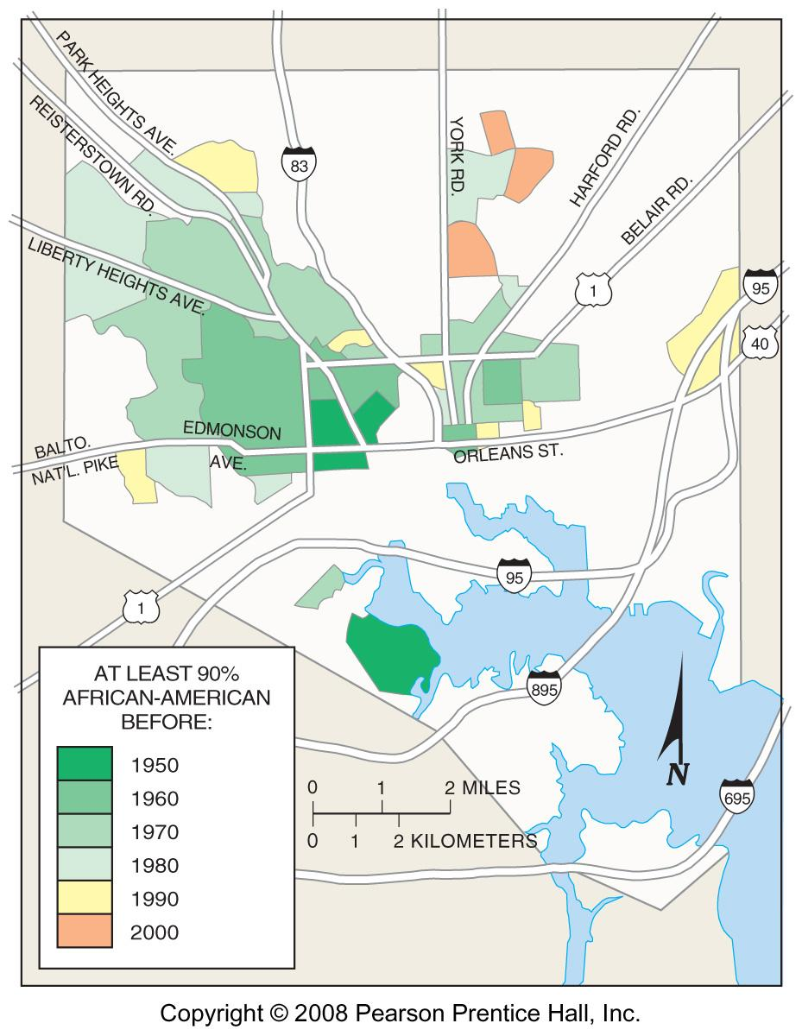
African Americans in Baltimore
Fig. 7-9: Areas with 90% African American population in Baltimore expanded from a core area northwest of downtown in the 1950s.

Slide 17
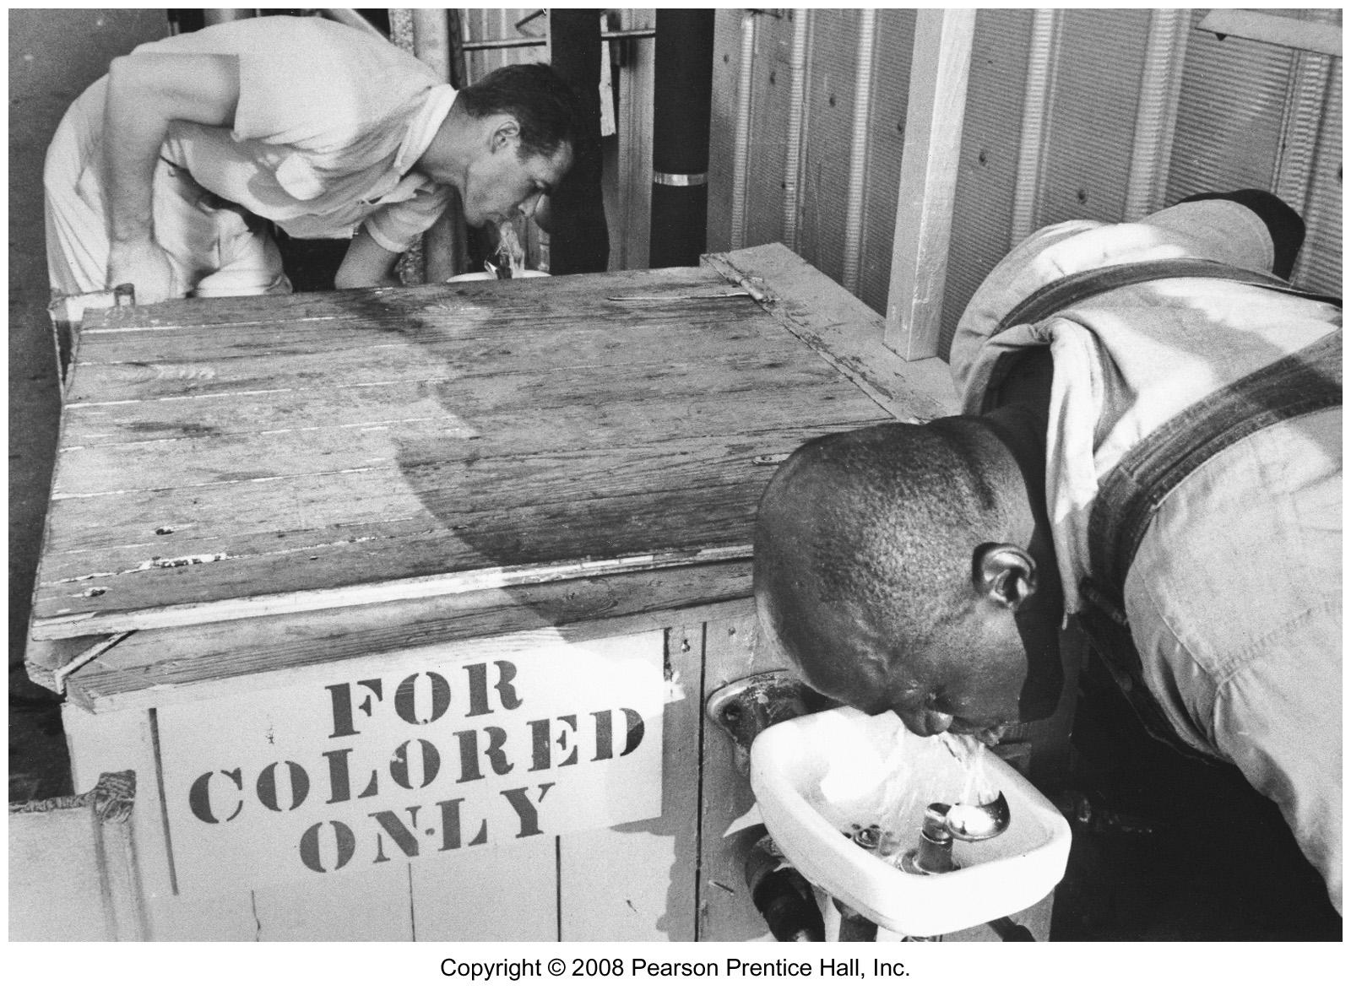
Segregation in the U.S.

Slide 18
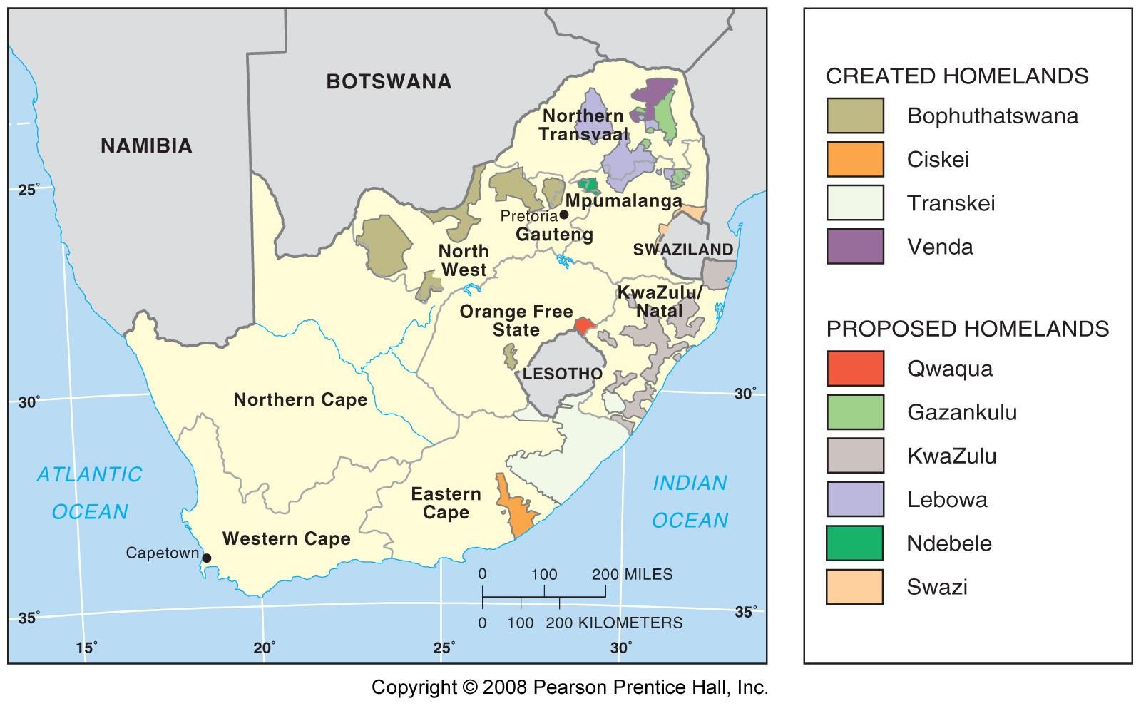
Black “Homelands” in South Africa
Fig. 7-10: During the apartheid era, South Africa created a series of black “homelands” with the expectation that every black would be a citizen of one of them. These were abolished with the end of apartheid.

Slide 19
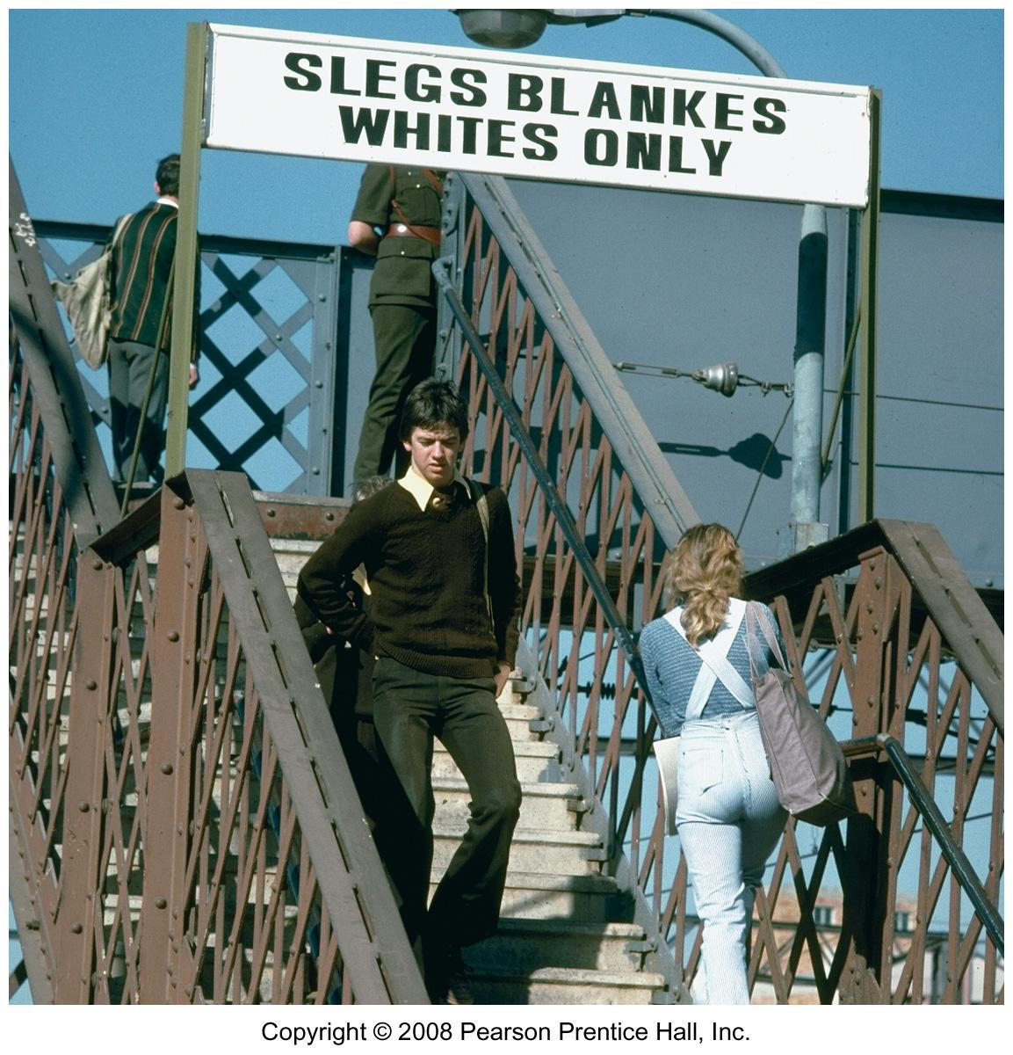
Train Station Stairs for Whites South Africa under Apartheid

Slide 20
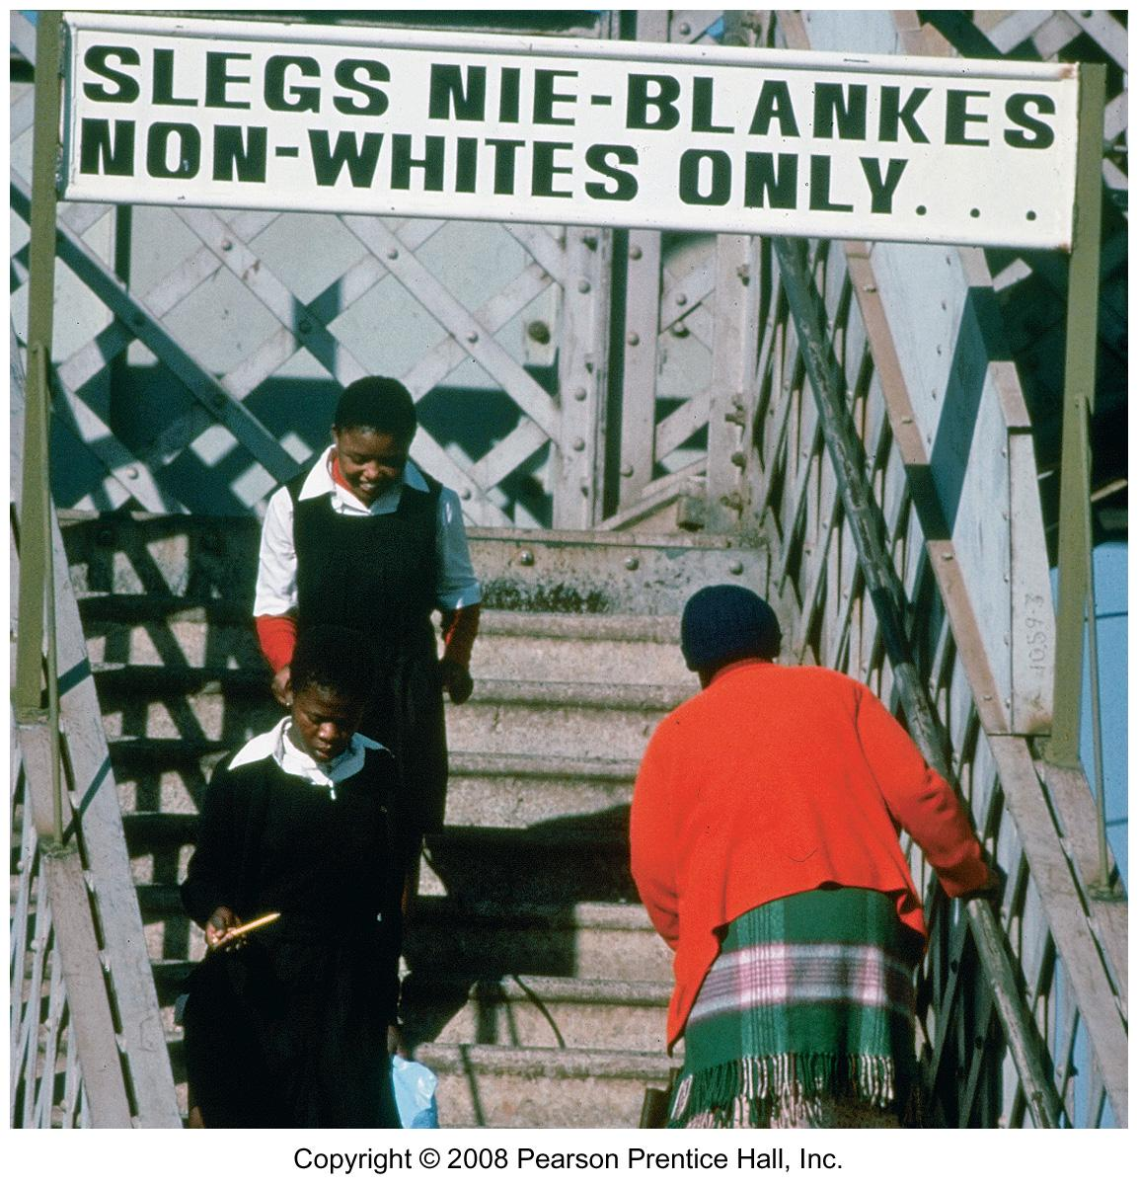
Train Station Stairs for Blacks South Africa under Apartheid

Slide 21
Ethnicities into Nationalities
Rise of nationalities
  Nation-states
  Nationalism
Multinational states
  Former Soviet Union
  Russia
  Turmoil in the Caucasus
Revival of ethnic identity
  Ethnicity and communism
  Rebirth of nationalism in Eastern Europe

Slide 22
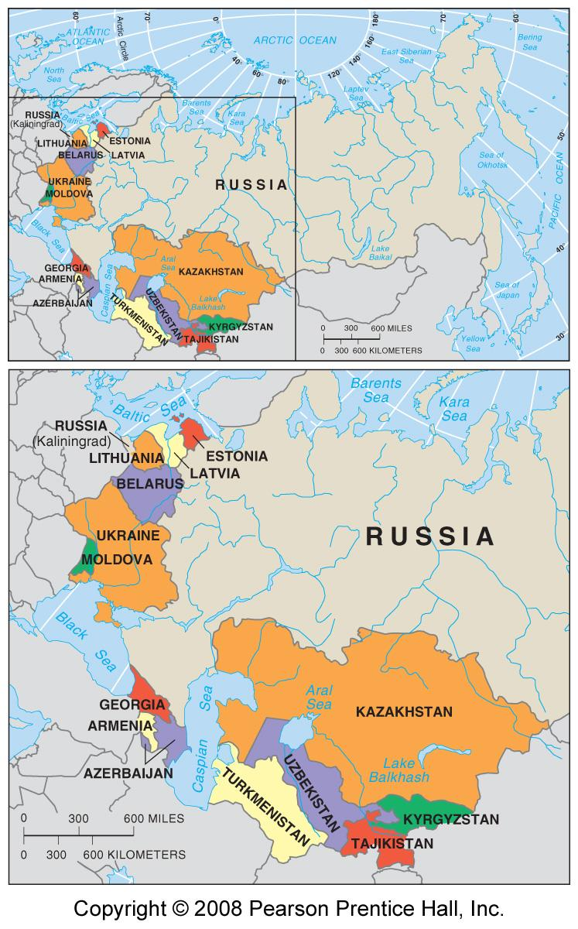
Republics of the Soviet Union
Fig. 7-11: The Soviet Union consisted of 15 republics that included the country’s largest ethnic groups. These all became independent countries in the early 1990s.

Slide 23
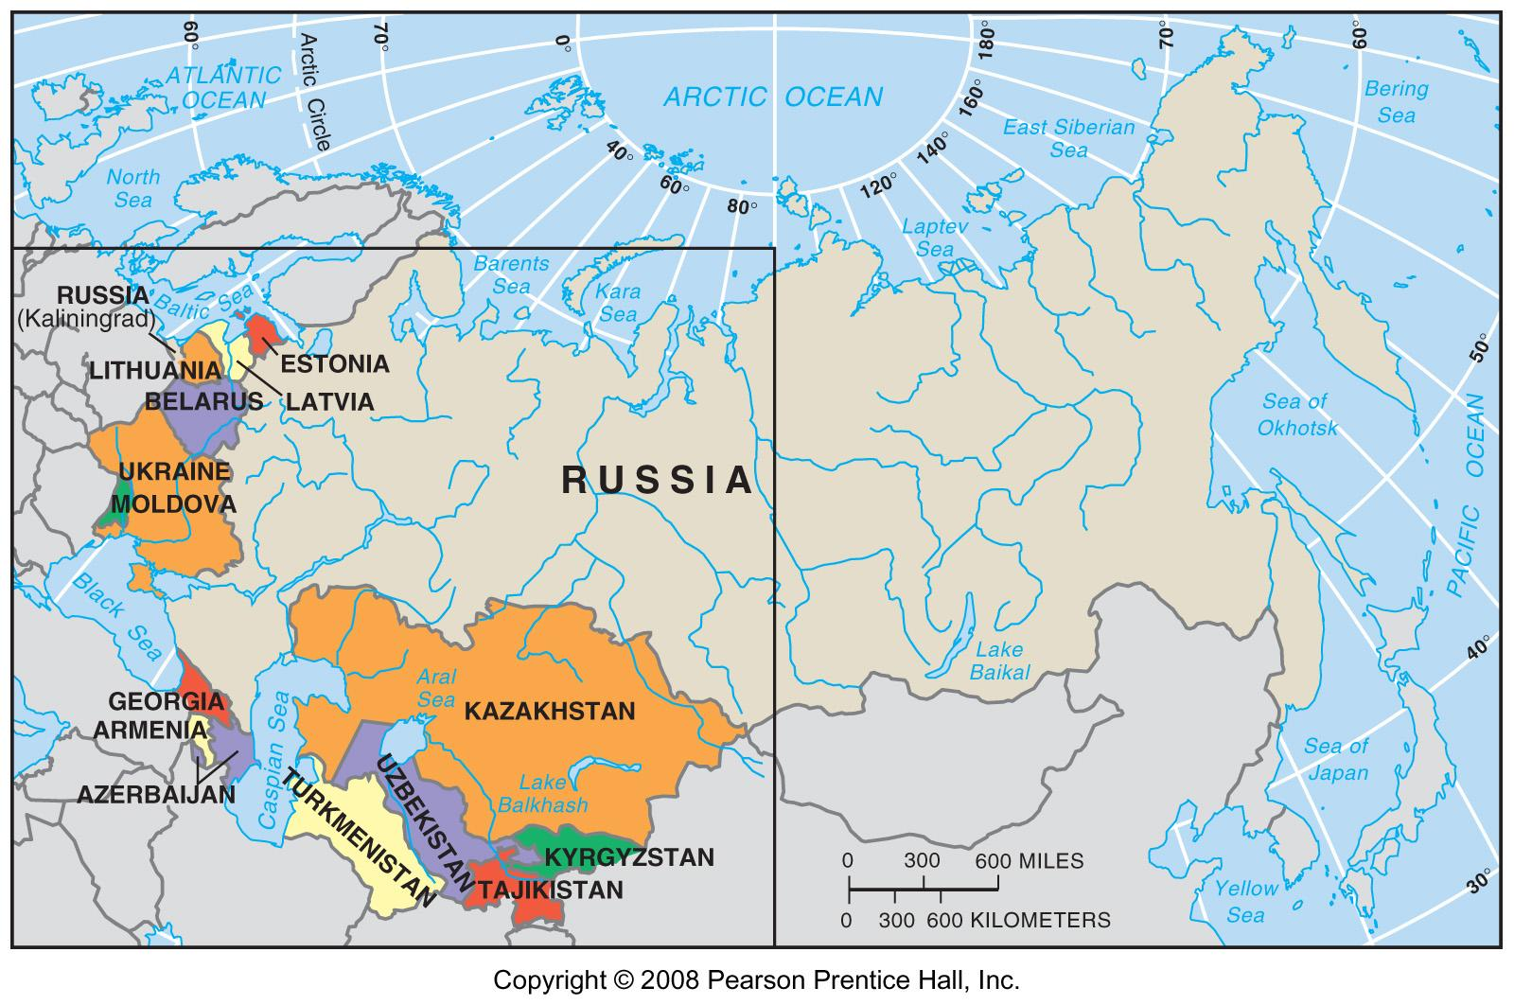
Republics of the Soviet Union
Fig. 7-11: The Soviet Union consisted of 15 republics that included the country’s largest ethnic groups. These all became independent countries in the early 1990s.

Slide 24
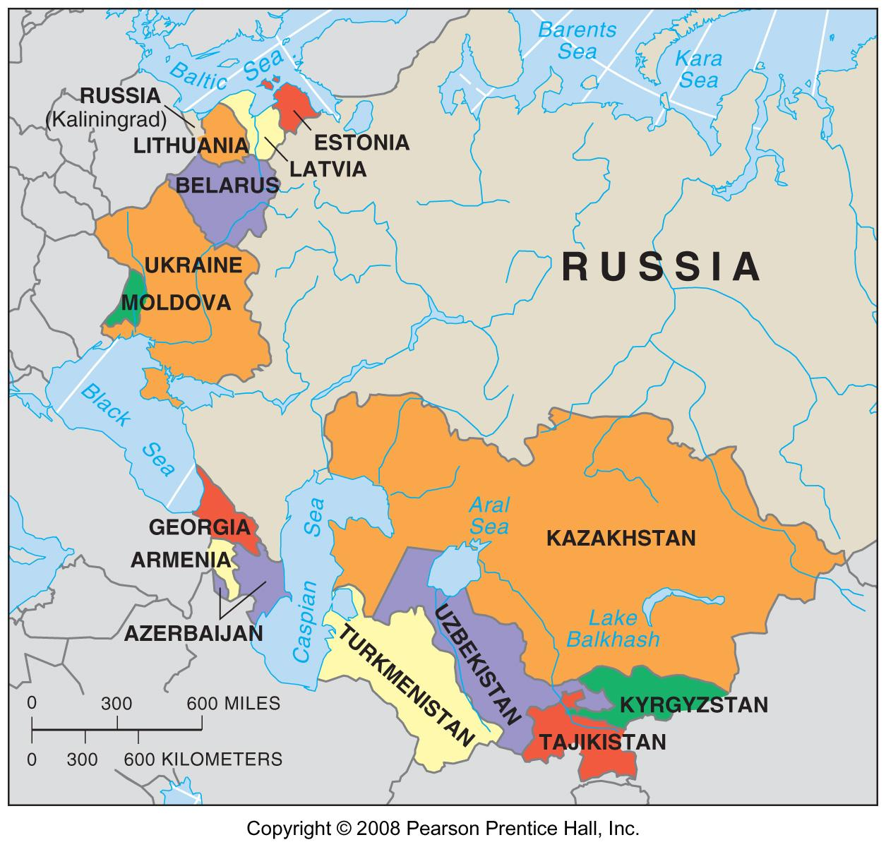
Republics of the Soviet Union
Fig. 7-11: The Soviet Union consisted of 15 republics that included the country’s largest ethnic groups. These all became independent countries in the early 1990s.

Slide 25
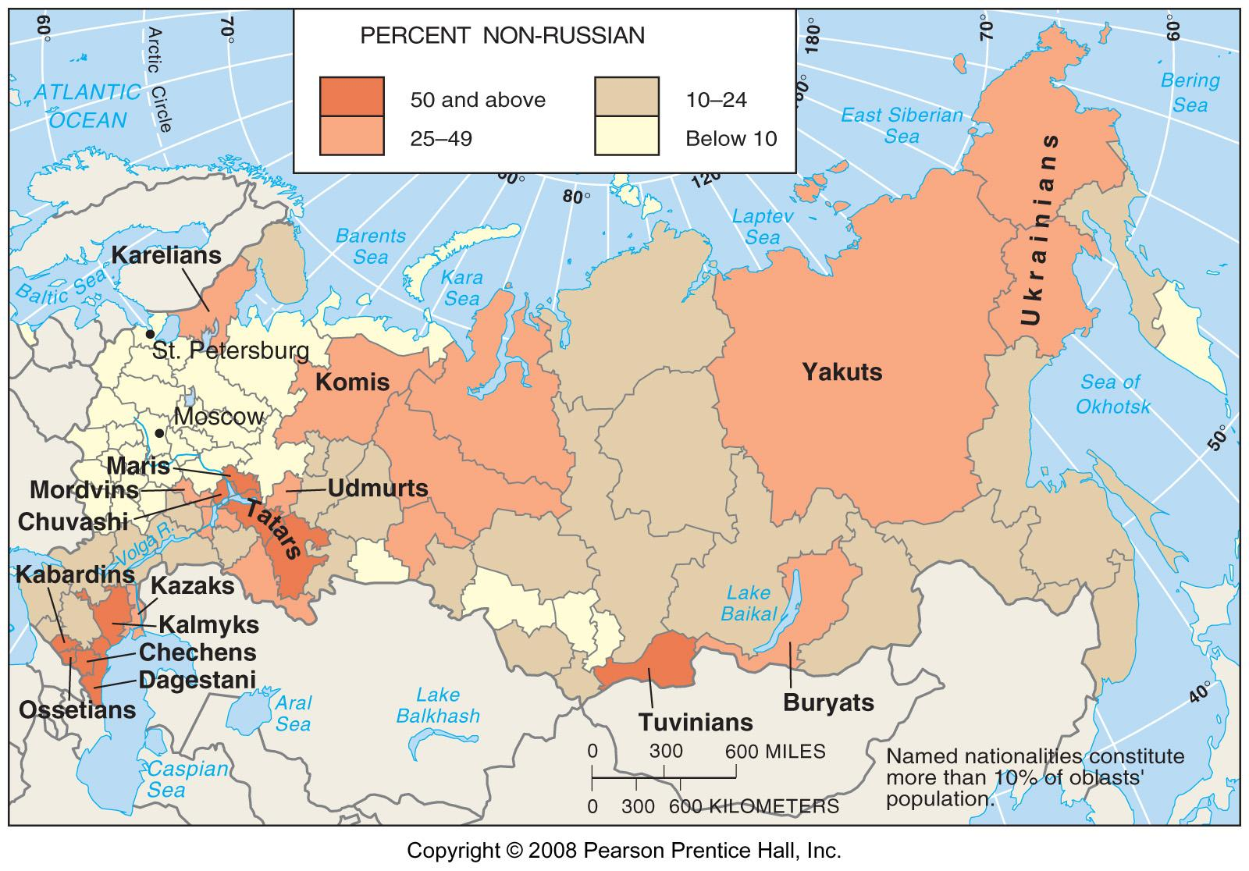
Ethnic Groups in Russia
Fig. 7-12: Russia officially recognizes 39 ethnic groups, or nationalities, which are concentrated in western and southern portions of the country.

Slide 26
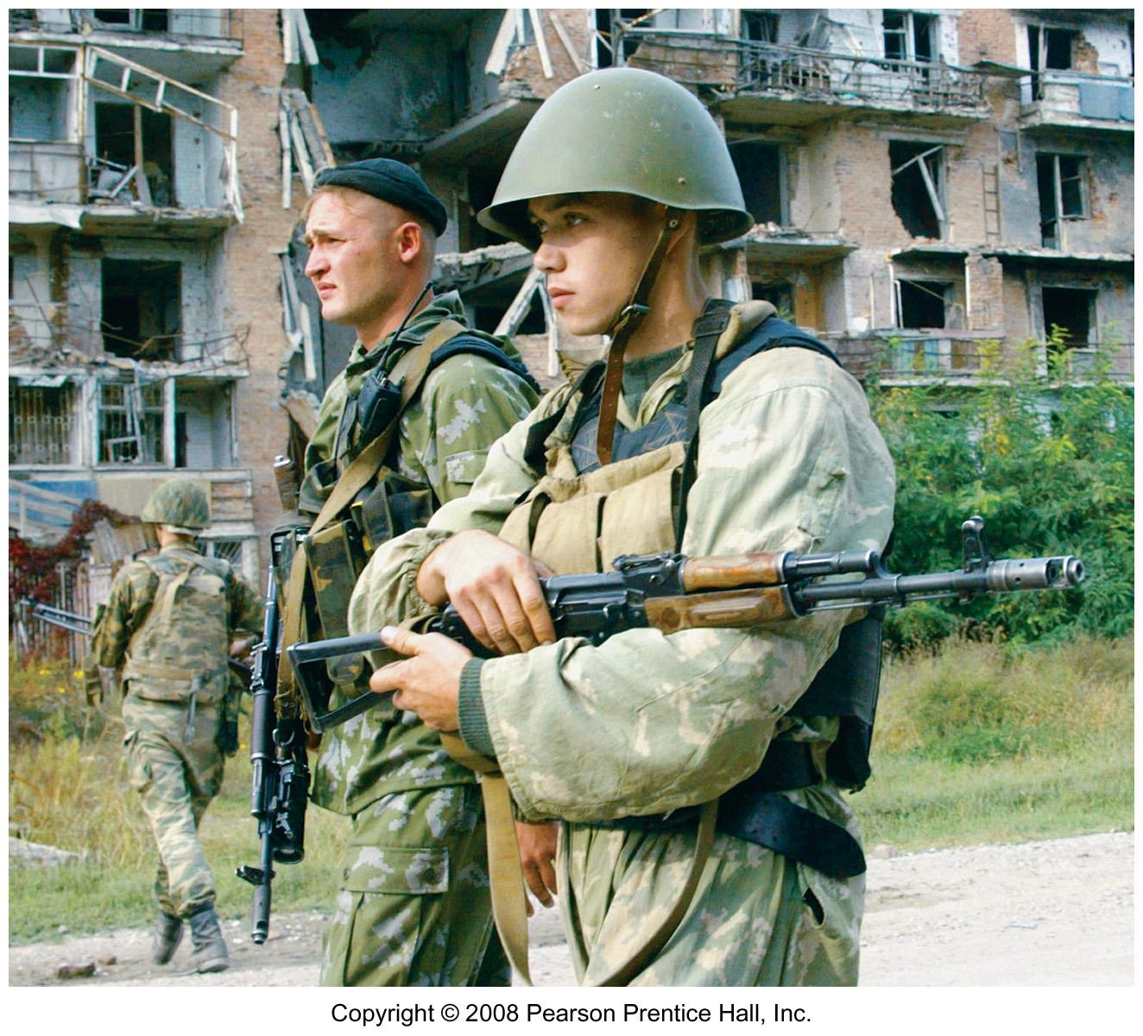
Russian Soldiers in Chechnya
The Russian army has occupied and destroyed much of Chechnya in suppressing Chechen rebel groups.

Slide 27
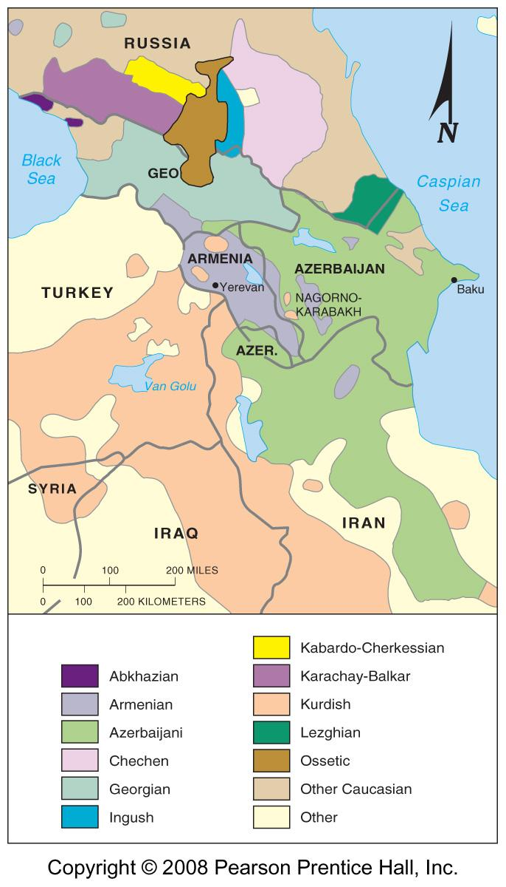
Ethnicities in the Caucasus
Fig. 7-13: The Caucasus region is extremely diverse ethnically. Ethnic groups are spread across several national boundaries.

Slide 28
Clashes of Ethnicities
Ethnic competition to dominate nationality
  Ethnic competition in the Horn of Africa
  Ethnic competition in Lebanon
Dividing ethnicities among more than one state
  Dividing ethnicities in South Asia
  Dividing Sri Lanka among ethnicities

Slide 29
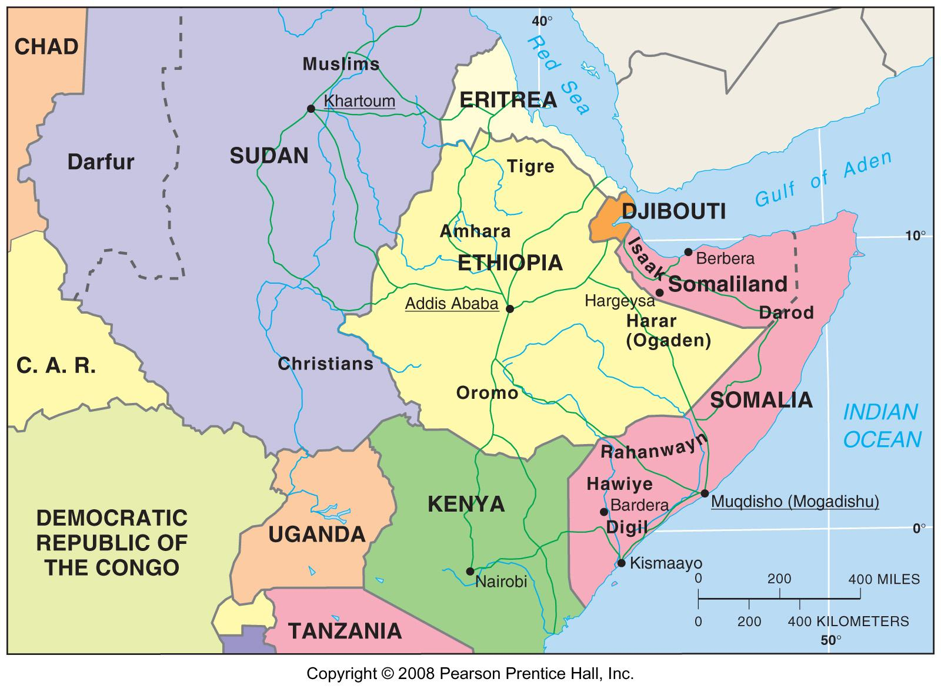
Ethnicity in the Horn of Africa
Fig. 7-14: There have been numerous inter-ethnic civil conflicts in the countries of the Horn of Africa (including the Sudan, Ethiopia, Eritrea, and Somalia).

Slide 30
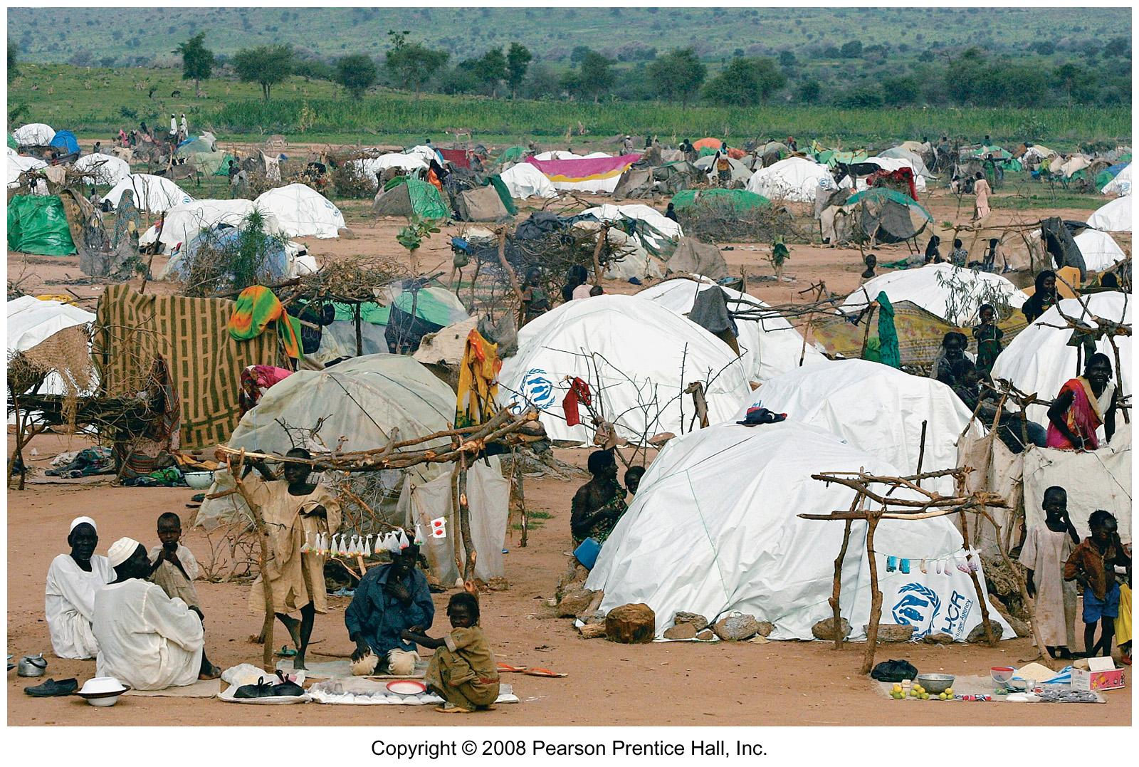
Refugee Camp in Darfur, Sudan
Farmers from Darfur in western Sudan have been chased from their homes by agents of the Sudanese government.

Slide 31
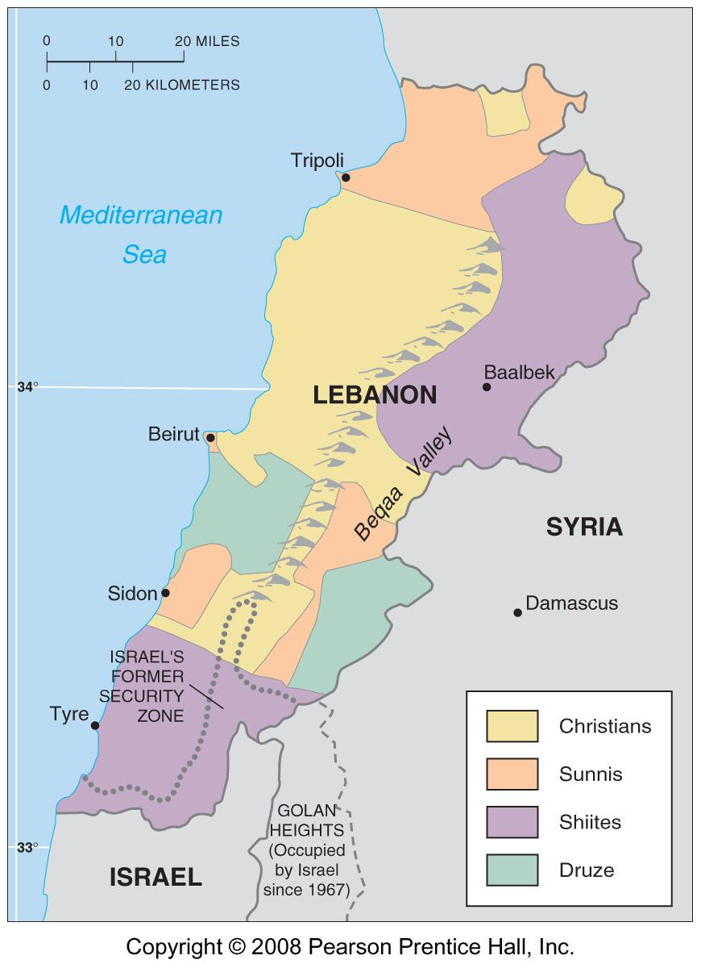
Ethnicities in Lebanon
Fig. 7-15: Christians, Sunni Muslims, Shiite Muslims, and Druze are dominant in different areas of the country.

Slide 32
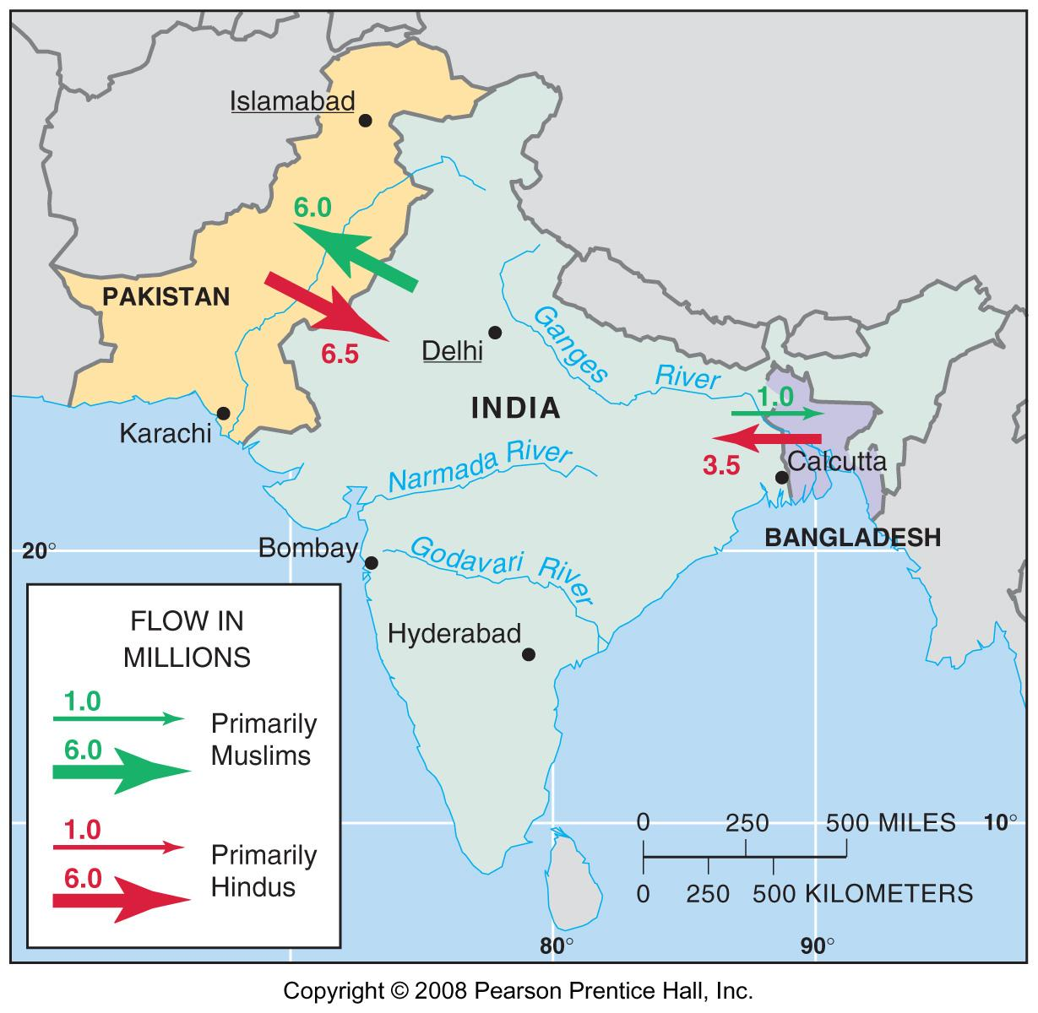
Ethnic Division of South Asia
Fig. 7-16: At independence in 1947, British India was divided into India and Pakistan, resulting in the migration of 17 million people and many killings. In 1971, after a brutal civil war, East Pakistan became the country of Bangladesh.

Slide 33
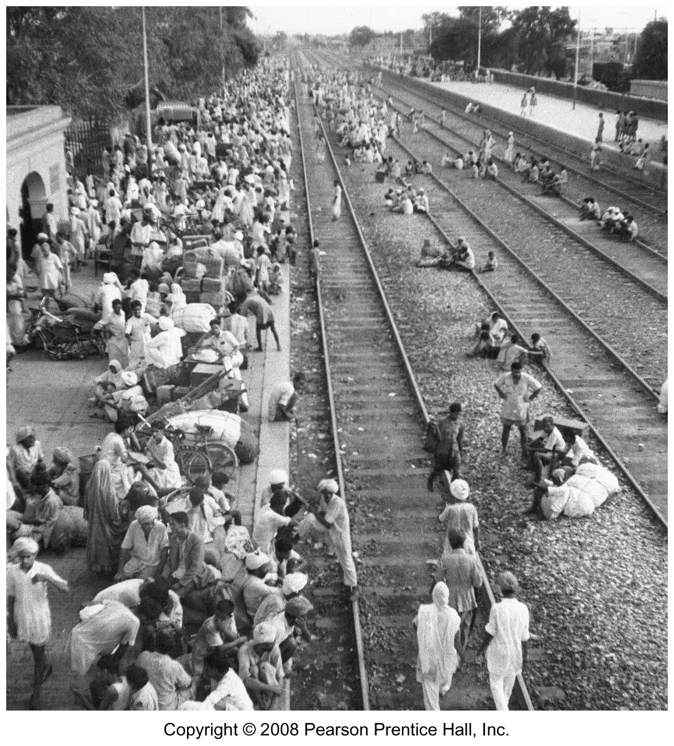
Train Station in Amritsar, India, October, 1947
The station is filled with Hindu refugees who have fled from the new country of Pakistan.

Slide 34
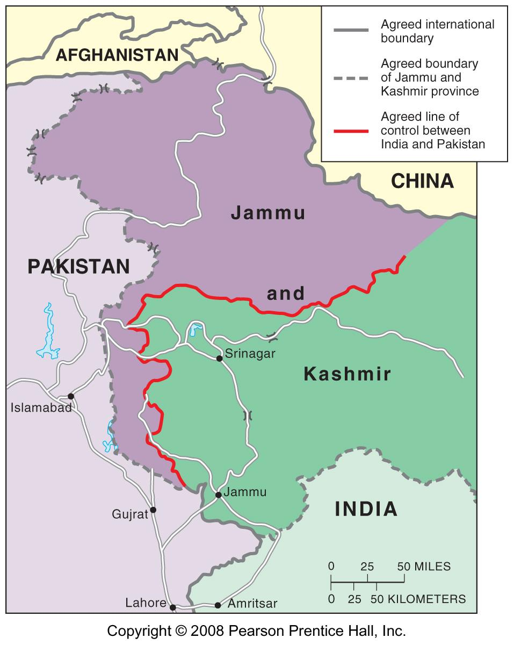
Jammu and Kashmir
Fig. 7-17: Although its population is mainly Muslim, much of Jammu and Kashmir became part of India in 1947. India and Pakistan have fought two wars over the territory, and there has been a separatist insurgency in the area.

Slide 35
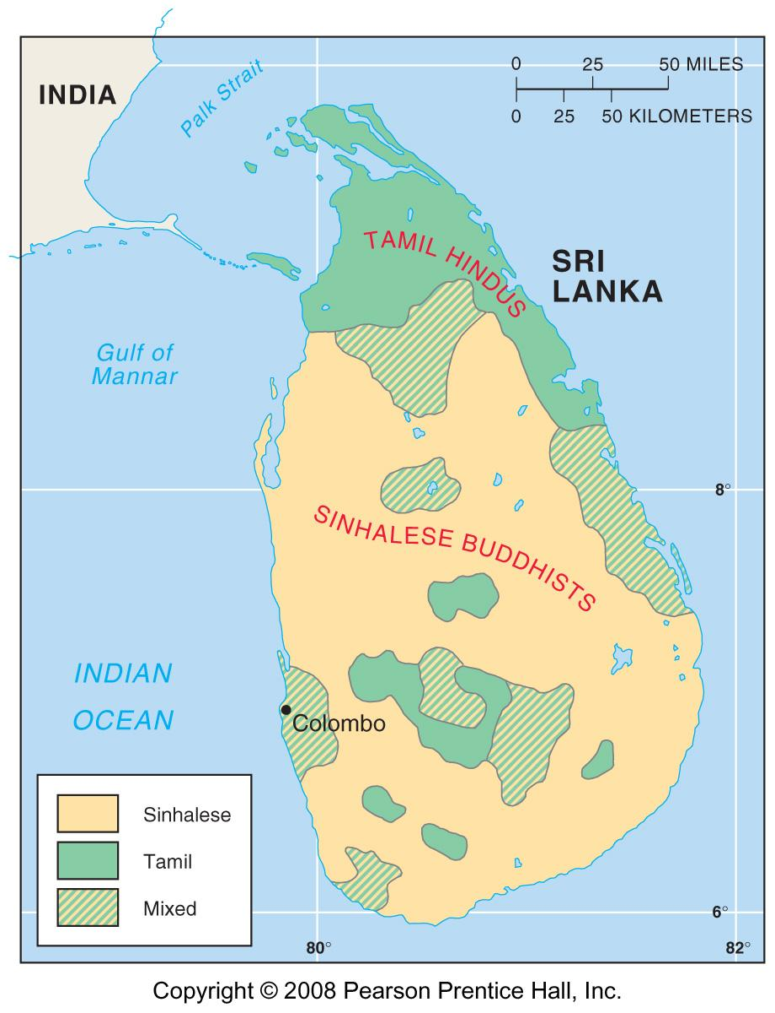
Sinhalese & Tamils in Sri Lanka
Fig.7-18: The Sinhalese are mainly Buddhist and speak an Indo-European language, while the Tamils are mainly Hindu and speak a Dravidian language.

Slide 36
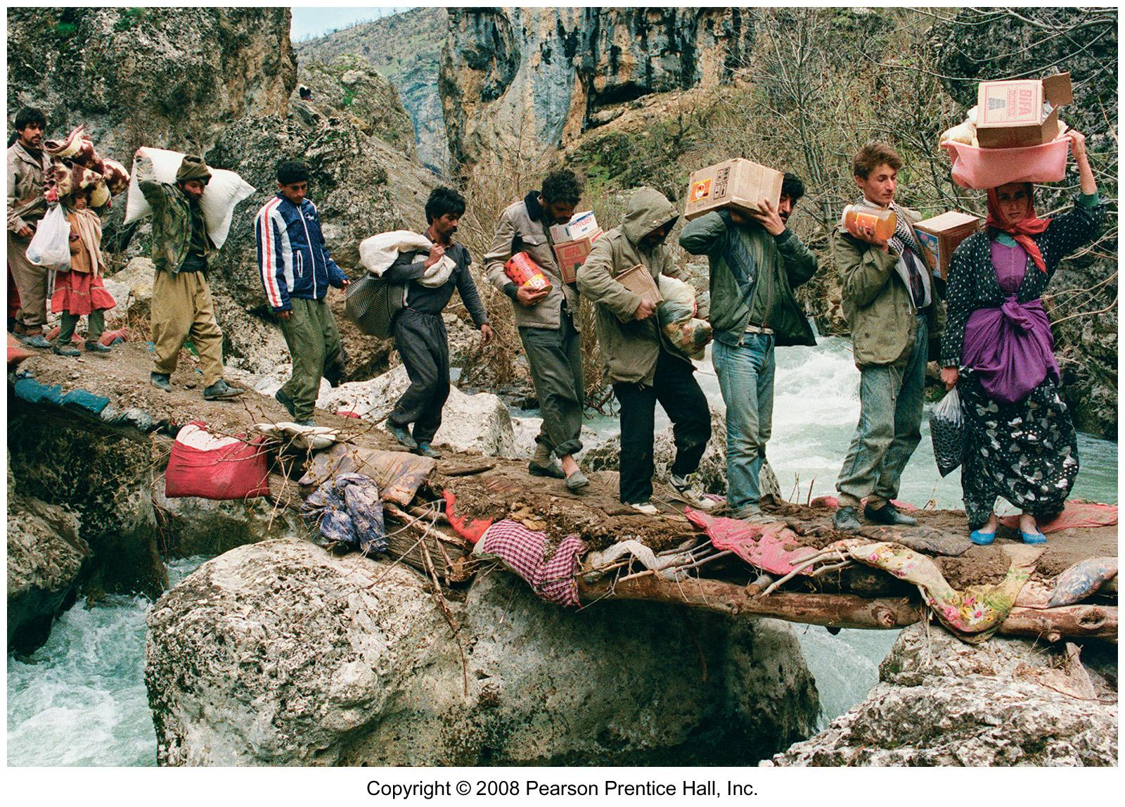
Kurdish Refugees from Iraq, 1991
Many Kurds fled Iraq after the 1991 Gulf War when Saddam Hussein’s armed forces attacked Kurdish regions in northern Iraq.

Slide 37
Ethnic Cleansing
Ethnic cleansing in Yugoslavia
  Creation of multi-ethnic Yugoslavia
  Destruction of multi-ethnic Yugoslavia
Ethnic cleansing in central Africa

Slide 38
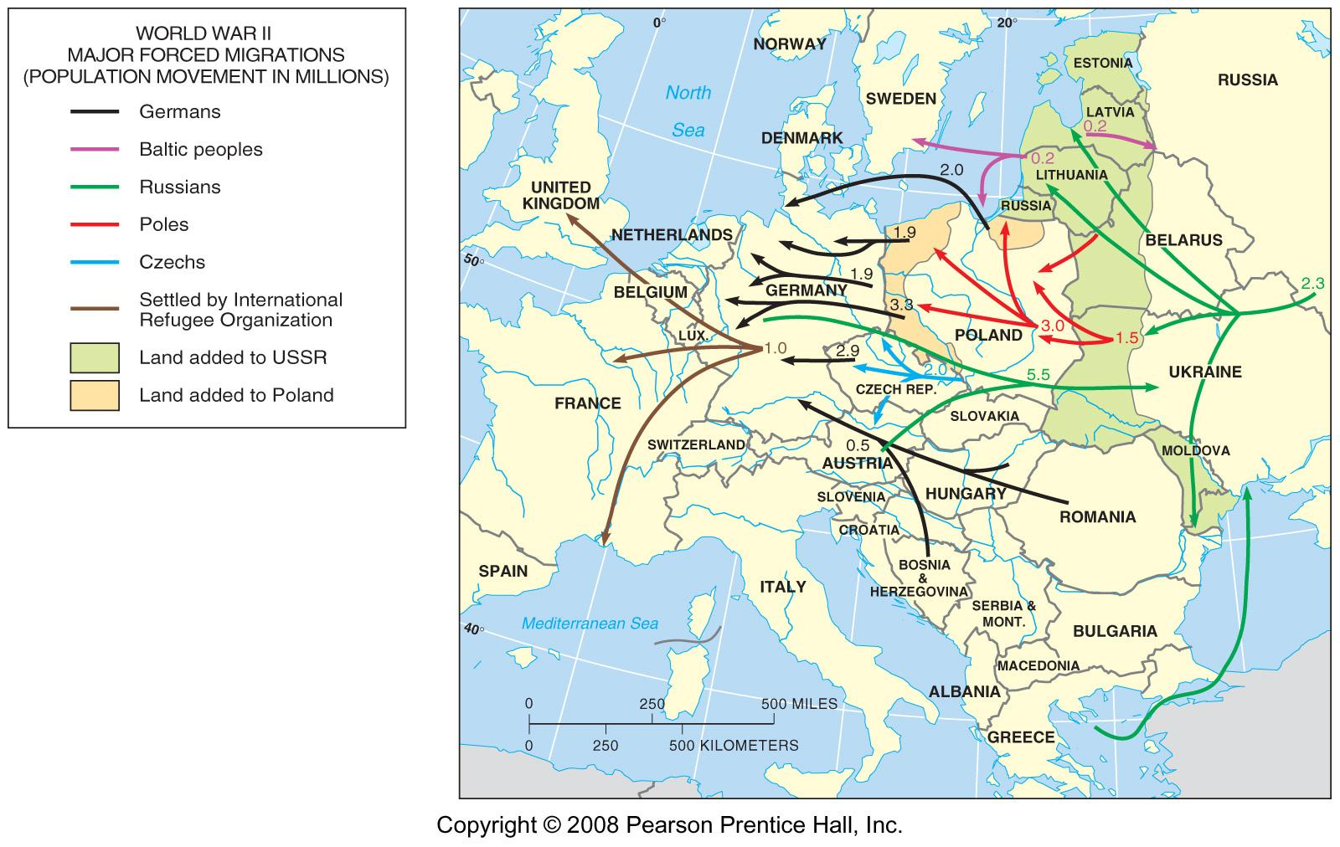
Forced Migrations after World War Two
Fig. 7-19: Territorial changes after World War II resulted in many migrations, especially by Poles, Germans, and Russians.

Slide 39
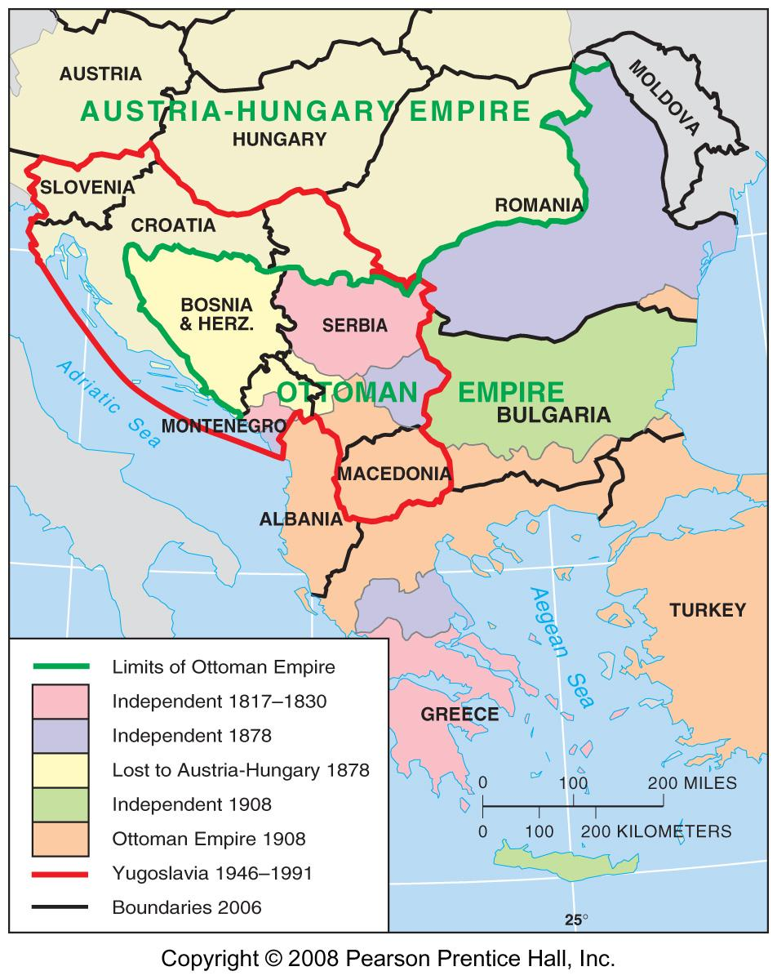
The Balkans in 1914
Fig. 7-20: The northern part of the Balkans was part of Austria-Hungary in 1914, while much of the south was part of the Ottoman Empire. The country of Yugoslavia was created after World War I.

Slide 40
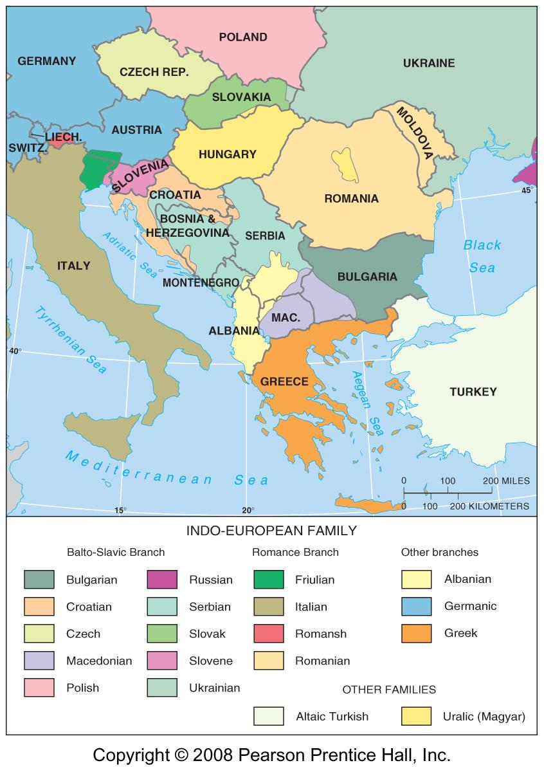
Languages in Southeastern Europe
Fig. 7-21: Several new states were created, and boundaries were shifted after World Wars I and II. New state boundaries often coincided with language areas.

Slide 41
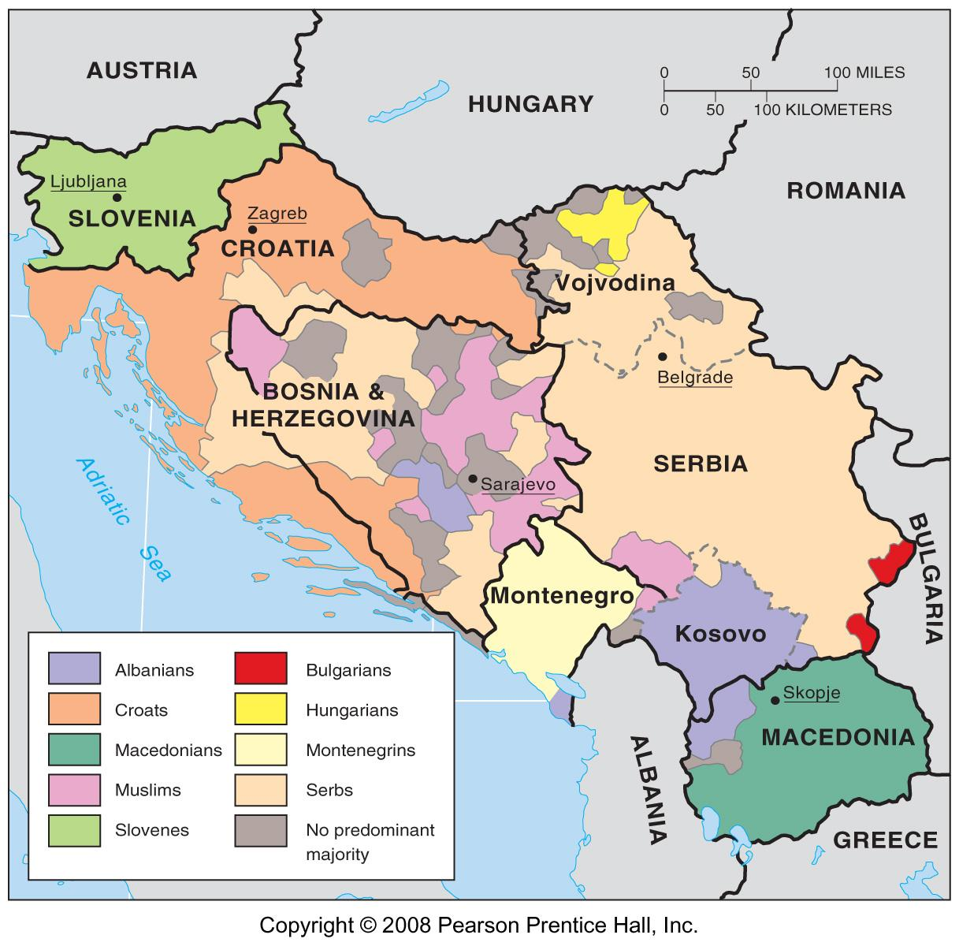
Ethnic Regions in Yugoslavia
Fig. 7-22: Yugoslavia’s six republics until 1992 included much ethnic diversity. Brutal ethnic cleansing occurred in Bosnia, Croatia, and Kosovo during the civil wars of the 1990s.

Slide 42
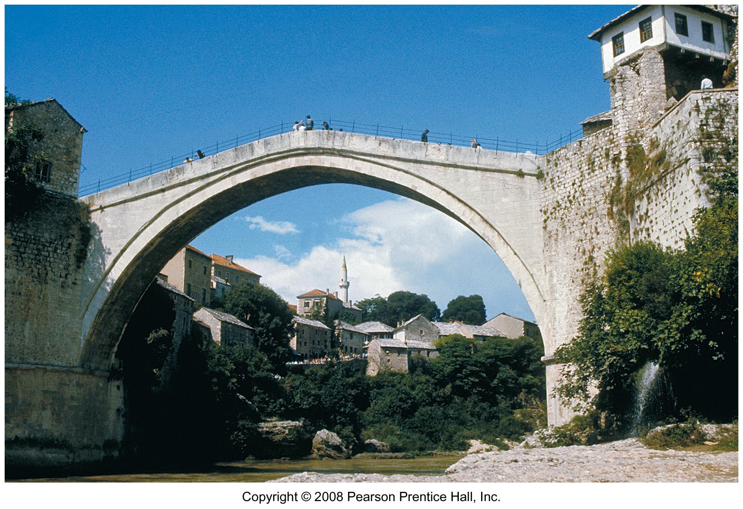
Bridge in Mostar, Yugoslavia
The Stari Most (old bridge) was built in 1566. This was the bridge before the civil war in Bosnia & Herzegovina.

Slide 43
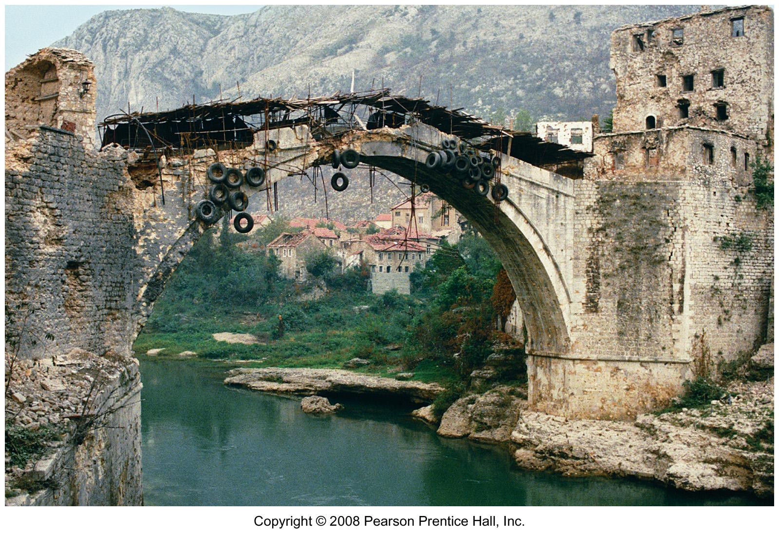
Bridge Destroyed in Bosnian War 1993

Slide 44
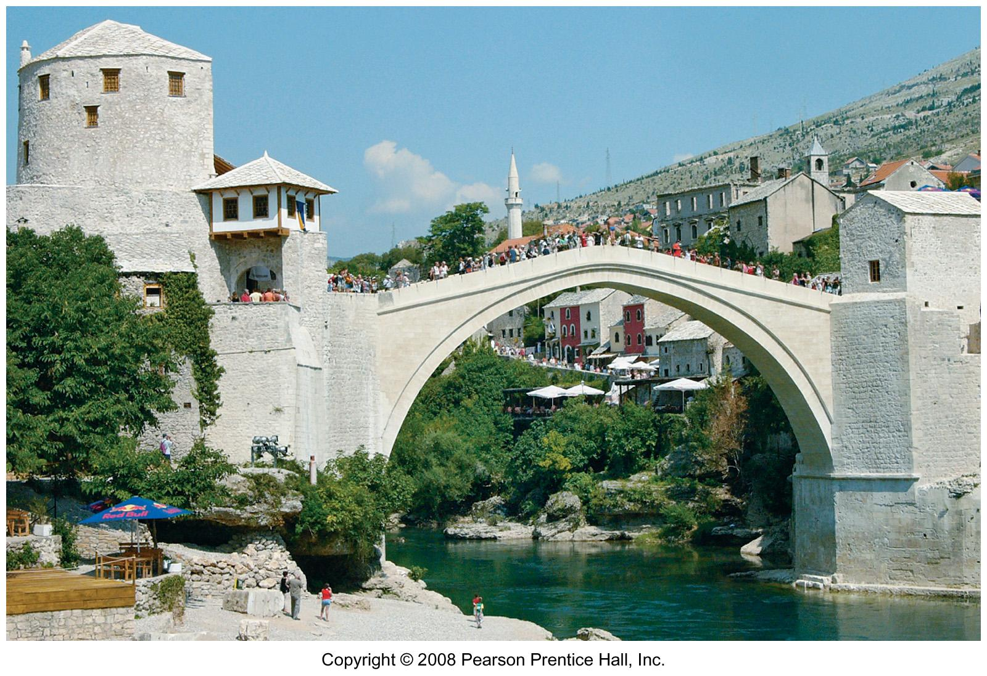
Rebuilt Bridge, 2004

Slide 45
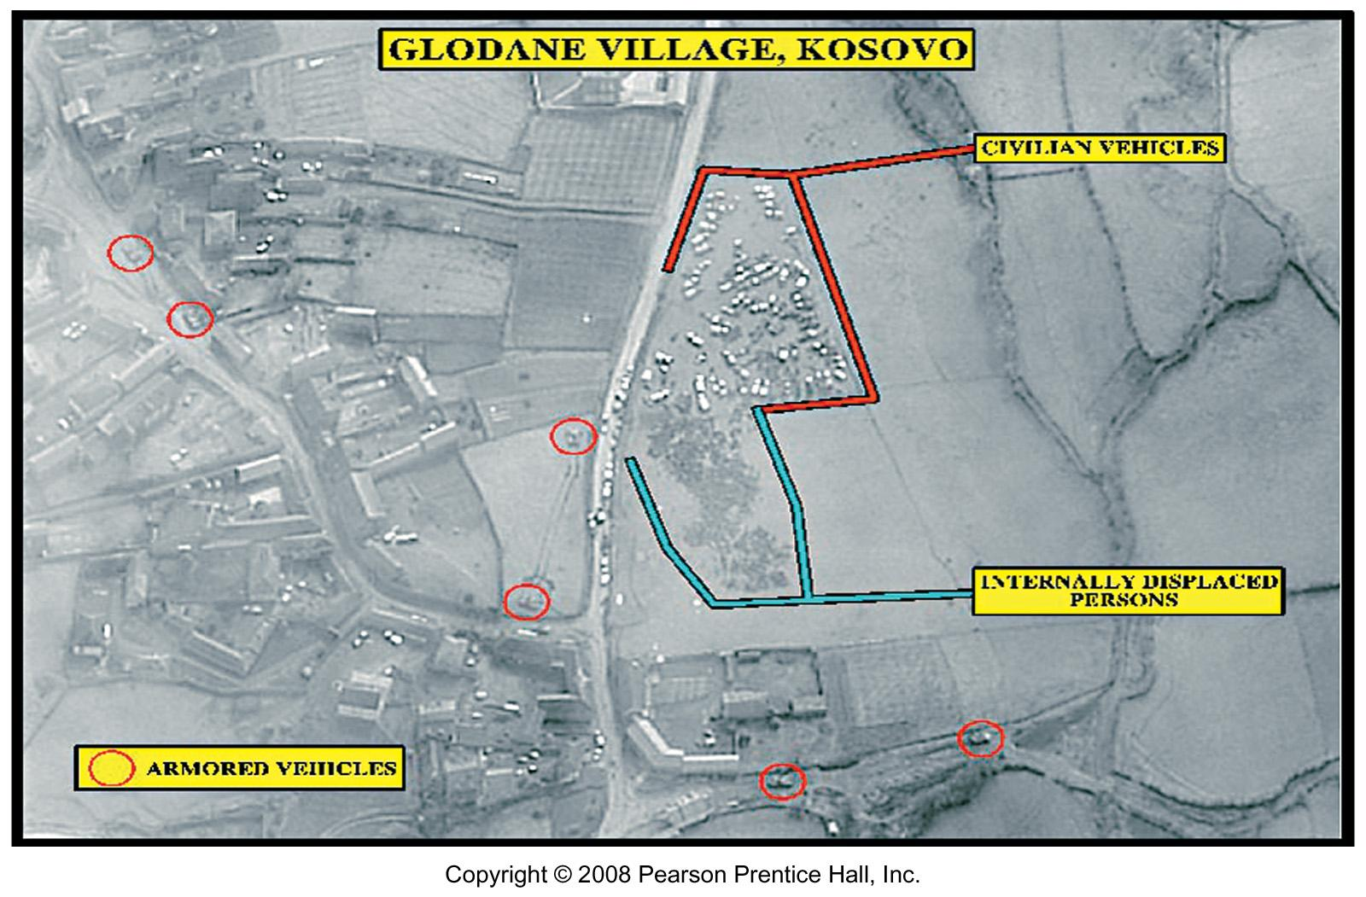
Ethnic Cleansing in Kosovo
Fig. 7-1.1: Aerial photography helped document the stages of ethnic cleansing in western Kosovo in 1999.

Slide 46
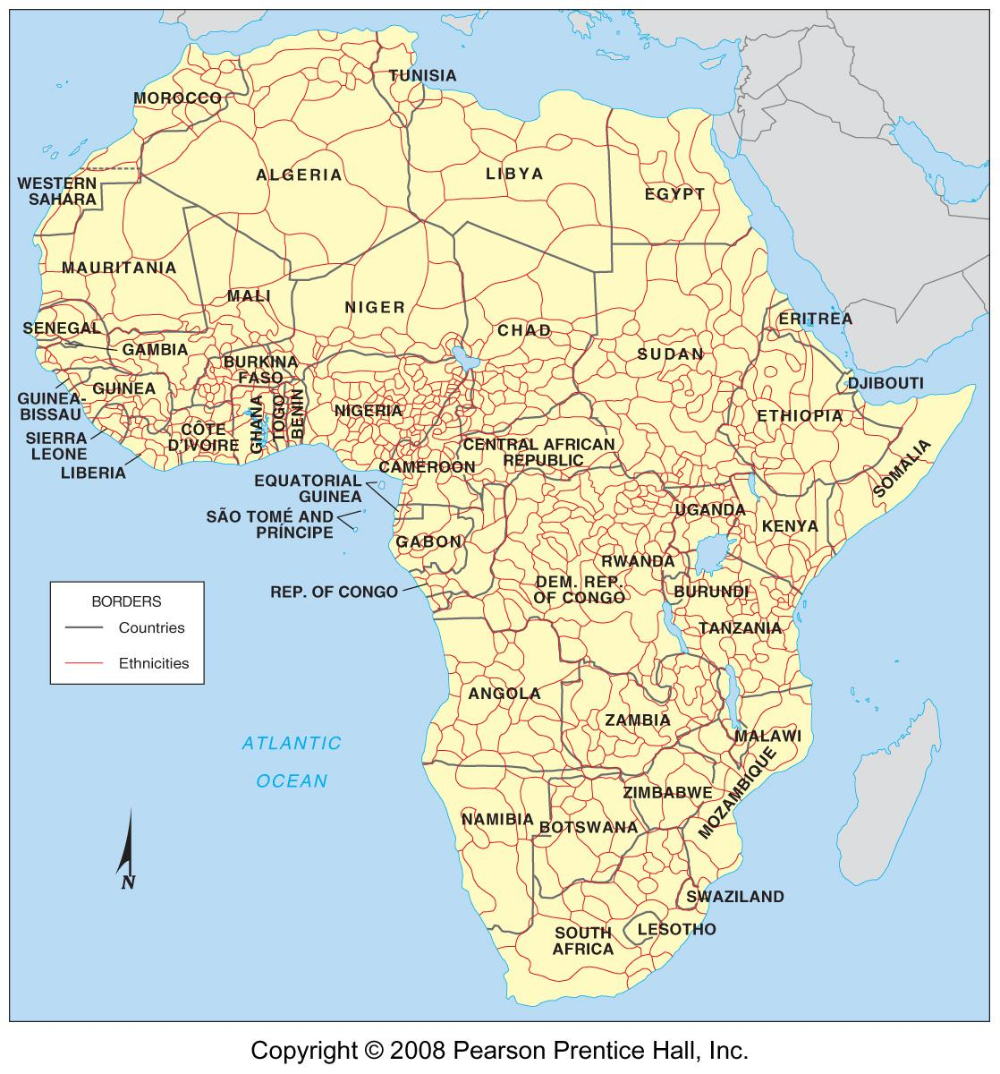
Ethnicities in Africa
Fig. 7-23: The boundaries of African states do not (and cannot) coincide with the thousands of ethnic groups on the continent.

