Slide 1
Chapter 10
Agriculture

Slide 2
Agricultural Origins & Regions
Origins of agriculture
  Hunters and gatherers
  Invention of agriculture
Location of agricultural hearths
  Vegetative planting
  Seed agriculture
Classifying agricultural regions
  Subsistence vs. commercial agriculture
  Mapping agricultural regions

Slide 3
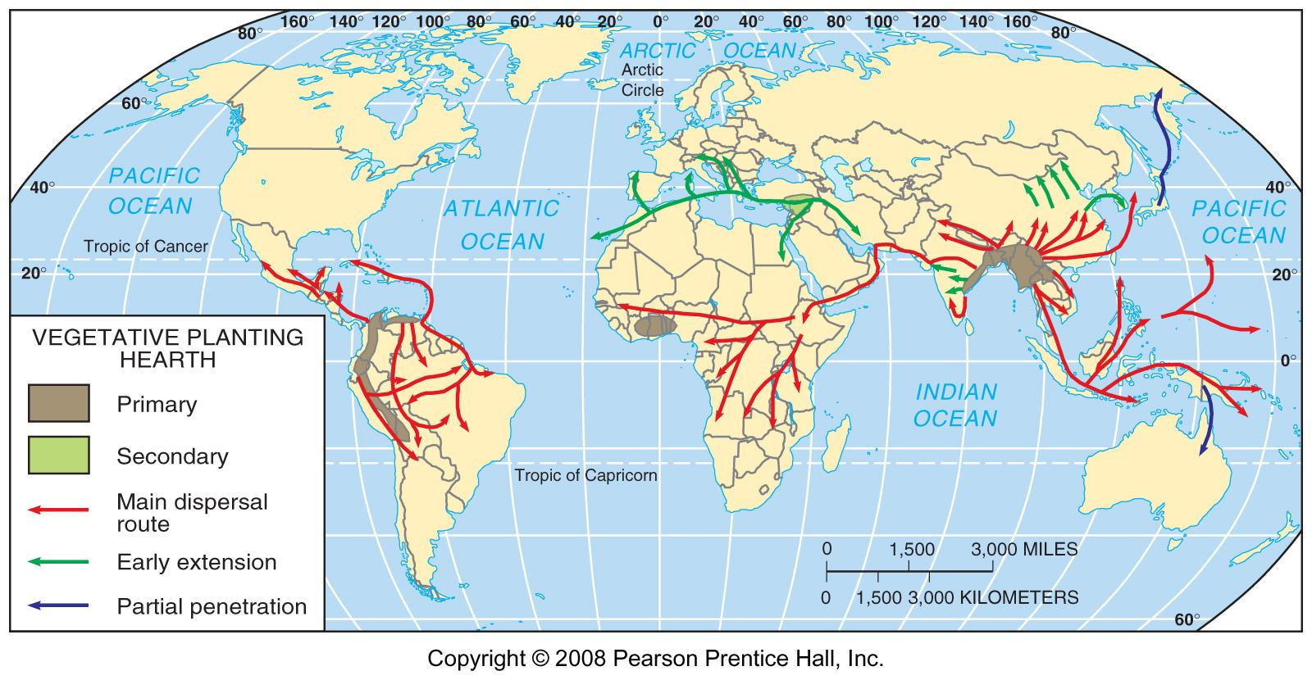
Vegetative Planting Hearths
Fig. 10-1: There were several main heaths, or centers of origin, for vegetative crops (roots & tubers, etc.), from which the crops diffused to other areas. Carl Sauer suggested that Southeast Asia was a primary hearth.

Slide 4
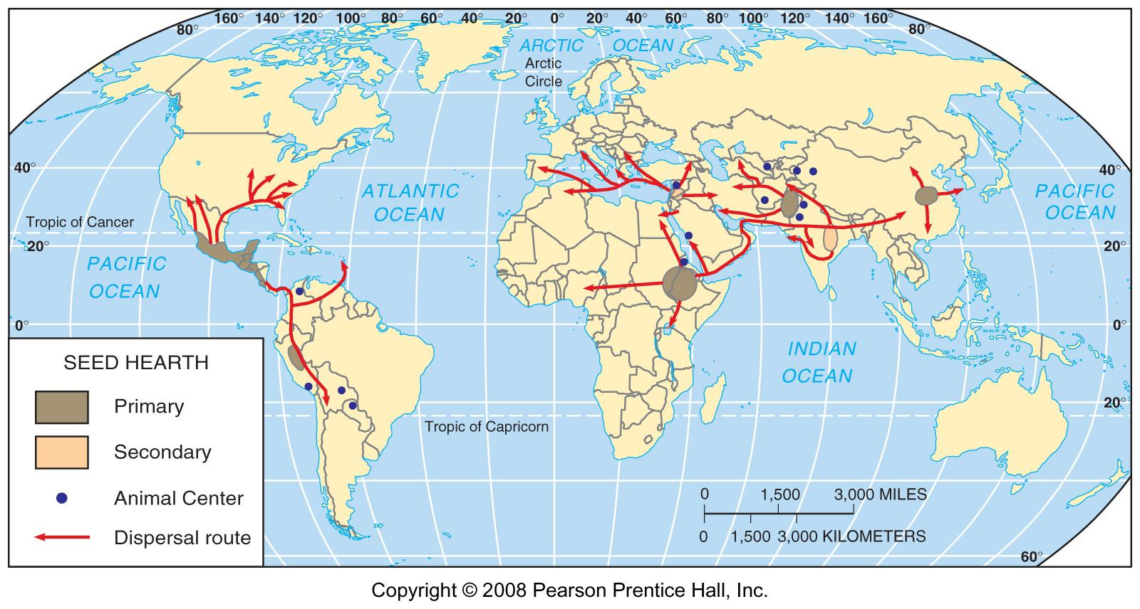
Seed Agriculture Hearths
Fig. 10-2: Seed agriculture also originated in several hearths and diffused from those elsewhere.

Slide 5
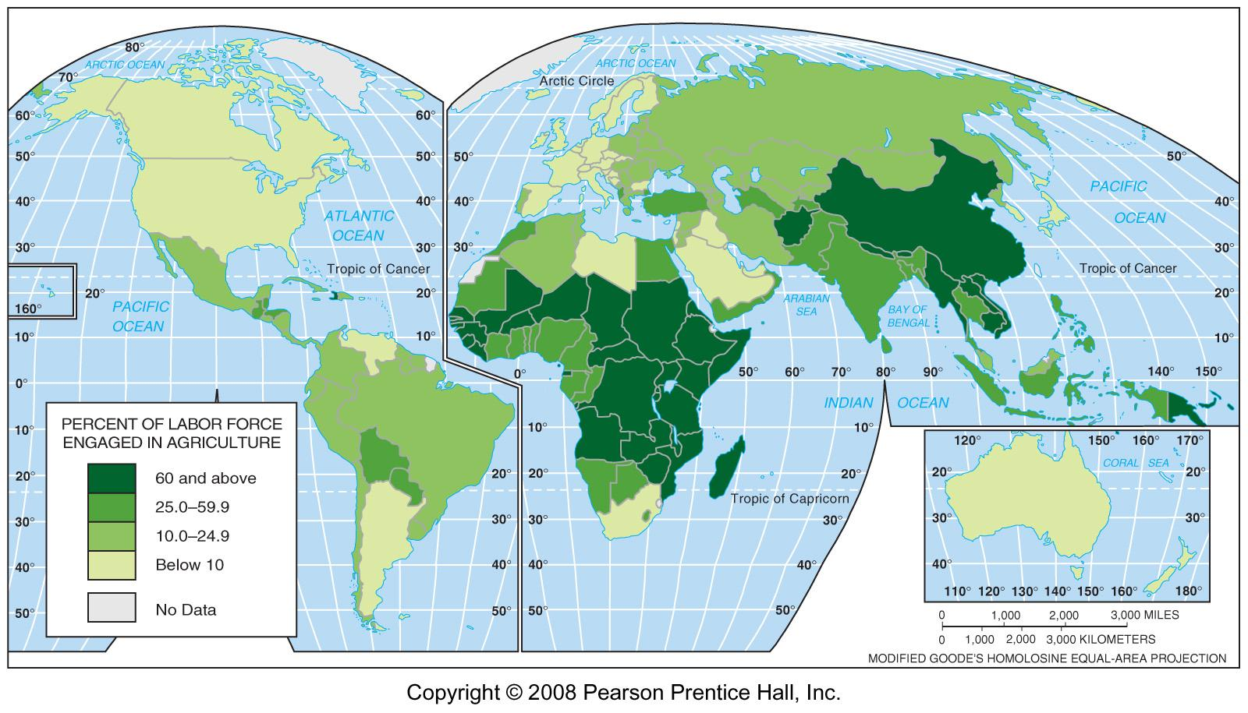
Labor Force in Agriculture, 2005
Fig. 10-3: A large proportion of workers in most LDCs are in agriculture, while only a small percentage of workers in MDCs are engaged in agriculture.

Slide 6
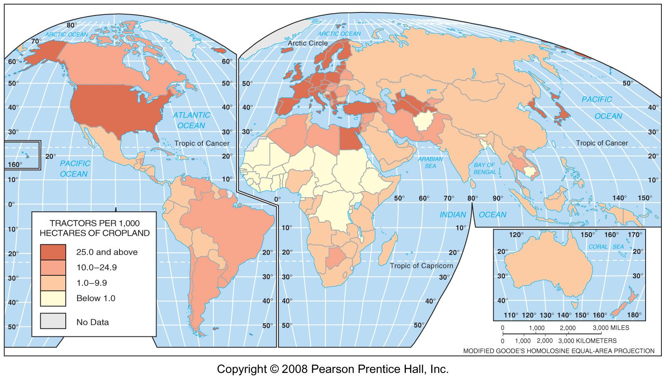
Tractors, per cropland
Fig. 10-4: Tractors per 1000 hectares of cropland. Use of machinery is extensive in most MDC agriculture, but it is much less common in LDCs.

Slide 7
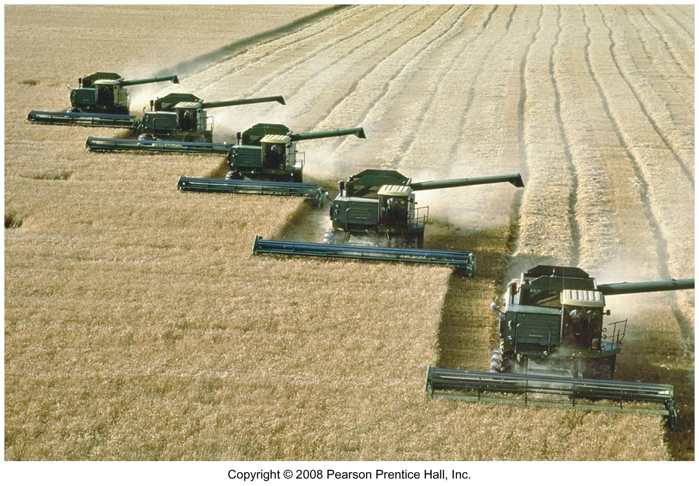
Combines on Wheat in Kansas
Combines can reap, thresh, and clean crops like wheat in a single operation.

Slide 8
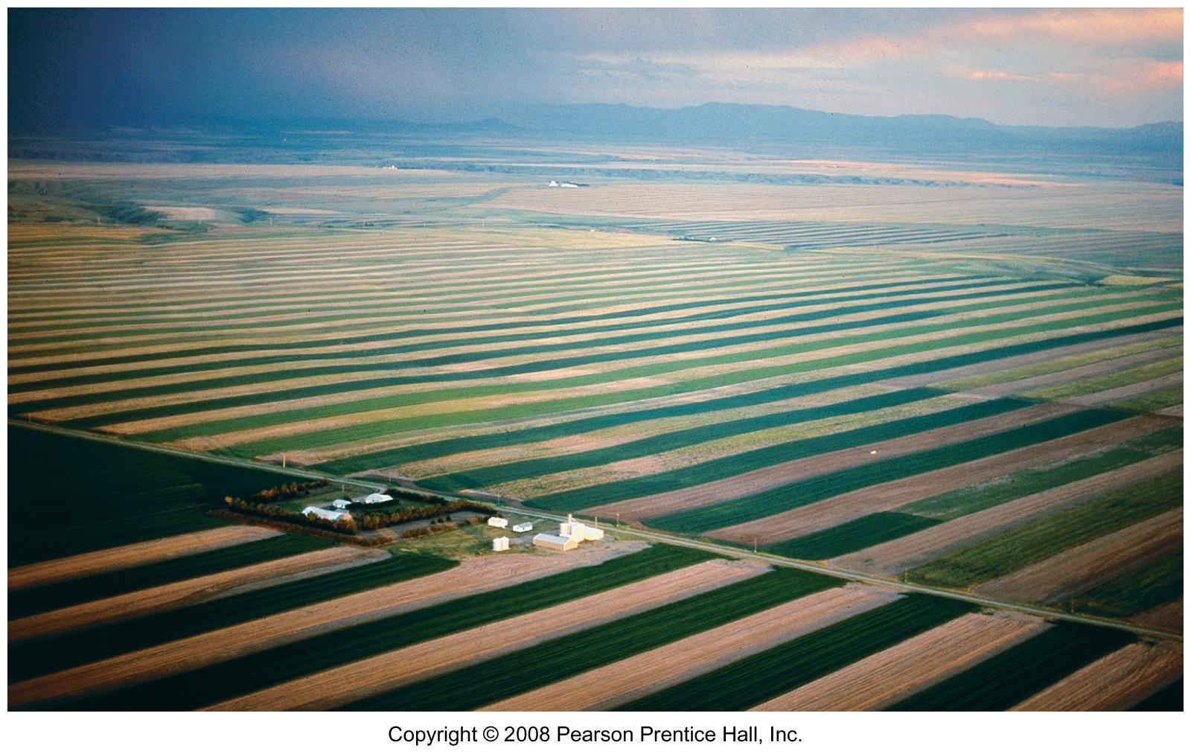
Wheat Farm in Montana
American grain farms can cover enormous amounts of land.

Slide 9
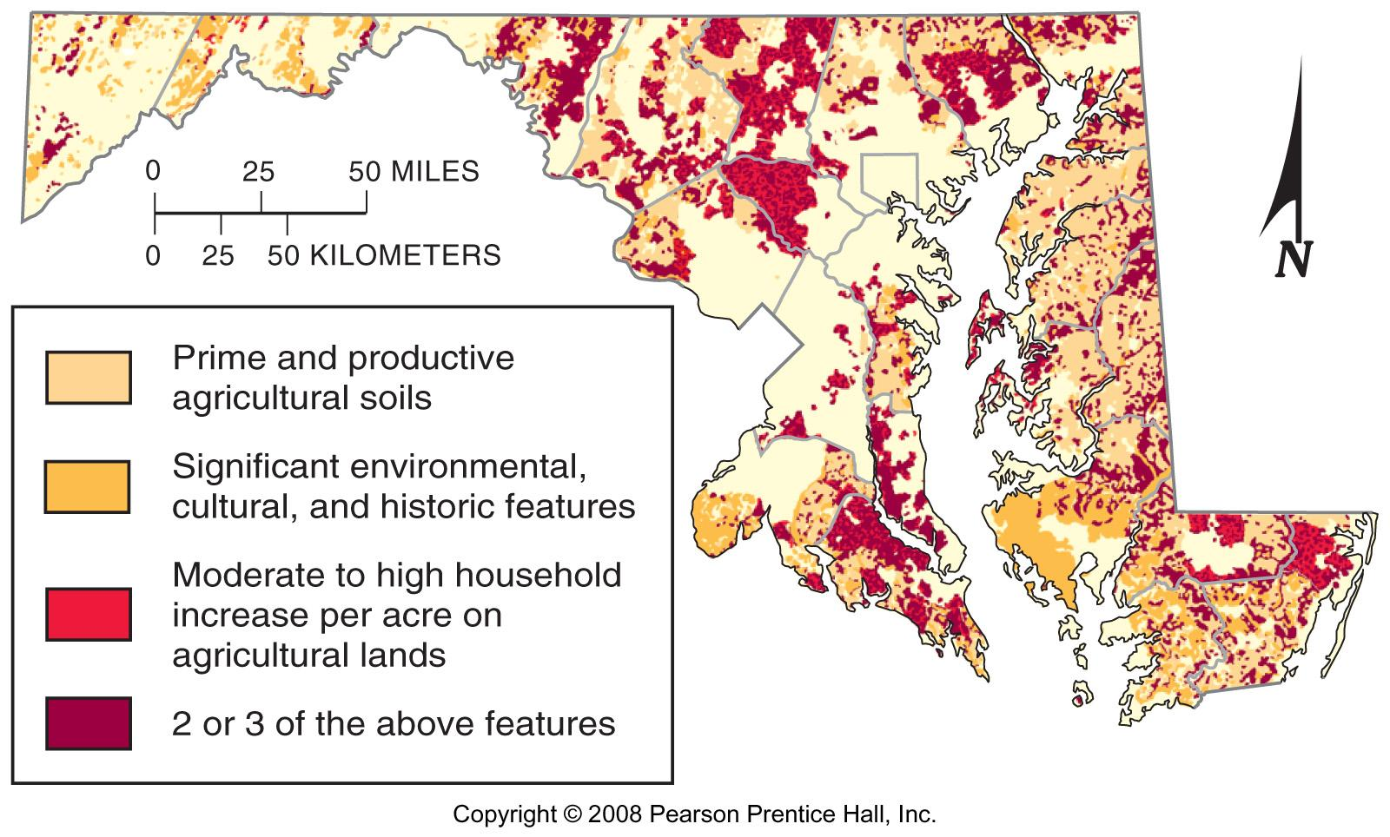
Farmland Loss in Maryland
Fig. 10-1.1: Overlaps of soil quality, environmental & cultural features, and population growth may show areas of greatest threat of farmland loss in Maryland.

Slide 10
Agriculture in Less Developed Countries
Shifting cultivation
  Characteristics of shifting cultivation
  Future of shifting cultivation
Pastoral nomadism
  Characteristics of pastoral nomadism
  Future of pastoral nomadism
Intensive subsistence agriculture
  Intensive subsistence with wet rice dominant
  Intensive subsistence with wet rice not dominant
Plantation farming

Slide 11
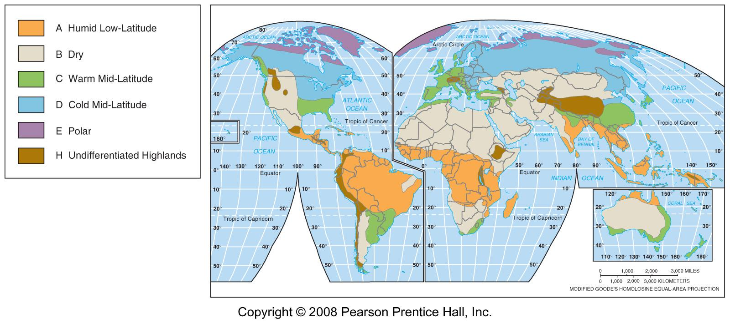
World Climate Regions
Fig. 10-5a: Simplified map of the main world climate regions (see also Fig. 2-2).

Slide 12
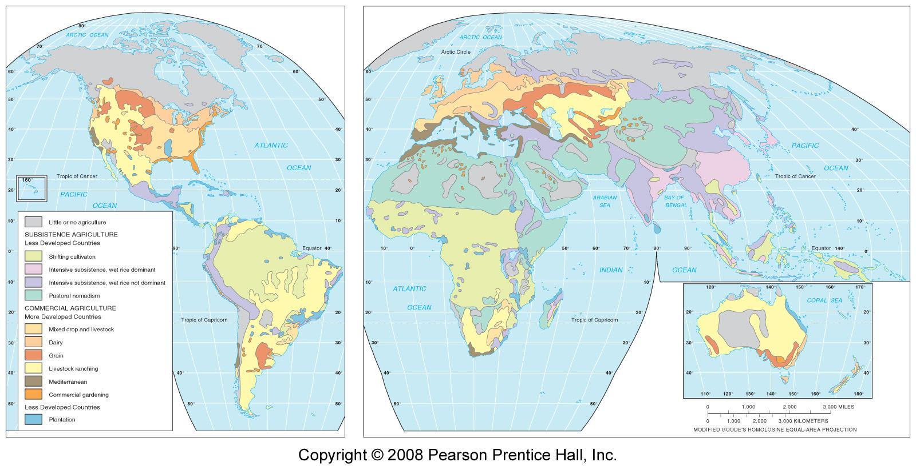
World Agriculture Regions
Fig. 10-5b: Locations of the major types of subsistence and commercial agriculture.

Slide 13
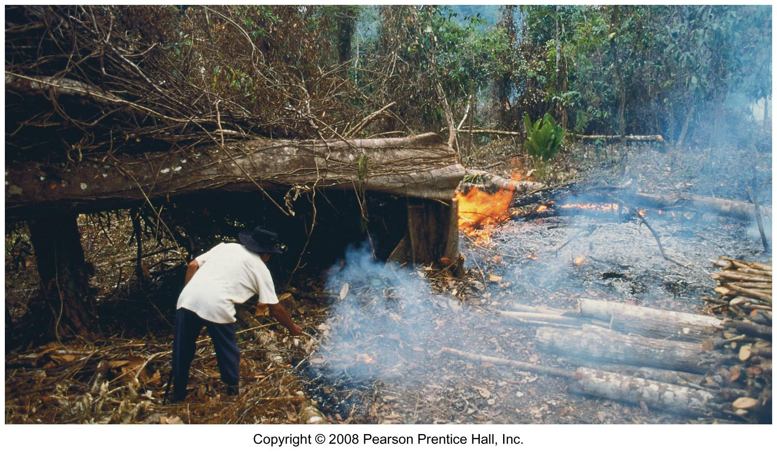
Shifting Cultivation in Guatemala
Dense vegetation has been cut and is being burned to open land for farming.

Slide 14
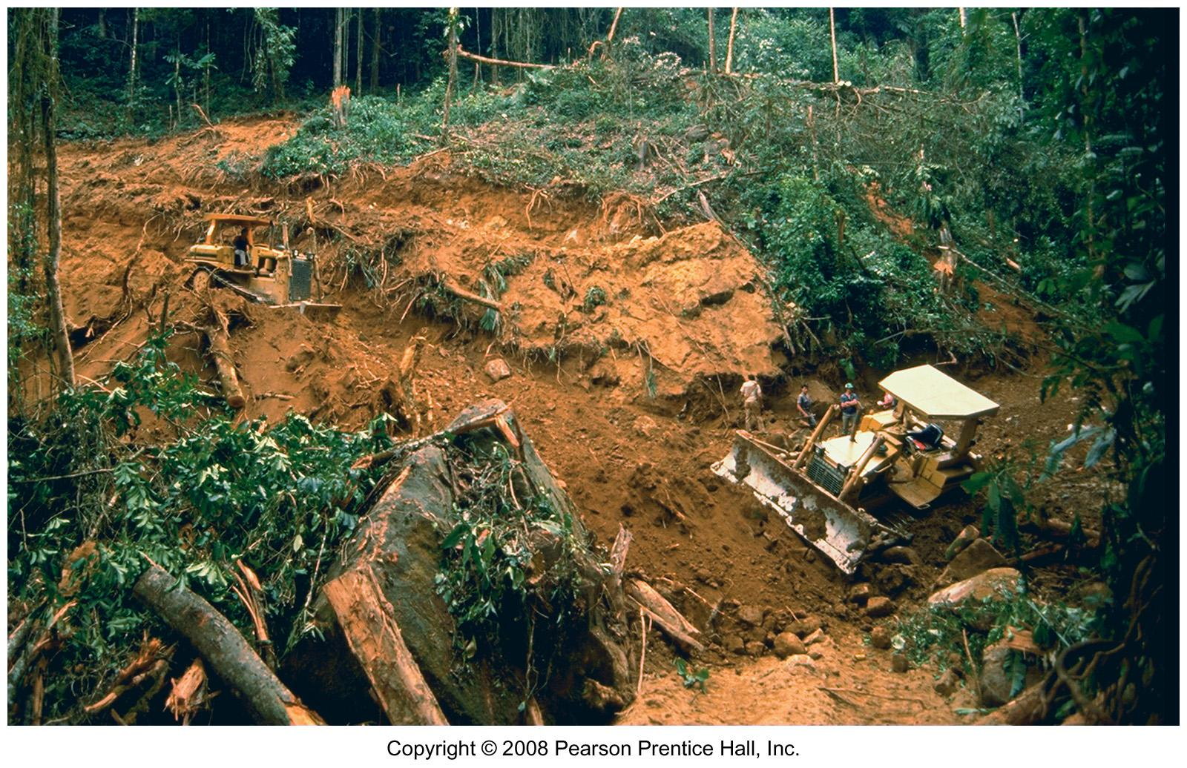
Land Clearing in Colombia
Bulldozers are used to plow a road through the rain forest in Colombia.

Slide 15
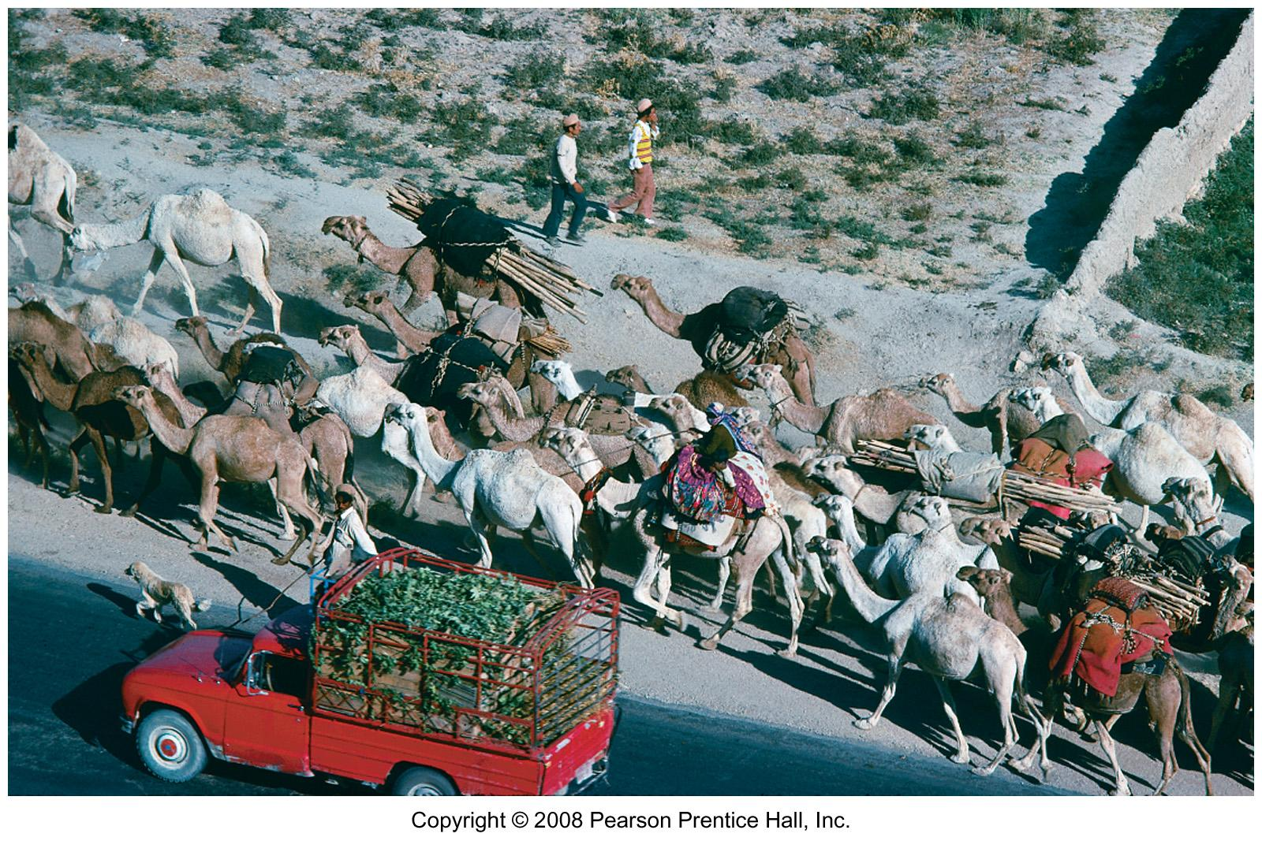
Pastoral Nomads in Iran
Qashqai nomads using paved roads to move their animals near Shiraz, Iran.

Slide 16
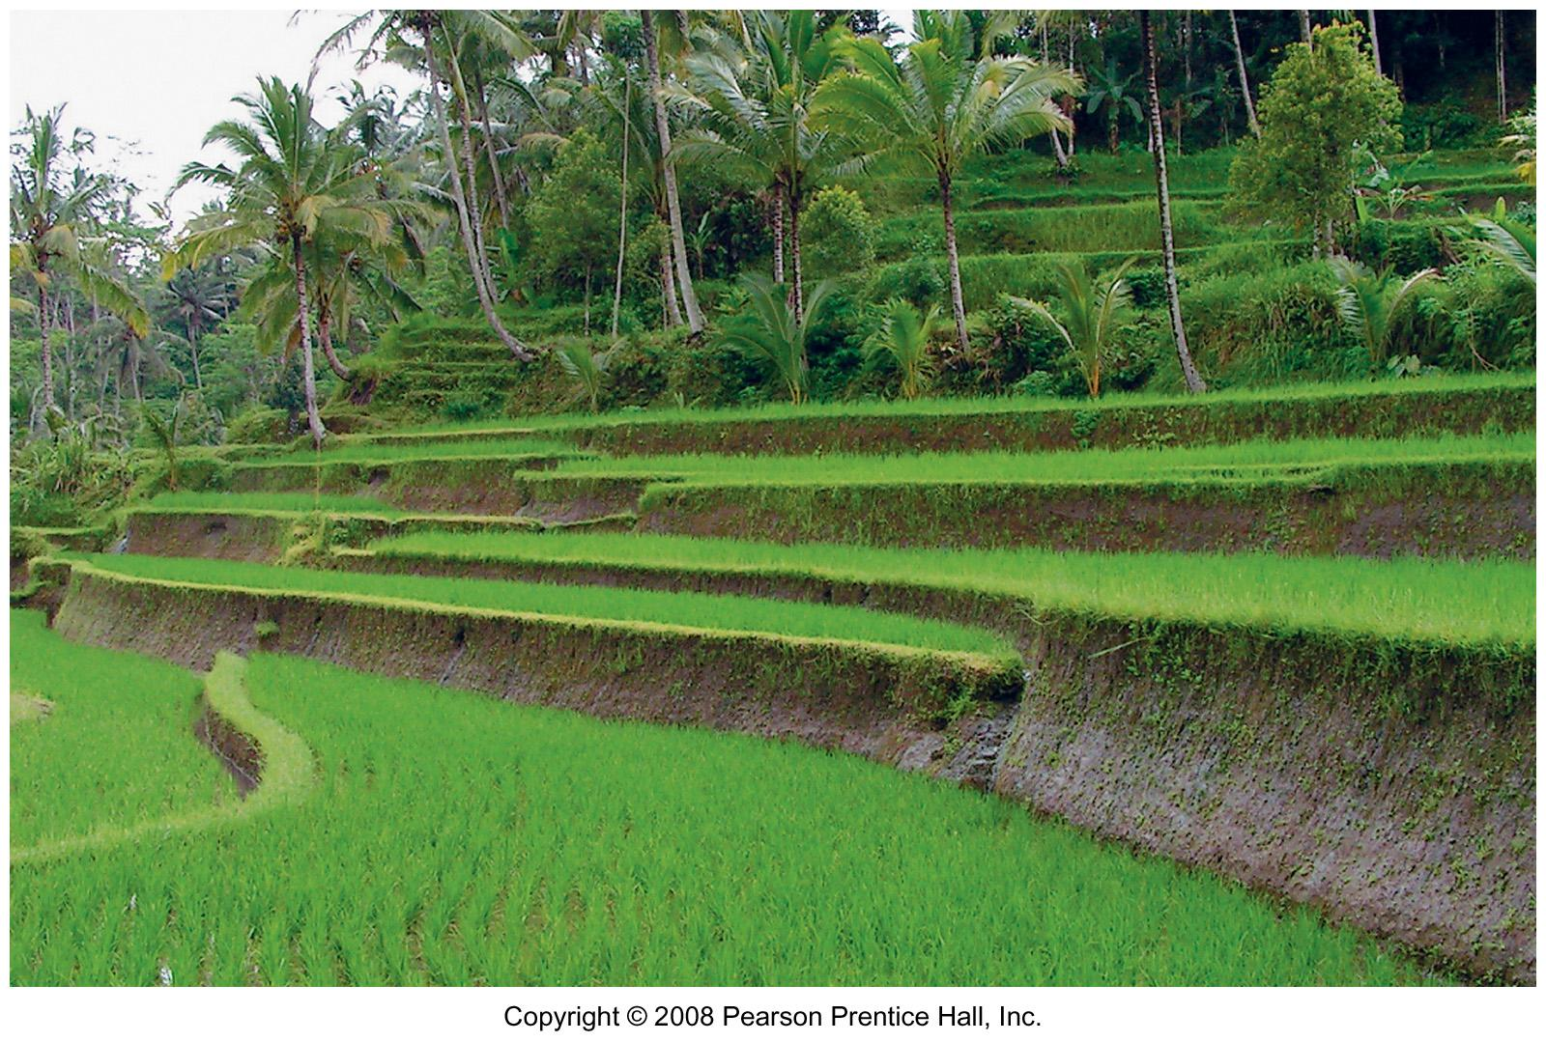
Wet Rice Terraces in Indonesia
Terraces create flat land for wet (irrigated) rice on hilly land in Indonesia.

Slide 17
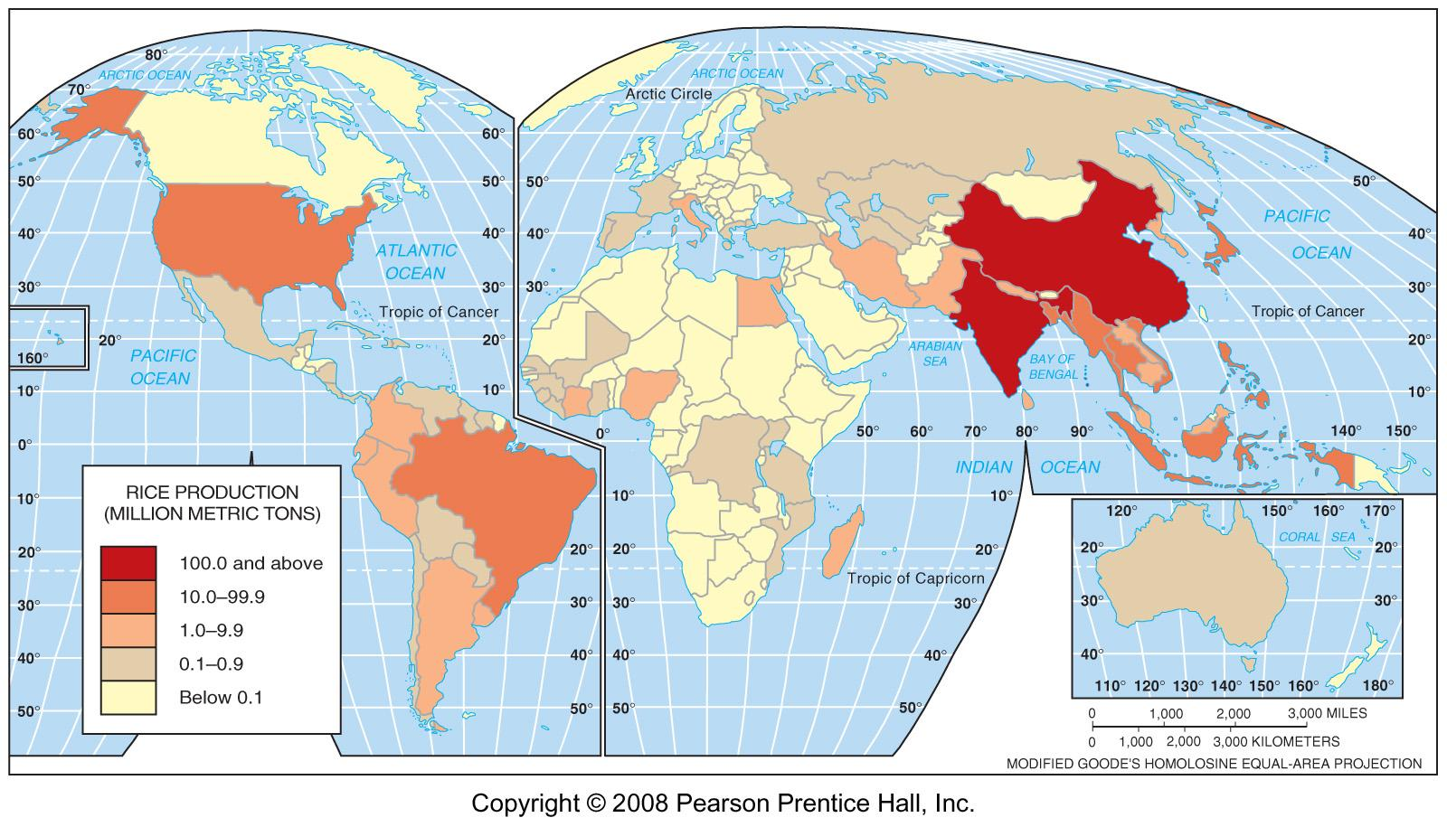
World Rice Production, 2005
Fig. 10-6: Asian farmers grow over 90% of the world’s rice. India and China alone account for over half of world rice production.

Slide 18
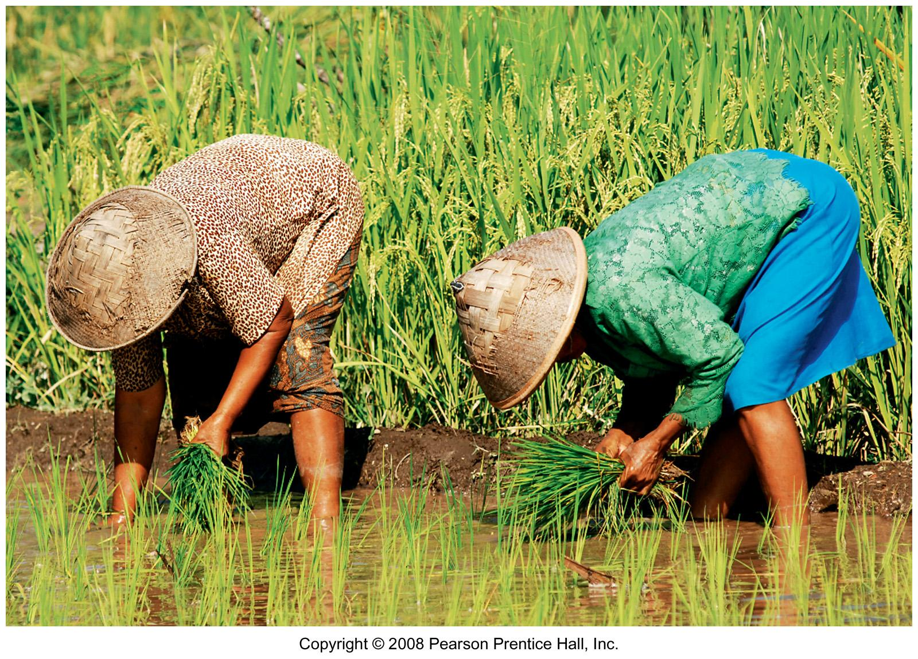
Rice Harvesting, Indonesia
Wet rice is often harvested by hand in Asia.

Slide 19
Agriculture in Developed Countries
Mixed crop and livestock farming
Dairy farming
Grain farming
Livestock ranching
Mediterranean agriculture
Commercial gardening and fruit farming
Access to markets

Slide 20
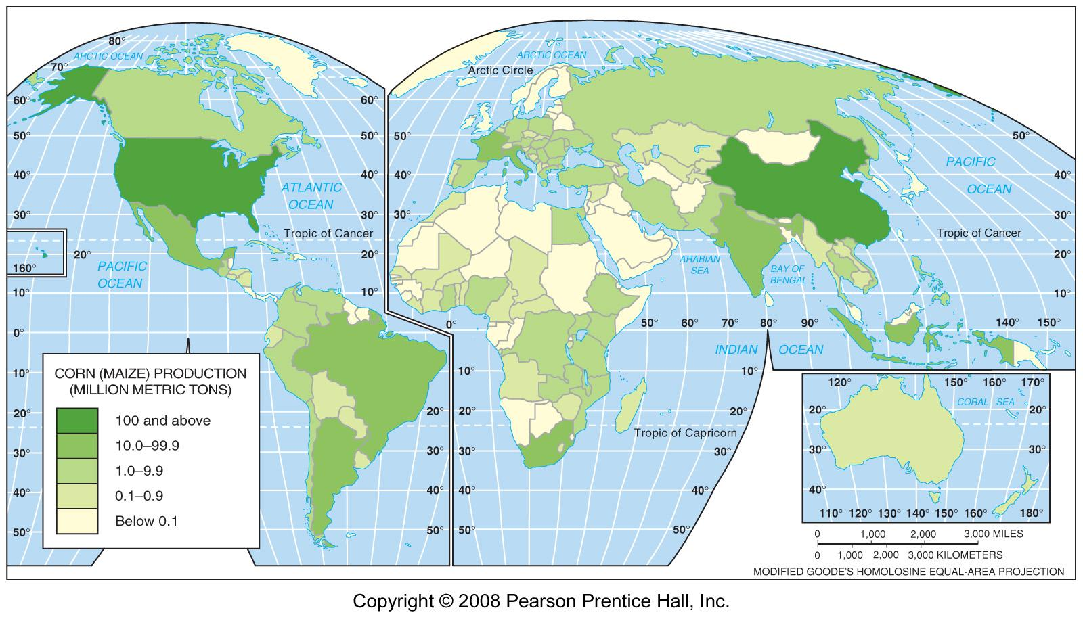
World Corn Production, 2005
Fig. 10-7: The U.S. accounts for about 40% of world corn (maize) production. China is the 2nd largest producer. Much of the corn in both countries is used for animal feed.

Slide 21
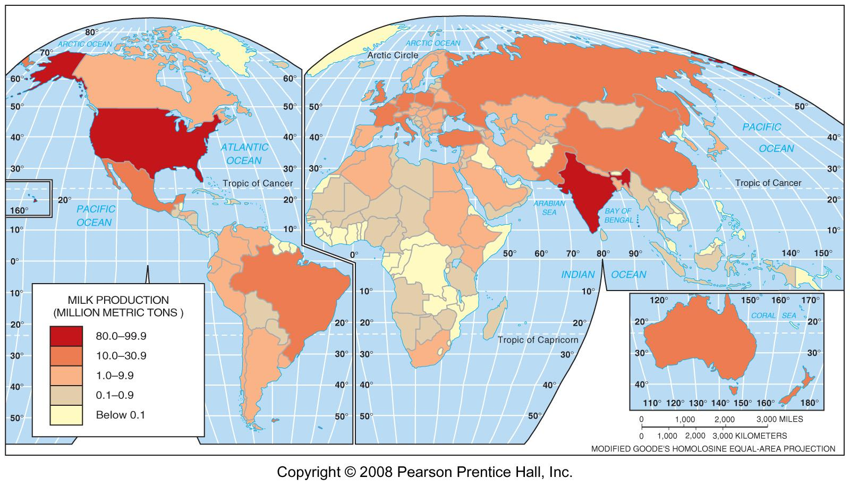
World Milk Production, 2005
Fig 10-8: Milk production reflects wealth, culture, and environment. It is usually high in MDCs, especially production per capita, and varies considerably in LDCs.

Slide 22
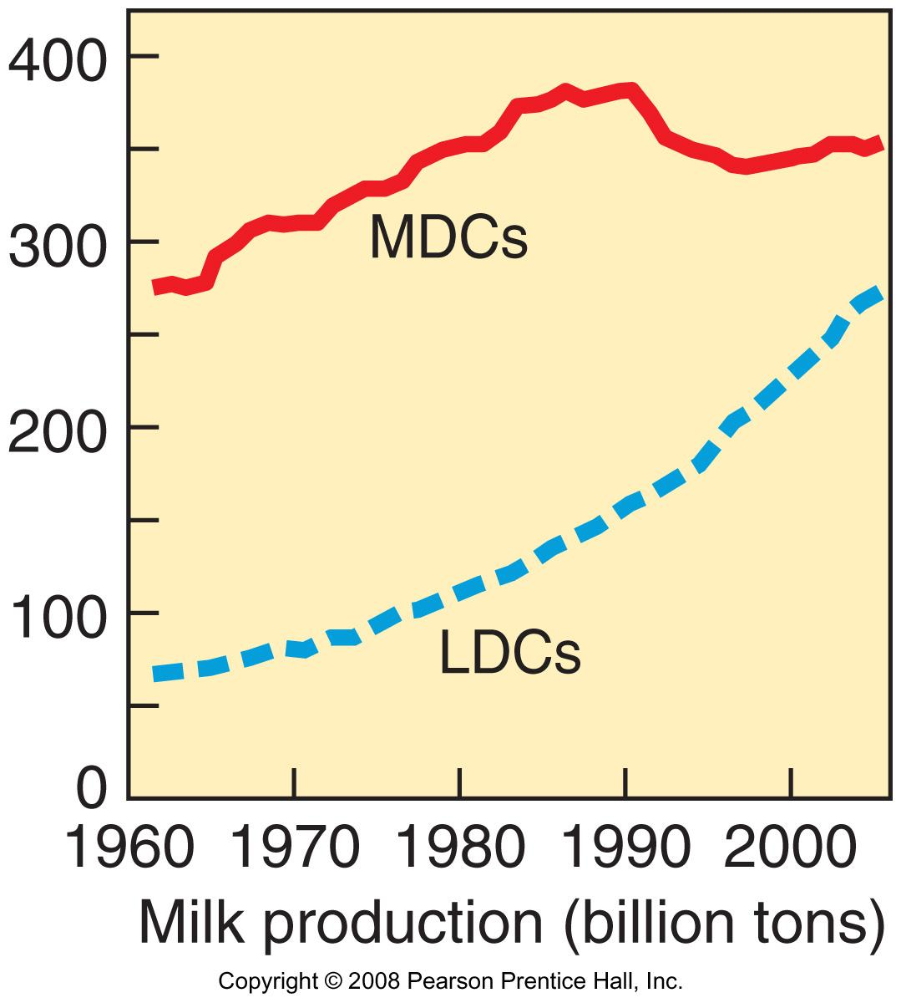
Milk Production in MDCs & LDCs
1960-2005
Milk production has grown more rapidly in LDCs than in MDCs since the 1960s.

Slide 23
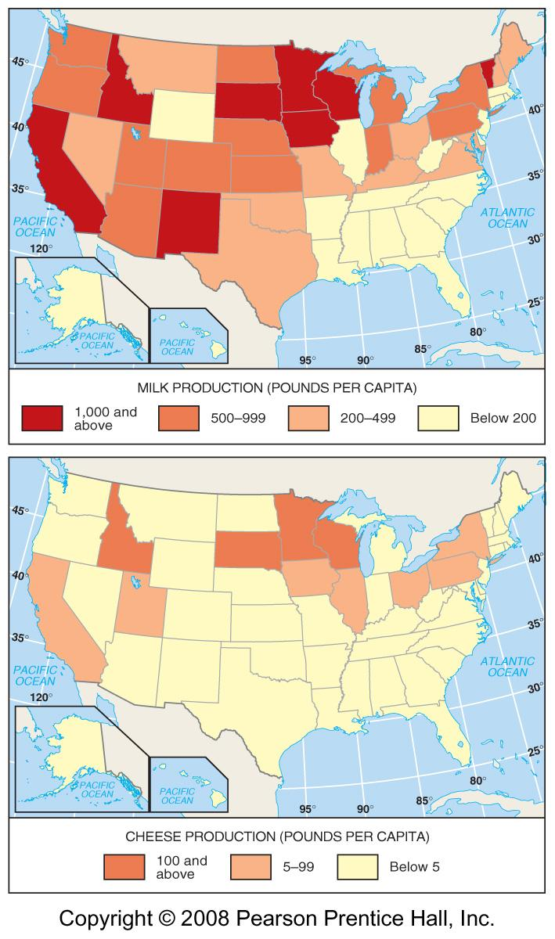
U.S. Dairy Production 2005
Fig. 10-9: Milk production is widely dispersed because of its perishability, but cheese production is far more concentrated.

Slide 24
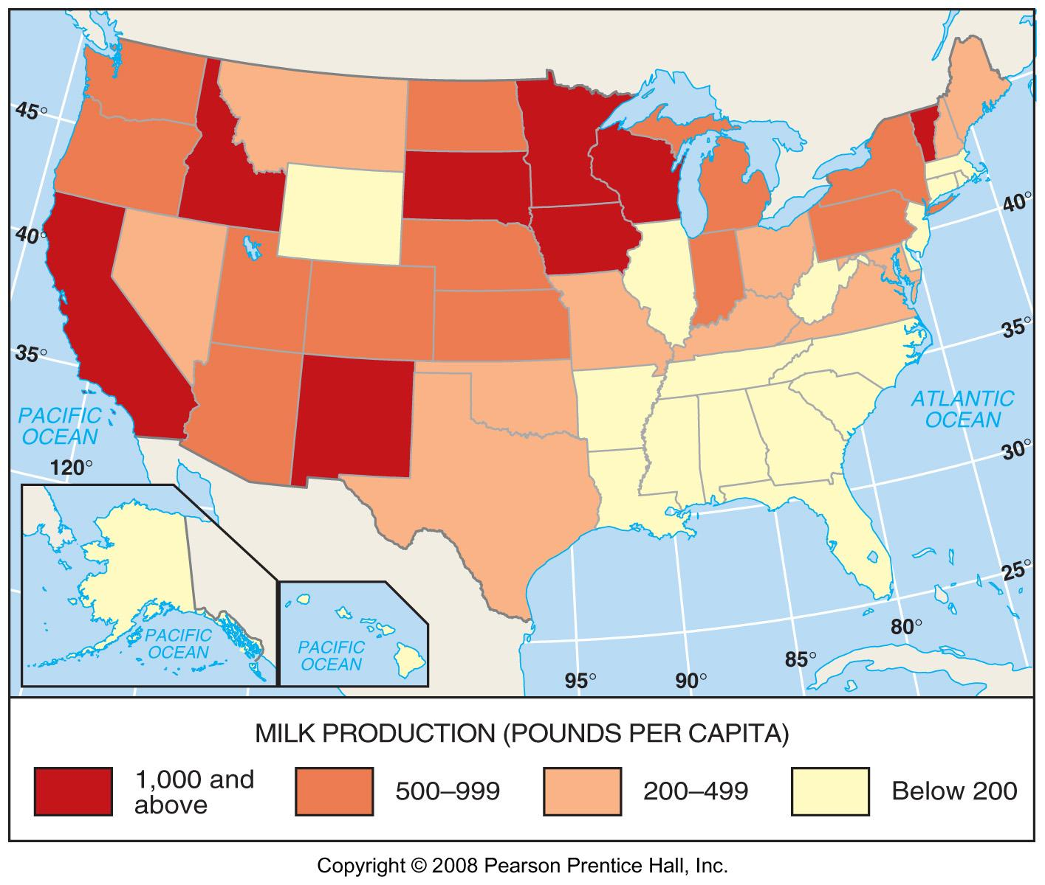
U.S. Milk Production, 2005

Slide 25
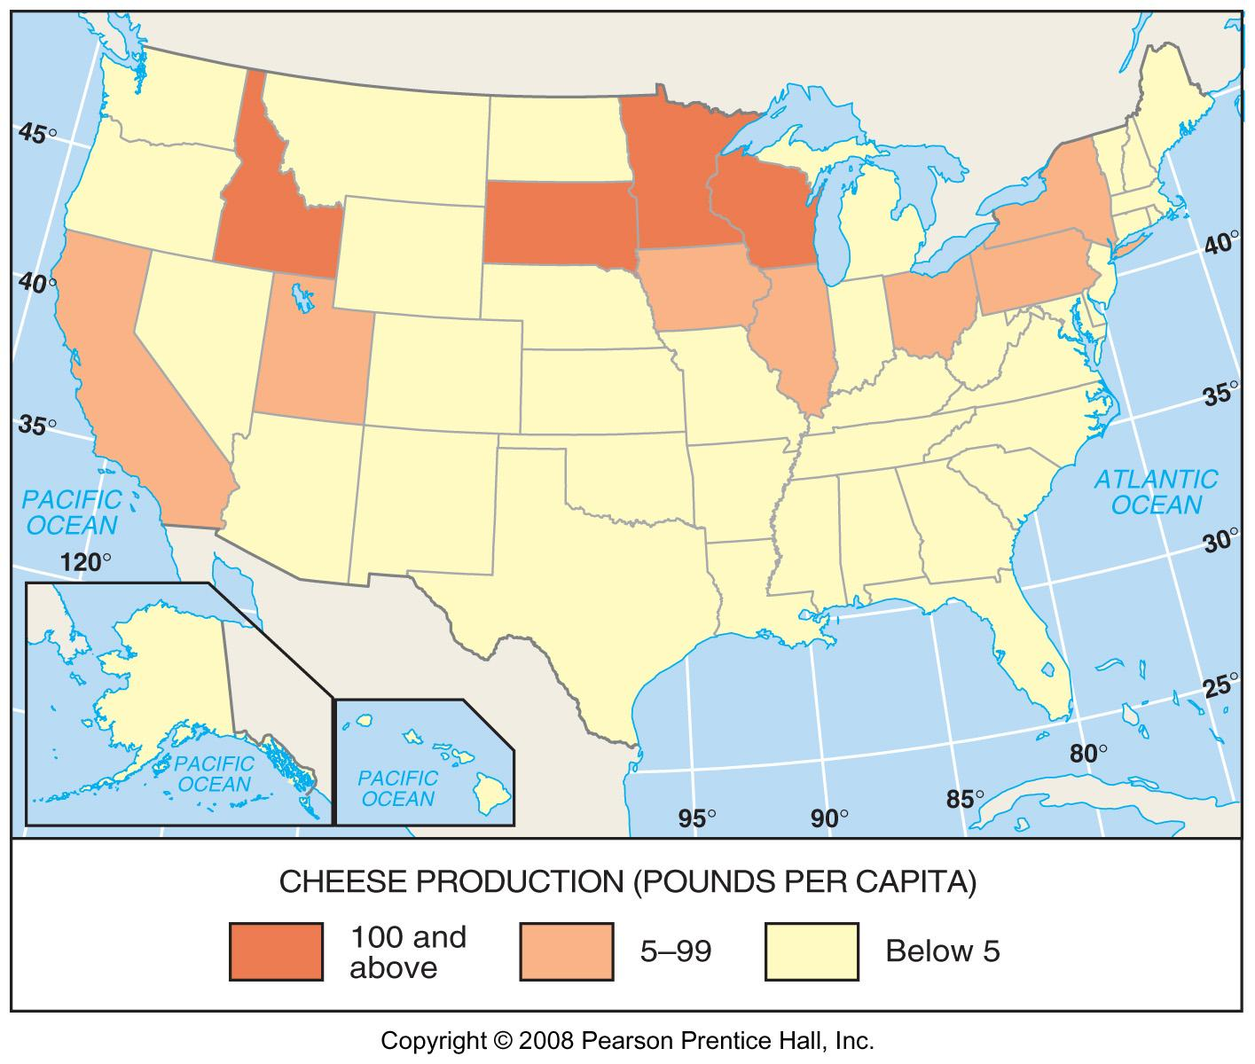
U.S. Cheese Production, 2005

Slide 26
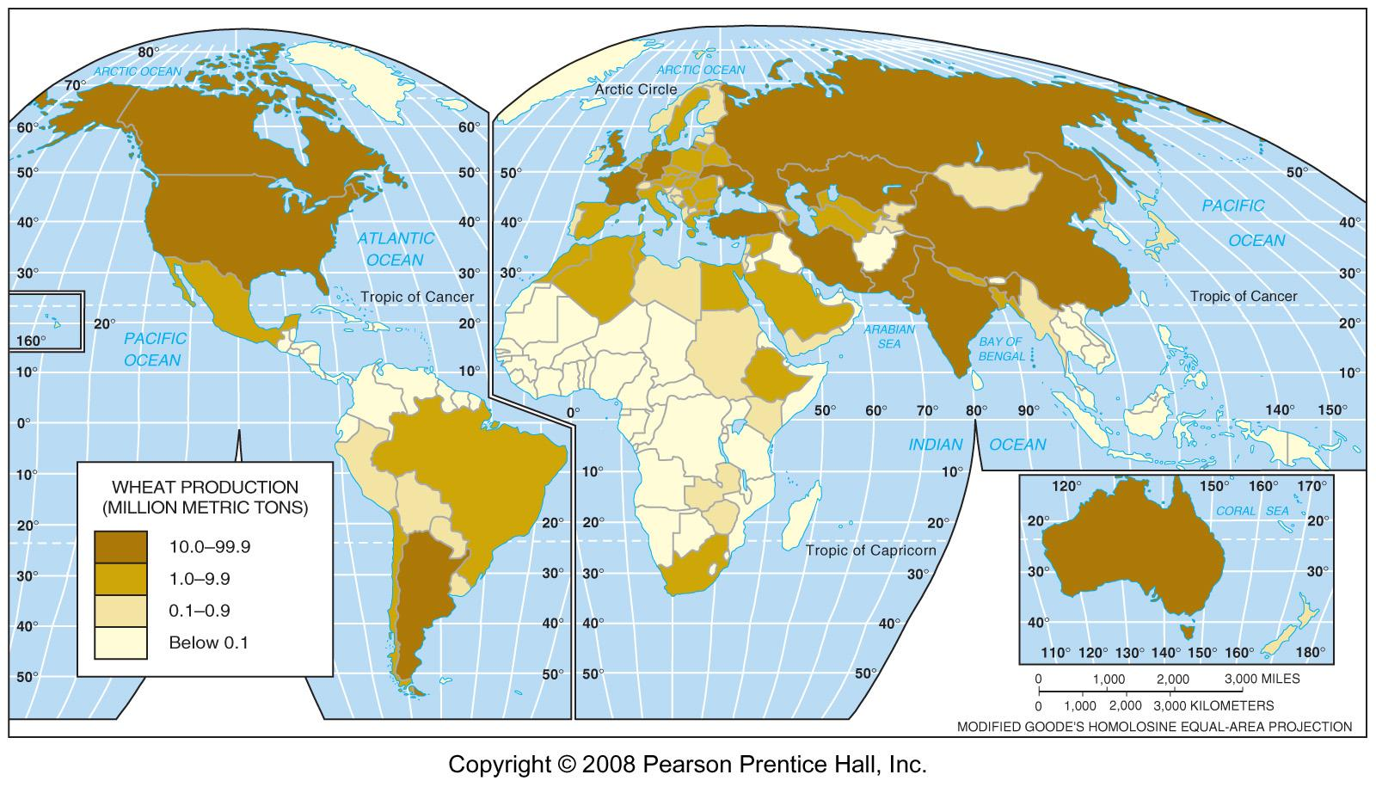
World Wheat Production, 2005
Fig. 10-10: China is the world’s leading wheat producer, but the U.S. is the largest producer of wheat for sale and the largest exporter.

Slide 27
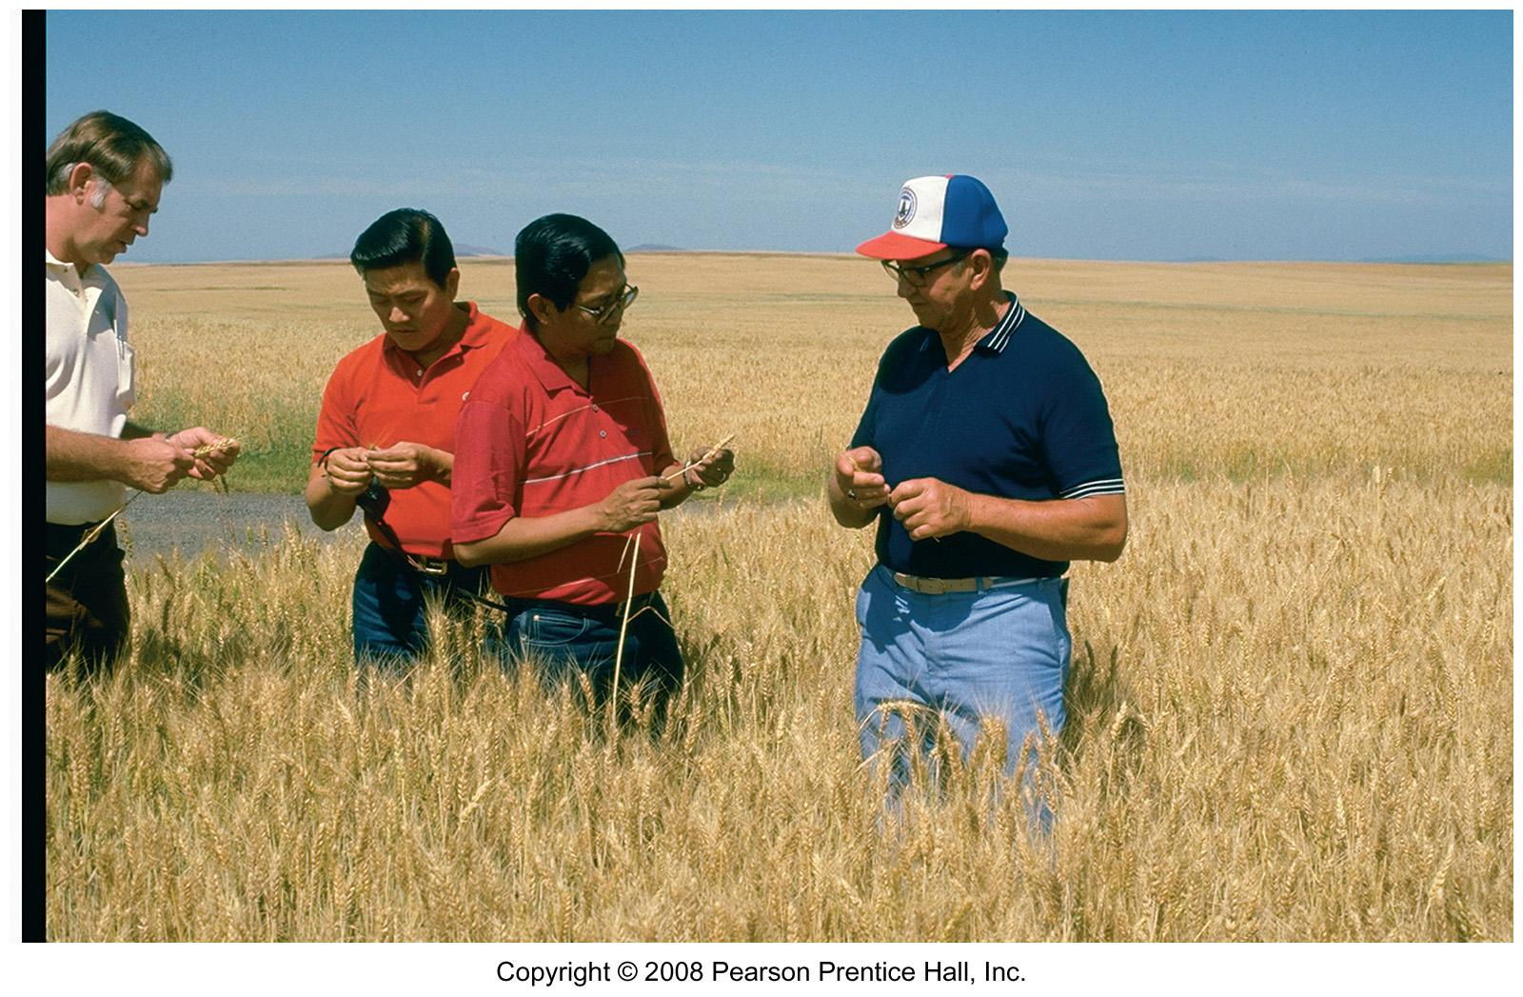
U.S. Wheat Farmer
A U.S. wheat farmer in Idaho is selling wheat to Asian buyers.

Slide 28
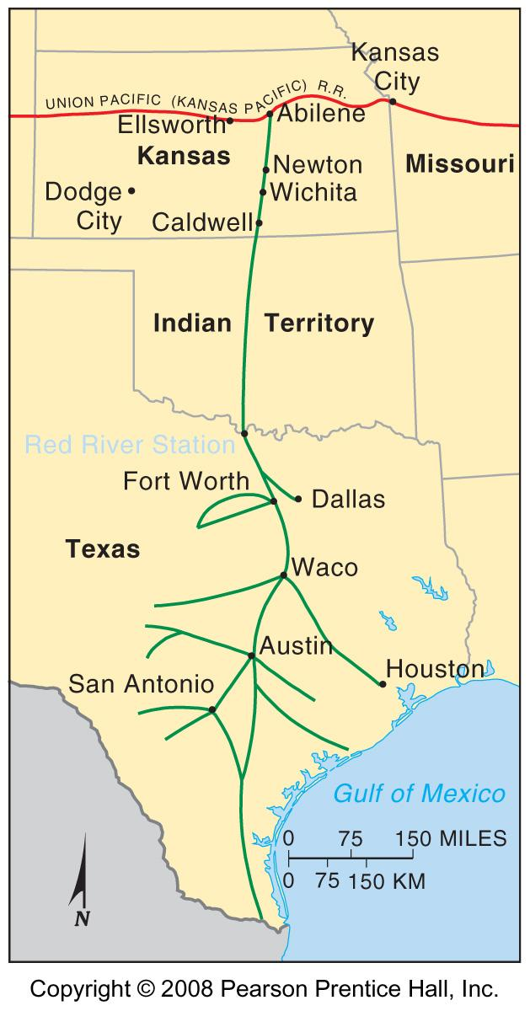
The Chisholm Trail
Fig. 10-11: The Chisholm Trail became famous as the main route for cattle drives from Texas to the railheads in Kansas.

Slide 29
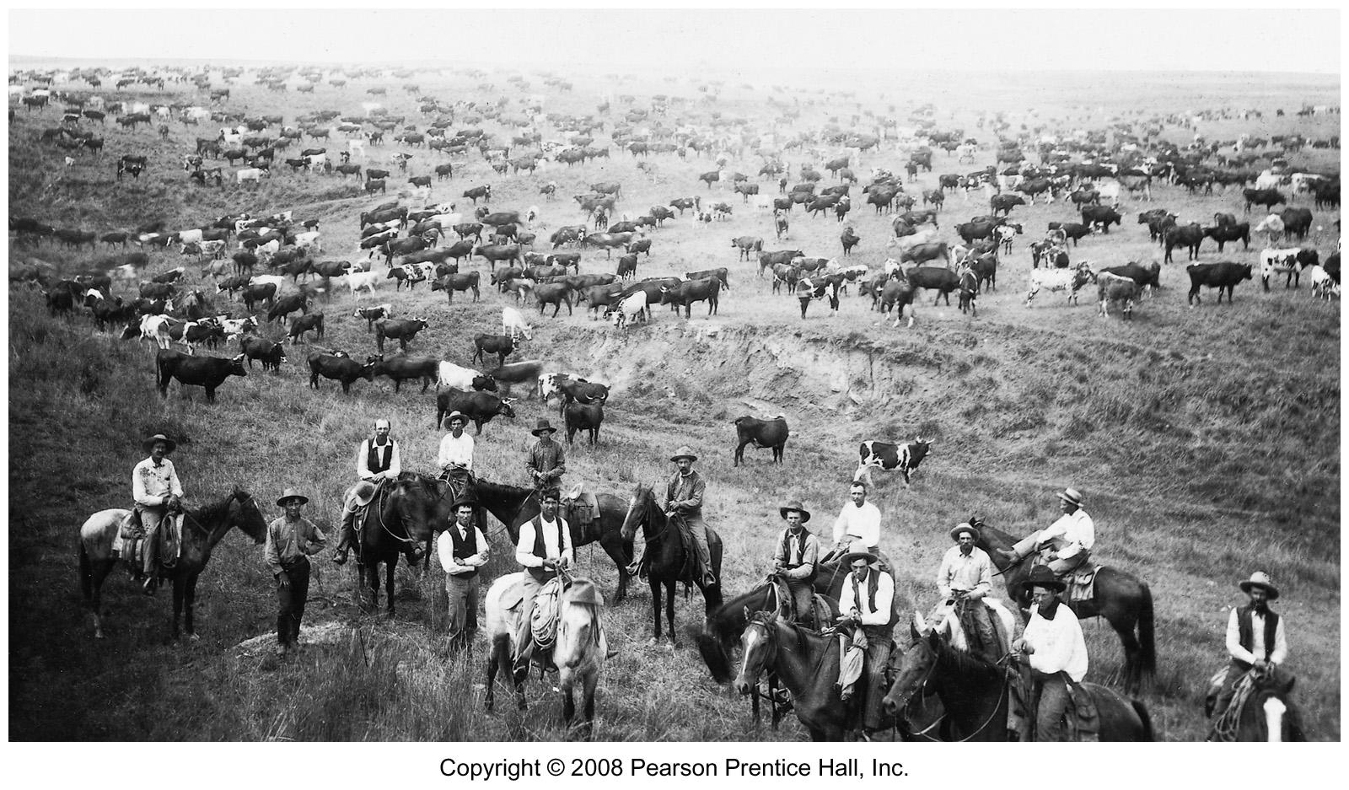
Cattle Drive on the Chisholm Trail

Slide 30
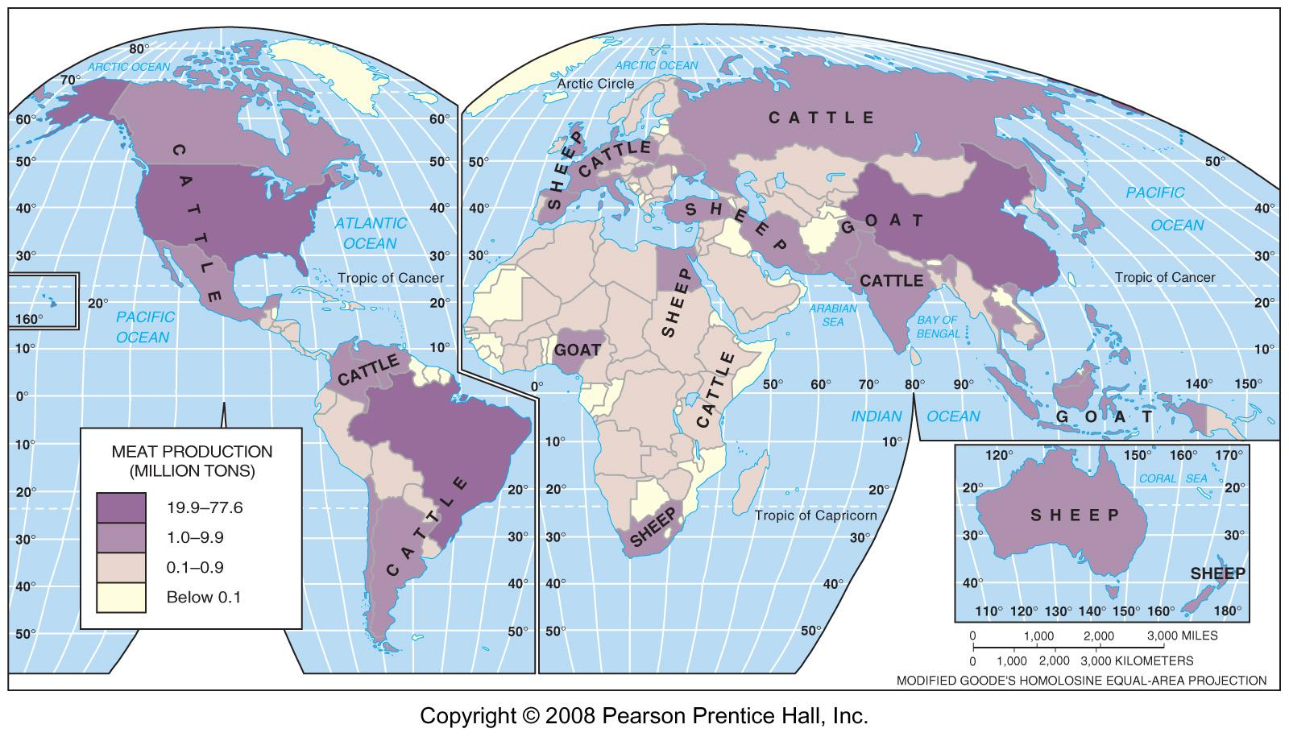
Meat Production on Ranches
Fig 10-12: Cattle, sheep and goats are the main meat animals raised on ranches.

Slide 31
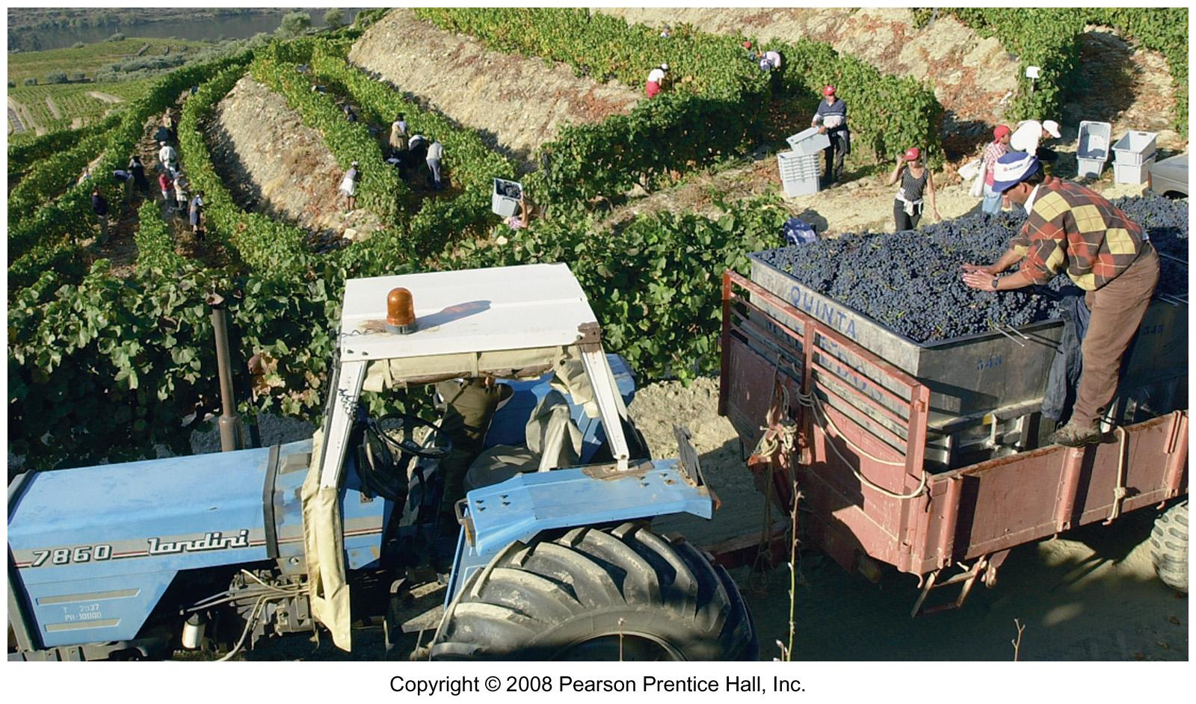
Vineyard in Portugal
Grapes loaded in vineyards on slopes above the Douro River in northern Portugal.

Slide 32
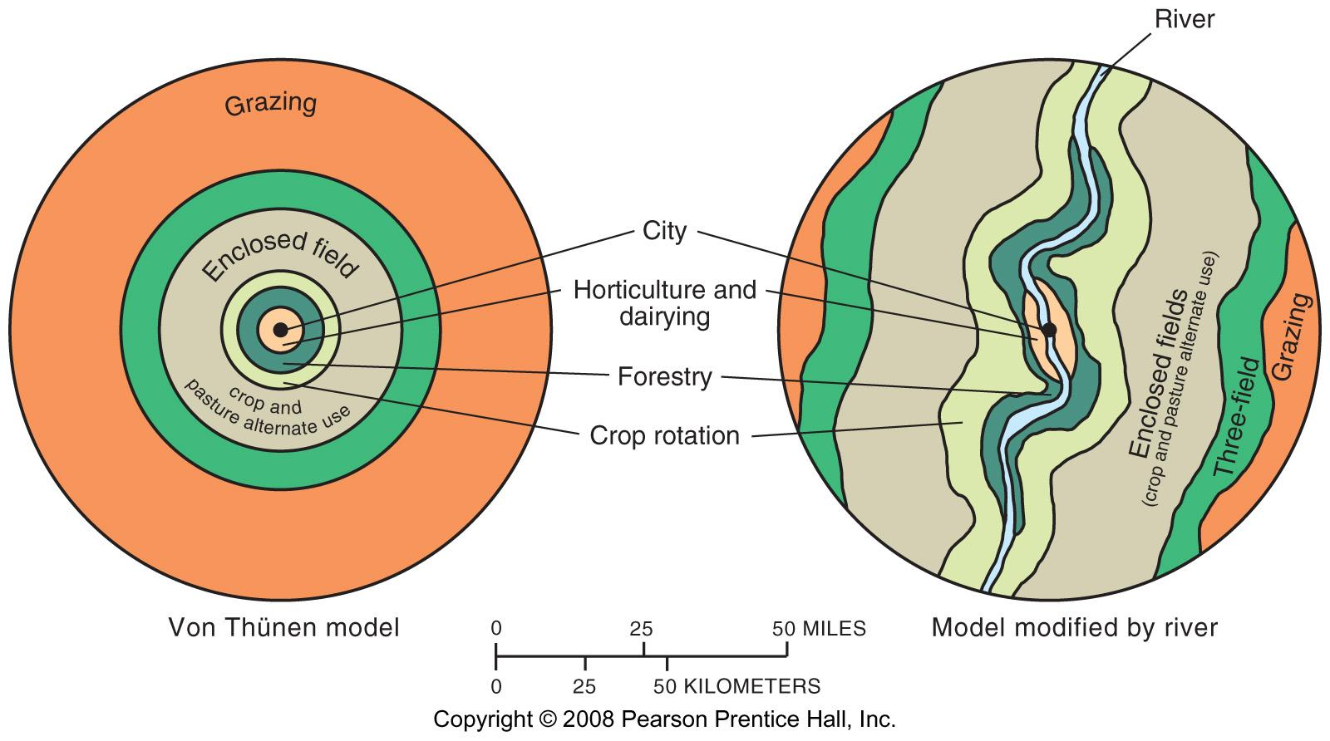
Von Thünen Model
Fig. 10-13: Von Thünen’s model shows how distance from a city or market affects the choice of agricultural activity in (a) a uniform landscape and (b) one with a river.

Slide 33
Economic Issues of Agriculture
Challenges for commercial farmers
  Overproduction
  Sustainable agriculture
Challenges for subsistence farmers
  Population growth
  International trade
Increasing food supply

Slide 34
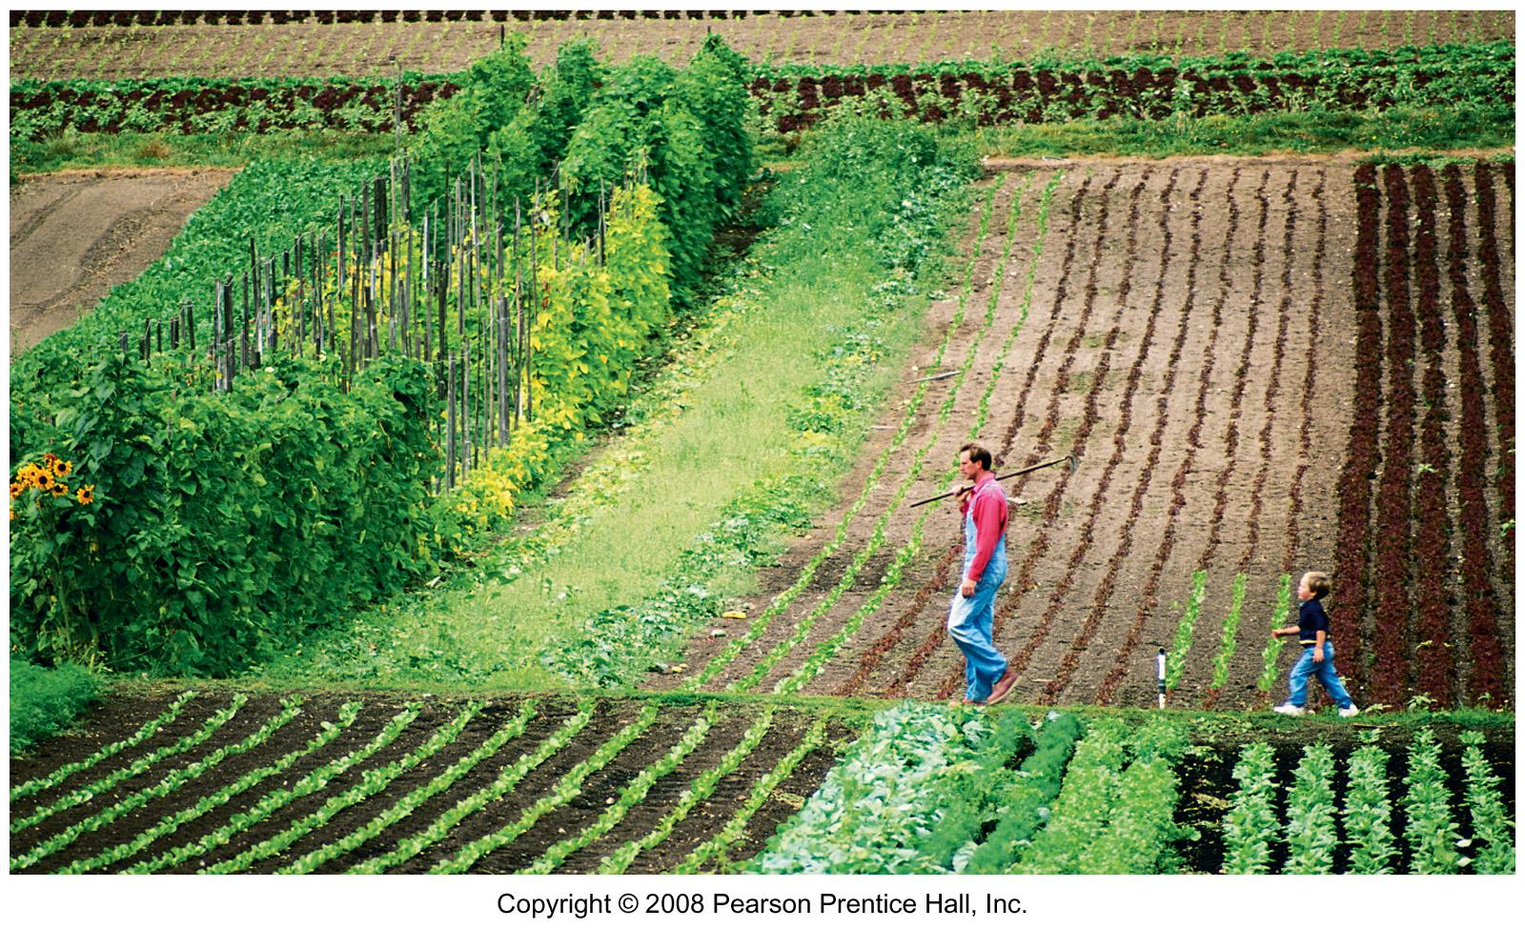
Organic Farm in Washington
There is limited use of chemicals and heavy machinery on organic farms such as this one in Whatcom County, Washington state.

Slide 35
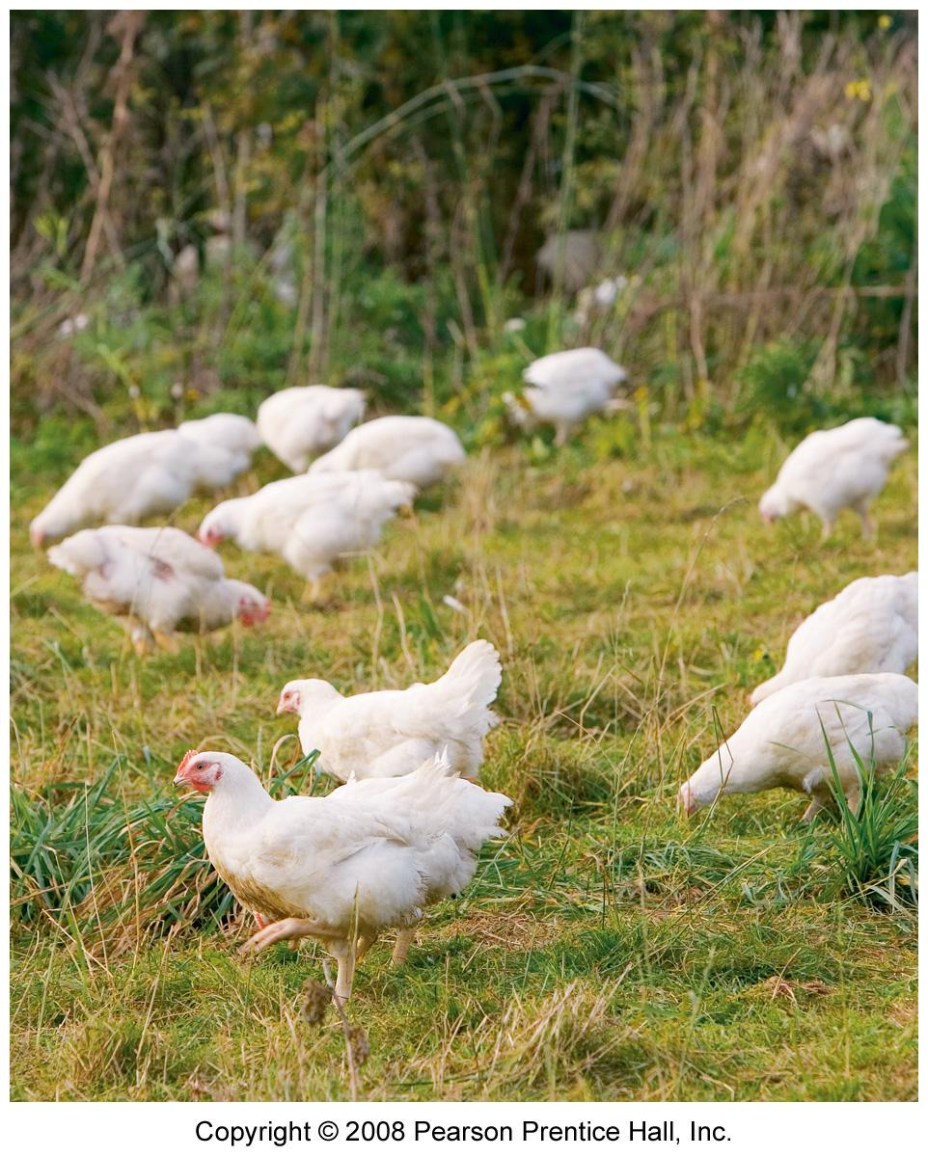
Free-range Chickens
Free-range chickens on an organic farm in England.

Slide 36
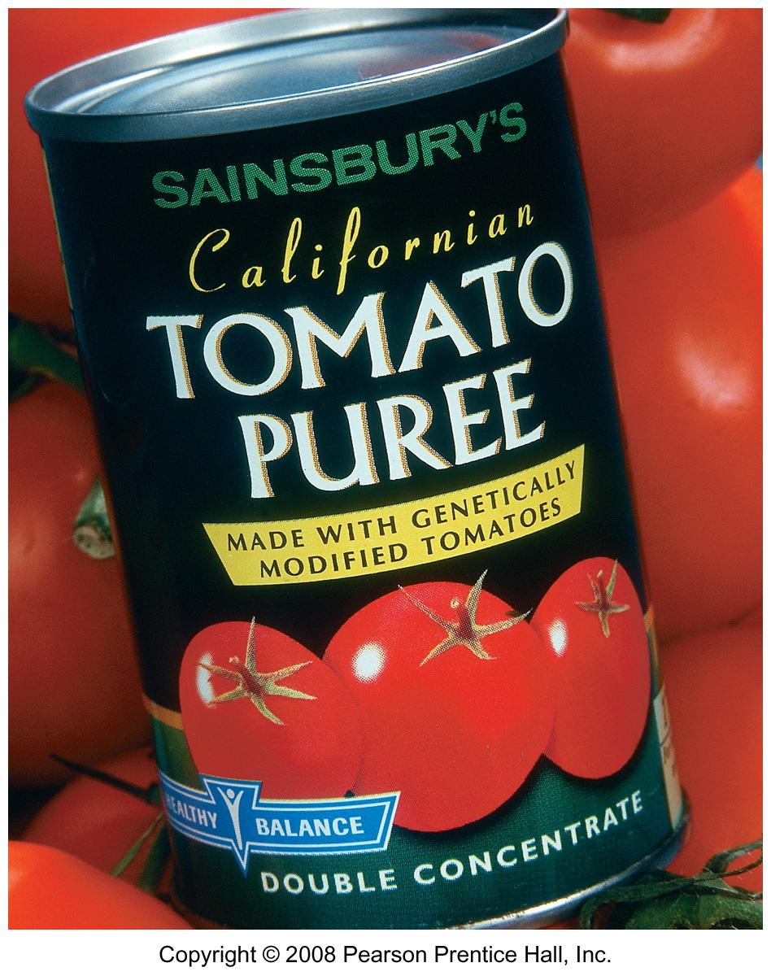
Genetically Modified Foods
Genetically modified foods must be labeled in Europe but not in the U.S.

Slide 37
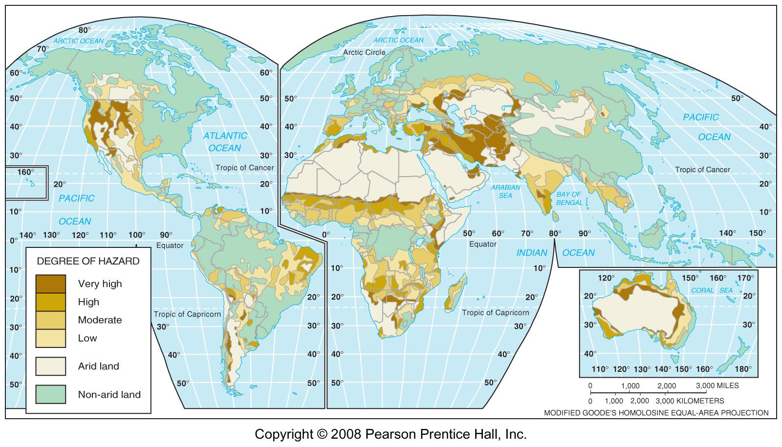
Desertification Hazard
Fig. 10-14: The most severe desertification hazard is in several parts of semiarid Africa, and parts southwestern Asia, North and South America, and Australia.

Slide 38
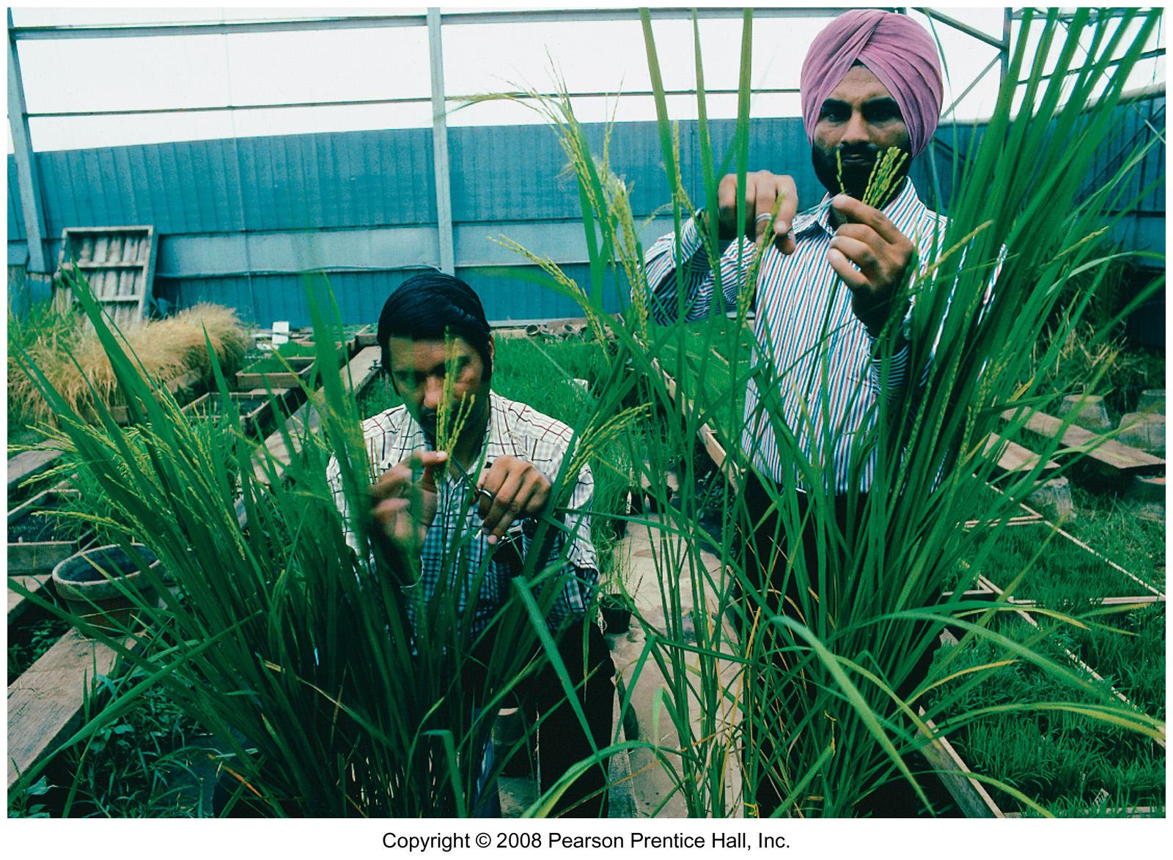
Green Revolution Experiments
Scientists at the International Rice Research Institute try to develop improved crop varieties.

Slide 39
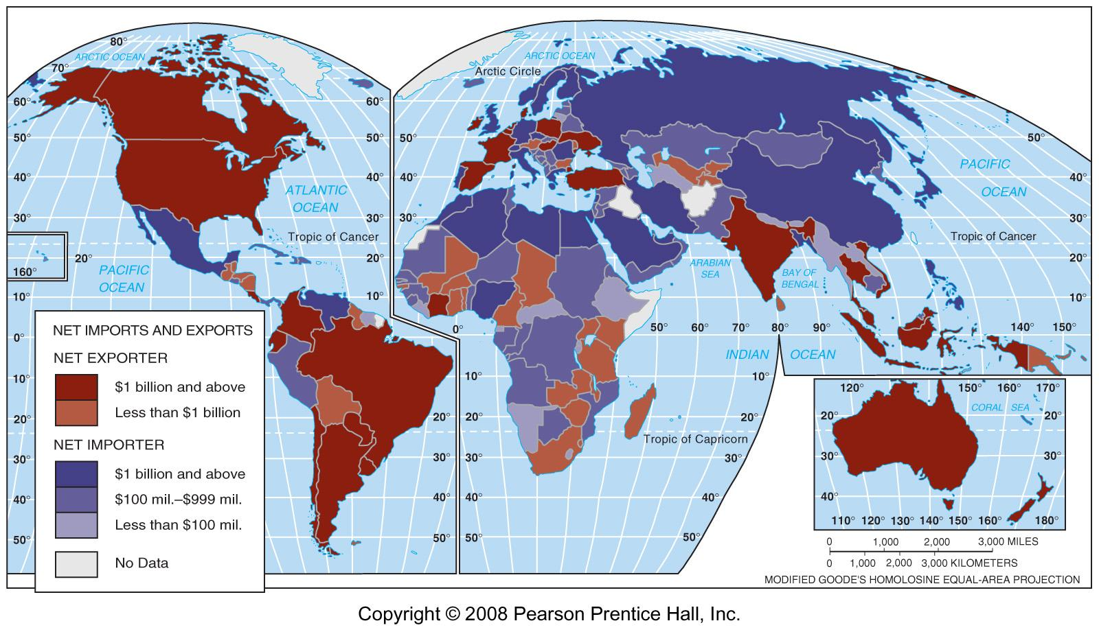
Grain Importers & Exporters
Fig. 10-15: Most countries are net importers of grain. The U.S. is the largest net exporter.

Slide 40
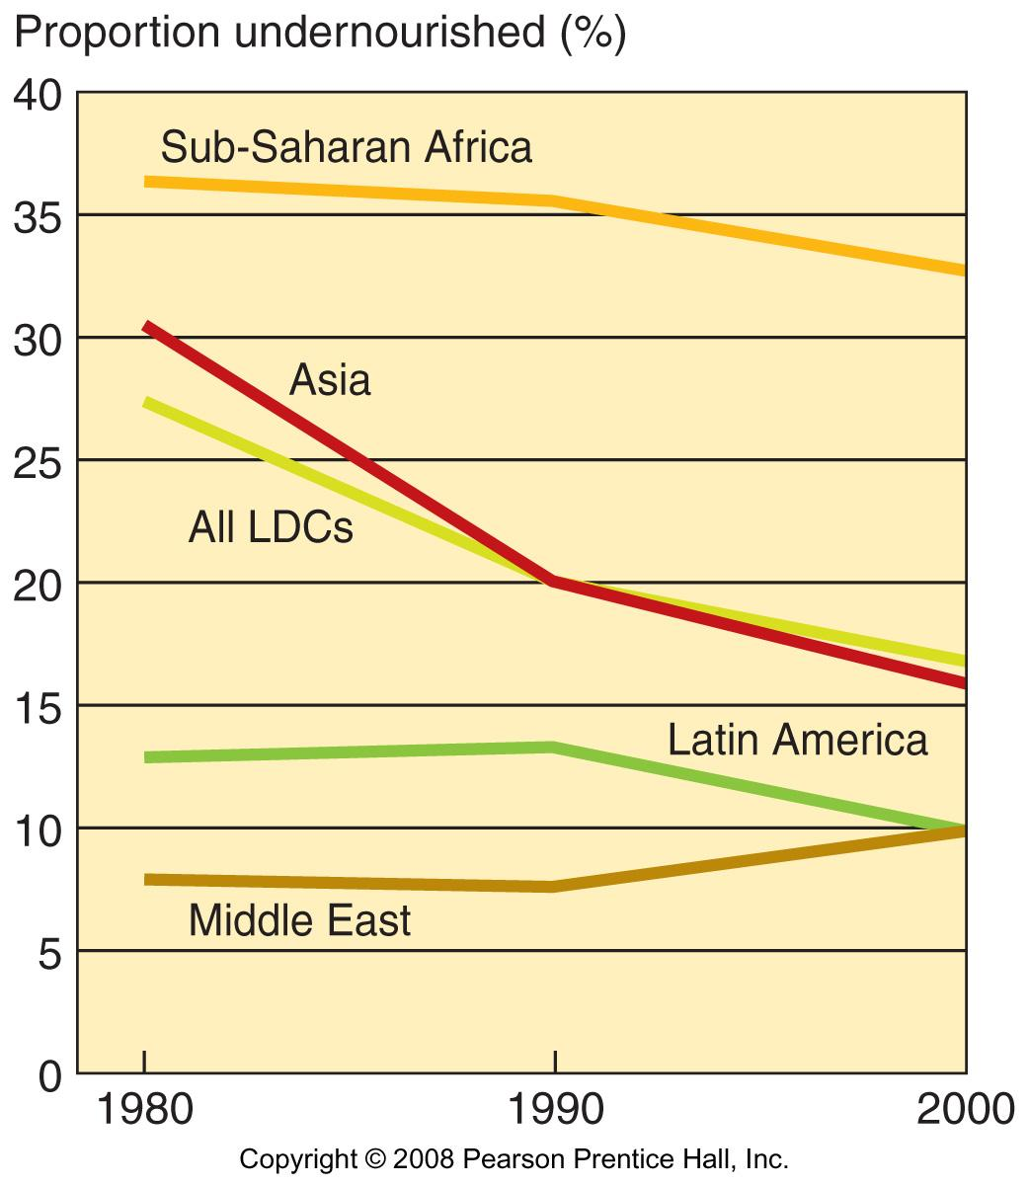
Undernourished Proportion
Fig. 10-16: The proportion of under-nourished population has declined in most LDCs, but is much higher in sub-Saharan Africa than in other areas of the world.

Slide 41
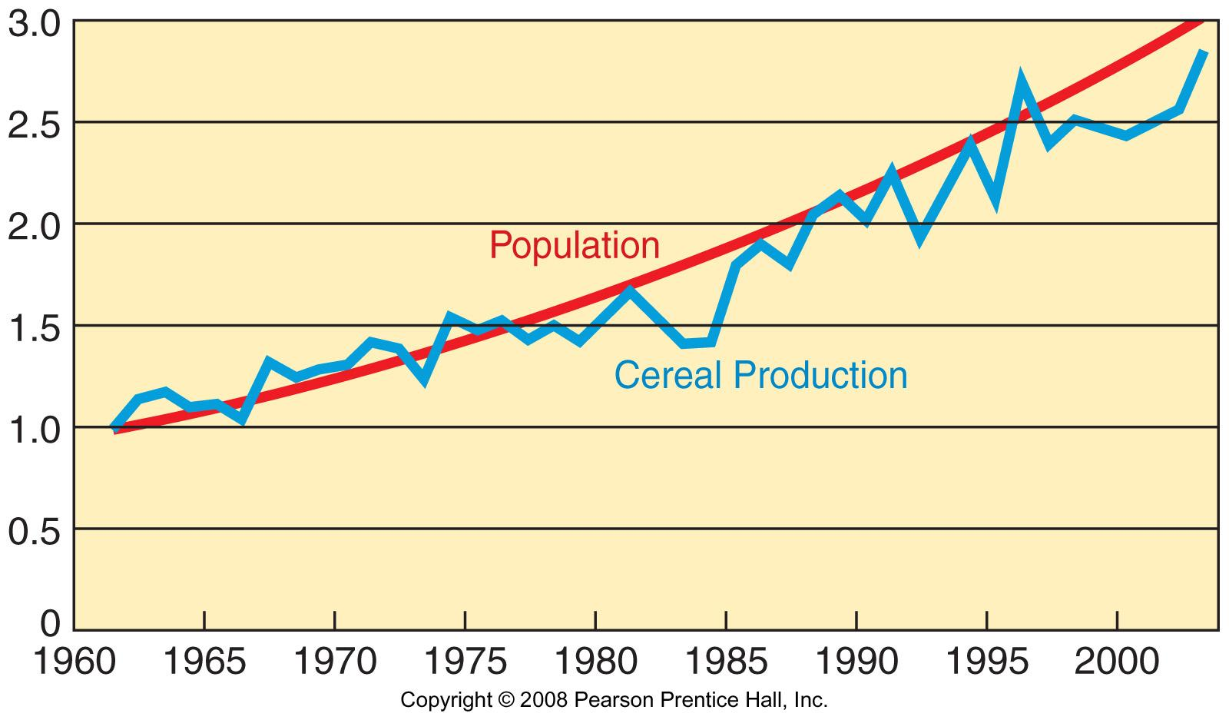
Population and Grain Production in Africa, 1961-2005
Fig. 10-17: Cereal production has not kept up with the high rate of population growth in sub-Saharan Africa. (The graph is set to a base of 1.0 in 1961).

Slide 42
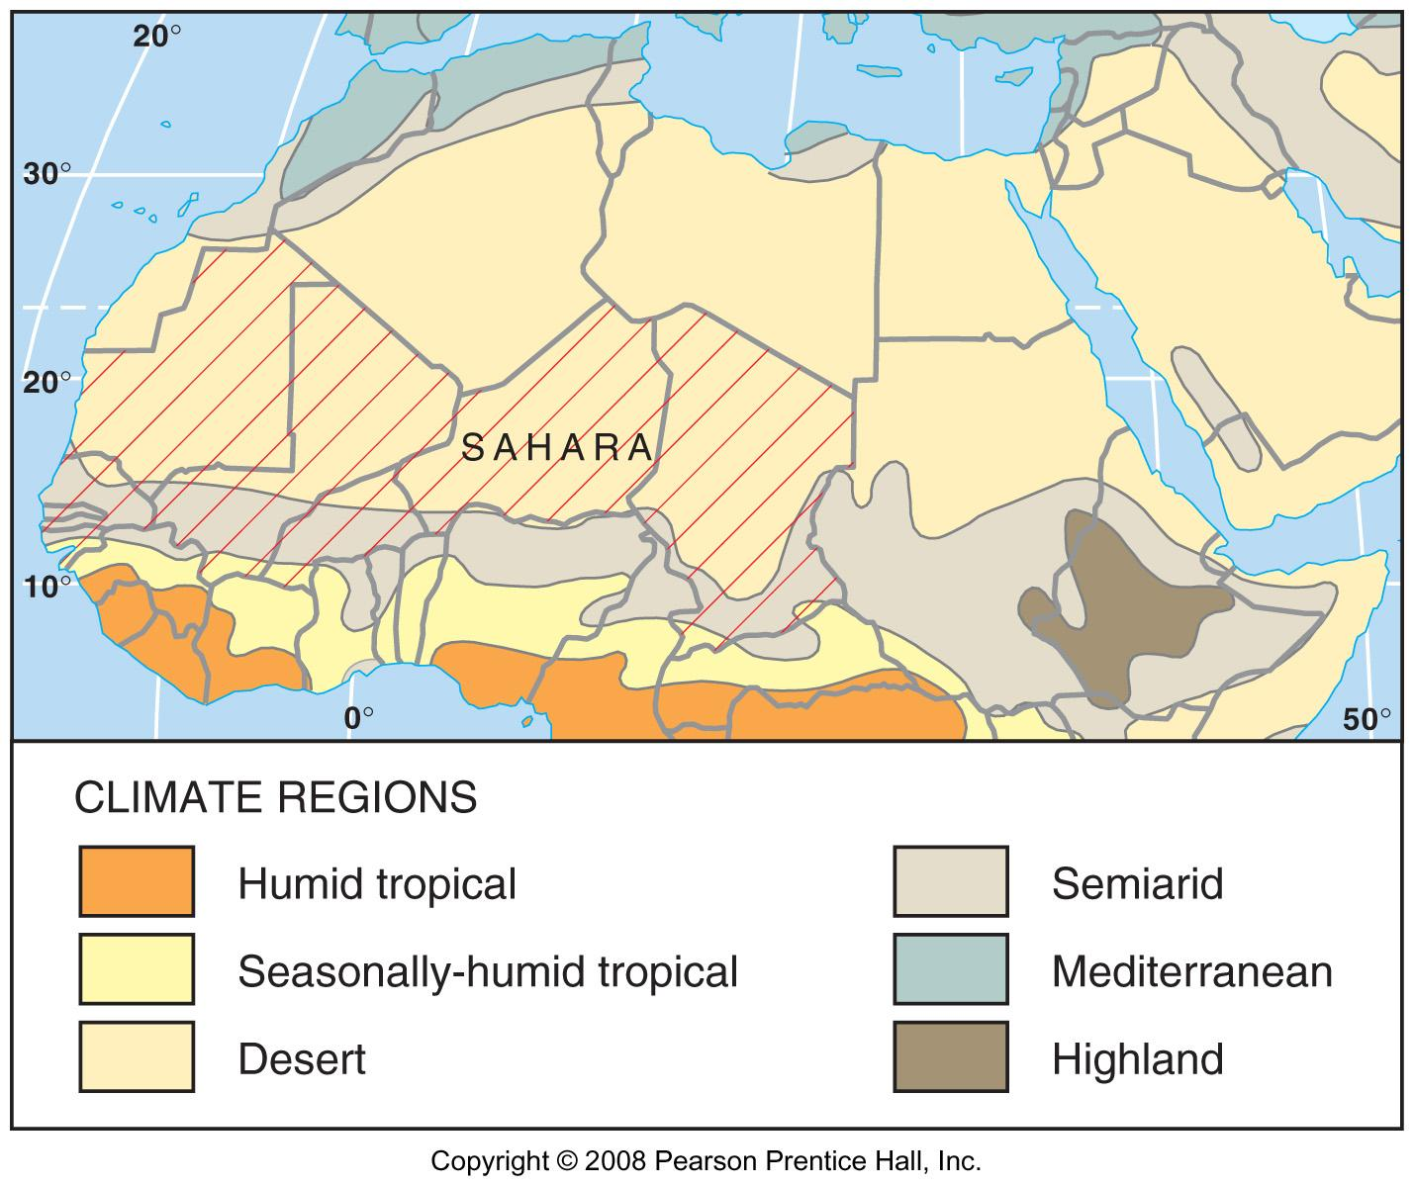
The Sahel
Fig. 10-18: The Sahel, which is south of the Sahara, frequently faces drought and food shortages, as does the Horn of Africa.

