Slide 1

Introduction To World War 2
For What Reasons Did World War 2 Start?

Slide 2
What was World War II?
-Largest, Biggest War Ever in human history
-Counties, Colonies, and Territories
-70 million+
-1939-1945.
-73 years ago
Notes:
https://www.britannica.com/event/World-War-II

Slide 3
Causes
W WI and the Treaty of Versailles
A ppeasement
R ise of Totalitarianism

Slide 4
WWI and the Treaty of Versailles
-Germany lost territories
-War reparations
-Allies collect $ to pay back war debts to US
-Germany pays $ trillions (modern day equivalent)
-Germans bankrupt, embarrassed, desperate, hopeless, and angry
-By November 1923, the US dollar was worth 4,210,500,000,000 German marks.

Slide 5
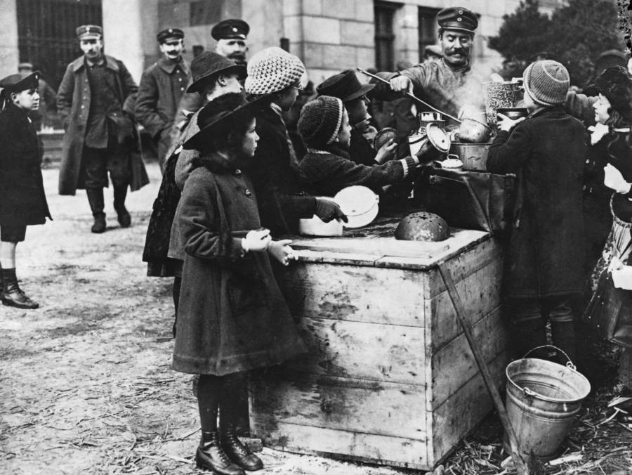
Notes:
Hungry children gather around a soldier ladling hot food at an outdoor soup kitchen.
Germany. 1918.https://allthatsinteresting.com/nazi-rise-to-power#9

Slide 6
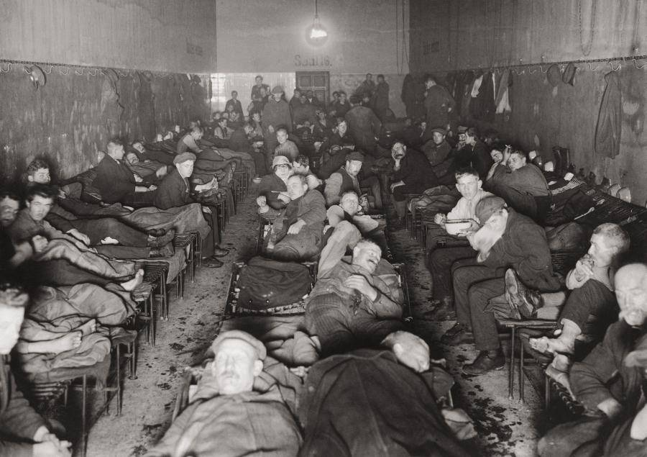
Notes:
People eat at a crowded dormitory of a lodging house for the homeless in Berlin.
1920.

Slide 7
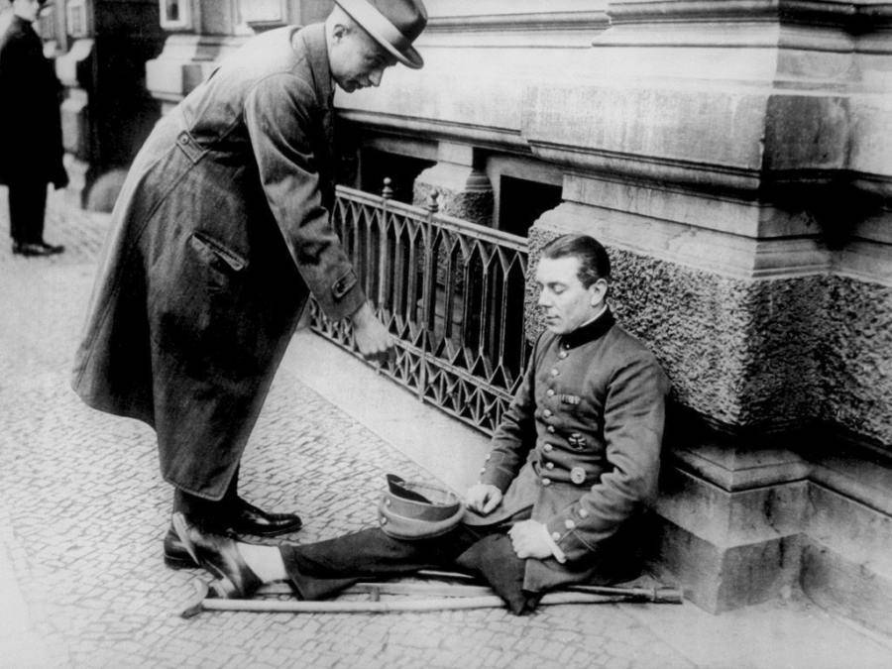
Notes:
German World War I amputee begs for money on the street.
Many German veterans were forgotten after their war, their lives in shambles, allowing a man like Hitler, a man promising change and revitalization, to take power.
1923.

Slide 8
Appeasement
-Giving someone something to make them happy and leave you alone.
-Germany demanded land and others just gave it to him.
-Nations were trying to prevent war (Isolationism).
-Germany keeps expanding.

Slide 9
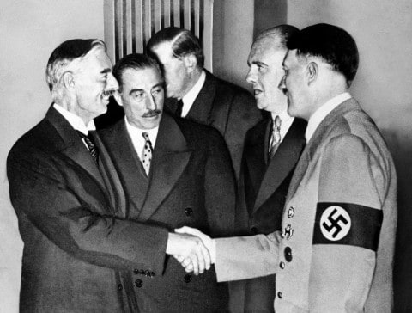
Notes:
Hands clasped in friendship, Adolf Hitler and England's Prime Minister Neville Chamberlain, are shown in this historic pose at Munich on Sept. 30, 1938.
https://www.washingtonpost.com/news/worldviews/wp/2015/07/20/in-defense-of-neville-chamberlain-hindsights-most-battered-punching-bag/?noredirect=on

Slide 10
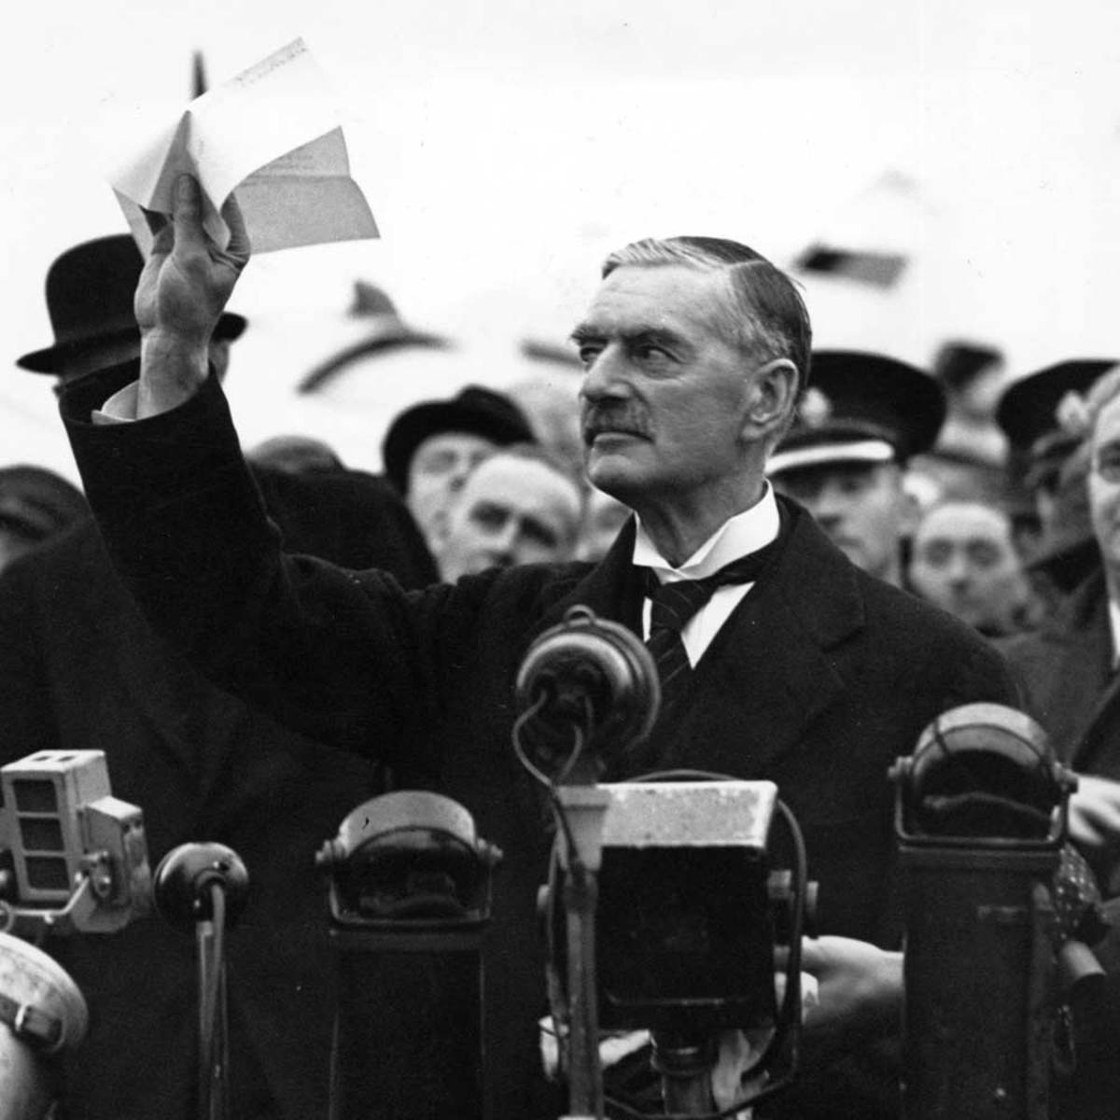
Notes:
https://www.history.com/news/chamberlain-declares-peace-for-our-time-75-years-ago
Chamberlain Declares “Peace for Our Time,” 75 Years AgoOn September 30, 1938, British Prime Minister Neville Chamberlain received a rowdy homecoming after signing a peace pact with Nazi Germany.

Slide 11
Rise of Totalitarianism
-System in which the state and its leader have nearly TOTAL control.
-Individual rights are not viewed as important as the needs of the nation.
-No right to vote
-No free speech
-Government controlled economy
-Often a police state

Slide 12
Totalitarian Countries
-USSR Communist Dictatorship
-Germany & Italy Fascist Dictatorship
-Japan : Military Dictatorship

Slide 13
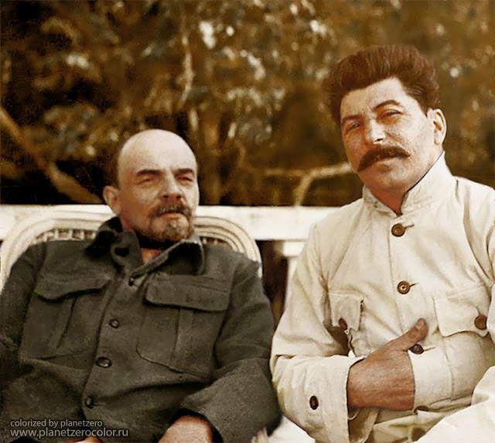
Notes:
https://www.vintag.es/2018/05/history-of-russia-in-the-beginning-of-20-century-in-color.html
Vladmir Lenin and Josef Stalin in Gorki, 1922

Slide 14
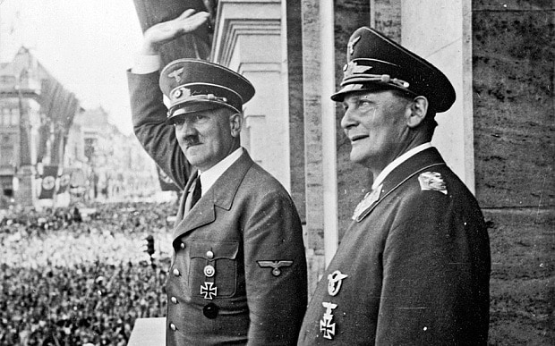
Notes:
http://www.ww2incolor.com/news/tag/adolf
Nazi leader Adolf Hitler, left, with his second-in-command Hermann Göring

Slide 15
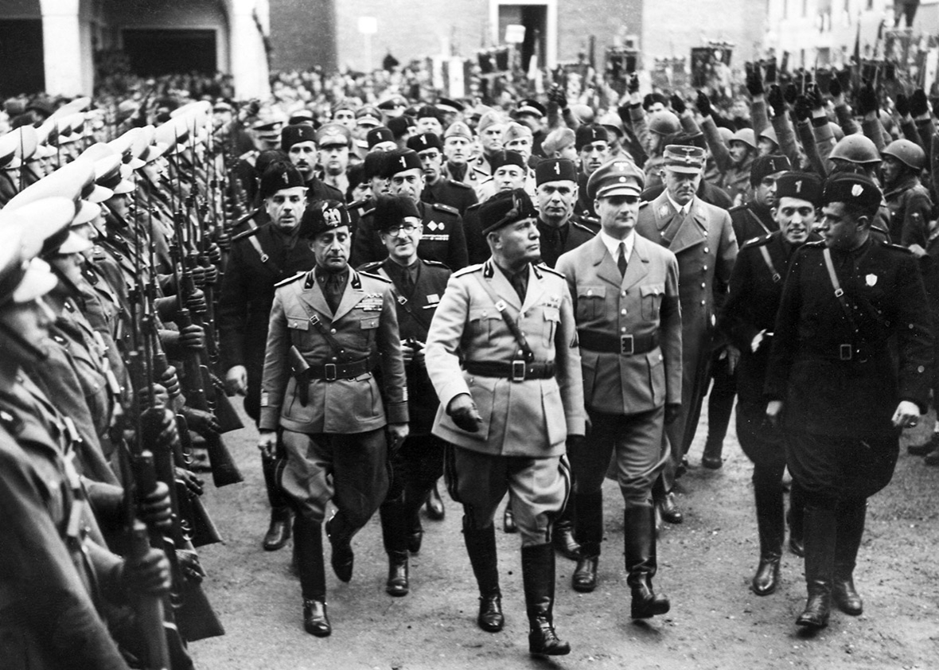
Notes:
Italian dictator Benito Mussolin reviews troops on Oct. 29, 1937, in Rome followed by Rudolf Hess, Adolf Hitler’s deputy, and other Italian fascist officials.
http://www.slate.com/articles/news_and_politics/fascism/2017/01/our_slate_academy_on_fascism_starts_with_italy_and_the_rise_of_mussolini.html

Slide 16
Fascism
-Political belief that says the individual is less important than the nation.
-Glorifies violence, believes it is needed to “prove” strength of a people.
-Uses nationalism and racism.
-Dictatorships.
-Italy and then Germany became fascist.

Slide 17
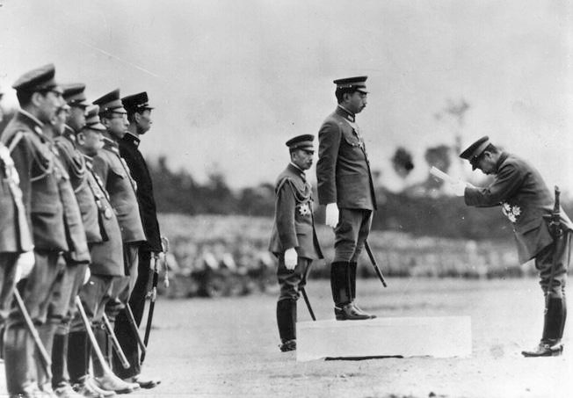
Notes:
https://www.reddit.com/r/MilitaryPorn/comments/8knk3s/japanese_war_minister_general_hideki_tojo/
Japanese War Minister General Hideki Tojo presents a proclamation to Emperor Hirohito following a military review in Tokyo on October 21, 1941, in celebration of the 2,600th anniversary of the founding of the Japanese Empire.

Slide 18
Who Was on Each Side?
Axis Powers
-Germany, Italy, Japan
Allied Powers
-Great Britain, Soviet Union, United States, France Surrendered to Germany in 1940 after 6 weeks

Slide 19
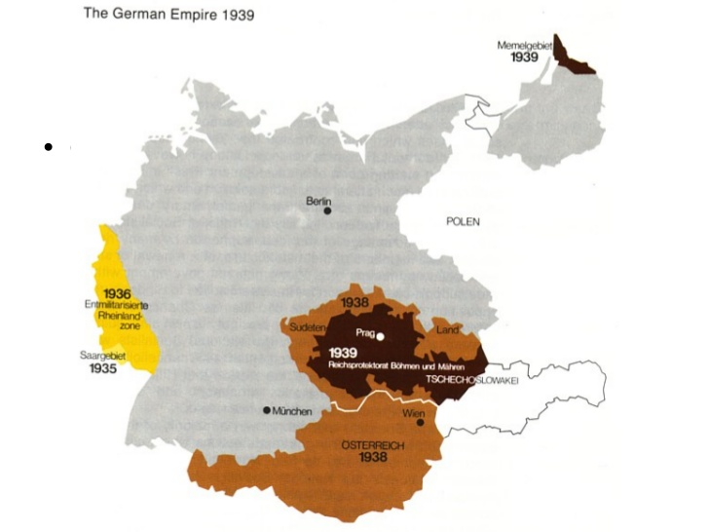
Notes:
How did WWII Start?-Germany invaded Poland to get lebensraum
https://image.slidesharecdn.com/sghssocialstudiesworldhonorsunit5worldwariihonors-090331133400-phpapp02/95/world-war-ii-power-point-13-728.jpg?cb=1327454168

Slide 20
Why did Germany Invade?
-Militarism
-Rhineland
-Lebensraum - “living space” , given by Britain and France
-Austria
-Sudetenland
-Czechoslovakia
-On to Poland….
Notes:
Militarism - soon after becoming chancellor he begins rearming Germany breaking the Treaty of Versailles
-Rhineland- moves troops into the Rhineland territory again breaking the Treaty of Versailles

Slide 21
How Does WWII Start?
-Germany invaded Poland.
-Allies declare war on Germany.
-Germany then invades France, Belgium, etc.
-Then Hitler invades Russia.
-Germans use “blitzkrieg” to overwhelm other armies.
-Blitzkrieg means “lightening war” in German.
-Surround with tanks and troops in trucks.

Slide 22
For next class...
What would it take for you to jump into a fight?
What if kanye west was the bully?
Would you save kanye west?

Slide 23
Last Class...
What would it take for you to jump into a fight?
What if kanye west was the bully?
Would you save kanye west?
Is it okay to jump into somebody else’s fight if you have nothing to do with it?
What if it was to take down a bully?
What if it was the WORST bully your school has ever seen?
Does jumping into a fight prove your strength or does it make you weak?

Slide 24
Canada’s Entrance into WW2

Slide 25
Canada Joins the War
-King and isolationism
-King in favour of the Britain war and made voters
-WWII was a choice feel that going to war was necessary
-Conscription was not enforced this time
-Parliament voted in favor of war

Slide 26
Canada’s Army
Canadian army 4300 troops
-Few light tanks and no modern artillery
-Small air force and navy
-Sep. 1939: 58,000 people volunteered for service
-Aboriginal people volunteered at a higher percentage than any other group in Canada
-Many people felt strong ties to Britain and volunteered from a sense of duty
-First Canadian troops sailed from Halifax on Dec. 3rd 1939

Slide 27
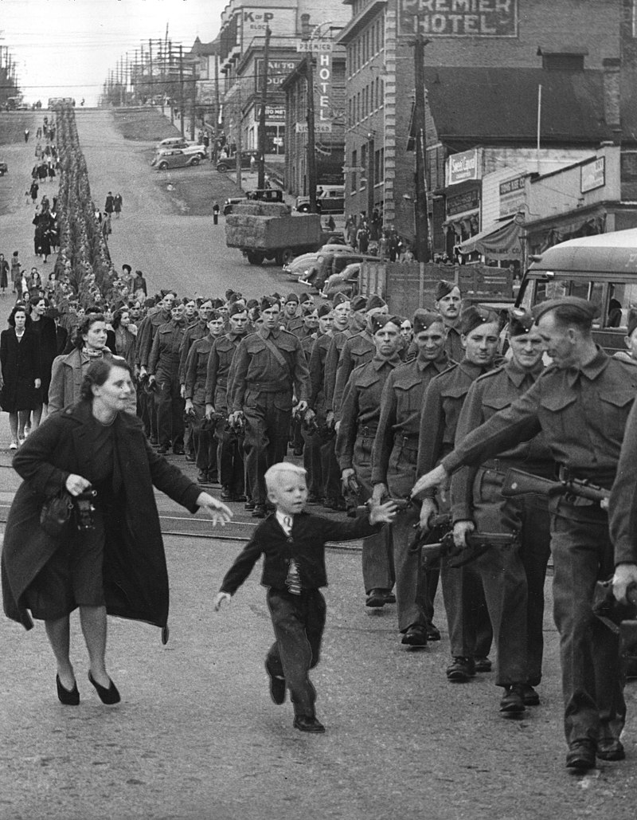
Notes:
"Wait for me daddy":British Columbia Regiment, DCO, marching in New Westminster, 1940 (LP 109)
https://en.wikipedia.org/wiki/Canada_in_the_World_Wars_and_Interwar_Years#/media/File:British_Columbia_Regiment_1940.jpg

Slide 28
Canada To the War Effort
Dec. 1939, Canada hosted BCATP (British Common Wealth Air Training Plan)
-Pilots and other flight personnel from all over the common wealth came to Canada to train with British instructors.
-Program was a major contribution to the war effort
-More than 130,000 pilots, navigators, flight engineers and ground crew were trained.
-Total cost was more than $2 billion, more than 70% of which Canada paid.
Notes:
Canada was chosen as the primary location for "The Plan" because of its ideal weather, wide open spaces suitable for flight and navigation training
BCATP remains as one of the single largest aviation training programs in history

Slide 29
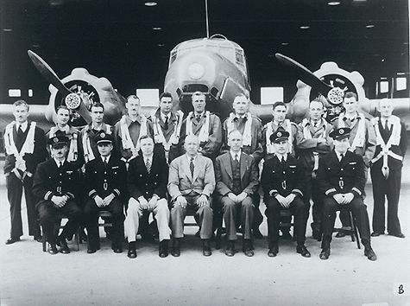
Notes:
Original pilots and office staff, of the British Commonwealth Air Training Plan, 1941
https://www.thecanadianencyclopedia.ca/en/article/british-commonwealth-air-training-plan

Slide 30
Canada’s Commitment to Total War
April 1940, Department of Munitions & Supply was created
Industrialist C.D. Howe was put in charge
-Vancouver was building ships for the navy
-Montreal was making new planes and bombers

Slide 31
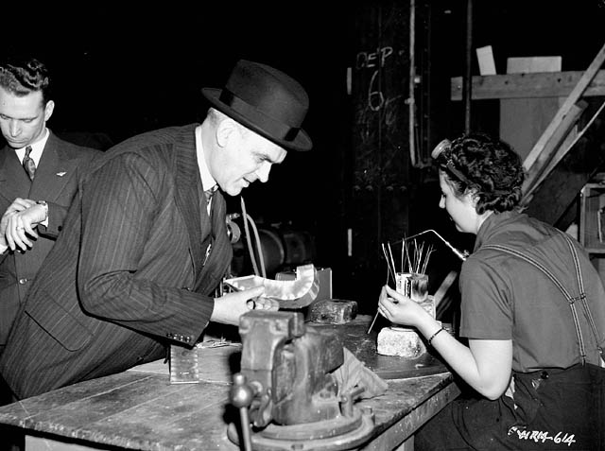
Notes:
https://en.wikipedia.org/wiki/C._D._Howe#/media/File:C.D._Howe_in_aircraft_factory.jpg
C.D. Howe speaks to a woman worker at an aircraft factory, March 1941

Slide 32
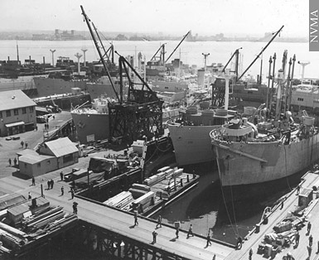
Notes:
North Vancouver's high productivity came as a surprise. Company owners and their swelling ranks of employees rallied strongly to the cause, structuring their lives around "shipyard time" to maximize output and participating enthusiastically in the community war effort.
http://collections.musee-mccord.qc.ca/scripts/printtour.php?tourID=VQ_P4_1_EN&Lang=2

Slide 33
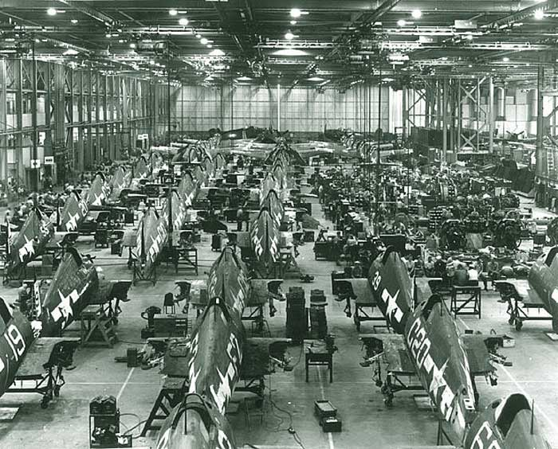
Notes:
Boeing Aircraft of Canada in Vancouver, and Canadian Vickers (later Canadair) in Montreal
http://www.vintagewings.ca/VintageNews/Stories/tabid/116/articleType/ArticleView/articleId/367/Manufactured-Victory.aspx

Slide 34
Commitment to Total War
-Canada’s car industries were producing military vehicles and tanks
-Ontario & Quebec opened munitions factories
-Farmers were told to produce more wheat, beef, dairy products and other foods
-Howe was called the “Minister of Everything”

Slide 35
Canada’s Economy
Supplied Britain with weapons and resources to resist Germany
Provided military and economic support to Allies
Value of goods Canada produced rose from $5.6 billion in 1939 to $11.8 billion in 1945
Canada gave the Allies billions of dollars in financial aid
The economy boomed in almost every respect
Wave of exploration led to discoveries of new oil fields in Alberta
Many jobs were created
Notes:
https://image.slidesharecdn.com/lesson2canadaandwwii-121115174453-phpapp01/95/lesson-2-canada-and-wwii-9-638.jpg?cb=1353001550

Slide 36
Women at War
Jobs that were traditionally held by men, and to serve in the military.
Canadian women enthusiastically embraced their new roles and responsibilities
-600,000 doubled to 1,200,000..
Took roles of men that went to war
More than More than 50,000 Canadian women served in the armed forces during the Second World War.
Notes:
only about 600,000 Canadian women held permanent jobs when the war started. During the war, their numbers doubled to 1,200,000.
With their sons overseas, many farm women had to take on extra work. One Alberta mother of nine sons - all of them either in the army or away working in factories - drove the tractor, plowed the fields, put up hay, and hauled grain to elevators, along with tending her garden, raising chickens, pigs and turkeys, and canning hundreds of jars of fruits and vegetables.

Slide 37
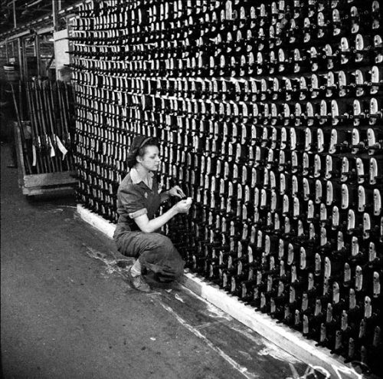
Notes:
Violet Carlson, Small Arms Manufacturing
October 13, 1943
Photographer: John H. Boyd
City of Toronto Archives
https://www.toronto.ca/city-government/accountability-operations-customer-service/access-city-information-or-records/city-of-toronto-archives/whats-online/web-exhibits/toronto-remembers-the-home-front-1939-1945/

Slide 38
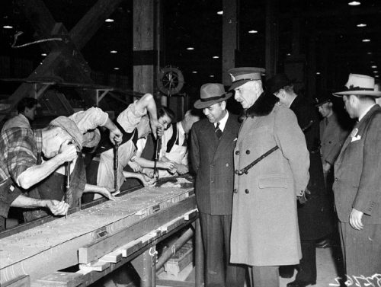
Notes:
Canada’s Governor General, the Earl of Athlone, visits Massey-Harris in Weston
December 10, 1942
Photographer: John H. Boyd
City of Toronto Archives

Slide 39
Canada in WW2
-By the end of WWII Canada had become a major player in global conflict
-Canada had one of the world’s largest navies and fourth-largest Allied air force
-Participation of minority groups, such as Asians, Aboriginals and African Canadians helped further civil rights for all Canadians
-WWII became a defining event that shaped Canada’s identity

Slide 40
End of World War II, Atrocities and the Nuremberg trials

Slide 41
How did WW2 End?
-Japan
-Germany
-Italy

Slide 42
Fall of the Axis Powers: Japan
-Japan Attacks Pearl Harbour December 7, 1941
-US enters the war
-Manhattan Project 1942
-Japan retreats after battles
-US successfully detonates bomb on 16 July 1945
-Would you use the bomb?

Slide 43
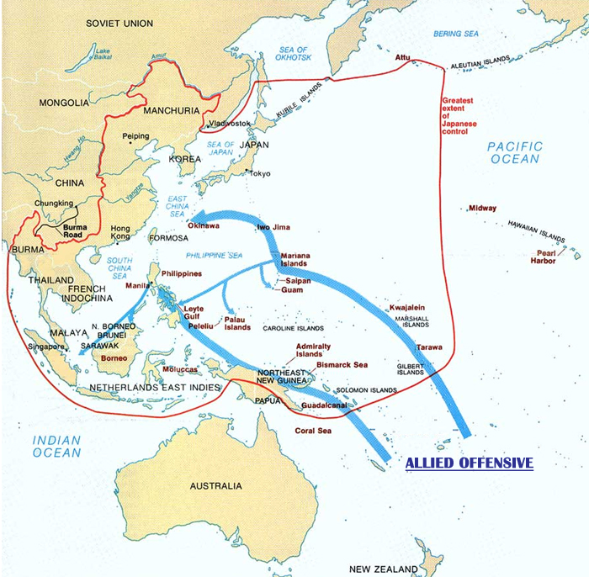
Notes:
http://world-war-2.wikia.com/wiki/Island_Hopping

Slide 44
Germany
-After Defeat from Stalingrad 1942
-Soviet Counter-Offensive
-Allies Operation Overlord June 6, 1944
-Hitler commits suicide on 30 April 1945
-Germany surrenders on May 7, 1945
Notes:
D-Day Allies Operation Overlord June 6, 1944
On May 7, 1945, Germany signed an unconditional surrender at Allied headquarters in Reims, France, to take effect the following day, ending the European conflict of World War II.

Slide 45
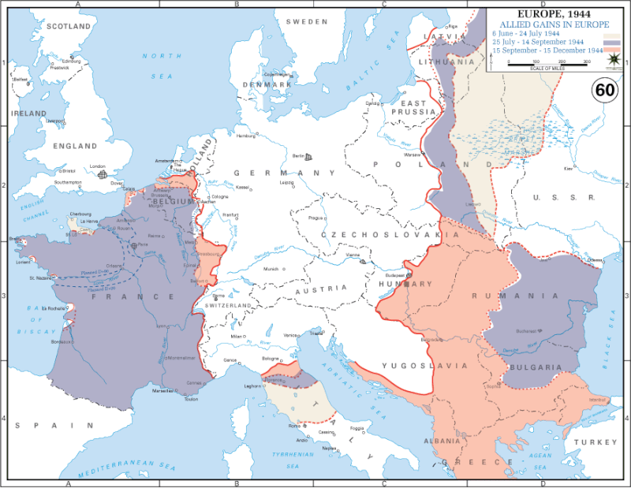
Notes:
https://www.vox.com/2014/11/13/7148855/40-maps-that-explain-world-war-ii

Slide 46
Italy
April 1945 Allies Breaking though Italy
Partisans resistance taking hold of cities
Mussolini Fled on 25
Captured on 27 by resistance
Shot Following afternoon on 28
2 Days Before 30th when hitler commits suicide

Slide 47
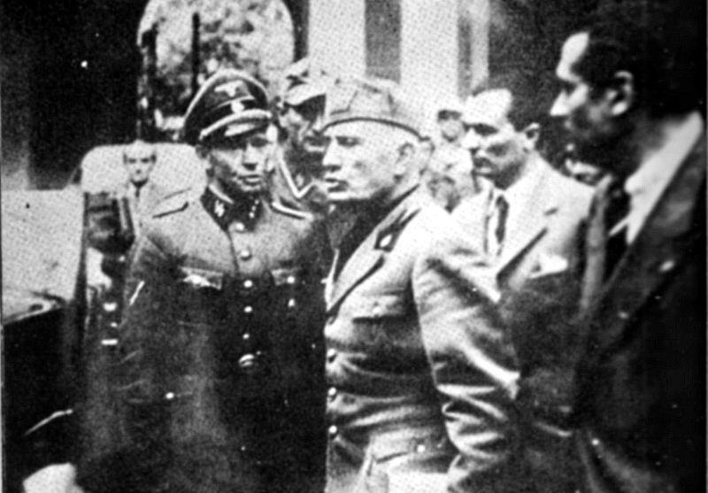
Notes:
Mussolini abandoning the Prefecture in Milan on 25 April 1945. Believed to be the last photo of him alive.
https://en.wikipedia.org/wiki/Death_of_Benito_Mussolini#/media/File:Benito_Mussolini_a_Milano_il_25_aprile_1945.jpg

Slide 48
End of the War
US drops the bomb August 6, 1945 on Hiroshima
Drops second on August 9 on Nagasaki
Japan surrenders on August 15, 1945
Officially signs on September 2, 1945
Notes:
The surrender of Imperial Japan was announced on August 15 and formally signed on September 2, 1945, bringing the hostilities of World War II to a close. By the end of July 1945, the Imperial Japanese Navy (IJN) was incapable of conducting major operations and an Allied invasion of Japan was imminent.

Slide 49
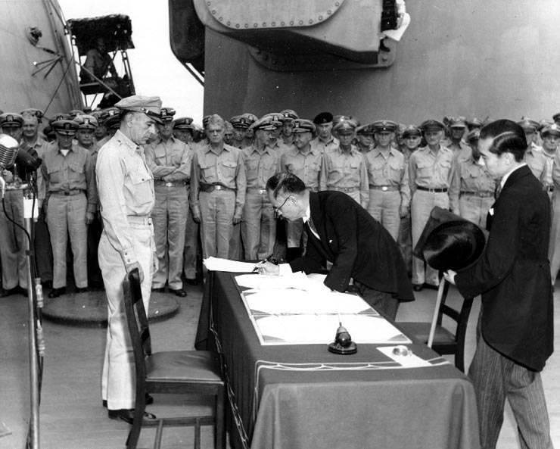
Notes:
Japanese foreign affairs minister Mamoru Shigemitsu signs the Japanese Instrument of Surrender on board USS Missouri as General Richard K. Sutherland watches, September 2, 1945
https://en.wikipedia.org/wiki/Surrender_of_Japan

Slide 50
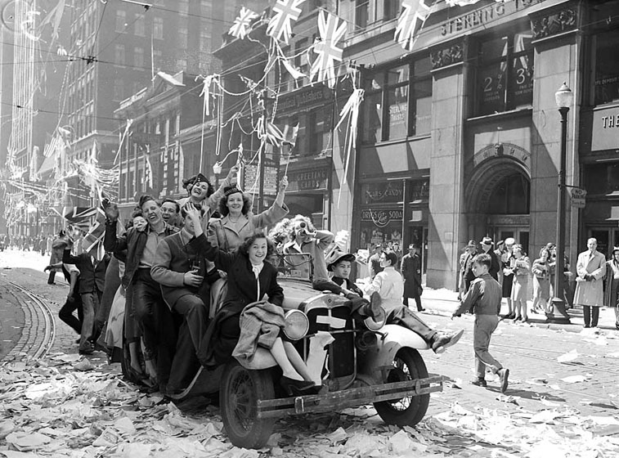
Notes:
City of Toronto
Cheering people sit in and on a car, waving flags
https://www.toronto.ca/city-government/accountability-operations-customer-service/access-city-information-or-records/city-of-toronto-archives/whats-online/web-exhibits/v-e-day-and-v-j-day-the-end-of-world-war-ii-in-toronto-1945/

Slide 51
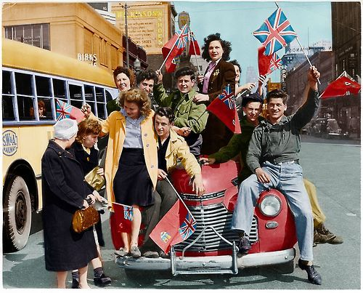
Notes:
https://www.pinterest.ca/pin/369224869427103414/?lp=true
Colorized Photo of Canadians celebrating the end of WWII in Windsor, Ontario

Slide 52
How did Axis Powers Lose?
No Combined Effort to organized war effort
Did not plan for war of attrition
Poor leadership?
Politics before military tactics
Underestimated Allies

Slide 53
Nuremberg Trials
20 November 1945
Military tribunals
Allied Forces Under international law
Prosecution of Nazis
"the greatest trial in history"
The Holocaust
Notes:
series of military tribunals held by the Allied forces under international law and the laws of war after World War II.
prosecution of prominent members of the political, military, judicial and economic leadership of Nazi Germany,

Slide 54
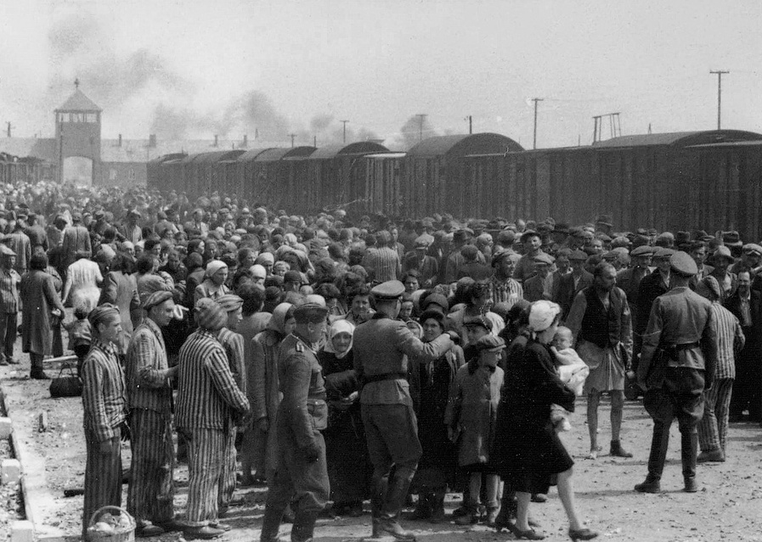
Notes:
https://en.wikipedia.org/wiki/The_Holocaust#/media/File:Selection_Birkenau_ramp.jpg
"Selection" of Hungarian Jews on the ramp at the death camp Auschwitz-II (Birkenau) in Poland during German occupation, May/June 1944.

Slide 55
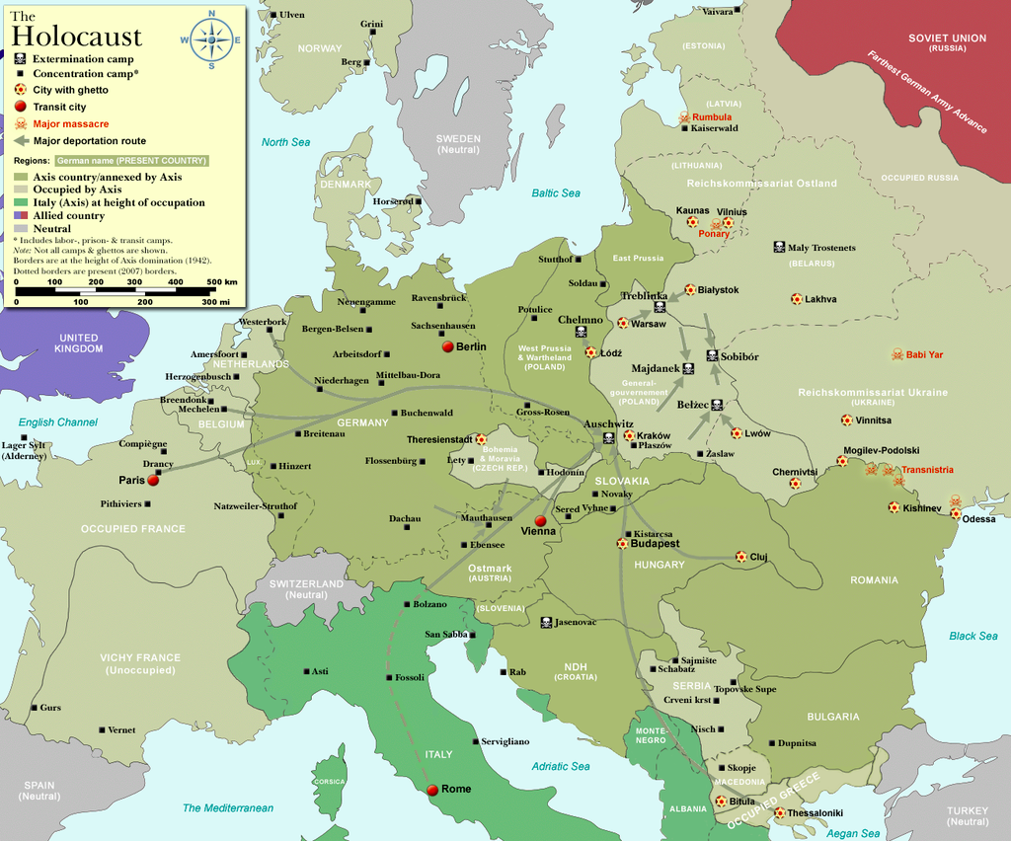
Notes:
https://en.wikipedia.org/wiki/The_Holocaust#/media/File:WW2-Holocaust-Europe.png

Slide 56
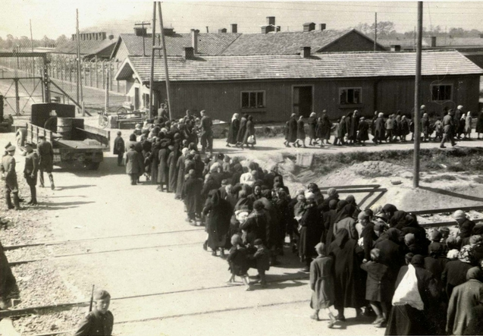
Notes:
March of new arrivals along the SS barracks at Birkenau toward the gassing bunker near crematoria II and III, 27 May 1944. (a photograph from a collection known as the Auschwitz Album)

Slide 57
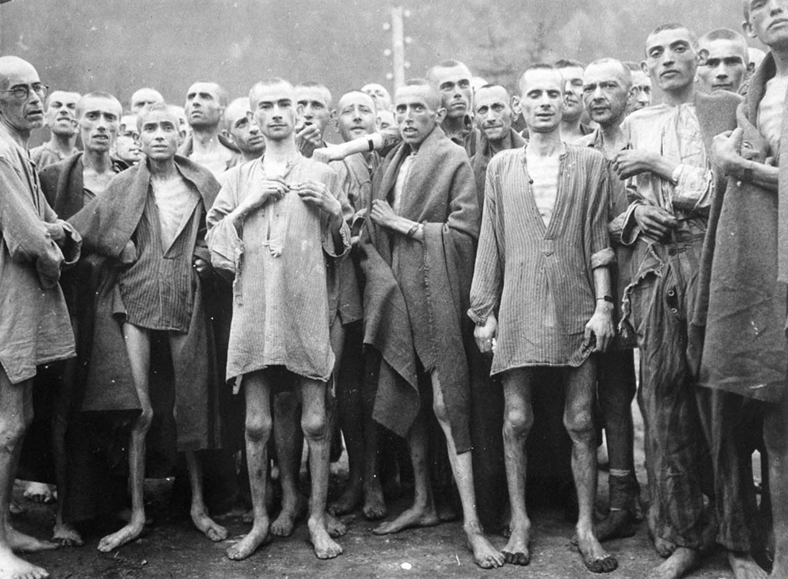
Notes:
Starved prisoners, nearly dead from hunger, pose in a concentration camp in Ebensee, Austria, on May 7, 1945. The camp was reputedly used for “scientific”
https://rarehistoricalphotos.com/holocaust-pictures/

Slide 58
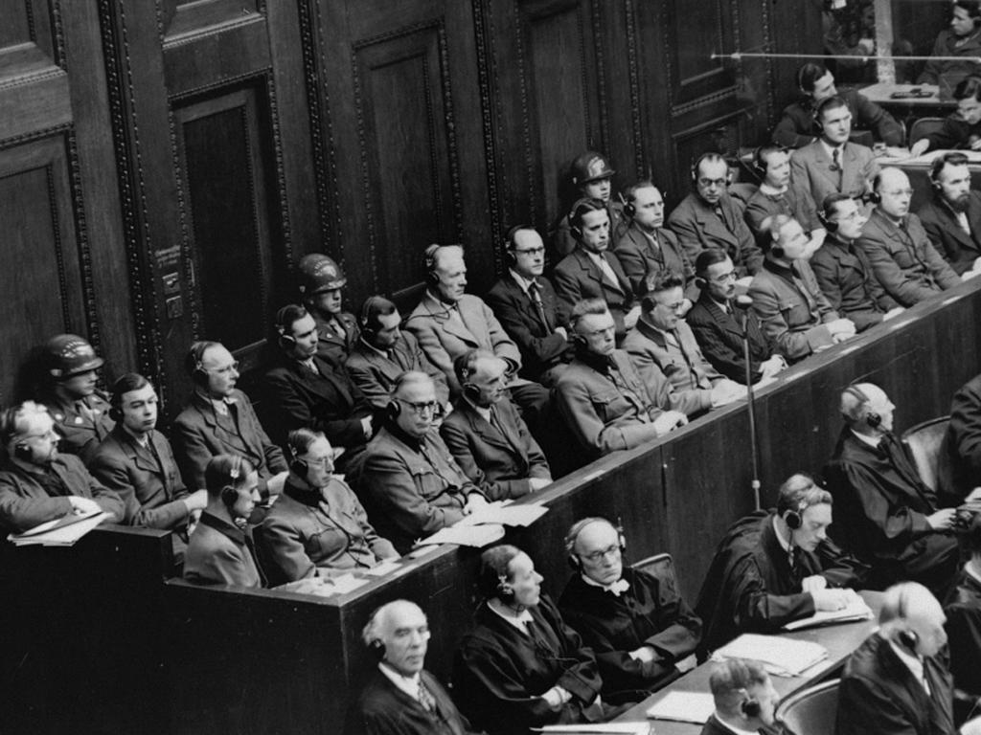
Notes:
https://en.wikipedia.org/wiki/The_Holocaust#/media/File:Doctors%27_trial,_Nuremberg,_1946%E2%80%931947.jpg

Slide 59

Notes:
https://en.wikipedia.org/wiki/Flag_of_Canada

Slide 60
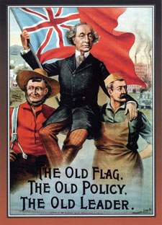
Notes:
http://www.spiritofcanadagallery.com/gallery.htm
Sir John A. Macdonald's 1891 campaign poster.

Slide 61
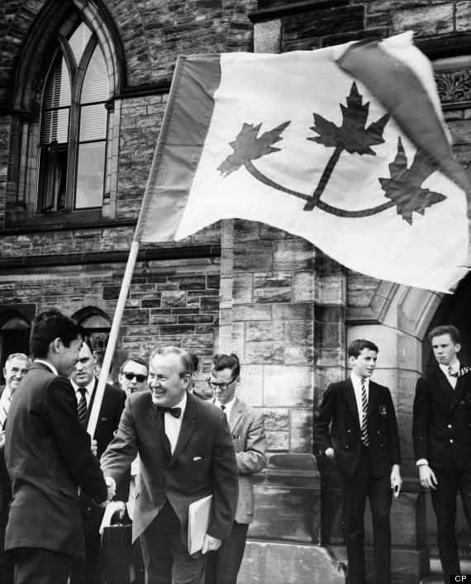
Notes:
https://www.huffingtonpost.ca/2013/10/16/canadian-flag-designs-photos_n_4109726.html
Pearson shakes hands with student Jim Soni in May of 1964 outside the Parliament buildings. The University of Toronto student presented the prime minister with a petition supporting his proposal for a maple leaf flag.

Slide 62
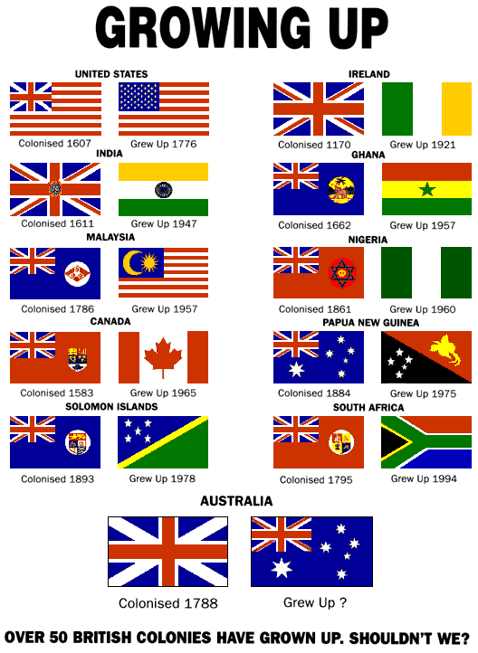
Notes:
https://countrydigest.org/australian-flag/

Slide 63


Slide 64

Notes:
https://en.wikipedia.org/wiki/New_Zealand_flag_debate#/media/File:NZ_flag_design_Silver_Fern_(Black,_White_%26_Blue)_by_Kyle_Lockwood.svg

Slide 65

Notes:
https://en.wikipedia.org/wiki/Flag_of_Manitoba#/media/File:Flag_of_Manitoba.svg

Slide 66

Notes:
https://en.wikipedia.org/wiki/Flag_of_Ontario#/media/File:Flag_of_Ontario.svg

