Slide 1

Political Geography
How space is organized politically; how boundaries between states are formed; how states develop and devolve;

Slide 2
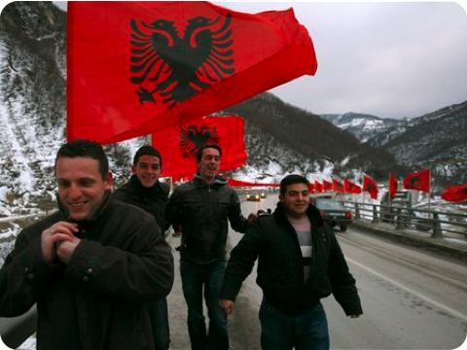
February 17, 2007: Kosovo
The latest state of the old Yugoslavia to become politically independent;
Political activity = basic to human culture (language/religion);
expressed by: individuals, groups, communities, nations, governments, supranational organizations

Slide 3
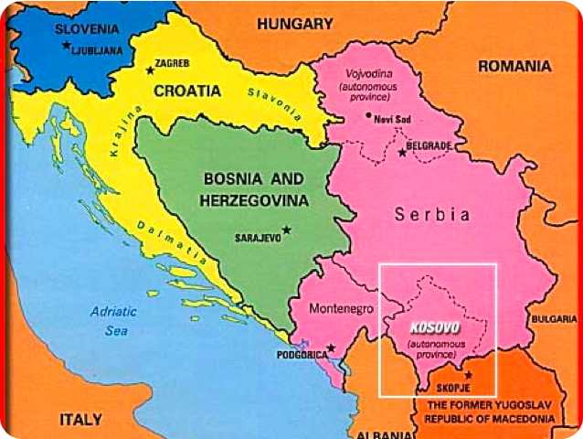
Kosovo:
- according to Serbians, a part of Serbia;
- population: majority Albanian; minority Serbian; the Devolution of Yugoslavia

Slide 4
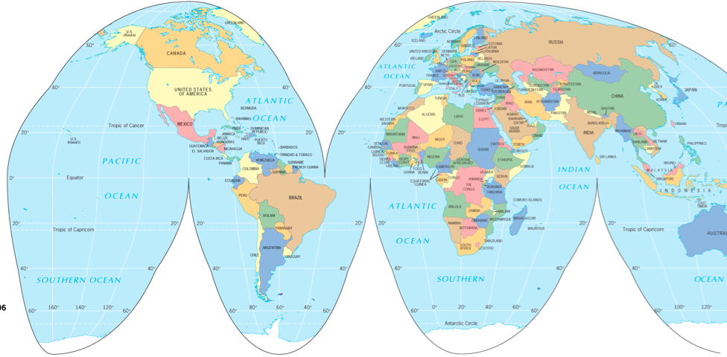
Political Geography:
- the study of the political organization of the world;
- the spatial manifestations of the political process at various scales;
State:
- politically organized territory with:
- a permanent population;
- a defined territory;
- a government;
- an entity recognized as such by other states;

Slide 5
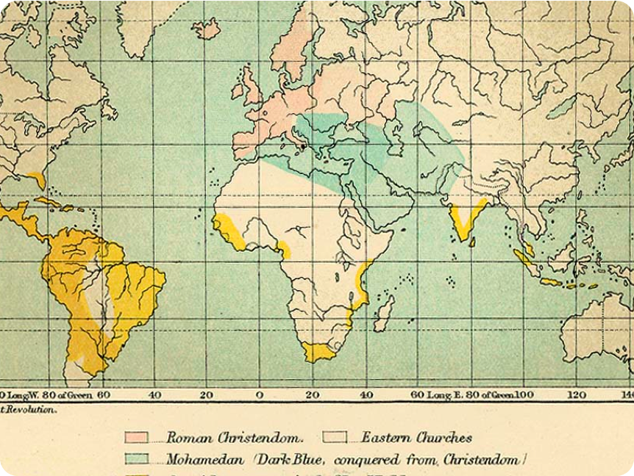

Slide 6
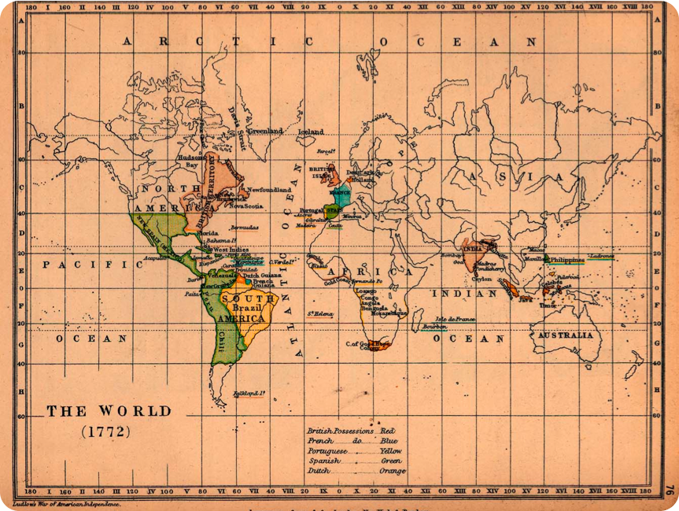

Slide 7
The world of states is new, less than 400 years old
states represent a way of politically organizing space
states and state boundaries are made, shaped, and refined by people, their actions, their history;
the idea of dividing the world into states is created and exported by people;
central concept: territoriality
  Robert Sack: “the attempt by an individual or a group to affect, influence, or control people, phenomena, and relationships, by delimiting and asserting control over a geographic area.” Central question: how and why different territorial strategies have been used by humans at different times at different places.
  Sovereignty: a state has absolute control - politically and militarily (and economically) - over a territory; international recognition of statehood = international recognition of sovereignty within specified geographic borders
  territorial integrity: states’ rights to defend their territory militarily against incursion from other states (or from within)
  origins: ideas of sovereignty, statehood, and territorial integrity diffuse from 17th century Europe

Slide 8
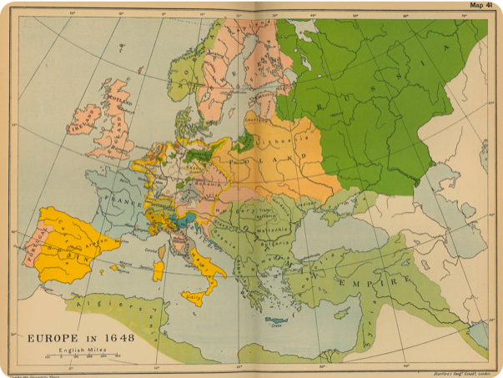
The Modern State Idea:
1648: the Peace of Westphalia: European political framework that recognizes statehood and nationhood, clearly defines borders, and guarantees security; regional stability for Spain, France, Dutch United Provinces, and Holy Roman Empire
Mercantilism: accumulation of wealth through plunder, colonization, protections of industry through tariffs
Significance: territory defines society, rather than society defining territory; territory becomes fixed, elusive element of political identification and of group survival;
states define exclusive, non-overlapping territories with sovereignty over territory and population

Slide 9
Nations:
Nation: a group of people with a shared past, a common future, relates to a specific territory and has political goals (autonomy/statehood)
  different kinds of nations: shared religion, language, ethnicity, history; collective amnesia: “we” have been through much “together” ; collective hypnosis: “we” will confront the future “together”
  imagined community: one will never meet all individual members of a nation and community; one perceives oneself to be part of an indivisible and real community/collective
Nation State: a politically organized area in which nation and state occupy the same space; the ultimate form of political-territorial organization (assumption: the presence of reasonably well-defined, stable nations within discreet territories)
Nationalism:
  people within a nation have loyalty and belief in its existence; does not coincide with the borders of a state;
  government of a state is nationalistic; seeks to promote a nation that coincides with the borders of the state;
    create a single nationality among divergent peoples within a state/ promote war against another state in the name of territorial integrity

Slide 10
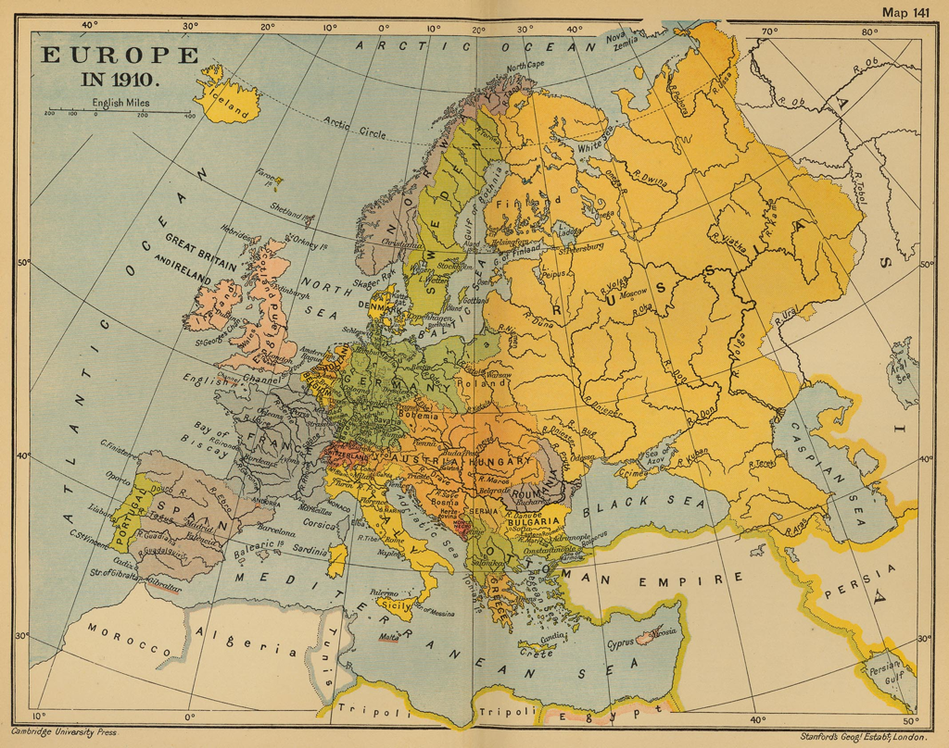
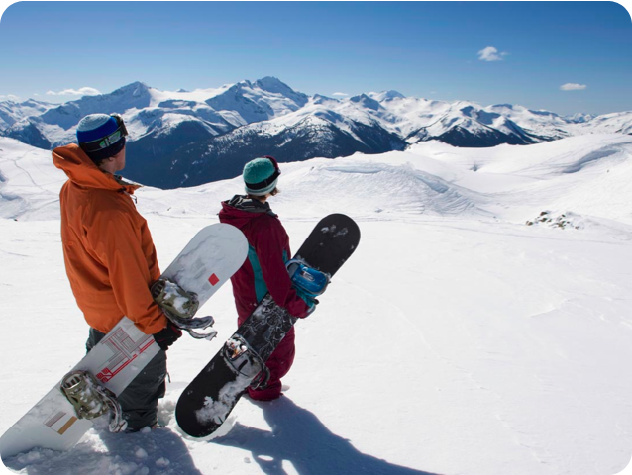

Slide 11
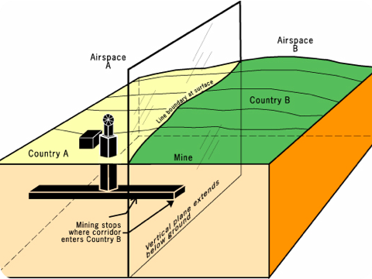
How are political boundaries established?
A boundary between states is a vertical plane that cuts through the rocks below (subsoil) and through the air above; divides one state territory from another; on surface: displayed as line on maps

Slide 12
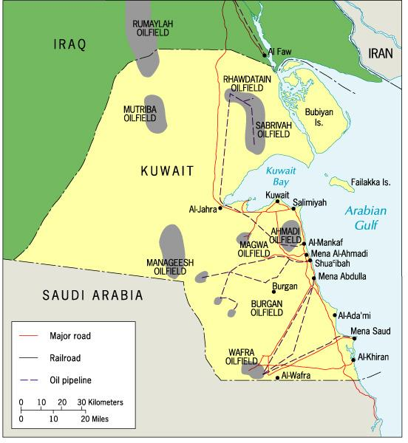
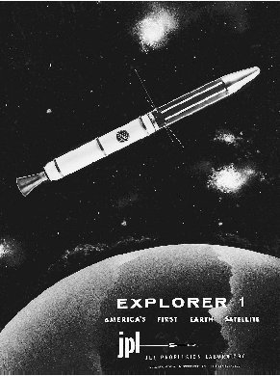
Problems of boundaries:
- predate knowledge of presence/extent of subsoil resources;
- predate technologies that extend reach of state into space, near-Earth space

Slide 13
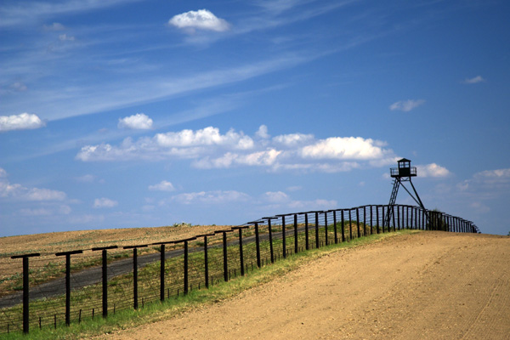
Steps to define a boundary:
  states define boundary through legal document: describes actual points in landscape, points of latitude/longitude;
  cartographers delimit boundary through map;
  states demarcate boundary through steel posts, concrete pillars, fences, walls;
  states administer boundary through customs, passports, visa;
The Iron Curtain, Czechoslovakia/Germany

Slide 14
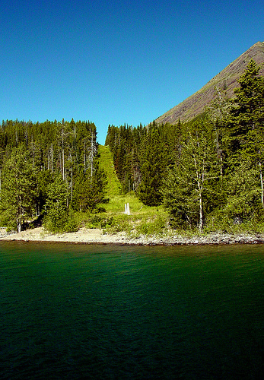
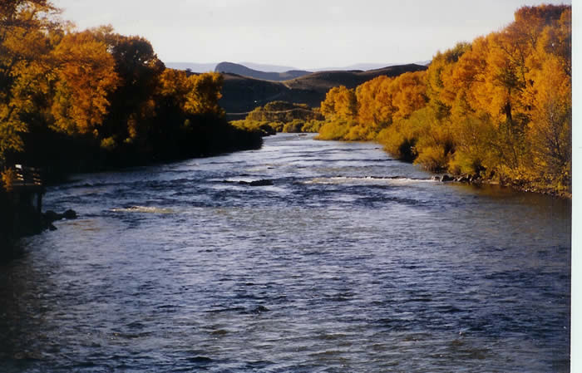
Types of Boundaries:
geometric boundary:
  uses grid system of latitude and longitude
physical-political:
  follows agreed-upon feature in physical landscape: center of river, crest of mountain range
U.S./Canadian border: geometric
U.S./Mexican border: physical-political

Slide 15
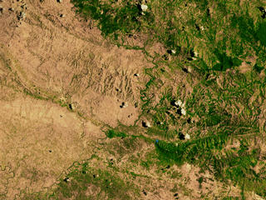
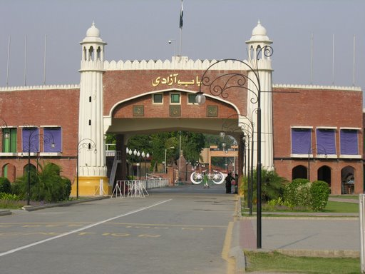
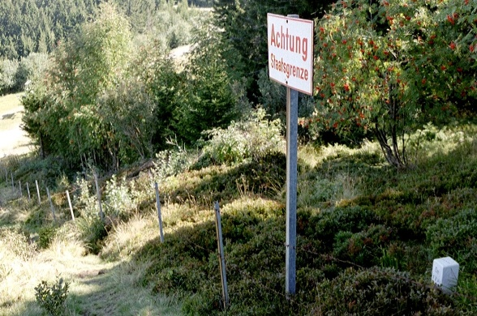
Cultural-Political: political boundary separates different cultures
Religious: political boundary that separates two or more religious communities
Language: political boundary that separates communities of different language speakers

Slide 16
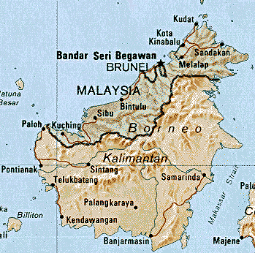
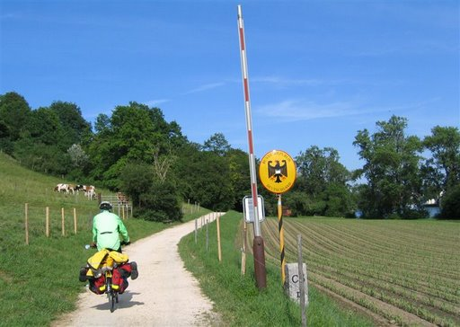
Antecedent: boundary predates present-day cultural landscape and nation states
Subsequent: boundaries result from historical processes and the formation of nation states
Super-Imposed: boundaries forced on population of territory as a result of conflict
Relict: boundary no longer exists,but continues to shape cultural landscape
Fortified: construction of physical barriers along boundary

Slide 17
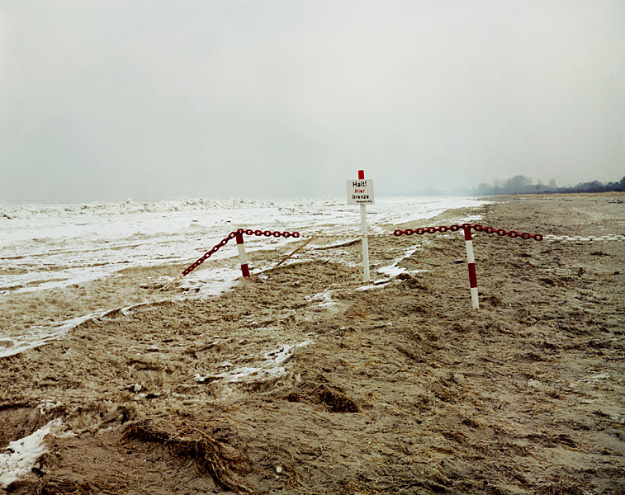
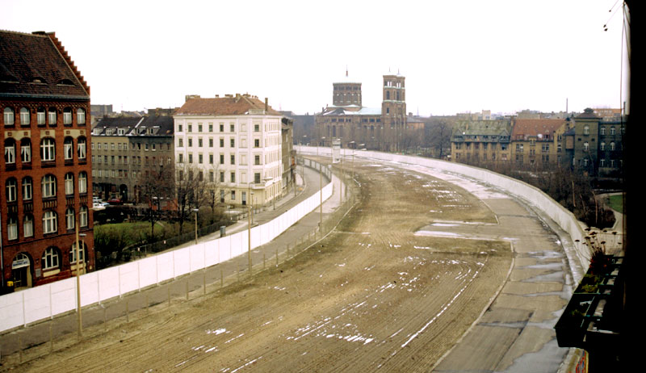
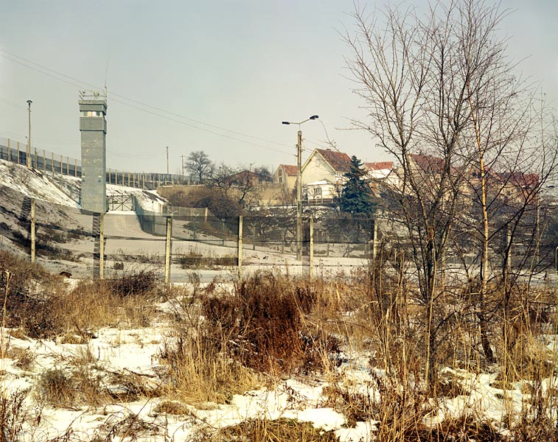
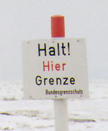

Slide 18
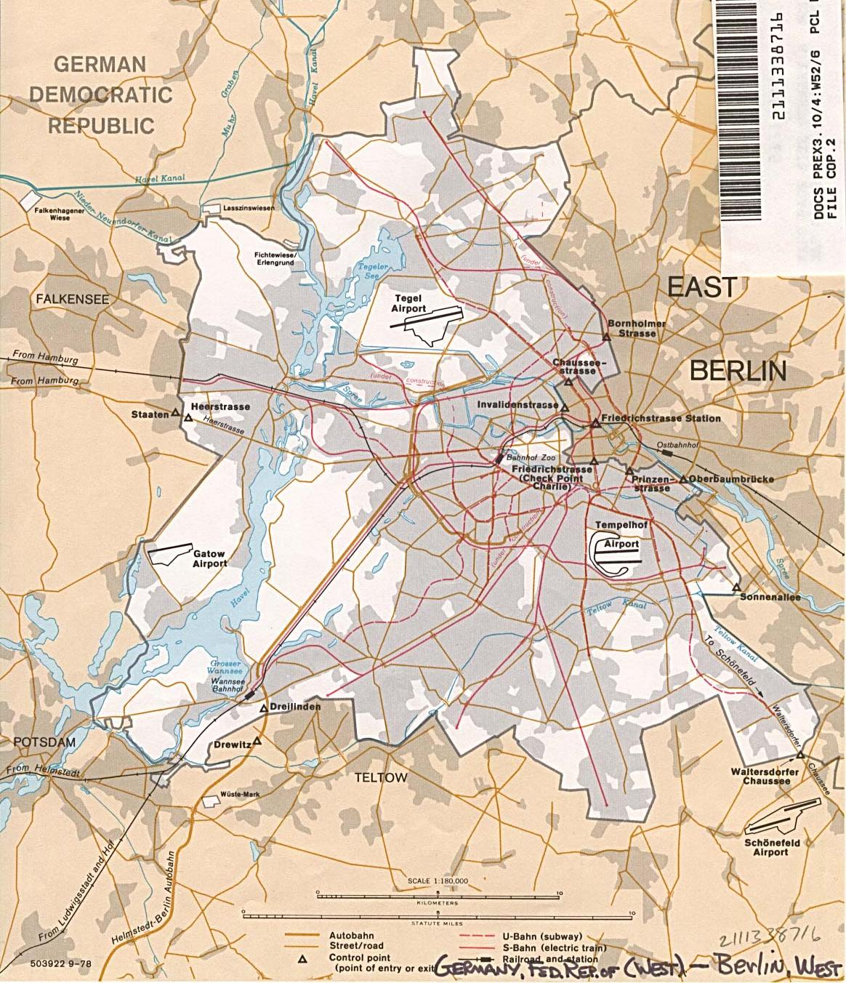
The Berlin Wall, 1961 - 1989
Berlin Wall On-Line
East Germany and West Germany

Slide 19
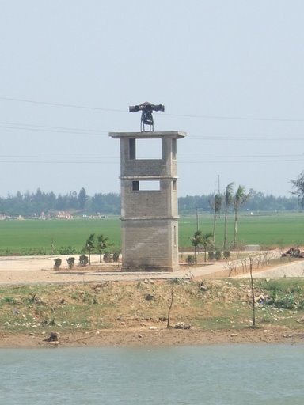
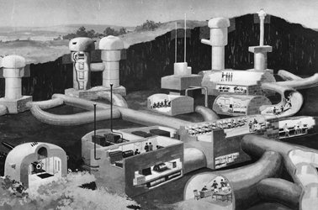
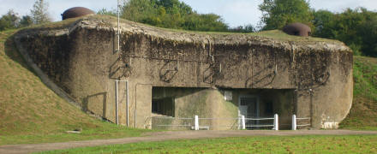

Slide 20
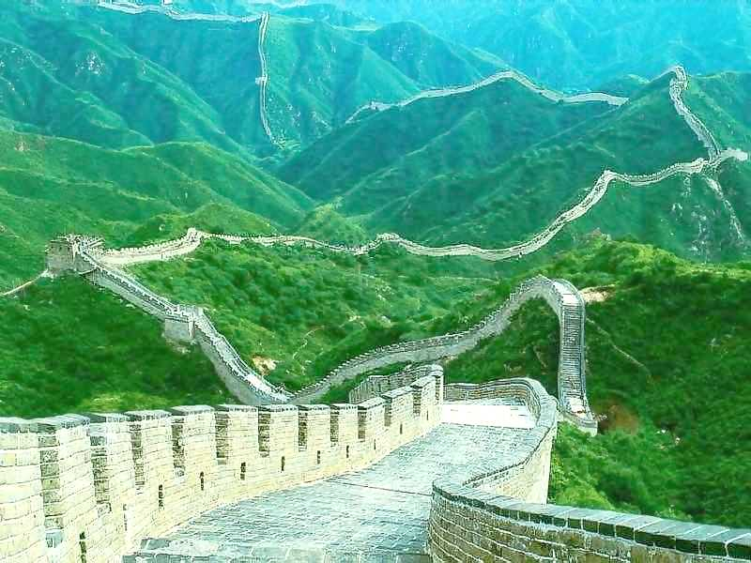

Slide 21
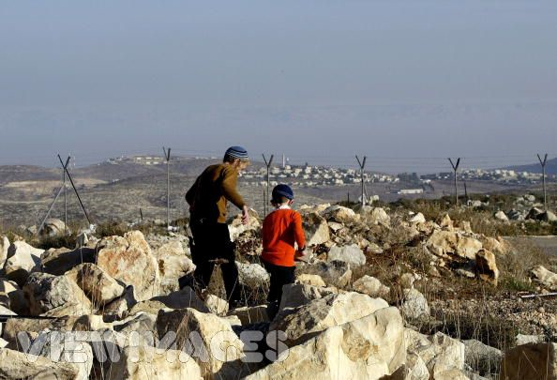
Boundary Disputes:
  legal description is old and imprecise: definitional
  dictated by stronger power
  geography of borderland has changed
  resources lie across boundary

Slide 22
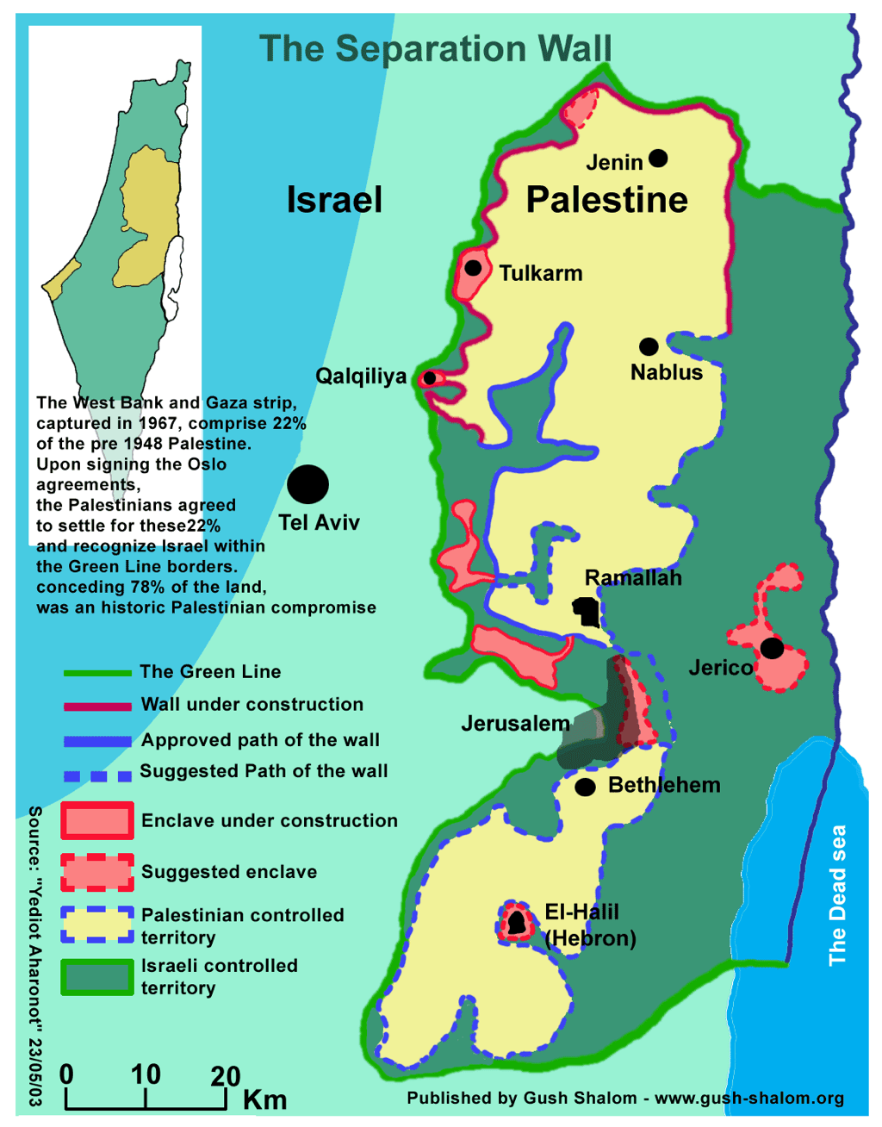
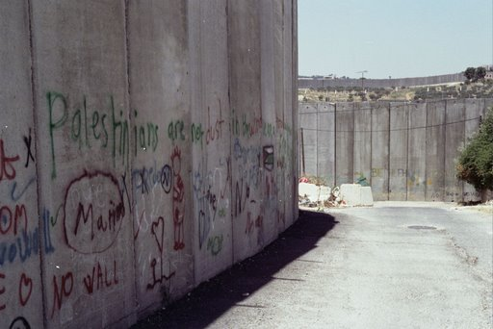
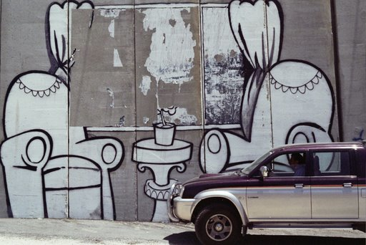
Definitional Disputes: the legality of the boundary is unclear - physical geography or political realities change and necessitate new definitions of boundary.

Slide 23
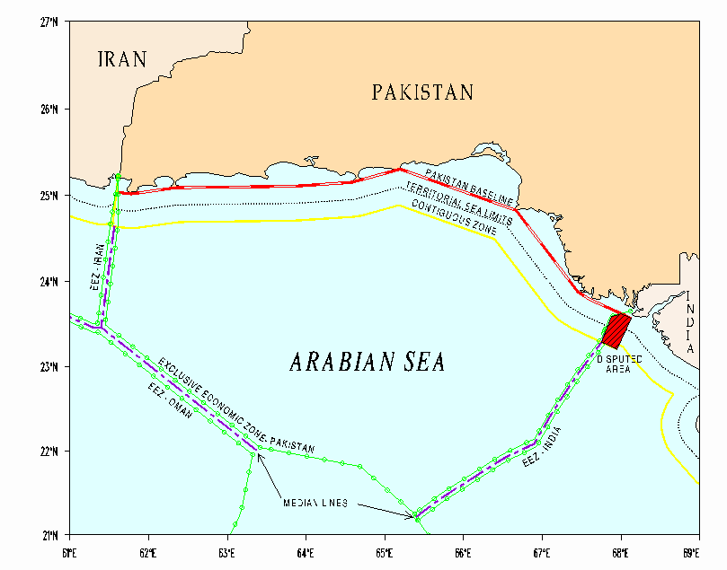
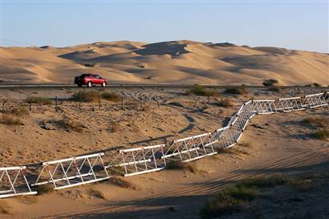
Locational Disputes:
- internal administrative borders within African colonies
- with independence: internal borders become international boundaries:
Operational disputes:
- divergent approaches regarding migration or smuggling;
- areas with nomads: movement of peoples and animals across border

Slide 24
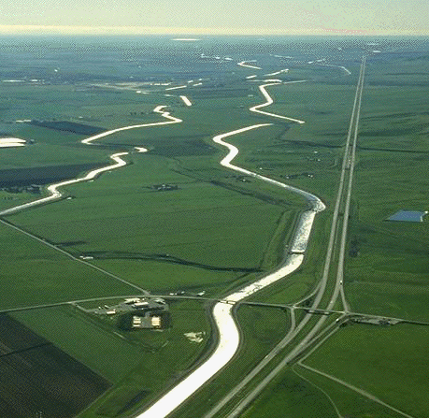
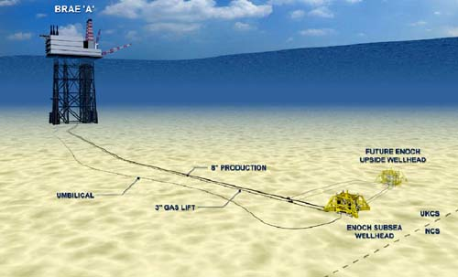
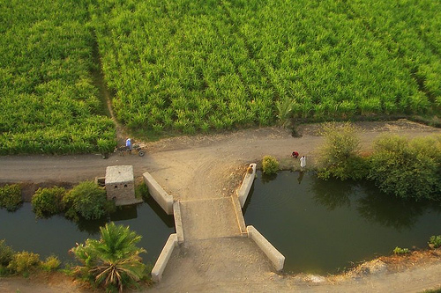
Allocational: cross border subsoil resources are discovered - oil reserves under the sea floor; allocation of water rights to upstream and downstream users.

Slide 25
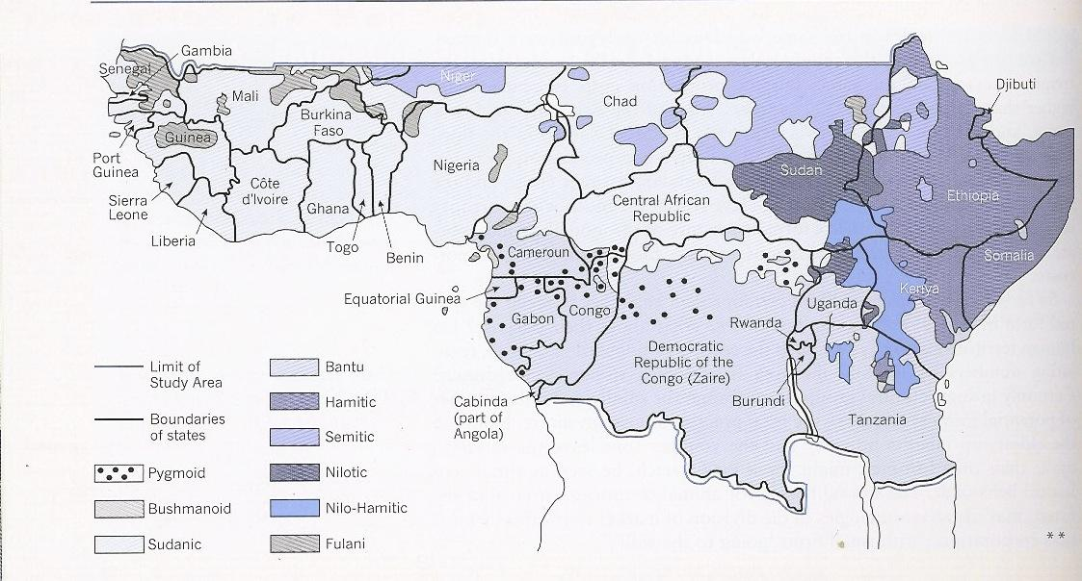

Slide 26
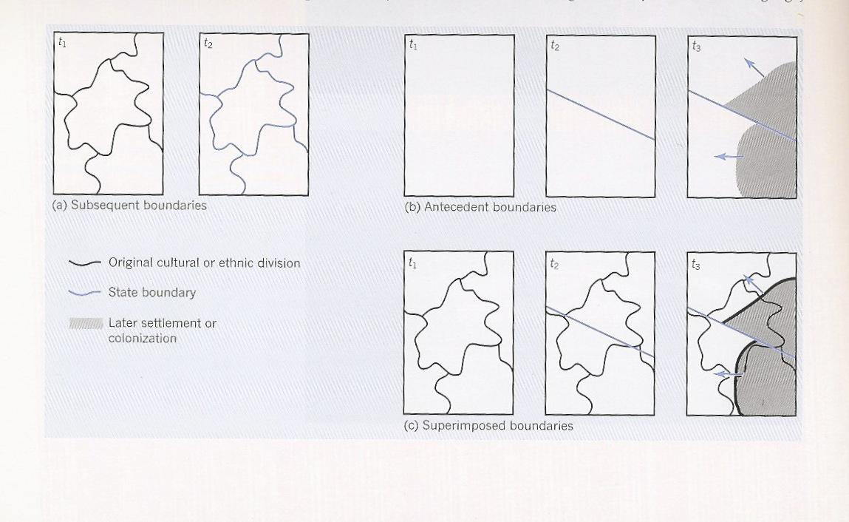

Slide 27
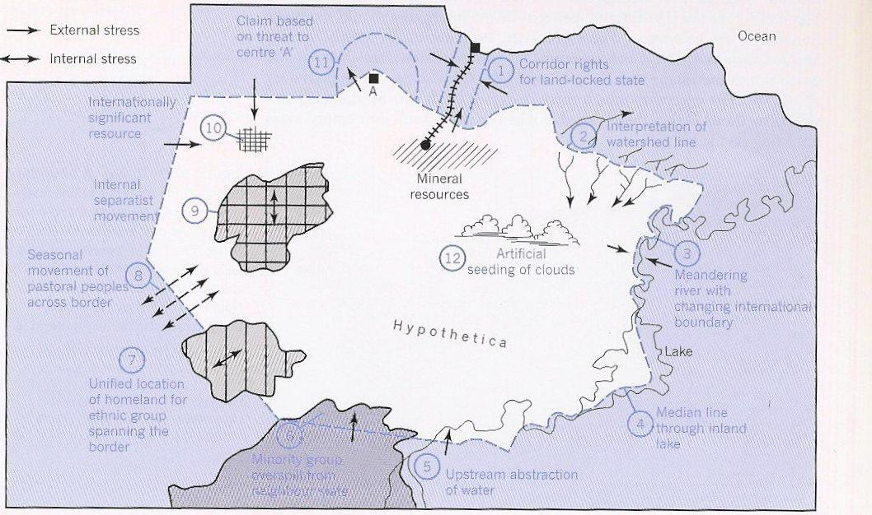

Slide 28
The Forms of States
Elongated: territory is geographically long and narrow
Fragmented: territory is split into many different pieces, separated by intervening obstacles
Landlocked: territory does not have any direct access to an ocean
Perforated: territory of one state surrounds the territory of a second state
Prorupt: a portion of a state’s territory that is extremely elongated
Micro: territory of state is extremely small
Compact: distance from the geographic center of the territory to its boundaries does not vary greatly
Enclave: a portion of a state is completely surrounded by the territory of a second state
Exclave: a portion of a state is separated from the main state by the territory of a second state

Slide 29
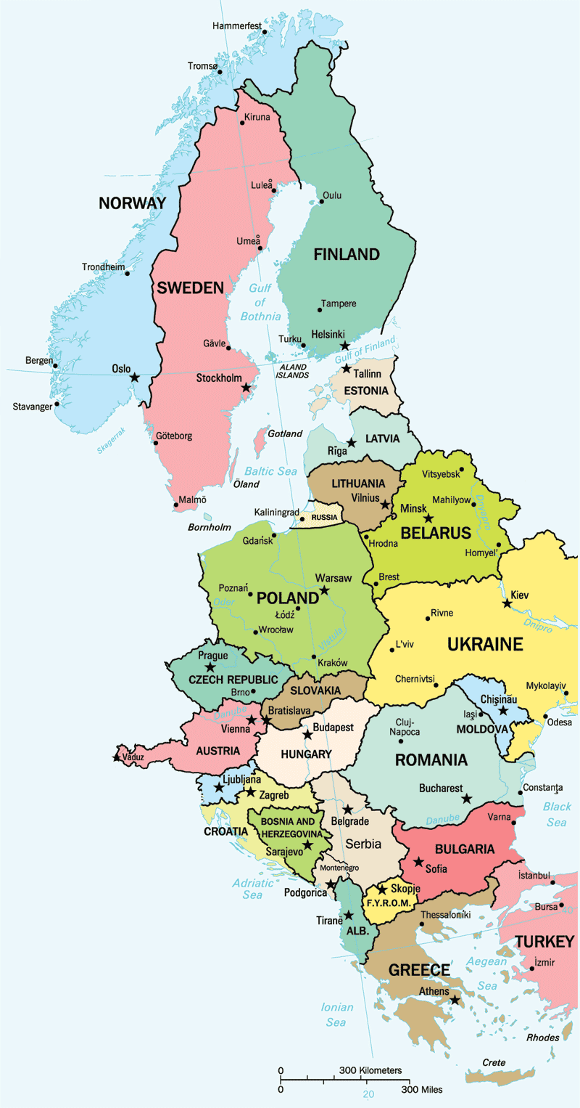
Examples:

Slide 30
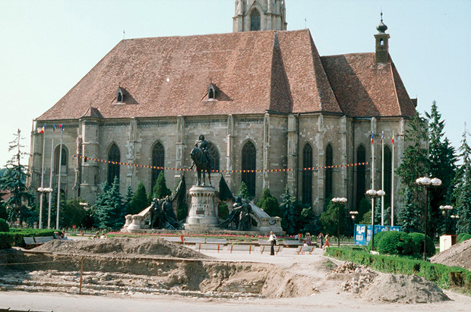
Multi-State Nations, Multinational States, Stateless Nations.....
Multinational States: a state with more than one nation; example: Yugoslavia
Multi-State Nation: a territory fought over by more than one state; example: Transylvania (Romania)
populated by Hungarians and Rumanians; shared historical sites with significant links to national histories: “the control and maintenance of territory is as crucial as the control and maintenance of a national language, religion, or a particular way of life.”
Cluj Napoca
King Matthias v.
Roman Ruins

Slide 31
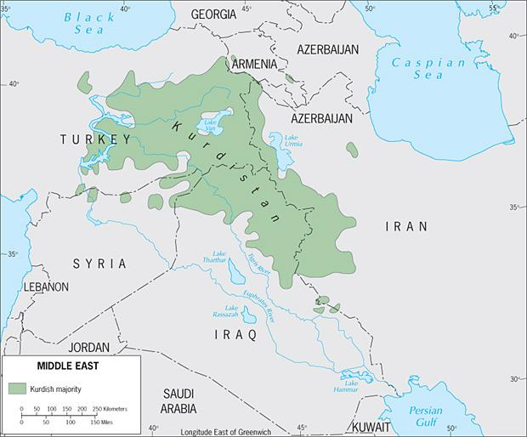
Stateless Nations: a lack of fit between the nation and the state; examples: Palestinians and Kurds
Kurdistan: 20 million Kurds in six states; almost half in Turkey

Slide 32
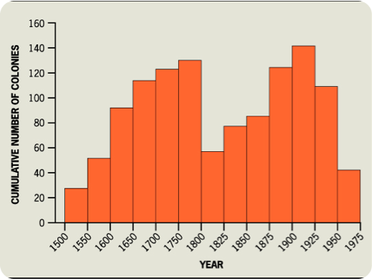
The Diffusion of the Nation-State Model: European Colonialism
- Two waves of colonialism:
        16th century: Spain and Portugal, later joined by France, Netherlands and Britain: establishment of far-reaching capitalist system;
        late 18th century: Britain, France, Germany, Italy, Belgium, United States; motives range from desire for economic profit, bring Christianity, and project European power to European organization of space

Slide 33
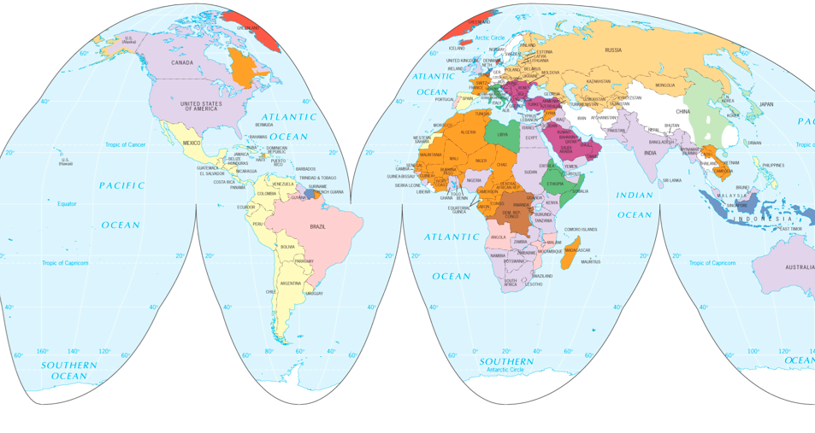
Dominant colonial influences, 1550 - 1950
Colonialism: organization of space for maximum economic exploitation; organization of flow of raw materials towards colonizing power; regimentation of colonized population in the economic service of colonizer

Slide 34
The Capitalist World Economy
Immanuel Wallerstein, World Systems Theory
  The world economy has one market and a global division of labor
    Global capitalism: people, corporations, states produce goods, exchange them in search of profit; profit results from cheapest source of labor in a global labor market
    Commodification: placing a price on a good for the purpose of trading, buying, selling
  Although the world has multiple states, almost everything takes place within the context of the world economy
    Colonialism creates interdependent global economy, where political independence (colonies become states) does not entail economic independence

Slide 35
  The world economy has a three-tier structure
    Core: incorporates high level of education and salaries, more technology; processes generate more wealth in world economy;
    periphery: incorporates low levels of education and salaries; less technology; processes generate less wealth in world economy; exploited by core: cheap labor, lax environmental standards
    semi-periphery: places where both core and periphery processes are taking place; places exploit the periphery - are exploited by the core; buffer between core and periphery

Slide 36
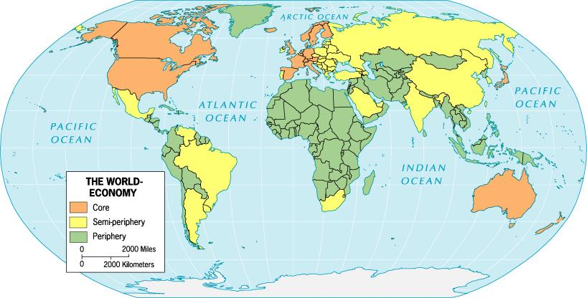

Slide 37
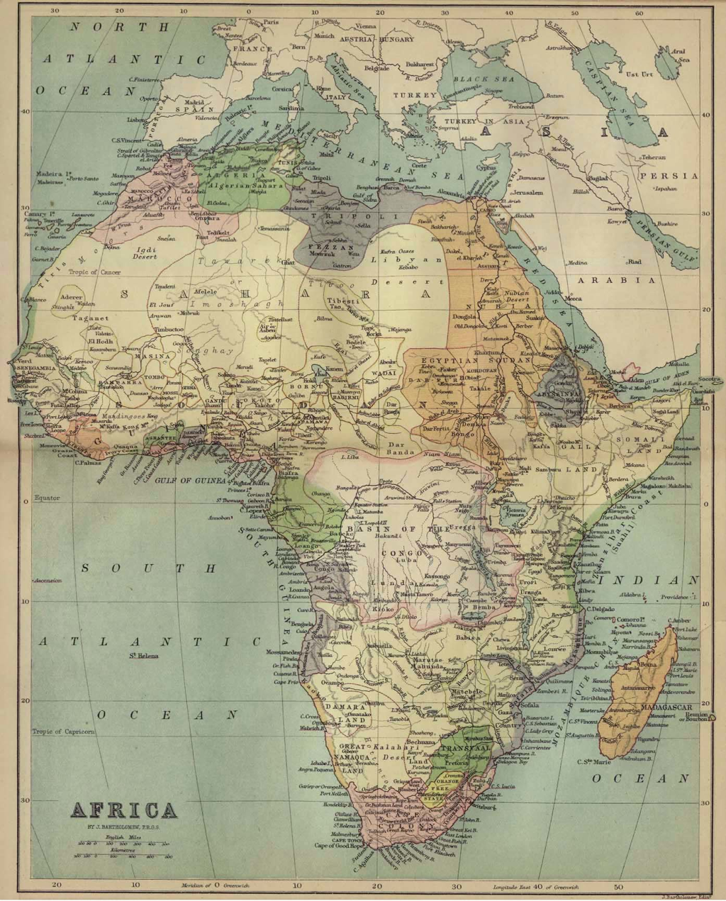
Africa
From colonial system to independent states
- 1884/5: Europeans divide continent into system of competing colonial empires
- former colonies become independent states
- colonial administrative borders become international boundaries
- colonial administrative towns become capital cities
- African nation states: quell ethnic and religious divisions, secure territory, develop economic systems of organization, make “states” and “nations” fit
Scottish Geographical Magazine, Volume I, 1885

Slide 38
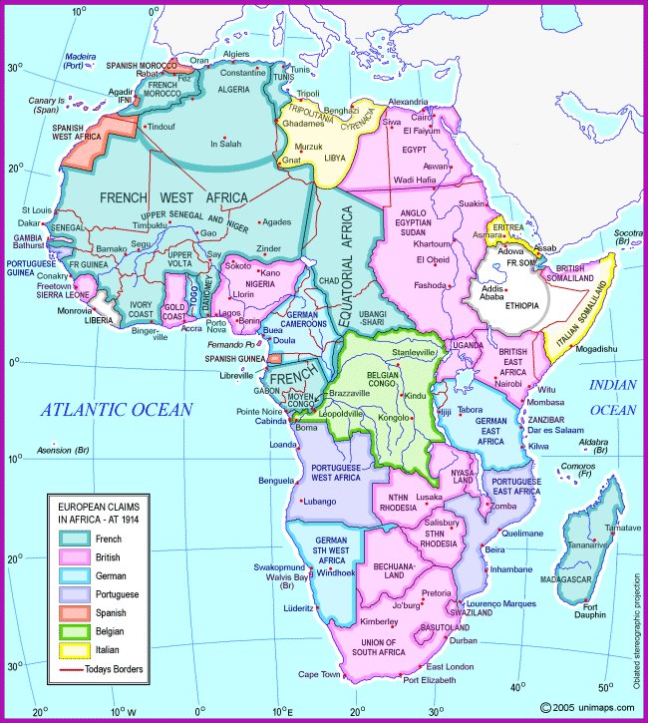
UniMaps.com/africa1914/index.

Slide 39
How do states spatially organize their governments?
centripetal and centrifugal forces?
nation-building?
  quell the nations within; define and defend national boundaries; express sovereign control over territory within boundary
form of government?
  unitary/centralized: capital city serves as focus of power; no accommodation of minorities or out-lying regions; administrative framework ensures government authority
  federal: organization of state territory into regions, substates, provinces, cantons; distribution of powers between central and regional governments

Slide 40
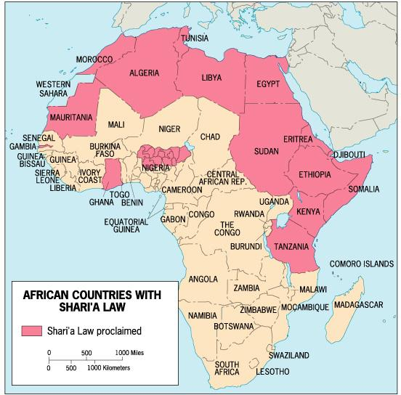
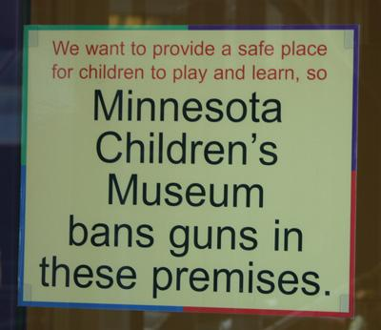
Example: Nigeria
36 states choose their own judicial system
Example: United States states determine death penalty, access to alcohol and concealed weapons

Slide 41

Devolution:
- movement of power from central to regional governments within a state;
- devolution as permanent: constitutional changes
- devolution as process: no alteration of constitution
- ethno-cultural devolution: ethnic minorities demands for self-governance; examples: Czechoslovakia and Yugoslavia

Slide 42



Invergordon, Scotland: North sea oil for an independent Scotland
Barcelona, Catalonia: 6 % of Spain’s territory, 17 % of population, 25 % of exorts/value, 40 % of exports/industry: Catalonian nationalism

Slide 43

Electoral geography
Territorial Representation: political representatives are elected from a territorially defined district
Reapportionment: territorial districts are moved based on population shifts; each district encompasses the same number of people
Splitting: vote of minority populations are diluted by division into separate districts
Majority-minority districts: packed district with minority population as majority of voters
Gerrymandering: redistricting to provide political advantage to one party

Slide 44


Slide 45
Geopolitics: the interplay among geography, power, politics, and international relations
German School:
  Friedrich Ratzel (1844-1904): states resemble biological organisms (birth, maturity, decline, death); existence of state depends on nourishment, the acquisition of territory (‘lebensraum’); territory is the state’s ‘essential, life-giving force.’
  Organic state theory: nation is aggregate of organisms, will therefore behave like an organism;
  extreme form of environmental determinism - basis for territorially expansionist German policies between 1914 and 1945

Slide 46

British/American School:
  Halford J. Mackinder (1861-1947): land-based power is more important than sea-based power; focus on global politics is control of Eurasian landmass - ‘an impregnable, resource rich pivot-area;’
  Heartland Theory:
    who rules East Europe commands Heartland
    who rules Heartland commands World Island
    who rules World Island commands the World
Impact on post-World War II strategic thinking in U.S.: containment - NATO

Slide 47


Slide 48
Critical Geopolitics:
  ideas about places are constructed by political leaders of most powerful countries; ideas influence and reinforce political behaviors and policy choices; ideas affect how populations process notions about places and politics;
  Spatialized politics: “us” vs. “them”
    “us”: pro-democracy, independent, self-sufficient, free
    “them”: opposed to all
  ‘the shining city on the hill’ vs. ‘Evil Empire’
  U.S. vs. “terrorists who come from diverse places but share a hatred for democracy, a fanatical glorification of violence, and a horrible distortion of their religion, to justify the murder of innocents.”

Slide 49
Geopolitical World Order
  post World War II: bipolar, Soviet block v. U.S. block
  post 1991: transition period - supranational organizations and multinational actions in the Middle East (Desert Shield/Desert Storm)
  post 2001: unilateral, U.S. is in position of hardpower dominance; creates antagonism among other countries; challenges to unilateralism: China, Russia, European Union

Slide 50
Supranational Organizations
  League of Nations:
    post World War I desire to prevent future wars
    failure of U.S. to join
    failure of league to act against German, Italian, and Japanese aggression in 1920s and 1930s
  permanent institutions:
    Permanent Court of International Justice
    international negotiation of maritime boundaries - size of territorial seas

Slide 51
The United Nations:
  191 member states
  General Assembly/Security Council
    subsidiaries:
      FAO: Food and Agriculture Organization
      UNESCO: United Nations Educations, Scientific and Cultural Organization
      WHO: World Health Organization
    Declarations and Documents:
      Universal Declaration on Human Rights
      Covenant on Civil, Political, Economic and Social Rights

Slide 52

Regional Supranational Organizations:
  Benelux region: Belgium, Netherlands, Luxembourg - common tariffs, import licenses/quotas
  European Community:
    single currency - Euro
    integration of former Eastern European states

Slide 53


Slide 54
The Impact of Supranational Organizations on states:
Global issues: Proliferation of weapons of mass destruction, economic globalization, global communication networks, terrorism
  nuclear weapons: small “rogue” states can inflict serious damage on larger/distant states
  globalization: supranationalism as a counterbalance to global capitalism
  global communication: networks of consumption/communication transcend established state boundaries
  religious revivals: new “bipolarism?” - increasing heterogeneity - interpenetration of peoples - difficulty of assigning single religious label to territory

