Slide 1
The Distinctive Problems of Inner Cities

Slide 2
Physical Problems and Deterioration
Filtering: larger middle class homes built in 19th century are subdivided into rental properties for low-income families;
  Maintenance of houses is dependent on the landlord’s profit; absence of profit leads to deterioration and finally to abandonment
  Inner-city neighborhoods are abandoned as populations seek better housing; schools and shops close for lack of demand
Urban Renewal: cities demolish substandard inner-city housing for the construction of newer buildings/services by public agencies or private developers

Slide 3
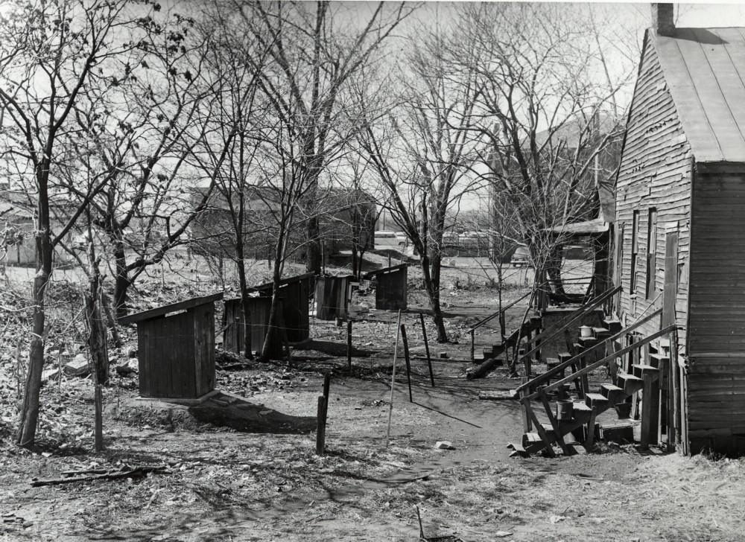

Slide 4
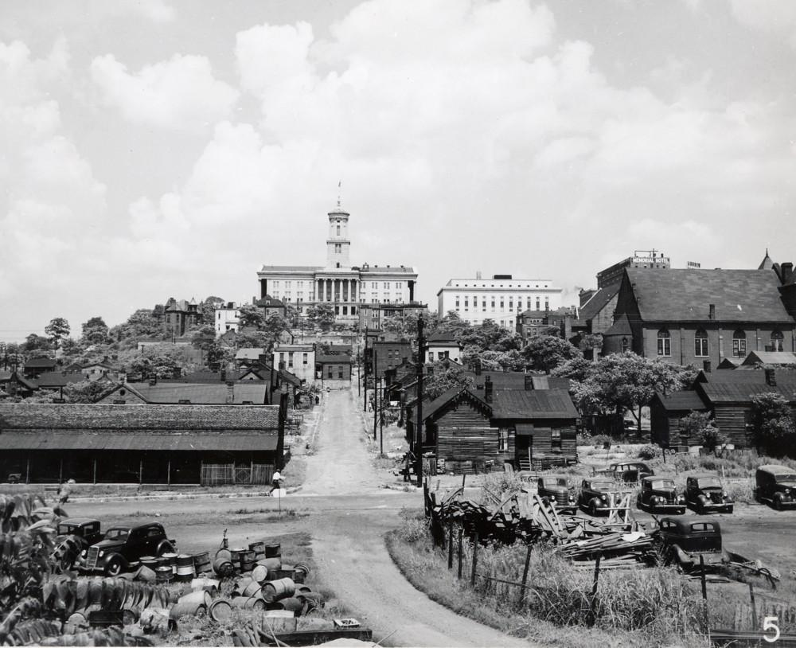

Slide 5
Public Housing
Public Housing is reserved for low-income households; accounts for high percentage of all dwellings in inner-city areas
  Most of public housing complexes built in the 1950s/1960s are today considered unsatisfactory environments for families with children
  High density public housing are viewed as the cause of social and economic problems
  Supply of public housing in the U.S. has declined by 1 million units between 1980 – 2000; at same time demand for public housing has increased by 2 million
  Urban Renewal has contributed further to the destruction and the reduction if the supply of low-cost housing

Slide 6
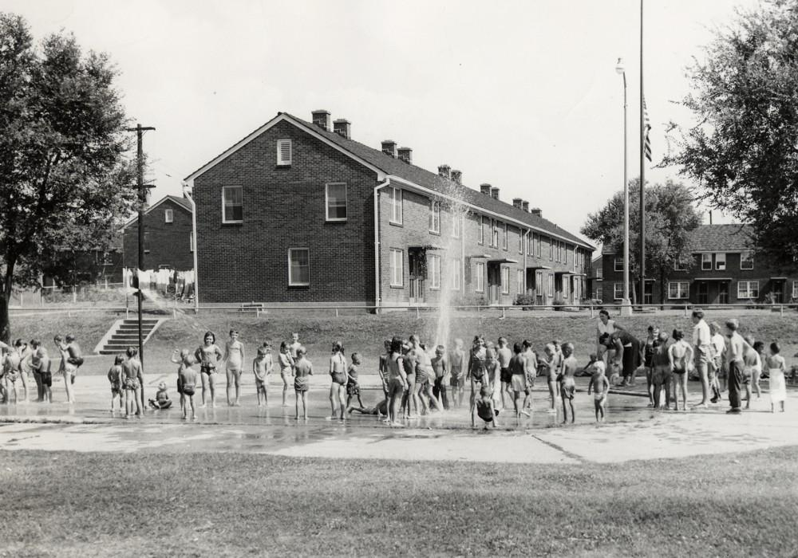

Slide 7
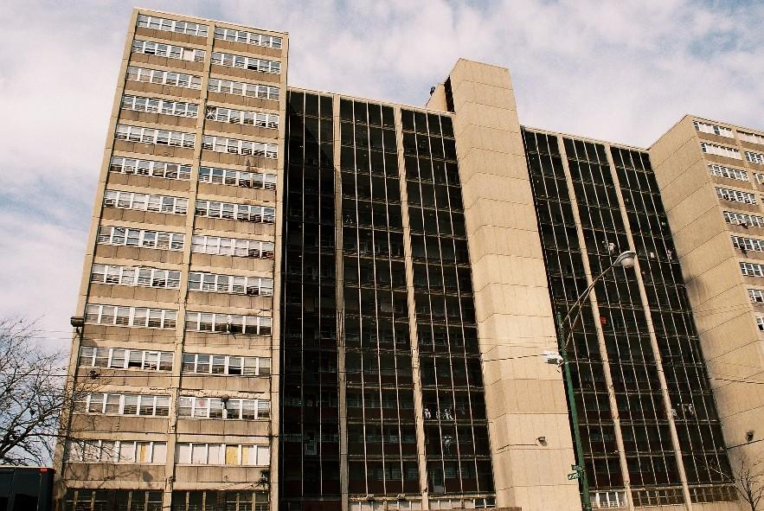
Cabrini Green, Chicago

Slide 8
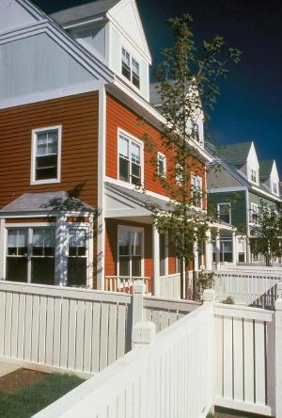
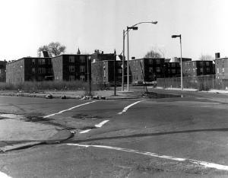
Orchard Hill, Boston (Before and After)

Slide 9
Renovated Housing
Renovated inner-city areas attract middle-class populations
Gentrification: the process by which middle-class populations move into deteriorated inner-city neighborhoods and renovate housing
  Gentrified inner-city neighborhoods attract middle-class individuals who work downtown
  Cities provide tax-breaks and low-cost loans to speed the process of gentrification: subsidies of middle class at expense of poor
Redlining: banks draw lines on a map to determine areas in which they will not invest/provide loans

Slide 10
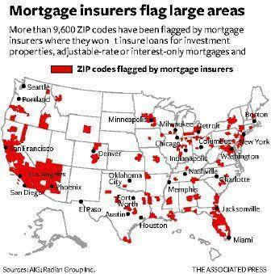

Slide 11
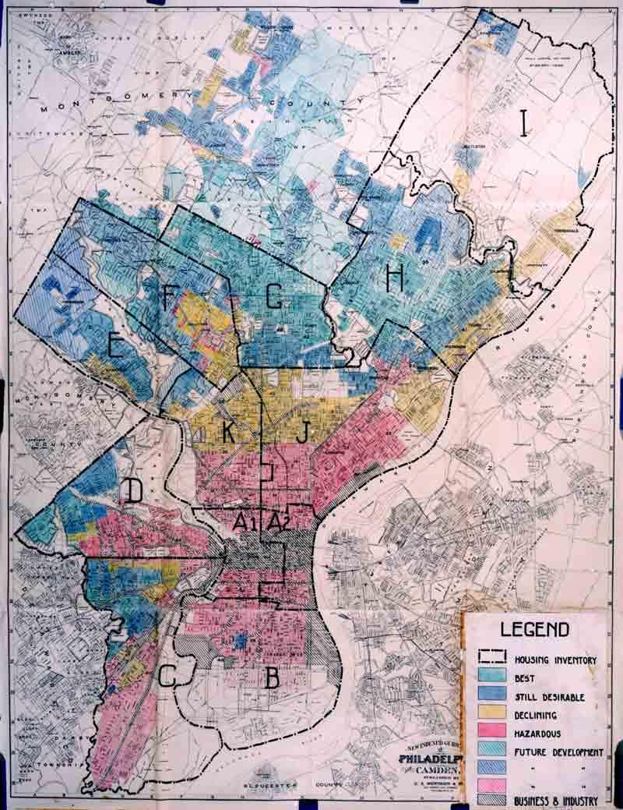

Slide 12
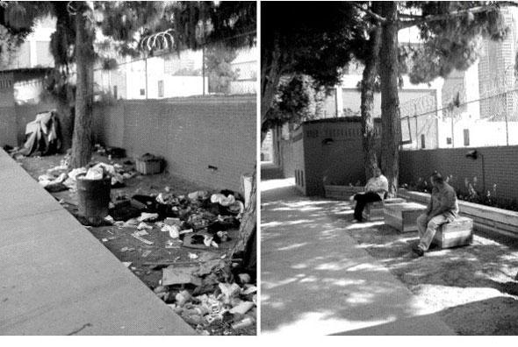

Slide 13
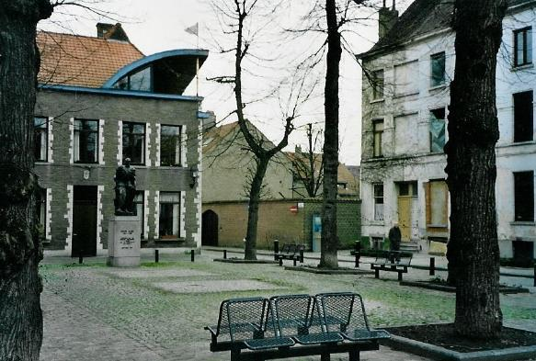

Slide 14
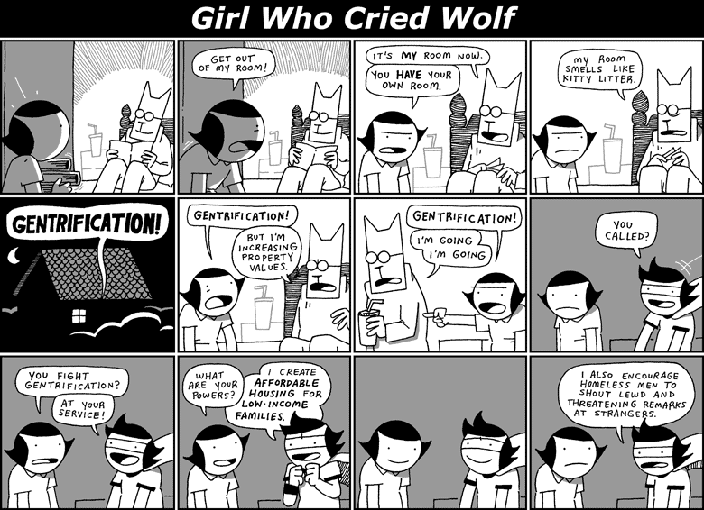

Slide 15
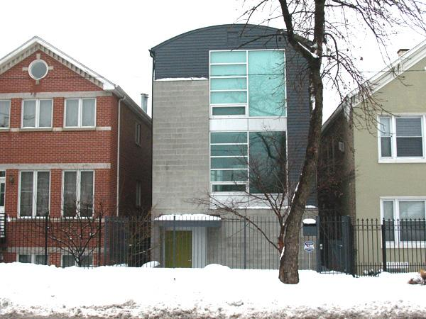
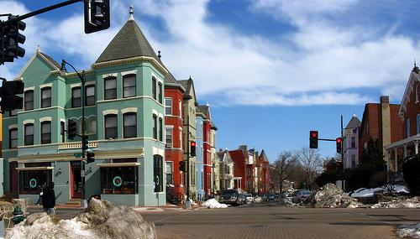

Slide 16
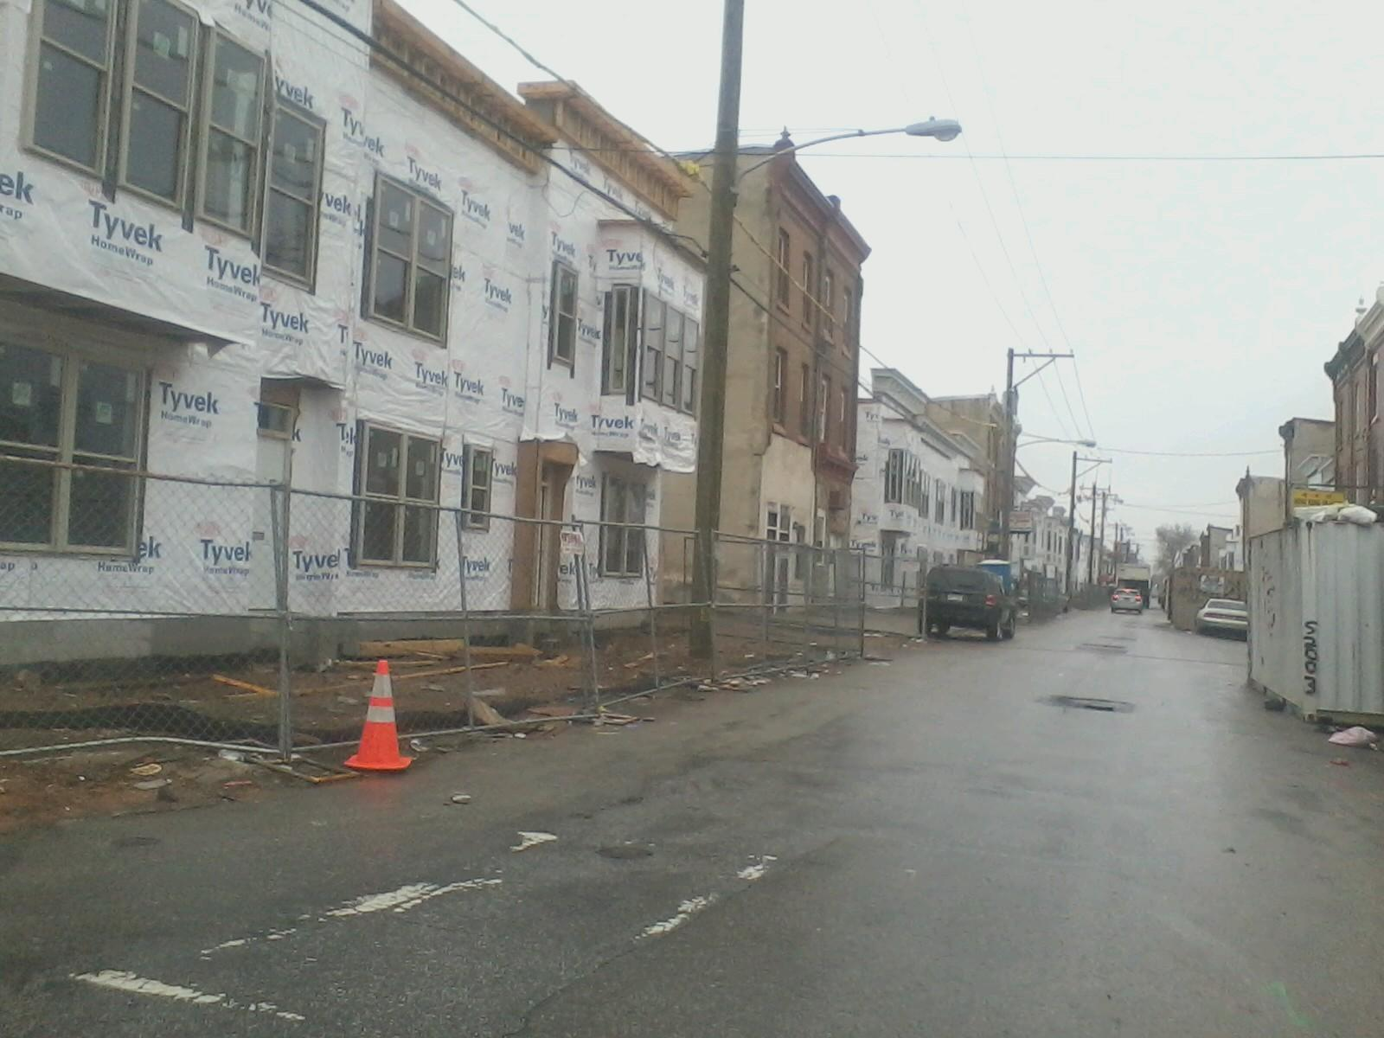

Slide 17
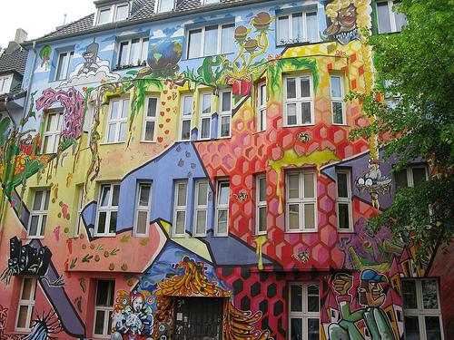

Slide 18
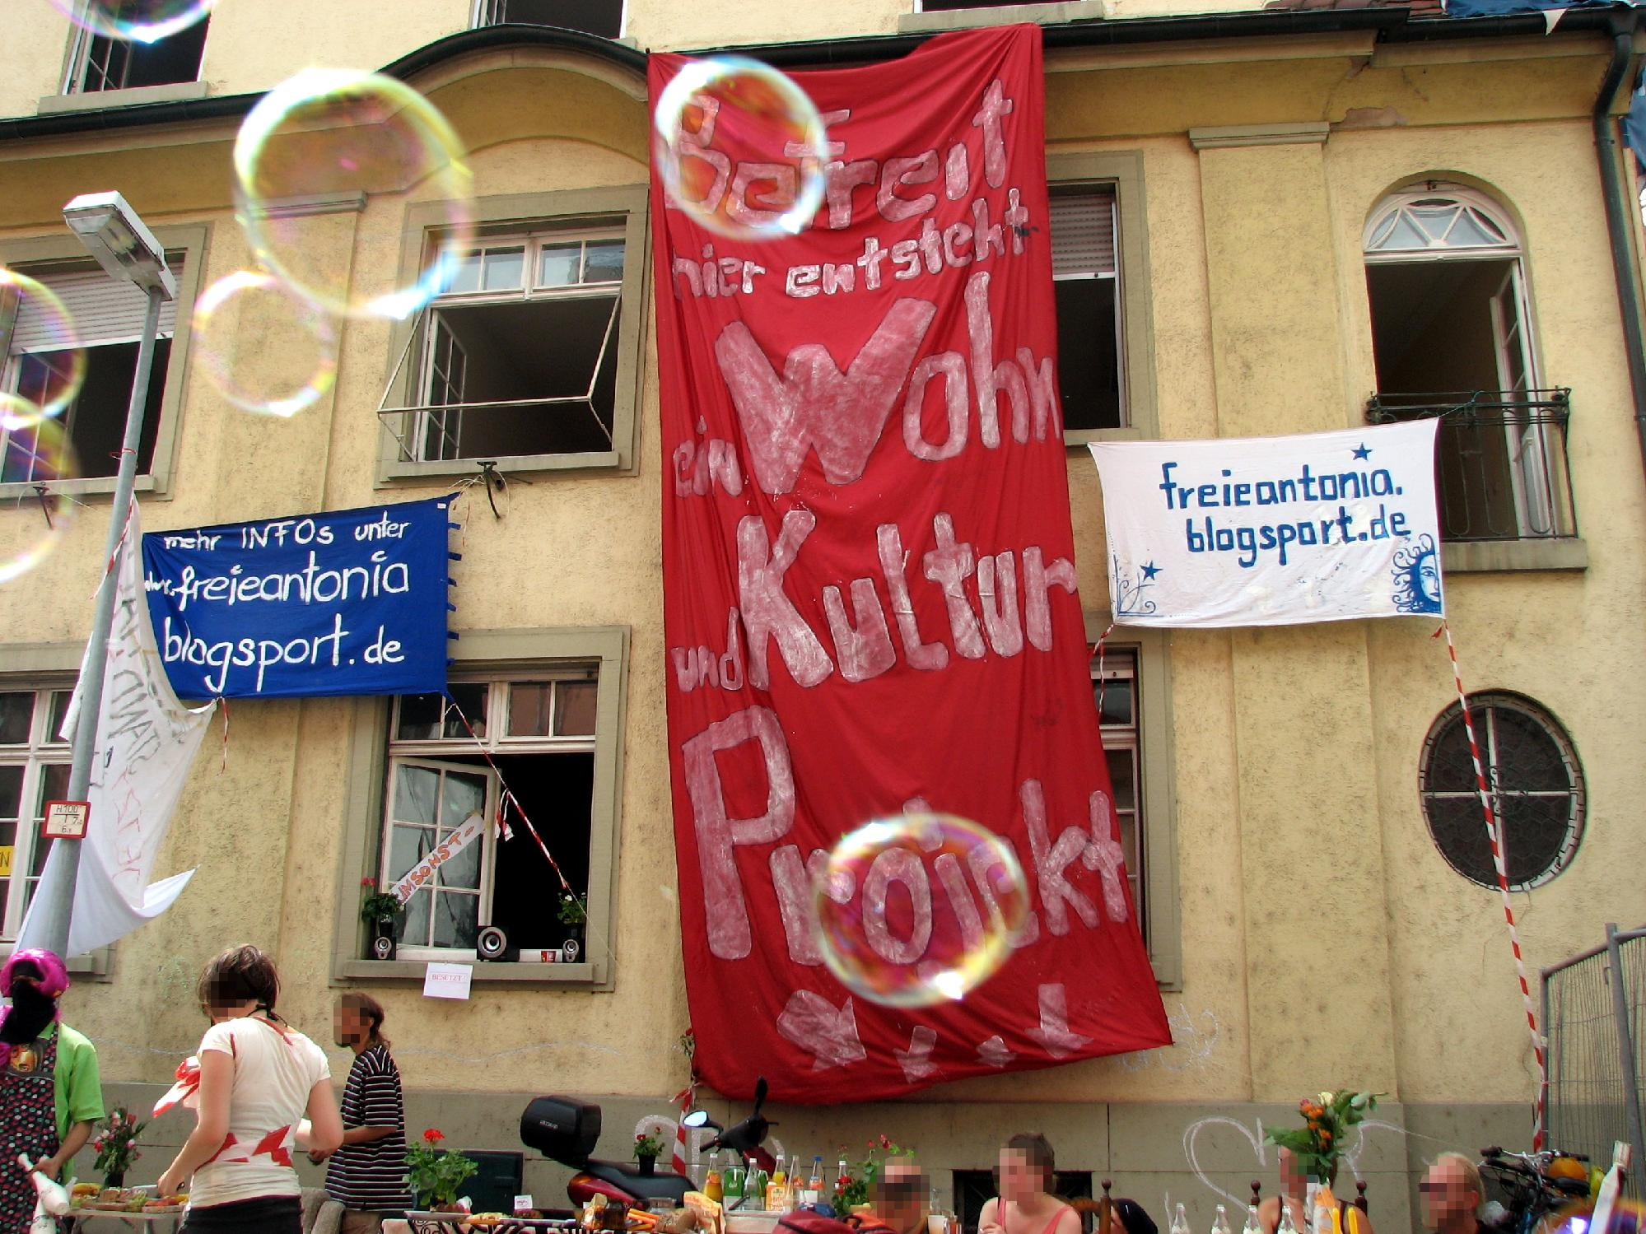

Slide 19
The permanent underclass and the “cultures of poverty”
Underclass: population that is trapped in a cycle of economic and social problems
  Lack of Job skills: widening gap between training/education of inner-city residents and skill sets required by employers
  Homelessness: growing number of Americans/Europeans/ populations world wide are unable to find affordable shelter
    1/3rd of homeless men/women in U.S. were released from hospitals and mental institutions against medical advice and demands of families
  Culture of Poverty: single-parent families; teenage pregnancies/ motherhood; inadequate child-care services; inadequate welfare policies; inadequate health-care/educational services

Slide 20
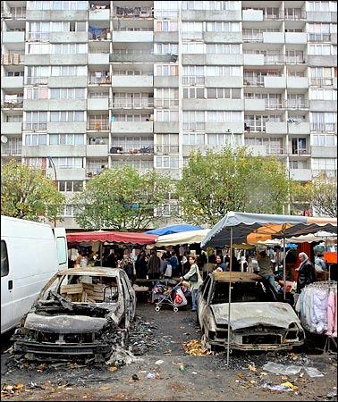
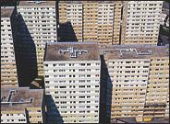

Slide 21
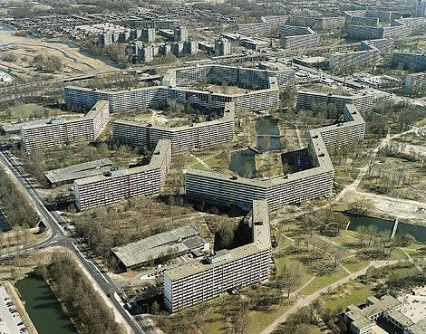

Slide 22
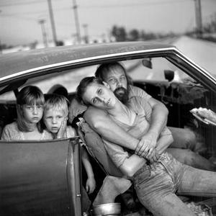

Slide 23
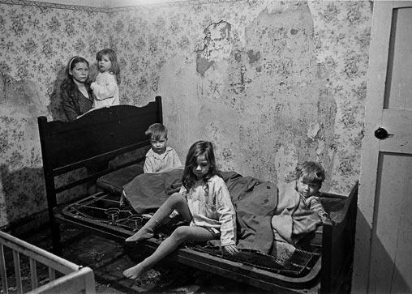

Slide 24
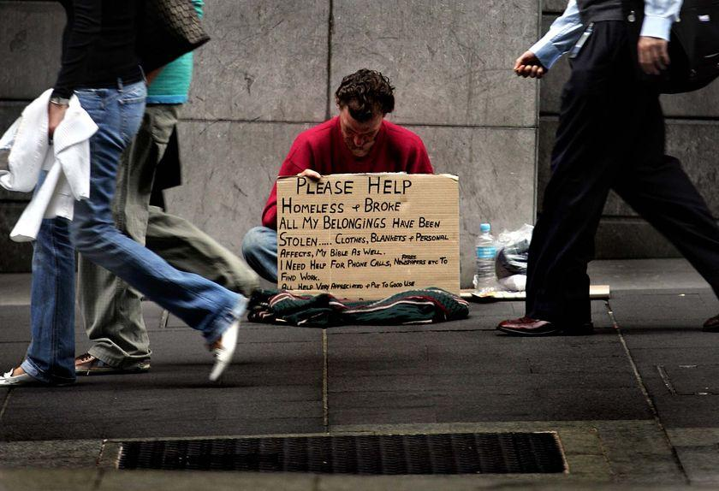

Slide 25
Crime, Segregation, and Racial Profiling
Drugs: increase of drug use/gang organization in inner cities; violence results from competition between gangs over drug distribution areas
  Racial Profiling: higher incidence of drug use among African-Americans results from lack of policing of drug use in middle-class suburbs
Segregation: neighborhoods in U.S. are segregated by ethnicity; existing overlap of ethnic and social distinction increases and deepens ethnic residential settlement patterns

Slide 26
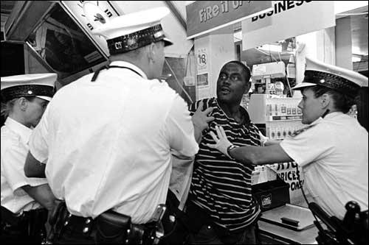

Slide 27
