Slide 1
The Political Spectrum

Slide 2
Left to Right
Communism
Socialism
Reform Liberalism
Classical Liberalism
Conservativism
Fascism

Slide 3
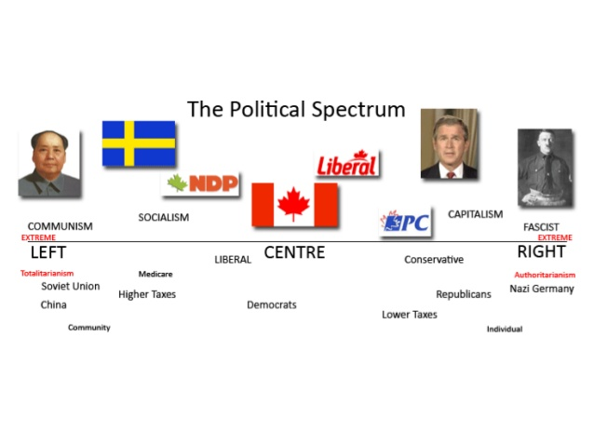

Slide 4
What do you think about when you hear the word politics?
What are political systems?

Slide 5
Democracy: Direct and Representative
Democracy is a form of government where all eligible citizens participate equally
This happens directly or through elected representatives
Proposal, development and creation of laws
Encompasses social, economic and cultural conditions that enable free and equal practice of self-determination

Slide 6
Direct Democracy
Each citizen votes on the issue in question

Slide 7
Representative Democracy
Representatives are elected by citizens from a pool of candidates
Usually representative of a political ideology
Represents citizens interests to the government

Slide 8
Monarchy: Absolute and Constitutional
Monarchy: ruled by a king or queen
Monarchies differ based on the amount of autonomy or power that the monarch holds
When the monarch has no or few legal restraints in state and political matters it is an absolute monarchy – a form of autocracy
When the monarchs discretion is limited (most common today) this is called a constitutional monarchy. We live in a constitutional monarchy

Slide 9
Totalitarian Governments
A totalitarian state is a term that describes a political system where the state holds total authority over the society and seeks control over all aspects of the private and public lives whenever and wherever possible.
This was first developed in a positive lights in 1920s by Italian Fascists.
Became very popular during the Cold War era

Slide 10
Autocracy
System of government in which all of the power is concentrated to the hands of a single person.
There are no external legal restraints or elections – except in the threat of a coup d'état or revolution.

