Slide 1
Three branches of Canadian government
Legislative, Judicial, Executive

Slide 2

What you will need to know…
The role of each branch
The positions of each branch
Who decides who will be in each position
How they decide who will be in each position
The work that each branch does

Slide 3

Legislative Branch
Role: to make laws

Slide 4
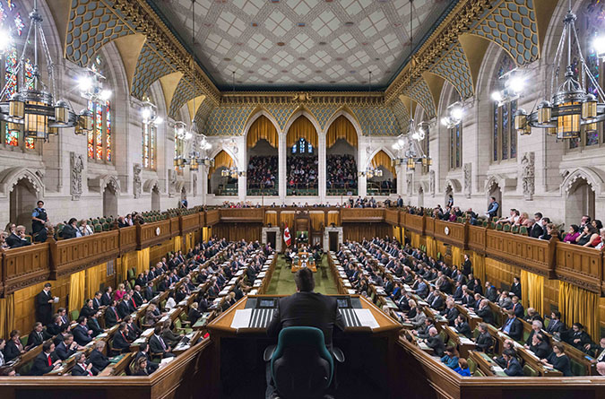
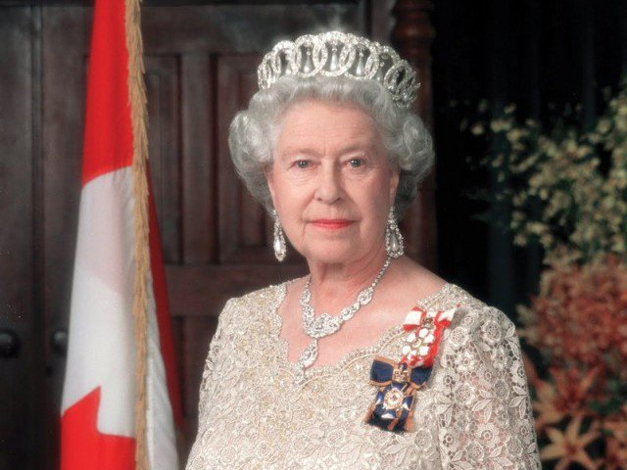
Legislative Branch
Positions in this branch:
House of Commons
Senate
Monarch (King/Queen)
Governor General
Lieutenant Governor

Slide 5

Legislative Branch
Who selects the people in the positions of the Legislative branch and how?
The house of commons is elected by the people (eligible voters of Canada) by voting
The senate is elected by the Prime Minister by appointment
The Governor General is appointed by the Queen after referral from the Prime Minister

Slide 6

Legislative Branch
The work of this branch:
To pass laws (from bills) which involves the House of Commons and Senate committee
Bills originate from: Cabinet, and private members bills
Governor General provides Royal Assent

Slide 7
Executive Branch
Role of this branch:
To carry out (implements) the countries laws
Operates the administration of the government

Slide 8
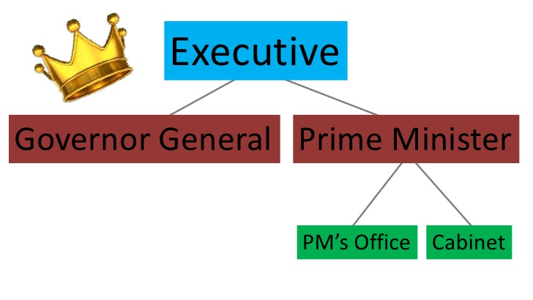
Executive Branch
Positions of this branch:
The monarch
Governor General
Lieutenant Governor
Prime Minister
Cabinet
Bureaucracy
Departments/ministries
Crown Corporations
Regulatory agencies
Advisory bodies

Slide 9
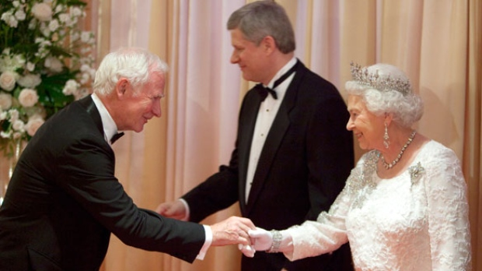
Executive Branch
Who Selects and How:
GG: appointed by the Queen with referral from the Prime Minister
Prime Minister: Chose by the political party
Cabinet: Appointed by the Prime Minister

Slide 10
Executive Branch
The work of this branch
Governor General – ceremonial
Prime Minister – Selects GG, Cabinet. Management of Political Party. Power of organizing the government: Departments, Prime Ministers office. Power of dissolution.

Slide 11
Executive Branch
Cabinet:
Operates by order in council (a type of legislation)
Two types: order in council exercising the Royal Prerogative or orders in council made in accordance with an act of parliament
In Canada they are made in the name of the Governor General by the Queen’s Privy council for Canada (provincial orders in council orders are the lieutenant governor in council.
An order in council made under the royal prerogative is primary legislation and does not depend on any statute for its authority. This includes things like standing orders for civil servavnts and appointing heads of crown corporations or overseas government departments.
Traditionally used as a way for the Prime Minister to make political appointments but they can also be used to issue a simple law as a sort of decree.
Cabinet includes: ministers of permanent departments: Ministers of state

Slide 12

Executive Branch
Bureaucracy and Government Departments:
To administer government
To provide government services
Departments
Crown Corporations
Regulatory Agencies – set rules for business
Advisory bodies
Royal commission
Tax forces

Slide 13

Judicial Branch
Role: Interprets the law, adjudicates legal disputes
Positions in the branch: judges, courts

Slide 14
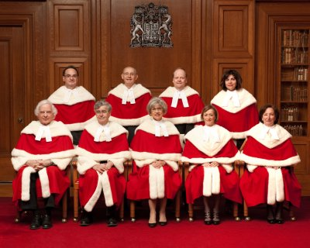
Judicial Branch
Who selects and how?
Superior Court Judges: Appointed by the Prime Minister
Provincial Court Judges: Appointed by the provincial government

Slide 15
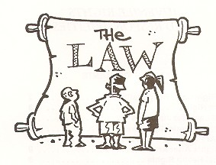
Judicial Branch
The work of this branch:
Judges: interpret the law, and adjudicate disputes over rights

Slide 16

THE END

