Slide 1
13
Reunification and Renaissance in Chinese Civilizations:
The Era of the Tang and Song Dynasties
Notes:
‹#›

Slide 2
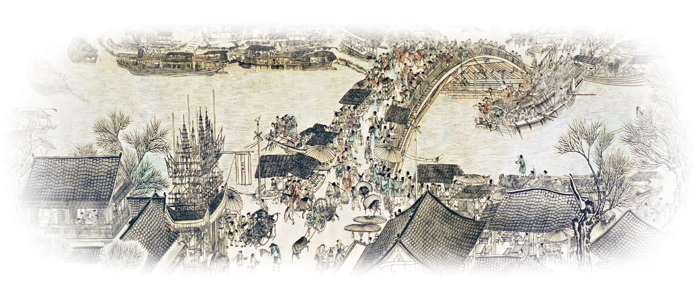
Figure 13.1 This cityscape of the Song city of Bian Liang (Kaifeng), painted by Zhang Zeduan, conveys the energy and prosperity that characterized Chinese urban life in the Tang-Song eras. Like Hangzhou, Bian Liang’s graceful bridges, bustling river markets, and spacious parks attracted many visitors, especially at times of festival celebrations like that depicted here.
Notes:
Figure 13.1 This cityscape of the Song city of Bian Liang (Kaifeng), painted by Zhang Zeduan, conveys the energy and prosperity that characterized Chinese urban life in the Tang-Song eras. Like Hangzhou, Bian Liang’s graceful bridges, bustling river markets, and spacious parks attracted many visitors, especially at times of festival celebrations like that depicted here.
‹#›

Slide 3
Chapter Overview
Rebuilding the Imperial Edifice in the Sui-Tang Era
Tang Decline and the Rise of the Song
Tang and Song Prosperity: The Basis of a Golden Age
Notes:
‹#›

Slide 4
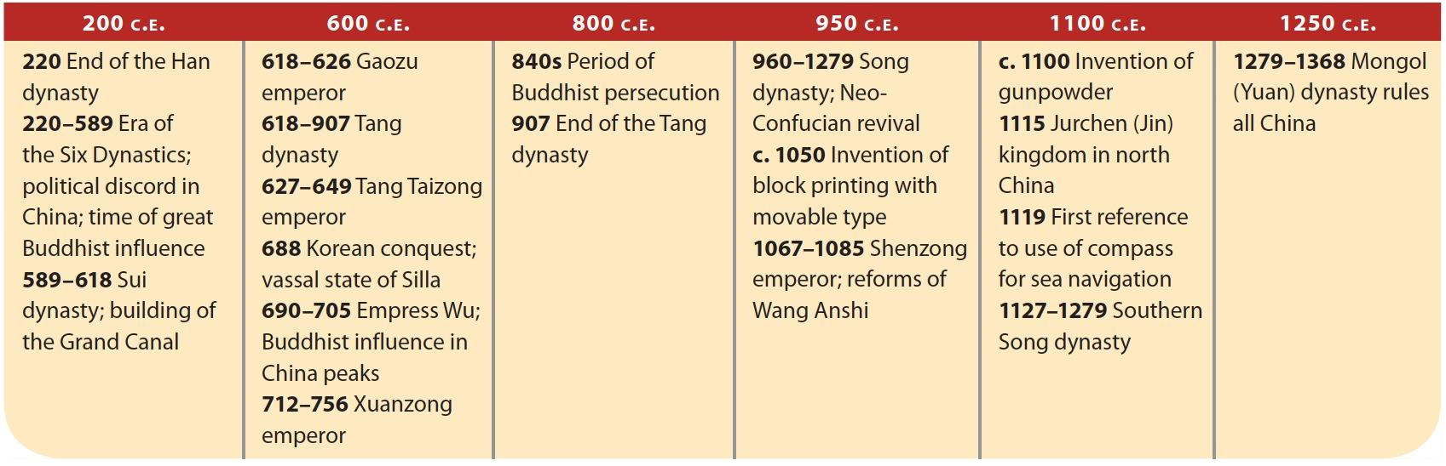
TIMELINE 200 C.E. to 1250 C.E.
Notes:
‹#›
TIMELINE 200 C.E. to 1250 C.E.

Slide 5
Rebuilding the Imperial Edifice in the Sui-Tang Era
Wendi (Yang Jian)
  Nobleman
  Leads nomadic leaders to control northern China
  589, defeat of Chen kingdom
    Established Sui dynasty
Notes:
‹#›

Slide 6
Rebuilding the Imperial Edifice in the Sui-Tang Era
Sui Excesses and Collapse
  Yangdi
    Son of Wendi
    Legal reform
    Reorganized Confucian education
    Scholar-gentry reestablished
    Loyang
      New capital
      Building projects
Notes:
‹#›

Slide 7
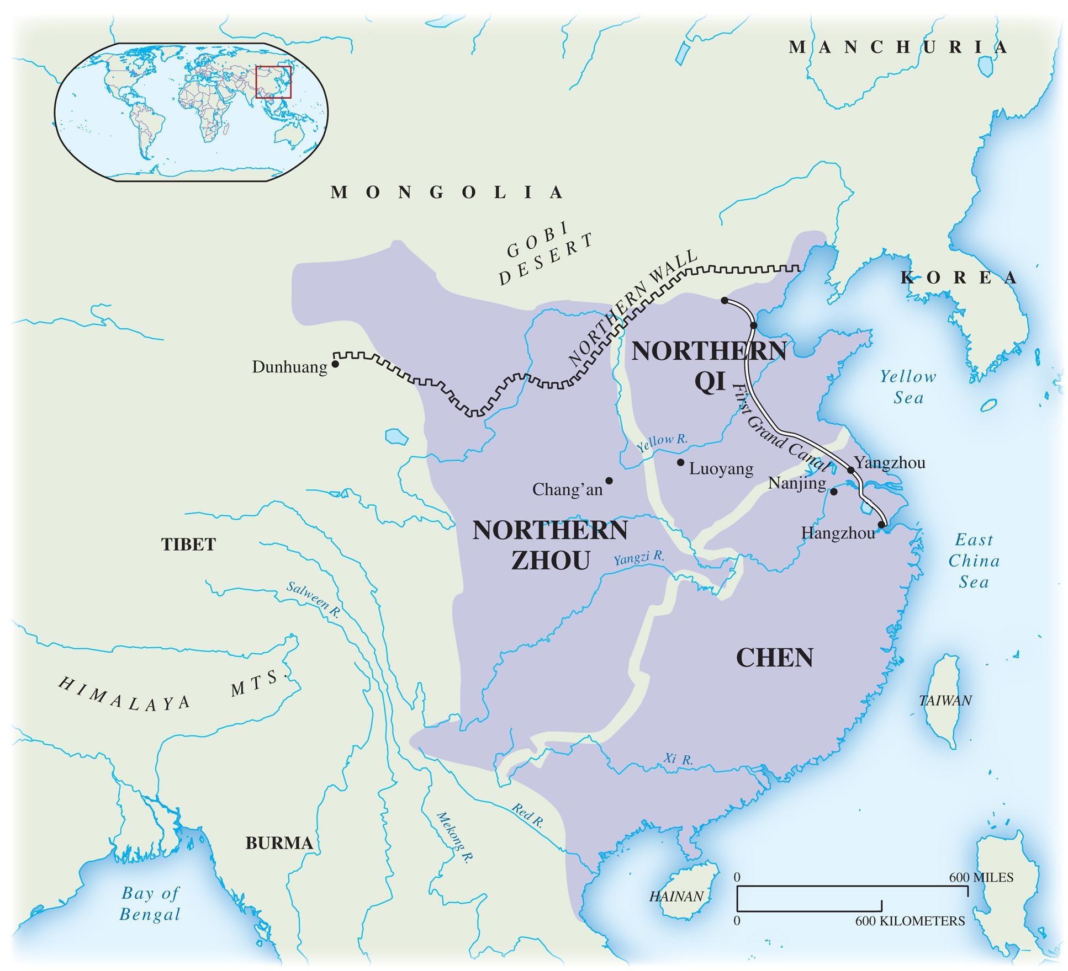
Map 13.1 China During the Age of Division After the collapse of the Han dynasty, China fragmented into warring kingdoms for nearly 400 years. The deep divisions of this period were captured by its designation in Chinese histories as the era of the Six Dynasties.
Notes:
Map 13.1 China During the Age of Division After the collapse of the Han dynasty, China fragmented into warring kingdoms for nearly 400 years. The deep divisions of this period were captured by its designation in Chinese histories as the era of the Six Dynasties.
‹#›

Slide 8
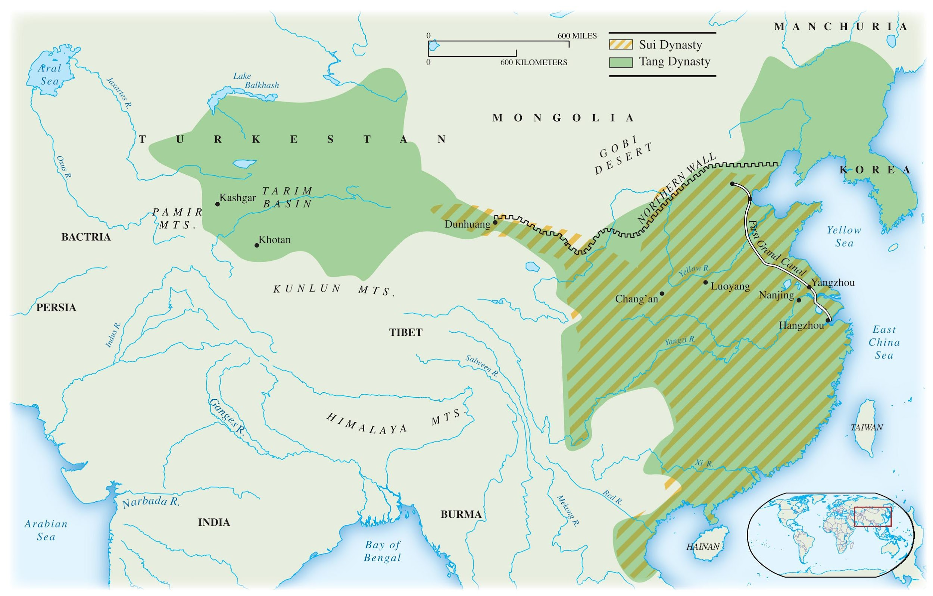
Map 13.2 The Sui Dynasty and the Tang Dynasty
The short-lived Sui dynasty laid the foundations for the expansive Tang. Under the latter the Chinese empire was restored on a scale not known since the Han era.
Notes:
Map 13.2 The Sui Dynasty and the Tang Dynasty
The short-lived Sui dynasty laid the foundations for the expansive Tang. Under the latter the Chinese empire was restored on a scale not known since the Han era.
‹#›

Slide 9
Rebuilding the Imperial Edifice in the Sui-Tang Era
Sui Excesses and Collapse
  Yangdi
    Canals built across empire
    Attacked Korea
    Defeated by Turks, 615
    Assassinated, 618
Notes:
‹#›

Slide 10
Rebuilding the Imperial Edifice in the Sui-Tang Era
The Emergence of the Tang and the Restoration of the Empire
  Li Yuan, Duke of Tang
    Uses armies to unite China
    Extends borders to Afghanistan
    Use of Turks in army
  Empire into Tibet, Vietnam, Manchuria, Korea
    Great Wall repaired
Notes:
‹#›

Slide 11
Rebuilding the Imperial Edifice in the Sui-Tang Era
Rebuilding the World's Largest and Most Pervasive Bureaucracy
  Unity
    Aristocracy weakened
    Confucian ideology revised
    Scholar-gentry elite reestablished
    Bureaucracy
    Bureau of Censors
  Chang'an
Notes:
‹#›

Slide 12
Rebuilding the Imperial Edifice in the Sui-Tang Era
Institutionalizing Meritocracy: The Growing Importance of the Examination System
  Ministry of Rites
  Birth, connections important for office
  Jinshi
Notes:
‹#›

Slide 13
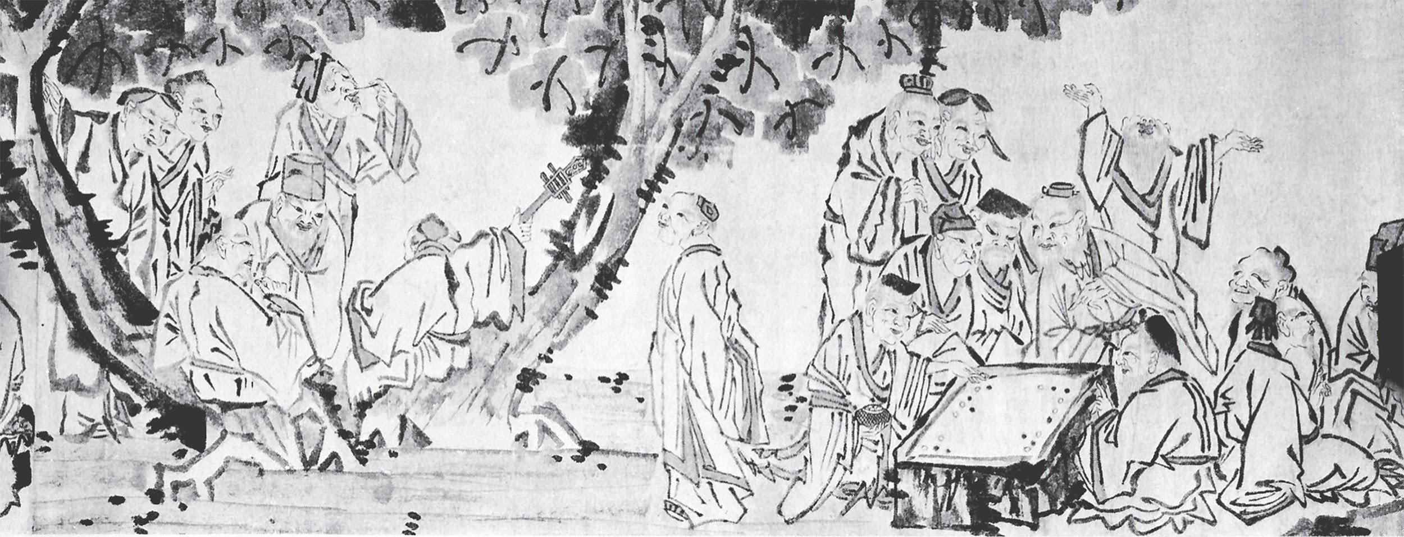
Figure 13.2 As shown in this ink drawing of Chinese philosophers of the Song dynasty, board games and musical recitals were highly esteemed leisure activities for the scholar-gentry class. Members of the scholar-gentry elite might also attend poetry reading or writing parties, travel to mountains to meditate amid scenic splendors, or paint the blossoming plum trees in their gardens. As in their work, members of this highly educated elite admired those who at leisure pursued a diverse array of activities.
(Handscroll “Gathering of Philosophers.” The Metropolitan Museum of Art, New York, NY, U.S.A. Image copyright © The Metropolitan Museum of Art/Art Resource, NY.)
Notes:
Figure 13.2 As shown in this ink drawing of Chinese philosophers of the Song dynasty, board games and musical recitals were highly esteemed leisure activities for the scholar-gentry class. Members of the scholar-gentry elite might also attend poetry reading or writing parties, travel to mountains to meditate amid scenic splendors, or paint the blossoming plum trees in their gardens. As in their work, members of this highly educated elite admired those who at leisure pursued a diverse array of activities.
(Handscroll “Gathering of Philosophers.” The Metropolitan Museum of Art, New York, NY, U.S.A. Image copyright © The Metropolitan Museum of Art/Art Resource, NY.)
‹#›

Slide 14
Rebuilding the Imperial Edifice in the Sui-Tang Era
State and Religion in the Tang and Song Eras
  Confucianism and Buddhism potential rivals
    Buddhism had been central
    Pure land Mahayana Buddhism popular in era of turmoil
    Chan (Zen) Buddhism common among elite
Notes:
‹#›

Slide 15
Rebuilding the Imperial Edifice in the Sui-Tang Era
State and Religion in the Tang and Song Eras
  Early Tang support Buddhism
    Empress Wu (690–705)
      Endows monasteries
      Tried to make Buddhism the state religion
    50,000 monasteries by c. 850
Notes:
‹#›

Slide 16
Rebuilding the Imperial Edifice in the Sui-Tang Era
The Anti-Buddhist Backlash
  Confucians in administration
    Support taxation of Buddhist monasteries
  Persecution under Emperor Wuzong
  (841–847)
    Monasteries destroyed
    Lands redistributed
  Confucian emerges the central ideology
Notes:
‹#›

Slide 17
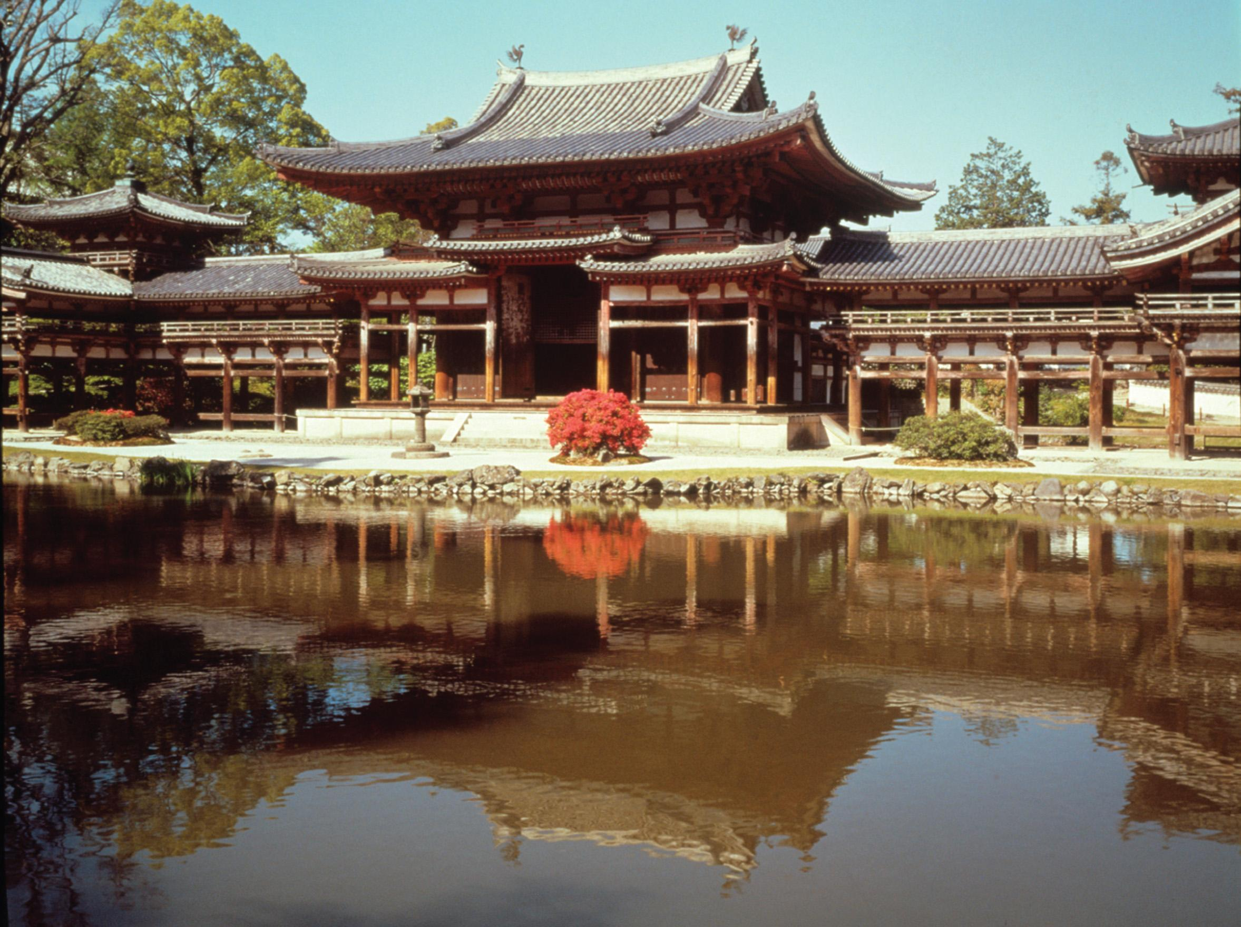
Figure 13.3 Tang era architecture at the Phoenix Pavilion in Japan. Some of the most characteristic features of this splendid style of construction are its steeply sloping tiled roofs with upturned corners, the extensive use of fine wood in the floors, walls, and ceilings, and the sliding panels that covered doors and windows in inclement weather and opened up the temples or monasteries to the natural world on pleasant days.
Notes:
Figure 13.3 Tang era architecture at the Phoenix Pavilion in Japan. Some of the most characteristic features of this splendid style of construction are its steeply sloping tiled roofs with upturned corners, the extensive use of fine wood in the floors, walls, and ceilings, and the sliding panels that covered doors and windows in inclement weather and opened up the temples or monasteries to the natural world on pleasant days.
‹#›

Slide 18
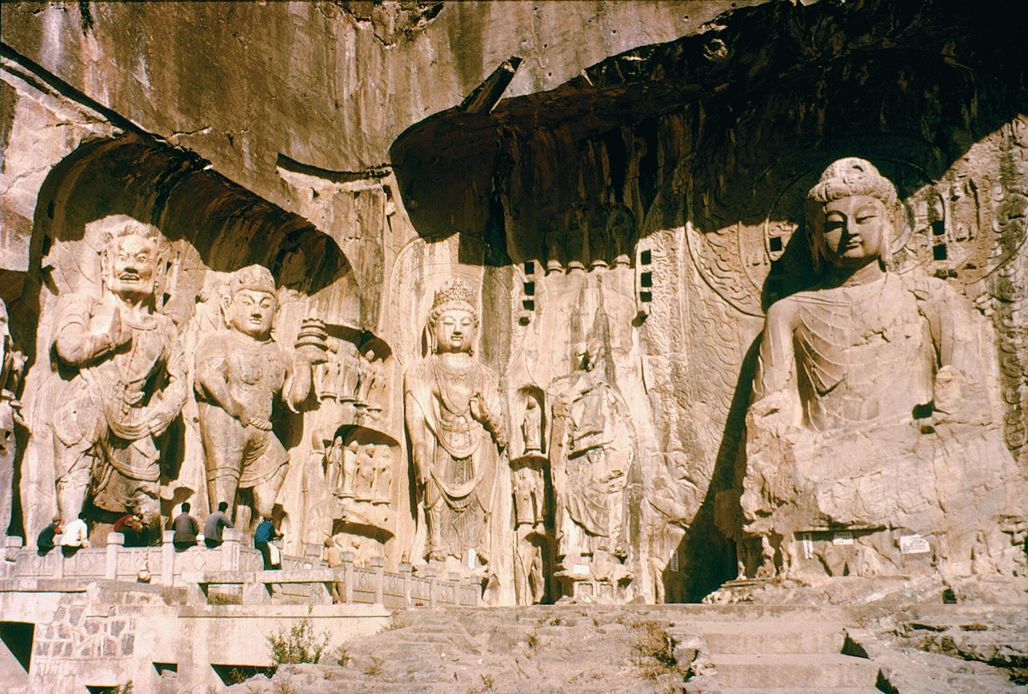
Figure 13.4 At sites such as Longmen near the Tang capital of Luoyang on the Yellow River and Yunkang far to the north, massive statues of the Buddha were carved out of rocky cliffsides beginning in the 6th century C.E. Before the age of Buddhist predominance, sculpture had not been highly developed in China, and the art at these centers was strongly influenced by that of central and even west Asia. Known more for their sheer size than for artistic refinement, the huge Buddhas of sites such as Longmen attest to the high level of skill the Chinese had attained in stone- and metalworking.
Notes:
Figure 13.4 At sites such as Longmen near the Tang capital of Luoyang on the Yellow River and Yunkang far to the north, massive statues of the Buddha were carved out of rocky cliffsides beginning in the 6th century C.E. Before the age of Buddhist predominance, sculpture had not been highly developed in China, and the art at these centers was strongly influenced by that of central and even west Asia. Known more for their sheer size than for artistic refinement, the huge Buddhas of sites such as Longmen attest to the high level of skill the Chinese had attained in stone- and metalworking.
‹#›

Slide 19
Tang Decline and the Rise of the Song
Emperor Xuanzong (713–756)
  Height of Tang power
  Mistress, Yang Guifei
    Powerful
    Relatives gain power in government
755, revolt
  But leaders ineffectual
  Frontier peoples, governors benefit
Notes:
‹#›

Slide 20
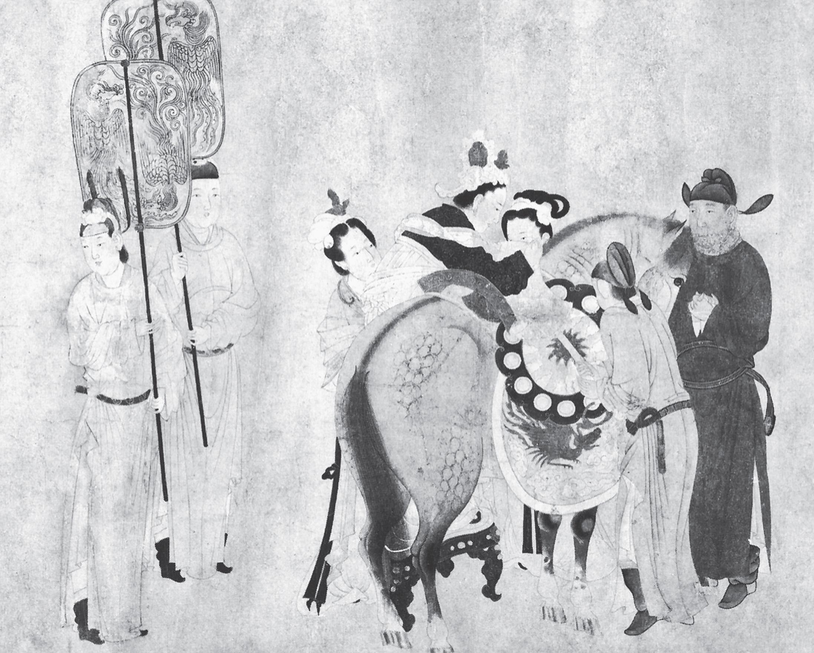
Figure 13.5 This painting of Yang Guifei gives a vivid impression of the opulence and refinement of Chinese court life in the late Tang era. Here a very well-dressed Yang Guifei is helped by some of her servants onto a well-fed horse, presumably for a trot through the palace grounds. Two fan-bearers stand ready to accompany the now-powerful concubine on her sedate ride while other attendants prepare to lead the horse through the confined space of the royal enclosure.
Notes:
Figure 13.5 This painting of Yang Guifei gives a vivid impression of the opulence and refinement of Chinese court life in the late Tang era. Here a very well-dressed Yang Guifei is helped by some of her servants onto a well-fed horse, presumably for a trot through the palace grounds. Two fan-bearers stand ready to accompany the now-powerful concubine on her sedate ride while other attendants prepare to lead the horse through the confined space of the royal enclosure.
‹#›

Slide 21
Tang Decline and the Rise of the Song
The Founding of the Song Dynasty
  907, last Tang emperor resigns
  Zhao Kuangyin (Taizu)
    960, founds Song dynasty
    Liao dynasty, Manchuria
      Khitan nomads
      Unconquered by Taizu
  Song unable to defeat northern nomads
    Song pay tribute to Liao
Notes:
‹#›

Slide 22
Tang Decline and the Rise of the Song
Song Politics: Settling for Partial Restoration
  Scholar-gentry patronized
    Given power over military
    Increased salaries, perks
    Many more successful candidates
Notes:
‹#›

Slide 23
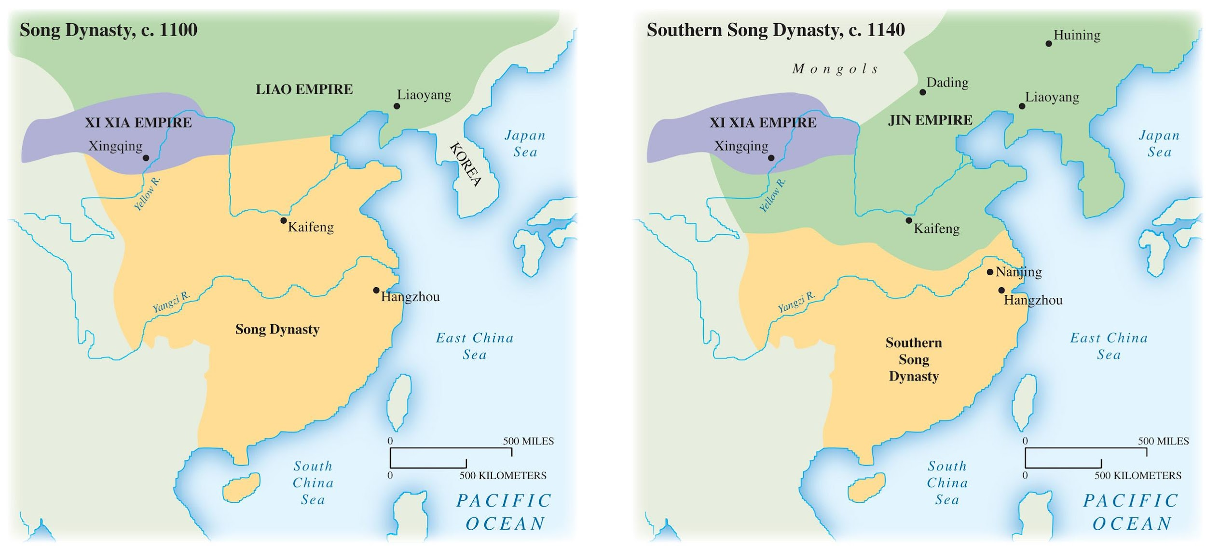
Map 13.3 China in the Song and Southern Song Dynastic Periods
A comparison of the territory controlled during the two phases of the Song dynasty clearly indicates both the growing power and pressure of nomadic peoples from the north and the weakened state of the Song rulers of China.
Notes:
Map 13.3 China in the Song and Southern Song Dynastic Periods
A comparison of the territory controlled during the two phases of the Song dynasty clearly indicates both the growing power and pressure of nomadic peoples from the north and the weakened state of the Song rulers of China.
‹#›

Slide 24
Tang Decline and the Rise of the Song
The Revival of Confucian Thought
  Libraries established
    Old texts recovered
  Neo-confucians
    Stress on personal morality
    Zhu Xi
      Importance of philosophy in everyday life
    Hostility to foreign ideas
    Gender, class, age distinctions reinforced
Notes:
‹#›

Slide 25
Tang Decline and the Rise of the Song
Roots of Decline: Attempts at Reform
  Khitan independence encourages others
  Tangut, Tibet
    Xi Xia
    Song pay tribute
  Wang Anshi
    Confucian scholar, chief minister
    Reforms
      Supported agricultural expansion
      Landlords, scholar-gentry taxed
Notes:
‹#›

Slide 26
Tang Decline and the Rise of the Song
Reaction and Disaster: The Flight to the South
  1085, emperor supporting Wang Anshi dies
    Reforms reversed
  Jurchens defeat Liao
    1115, found Jin kingdom
    Invade China
    Song flee south
      New capital at Hangzhou
      Southern Song Dynasty (1127–1279)
Notes:
‹#›

Slide 27
Tang and Song Prosperity: The Basis of a Golden Age
Canal system
  Built to accommodate population shift
  Yangdi's Grand Canal
    Links North to South
Notes:
‹#›

Slide 28
Tang and Song Prosperity: The Basis of a Golden Age
A New Phase of Commercial Expansion
  Silk routes reopened
    Greater contact with Buddhist, Islamic regions
  Sea trade
    Developed by late Tang, Song
    Junks
Notes:
‹#›

Slide 29
Tang and Song Prosperity: The Basis of a Golden Age
A New Phase of Commercial Expansion
  Commerce expands
    Credit
    Deposit shops
    Flying money
  Urban growth
    Chang'an
      Tang capital
      2 million
Notes:
‹#›

Slide 30
Tang and Song Prosperity: The Basis of a Golden Age
Expanding Agrarian Production and Life in the Country
  New areas cultivated
    Canals help transport produce
  Aristocratic estates
    Divided among peasants
    Scholar-gentry replace aristocracy
Notes:
‹#›

Slide 31
Tang and Song Prosperity: The Basis of a Golden Age
Family and Society in the Tang-Song Era
  Great continuity
  Marriage brokers
  Elite women have broader opportunities
    Empresses Wu, Wei
    Yang Guifei
  Divorce widely available
Notes:
‹#›

Slide 32
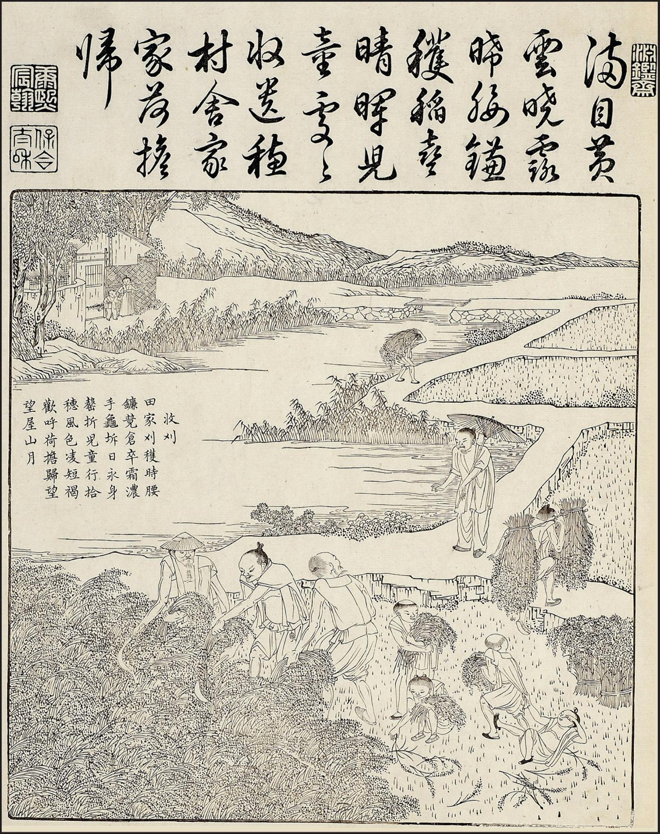
Figure 13.6 The farming methods developed in the Song era are illustrated by this 17th-century engraving. Note the overseer, protected by an umbrella from the hot sun. Improved productivity, particularly of staple crops such as irrigated rice, meant that China’s long-held advantages over other civilizations in terms of the population it could support increased in this era. By the early 14th century, as much as a quarter of humanity may have lived in the Chinese empire.
(© The Trustees of the British Museum/Art Resource, NY.)
Notes:
Figure 13.6 The farming methods developed in the Song era are illustrated by this 17th-century engraving. Note the overseer, protected by an umbrella from the hot sun. Improved productivity, particularly of staple crops such as irrigated rice, meant that China’s long-held advantages over other civilizations in terms of the population it could support increased in this era. By the early 14th century, as much as a quarter of humanity may have lived in the Chinese empire.
(© The Trustees of the British Museum/Art Resource, NY.)
‹#›

Slide 33
Tang and Song Prosperity: The Basis of a Golden Age
The Neo-Confucian Assertion of Male Dominance
  Neo-Confucians reduce role of women
    Confinement
    Men allowed great freedom
    Men favored in inheritance, divorce
    Women not educated
    Foot binding
Notes:
‹#›

Slide 34
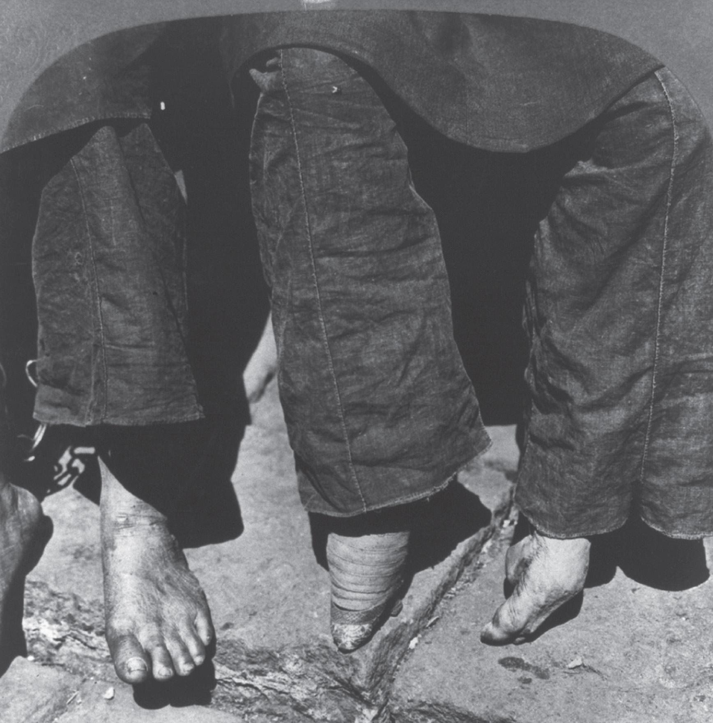
Footbinding as a Marker of Male Dominance
As this photograph vividly illustrates, mature women with bound feet needed special footware since they depended heavily on the very thick heel that resulted from footbinding for support when standing and walking. Little of the sole of the foot touched the ground, and toes were fused together to make a pointed foot.
Notes:
Footbinding as a Marker of Male Dominance
As this photograph vividly illustrates, mature women with bound feet needed special footware since they depended heavily on the very thick heel that resulted from footbinding for support when standing and walking. Little of the sole of the foot touched the ground, and toes were fused together to make a pointed foot.
‹#›

Slide 35
Tang and Song Prosperity: The Basis of a Golden Age
Invention, Artistic Creativity, and China's Global Impact
  Influence over neighbors
  Economy stimulated by advances in farming, finance
  Explosives
    Used by Song for armaments
Notes:
‹#›

Slide 36
Tang and Song Prosperity: The Basis of a Golden Age
Invention, Artistic Creativity, and China's Global Impact
  Compasses, abacus
  Bi Sheng
    Printing with moveable type
      Greatest level of literacy in preindustrial civilization
Notes:
‹#›

Slide 37
Tang and Song Prosperity: The Basis of a Golden Age
Scholarly Refinement and Artistic Accomplishment
  Scholar-gentry key
    Change from Buddhist artists
    Secular scenes more common
  Li Bo
    Poet
  Nature a common theme in poetry, art
Notes:
‹#›

Slide 38
Artistic Expression and Social Values
Art reveals much about the beliefs and values of a civilization.
  Techniques, materials
  Producers, purpose
China's political elite as landscape artists
  Preference for civil leaders in society
  Contrasted with religious paintings and sculpture in other societies

Slide 39
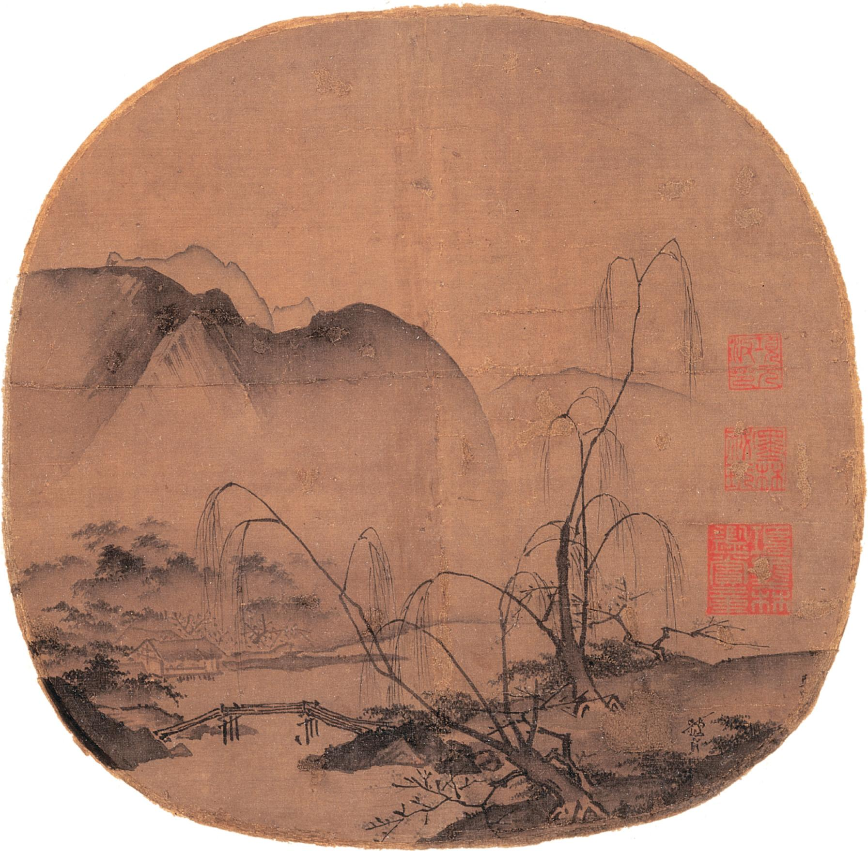
Figure 13.7 The simplicity of composition, the use of empty space, and the emphasis on nature are all characteristic of Chinese landscape painting at its height in the Song era. The colors used tended to be muted; often only brown or black ink was used. Most artists stamped their work with signature seals, like the red ones in this image, and poems describing scenes related to those in the painting floated in the empty space at the top or sides.
(Ma Yuan, Chinese, 1190–1235 “Bare Willows and Distant Mountains.” Photograph © 2010 Museum of Fine Arts, Boston. Special Chinese and Japanese Fund, 14.61)
Notes:
Figure 13.7 The simplicity of composition, the use of empty space, and the emphasis on nature are all characteristic of Chinese landscape painting at its height in the Song era. The colors used tended to be muted; often only brown or black ink was used. Most artists stamped their work with signature seals, like the red ones in this image, and poems describing scenes related to those in the painting floated in the empty space at the top or sides.
(Ma Yuan, Chinese, 1190–1235 “Bare Willows and Distant Mountains.” Photograph © 2010 Museum of Fine Arts, Boston. Special Chinese and Japanese Fund, 14.61)
‹#›

