Slide 1
Networks of Exchange

Slide 2
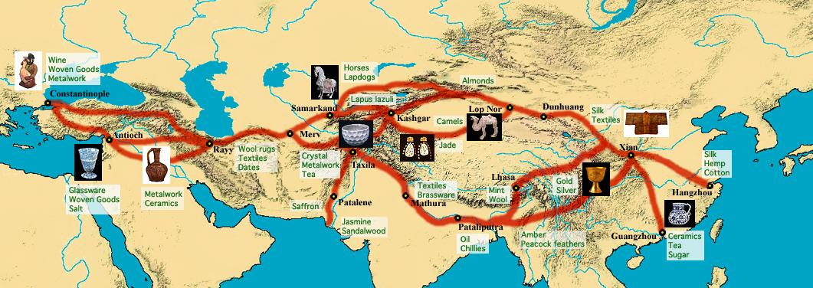
2.1 Silk Road Trade opened around 139 B.C.E. during Han dynasty
https://youtu.be/vfe-eNq-Qyg --Watch on your own, if interested
Notes:
‹#›

Slide 3
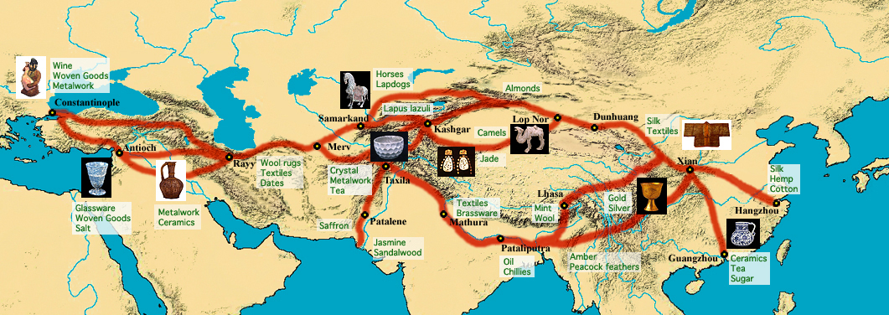
Route of the Overland Silk Road
definition: series of trade routes that ran from western China, usually through Central Asia (some ran through India) to Mediterranean
frequently involved direct interaction between merchants from established agricultural economies and nomadic traders
Notes:
Although it is suspected that significant trade occurred for about 1,000 years beforehand, the Silk Road opened around 139 B.C., once China was unified under the Han dynasty
‹#›

Slide 4
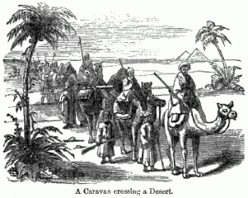
Organization of Long-distance Trade
individual merchants usually did not travel from one end of Eurasia to the other— functioned as a chain
handled long-distance trade in stages
  Chinese, Parthians, Persians, Indians, Romans, and others would dominate the caravan or maritime trade routes within their empire or territory of influence
  since the transport capacity was limited, over long distance and often unsafe, luxury goods were the only commodities that could be traded—limited capacity also explains why Silk Road did not generate particularly intense cultural or technological exchanges
Notes:
From the 9th century, maritime routes controlled by the Arab traders emerged and gradually undermined the importance of the Silk Road. Since ships were much less constraining than caravans in terms of capacity, larger quantities of goods could be traded.
‹#›

Slide 5
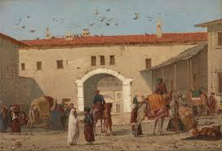
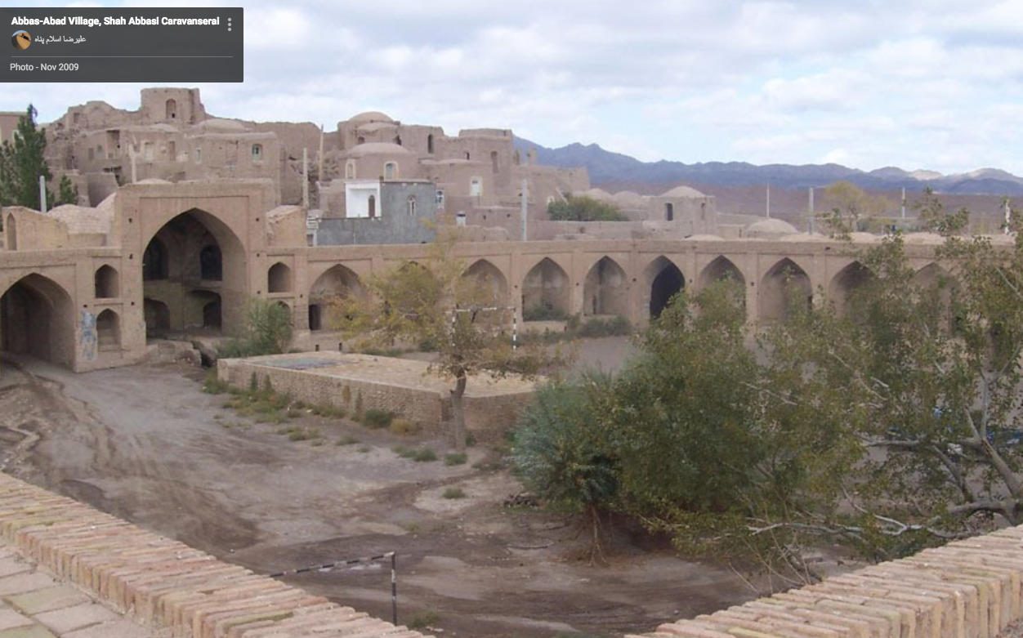
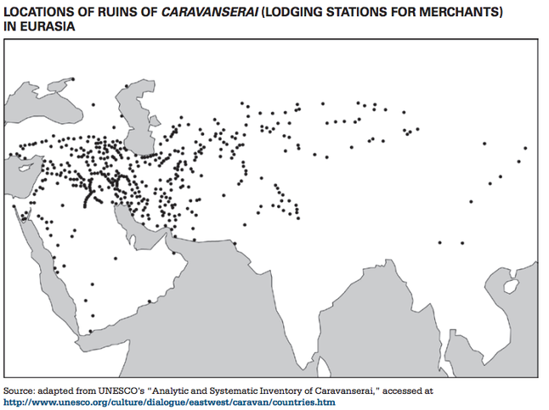
Caravansarais
use of caravans—oasis towns and caravanserais (roadside settlements providing safety and shelter) usually built a day’s journey apart
Mylasa in Asia Minor
Shah Abbas’ caravansarai, Abbasabad, Iran

Slide 6
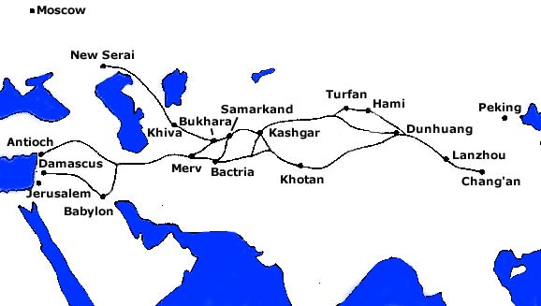
Key Trading Cities
Chang’an (capital of China during Tang)
Baghdad
Samarkand (modern day Uzbekistan)
Kashgar, China

Slide 7
Chang’an, China
imperial capital from 4th century on
marked beginning of Silk Road
melting pot of people from different ethnic & religious backgrounds
“At the height of its glory in the mid-eighth century, Chang’an was the most populous, cosmopolitan, and civilised city in the world” (Richard B. Mather, forward to Xiong).

Slide 8
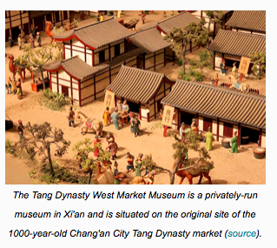
Chang-an
trading hub
Sogdian merchants from Central Asia were vital in transporting & trading goods to China

Slide 9
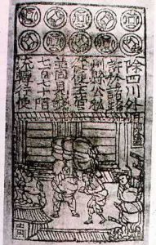
Innovations Facilitating Trade
Paper Money
Letters of Credit
letters from a bank
carry when traveling
arrive at destination, show letter to bank, bank gave you some money
didn’t have to carry bags of money with you—might get stolen

Slide 10
demand for luxury goods increased in Afro-Eurasia
  Chinese, Persian, Indian artisans expanded their production of textiles and porcelains for export
  manufacture of iron and steel expanded in China

Slide 11
Products that Contributed to Silk Road Commerce
China: silk, bamboo, mirrors, gunpowder, paper, ginger, porcelain
Siberia and Central Asia: furs, amber, horses, copper vessels, tents, saddles, slaves, and jade that was highly prized by Chinese stone carvers
India: cotton textiles, herbal medicine, precious stones, spices
Middle East: dates, nuts, dried fruit, dyes, lapis lazuli (ore to make blue dye), swords
Mediterranean: gold coins, glassware, grapevines, jewelry, artworks, perfume, wool and linen textiles, olive oil, bronze goods, pottery

Slide 12
Importance of Silk Road
trade was important for some silk manufacturing centers in western China and for Chinese merchants
trade pattern did not have a major impact on the economies of any other major societies involved
ups and downs—needed strong empires to protect travelers
  active from 100 BCE to 800 CE
  disrupted from about 800-1200 CE
  reached peak from 1200-1400s (after fall of Constantinople to the Turks)—during Pax Mongolica
  dwindled more in 1500s, as European maritime trade took off

Slide 13
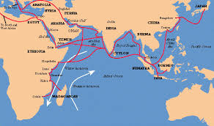
2.3 INDIAN OCEAN TRADE 600 -1450 C.E.

Slide 14
Improved transportation technologies and commercial practices led to an increased volume of trade and expanded the geographical range of existing trade routes, including the Indian Ocean, promoting the growth of powerful new trading cities.

Slide 15
Indian Ocean Network
700 C.E.—knew how to use monsoons (seasonal winds), rise of Islam and its acceptance of merchants (unlike China)
1000-1200—increased trade (revival of China)
Silk Roads declined after Mongols defeated; Indian Ocean trade picked up
surged during 13th & 14th centuries

Slide 16
Indian Ocean Trade 600-1450 C.E.
Ming renewed focus on Indian Ocean Trade with the voyagers of Zheng He
by the 13th century, the Bantu people arrived on the east coast where their language merged with Arabic languages from Muslim traders🡪formed Swahili languages.

Slide 17
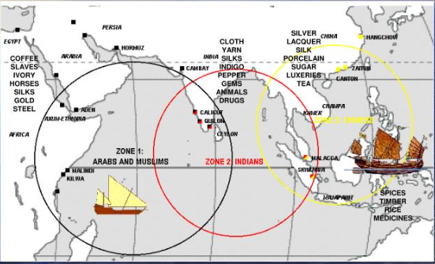
Indian Ocean Trade
Zone 1--west coast of India to Persian Gulf and East coast of Africa
Zone 2--east coast of India to islands of Southeast Asia
Zone 3--South China Sea
the Indian Ocean trade network included sailors from China, Malaysia, Southeast Asia and Persia.

Slide 18
Indian Ocean Trade
probably most important trade network
trade was between towns and cities, not states
sea transport is cheaper
more bulk goods (instead of luxury) traded: textiles, pepper, timber, rice, sugar, wheat
enabled people to concentrate their efforts on economic activities best suited to their regions

Slide 19
Products that Contributed to Indian Ocean Commerce
Mediterranean—ceramics, glassware, wine, gold, olive oil
East Africa—ivory, gold, iron goods, slaves, quartz, leopard skins
Arabia—frankincense (desired far beyond Indian Ocean world), myrrh, perfumes
India—grain, ivory, precious stones, cotton textiles, spices, timber
SE Asia—tin, sandalwood, cloves, nutmeg, mace
China—silks, porcelain, tea
https://youtu.be/a6XtBLDmPA0

Slide 20
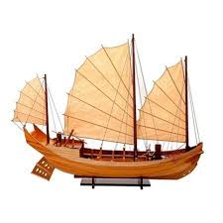
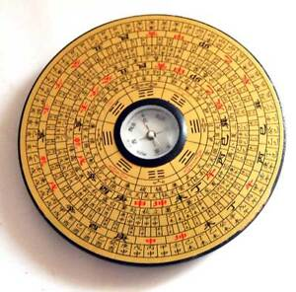
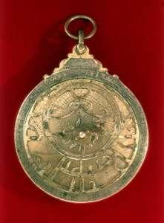
Technology
Chinese Junk
Magnetic Compass
Astrolabe

Slide 21
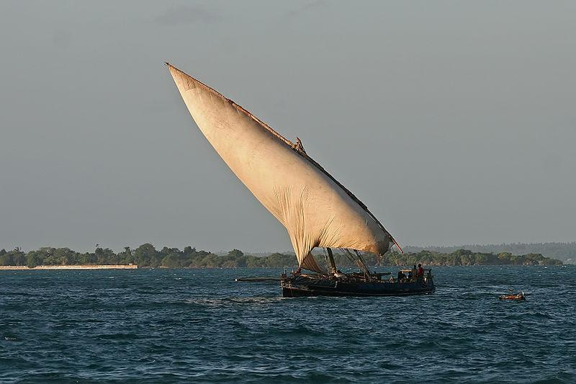
Lateen Sail
(on dhow)
believed to have been used in the eastern Mediterranean as early as the 2nd century CE, possibly imported from Egypt or the Persian Gulf.
its effective use by the Arabs caused its rapid spread throughout the Mediterranean, contributing significantly to the resurgence of medieval commerce.
combined with the square sail, it produced the ocean-conquering full-rigged ship.

Slide 22
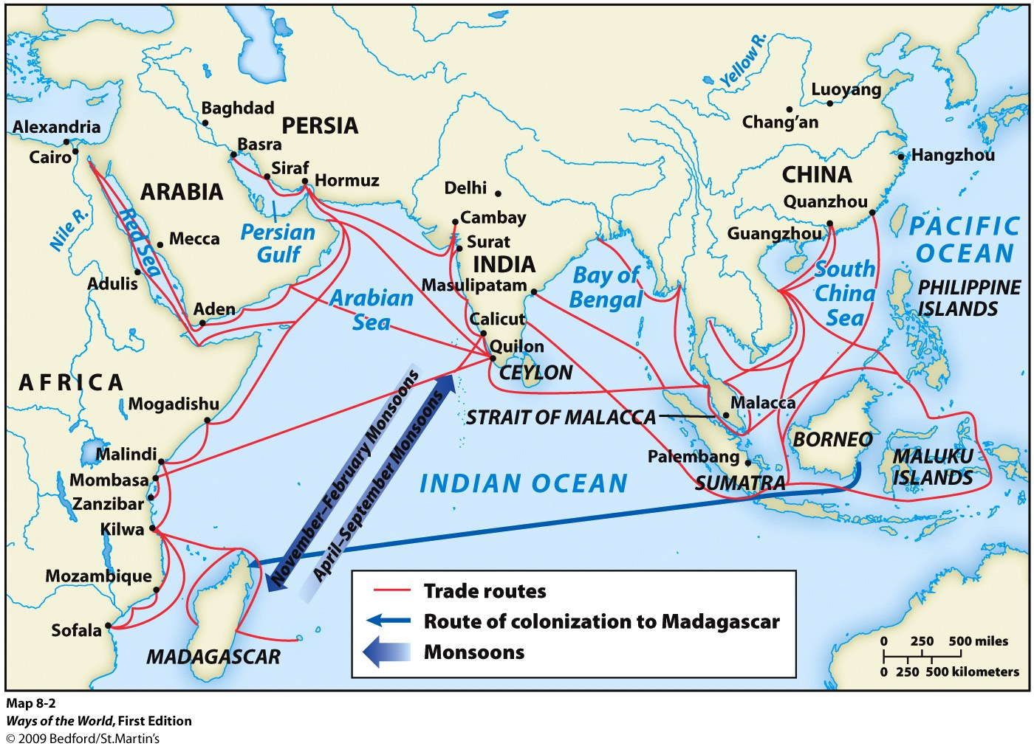
Monsoons (seasonal winds)
monsoon changes were crucial:
  Nov-Feb blew to SW
  April-Sept blew to NE
  key was regularity
sailors used the monsoon winds to chart their course and carry out voyages that linked sections from East Africa to Southern China
limited sailing time🡪 development merchant diasporic communities
The expansion and intensification of long-distance trade routes often depended on environmental knowledge, including advanced knowledge of the monsoon winds.
Notes:
‹#›

Slide 23
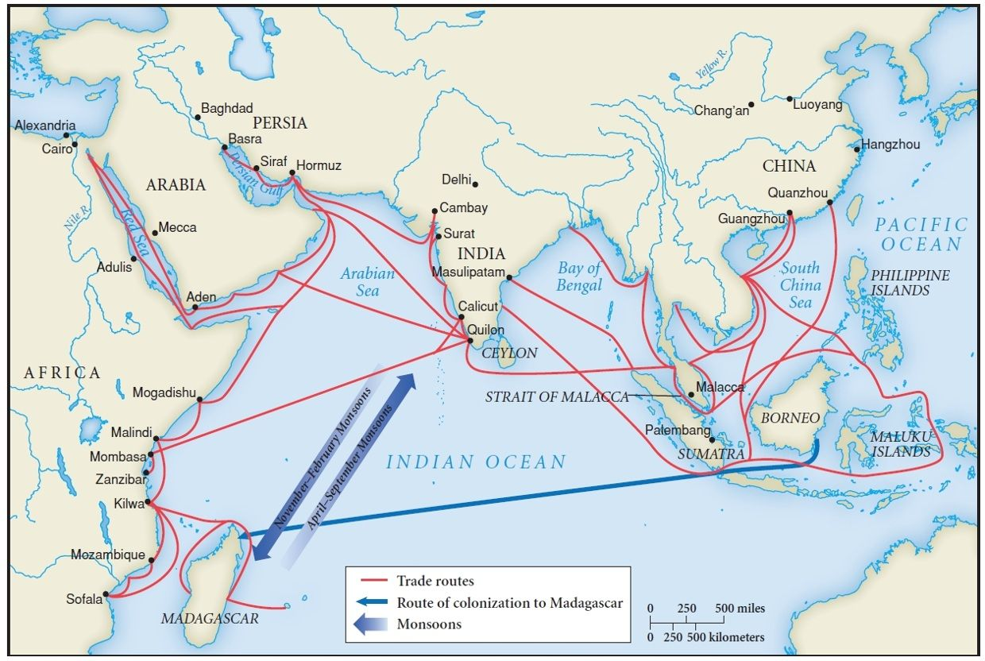
Major Trading Cities
key ports—Swahili city-states of East African coast; Mecca; Hormuz, Persia; Calicut, India; Melaka (Malacca), Malaysia, Canton (Guangzhou), China

Slide 24
Effect—Growth of States
Southeast Asia and East Africa, trade stimulated political change as aspiring rulers used wealth derived from trade to construct larger & more centrally governed states or cities

Slide 25
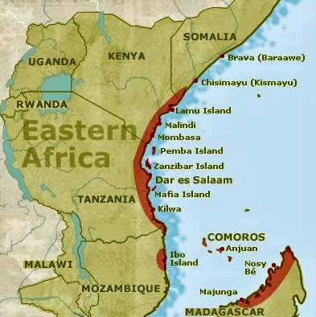
Swahili Civilization
earlier ancestors lived in small farming & fishing communities, spoke Bantu languages, traded with Arabian, Greek & Roman merchants
8th century, civilization took shape as set of commercial city-states stretching along East African coast, from present-day Somalia to Mozambique
gold, ivory, quartz, leopard skins, sometimes slaves acquired from interior societies, as well as iron & process timber manufactured along coast sold in Arabia, Persia, India🡪merchant class, villages became sizable towns, clan chiefs became kings

Slide 26
Swahili States
city-states (like Greece)--each city was politically independent, generally governed by its own king
competed with other cities
commercial centers that accumulated goods from interior & exchanged them for products of distant civilizations (e.g. Chinese porcelain & silk, Persian rugs, Indian cottons)
Islam voluntarily and widely adopted
syncretism—family lineage traced through mother (controlled property) & father (Muslim custom)
neither Islam nor Swahili culture penetrated much beyond the coast until 19th century
Notes:
Swahili was grammatically an African tongue within the larger Bantu family of languages, but it was written in Arabic script and contained a number of Arabic words.
‹#›

Slide 27
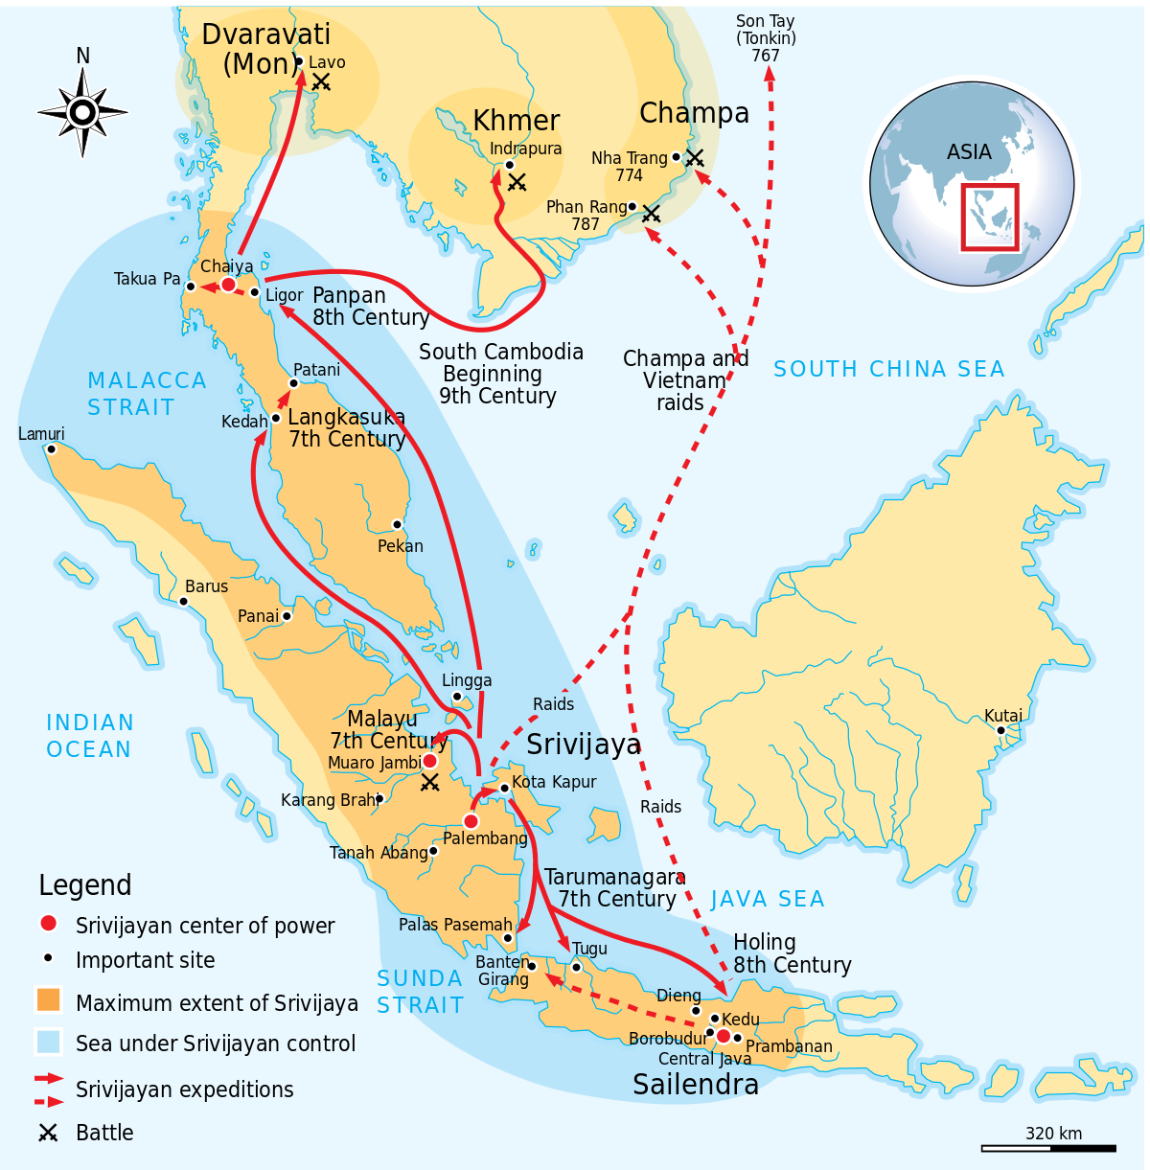
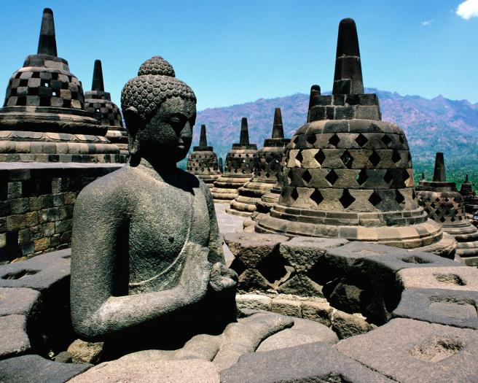
Kingdom of
Srivijaya
Malay peninsula in southeast Asia
Buddhist kingdom
plentiful supply of gold, access to source of highly sought-after spices (e.g. cloves, nutmeg, mace) & taxes levied on passing ships provided resources to attract supports, fund bureaucracy, create military and naval forces
important kingdom for the diffusion of Buddhism across the region—center of Buddhist observance & teaching

Slide 28
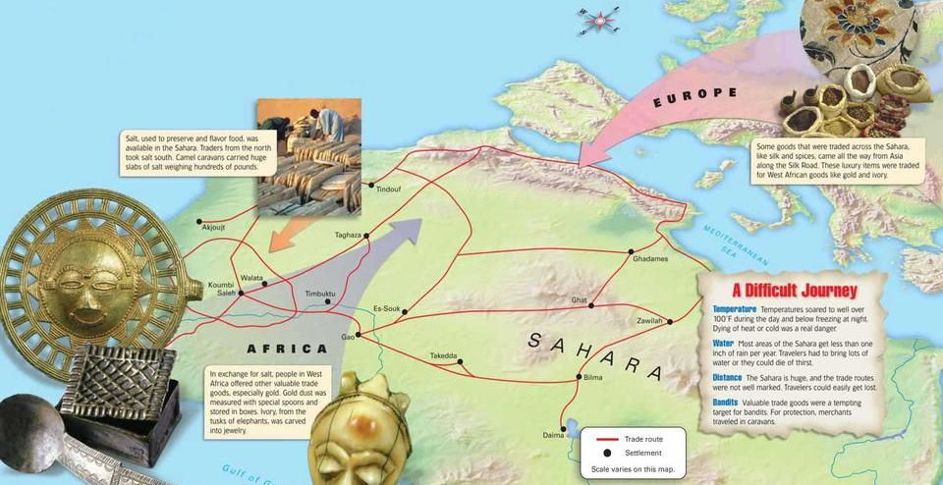
2.4 Trans-Saharan Caravan Routes (Sand Roads)

Slide 29
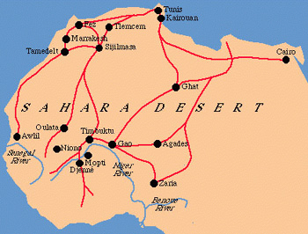
Trans-Saharan Trade 600-1450
provided both incentive & resources for construction of new & larger political structures (e.g. kingdoms)
Timbuktu was a major trading hub, center of learning

Slide 30
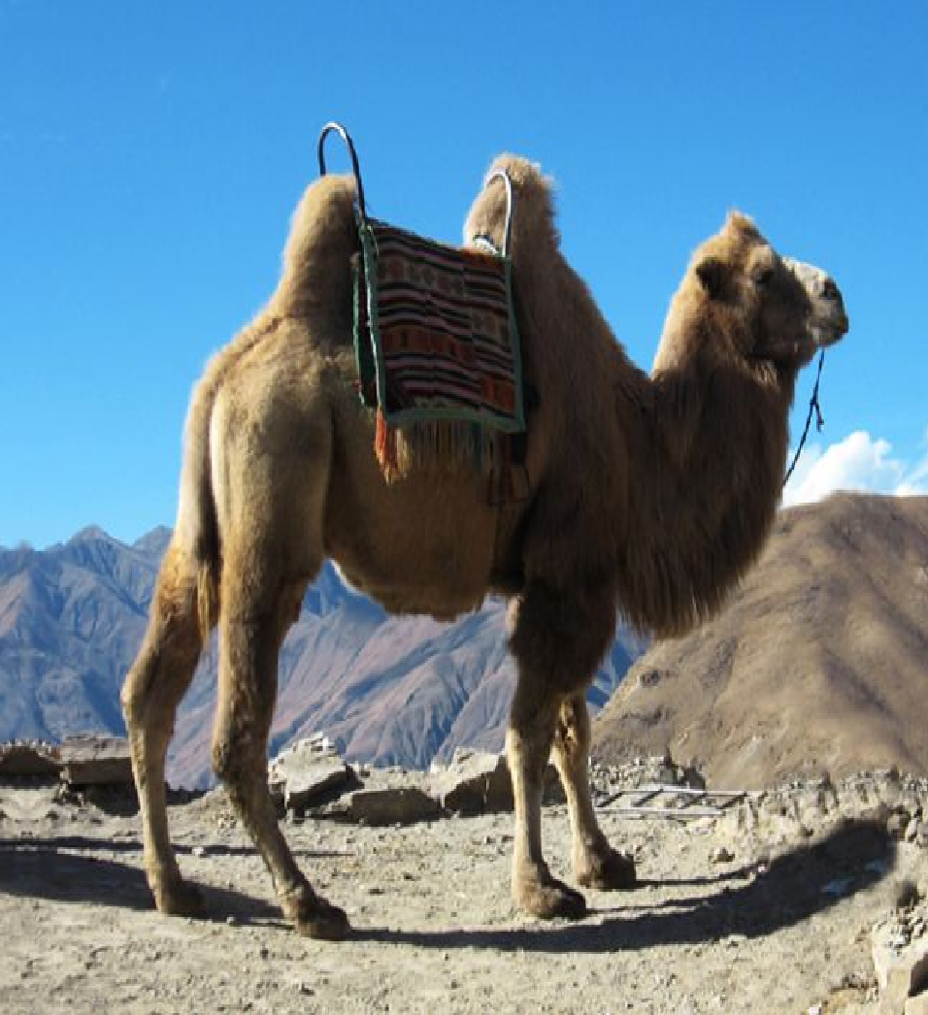
Causes of Trade Growth
trade was influenced by changes like fall of Rome, expansion of Islam into North and West Africa, and formation of strong African states like Ghana and Mali
technology—domestication of camels and camel saddle (introduced around 200 CE)
huge caravans, up to 5000 camels
Notes:
Camels could go for 10 days without water
‹#›

Slide 31
Exchange across the Sahara by 300-400 CE
  trans-Saharan trade led to an exchange of salt for gold
commercial beginnings in West Africa:
  North had manufactured goods, salt, horses, cloth, dates
  South had crops, gold, ivory, kola nuts, slaves
  West had ivory, kola nuts, slaves, gold
  2 items took on greater importance—gold, slaves (Arab slave trade)
  spices, cloth (esp. silk), dates, various manufactured goods from Europe and North Africa

Slide 32
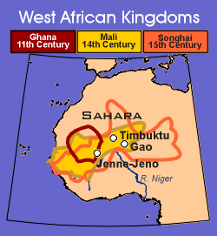
Trans-Saharan Trade
series of powerful trading kingdoms emerged in West Africa—Mali, Ghana, Songhai
  controlled important trade routes that connected North Africa and West Africa
  expansion of empires facilitated Afro-Eurasian trade and communication as new people were drawn into the economies and trade networks

Slide 33
2.5 Cultural Consequences of Connectivity

Slide 34
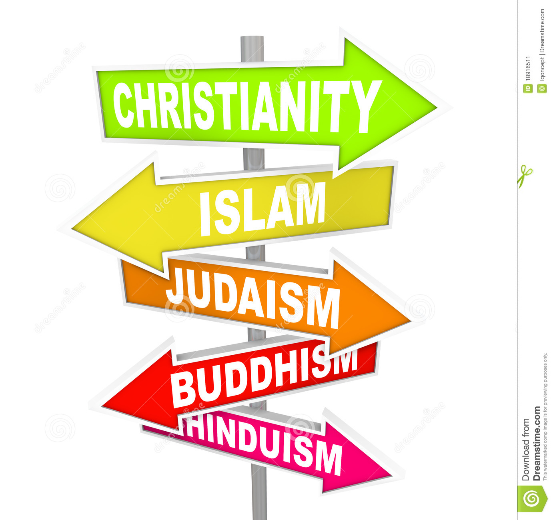
The Spread of Religion

Slide 35
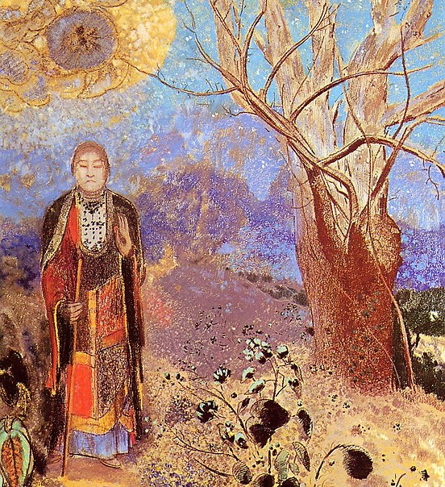
Buddhism in India
Siddhartha Gautama (Buddha) first announced his doctrine publicly in India in 528 B.C.
by the 3rd century B.C., Buddhism was well-established in northern India
merchants carried Buddhism along the Silk Roads where it first established a presence in the oasis towns where merchants and their caravans stopped for food, rest, lodging, and markets
Buddhism was especially successful in attracting merchants as converts

Slide 36
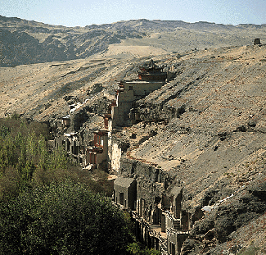
Buddhism at Dunhuang
  oasis town
  between 600 and 1000 A.D., Buddhists built hundreds of cave temples around Dunhuang depicting scenes of Buddha
  assembled libraries of religious literature
  supported missionaries which spread Buddhism throughout China
  Buddhist statements about value of celibacy and individual spiritual quests were recast to make Buddhism more harmonious with Chinese values--syncretism

Slide 37
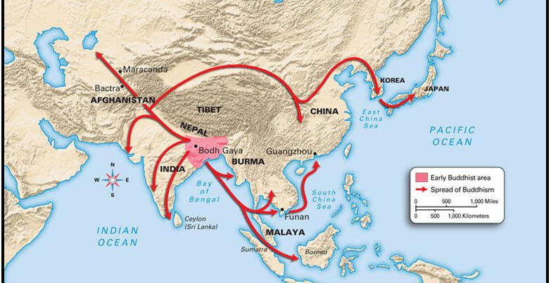
Expansion of Buddhism

Slide 38
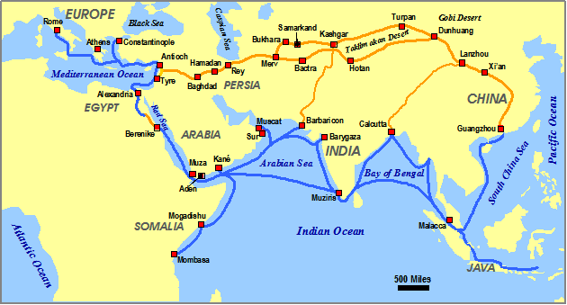
Spread of Hinduism
  Hinduism also spread along the Silk Roads, primarily along the sea lanes
    Indian merchants brought Brahmin priests who spread Hinduism from India to Malaya

Slide 39
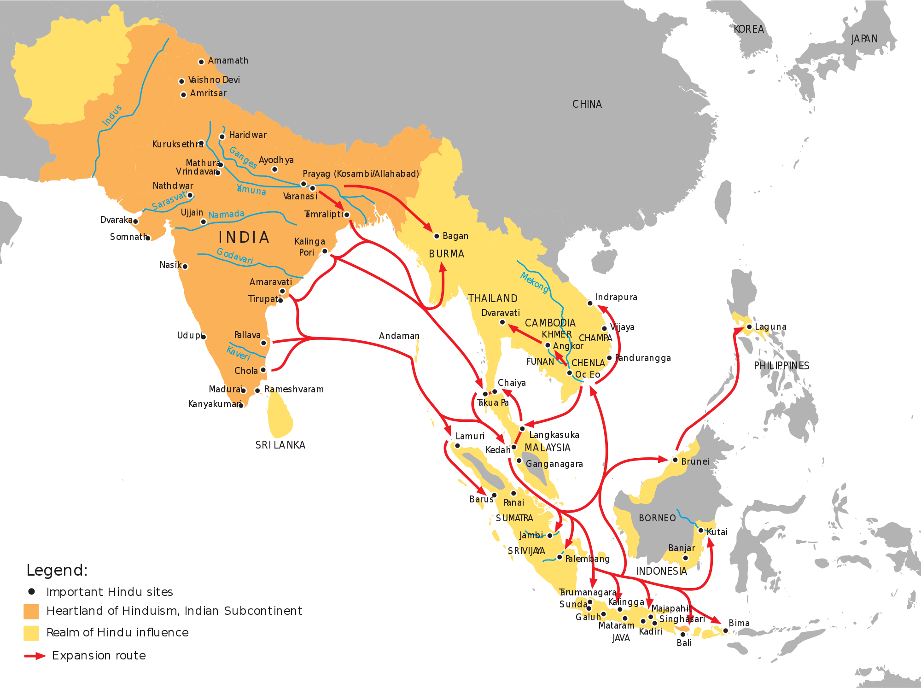
Hindu Influence in SE Asia

Slide 40
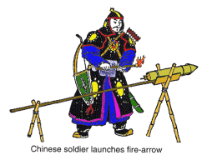
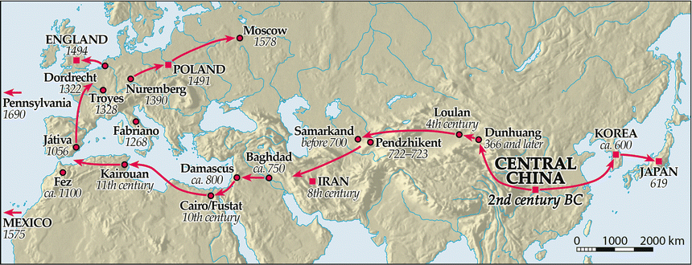
Spread of Technology—
Paper and Gunpowder
Spread of Paper

Slide 41
Travelers
As exchange networks intensified, an increasing number of travelers within Afro-Eurasia wrote about their travels.

Slide 42
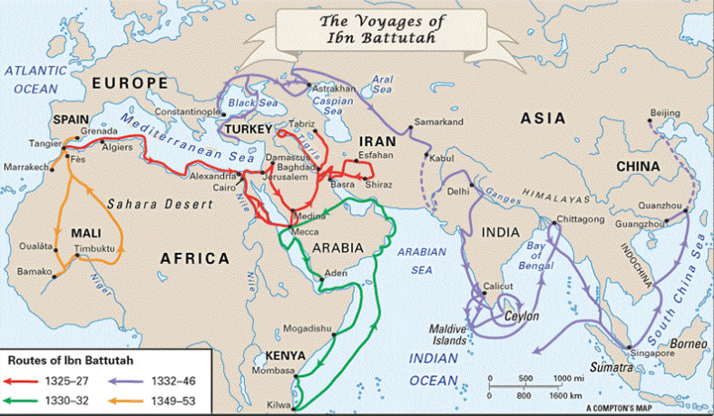
Ibn Battuta
made hajj
traveled over 73000 miles (almost 3x distance around the world) over 29 years
traveled within Dar al-Islam (“The Abode of Islam”)
near end of Battuta’s life, Sultan of Morocco insisted he dictate story of his travels to a scholar: A Gift to Those Who Contemplate the Wonders of Cities and the Marvels of Travelling

Slide 43
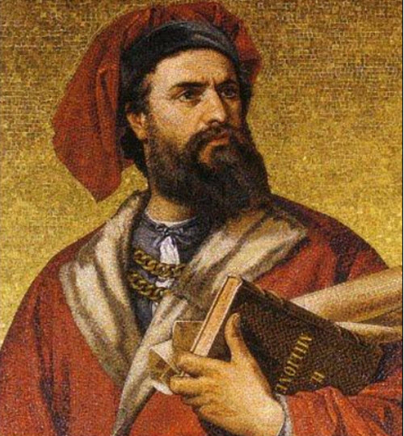
Marco Polo
Venetian merchant who traveled Silk Road to China
wrote Book of the Marvels of the World, aka The Travels of Marco Polo
  describes Peking, capital of China & other Asian cities and countries
brought noodles from China to Italy

Slide 44
2.6 Environmental Consequences of Connectivity
There was continued diffusion of crops and pathogens, with epidemic diseases, including the bubonic plague, along trade routes.

Slide 45
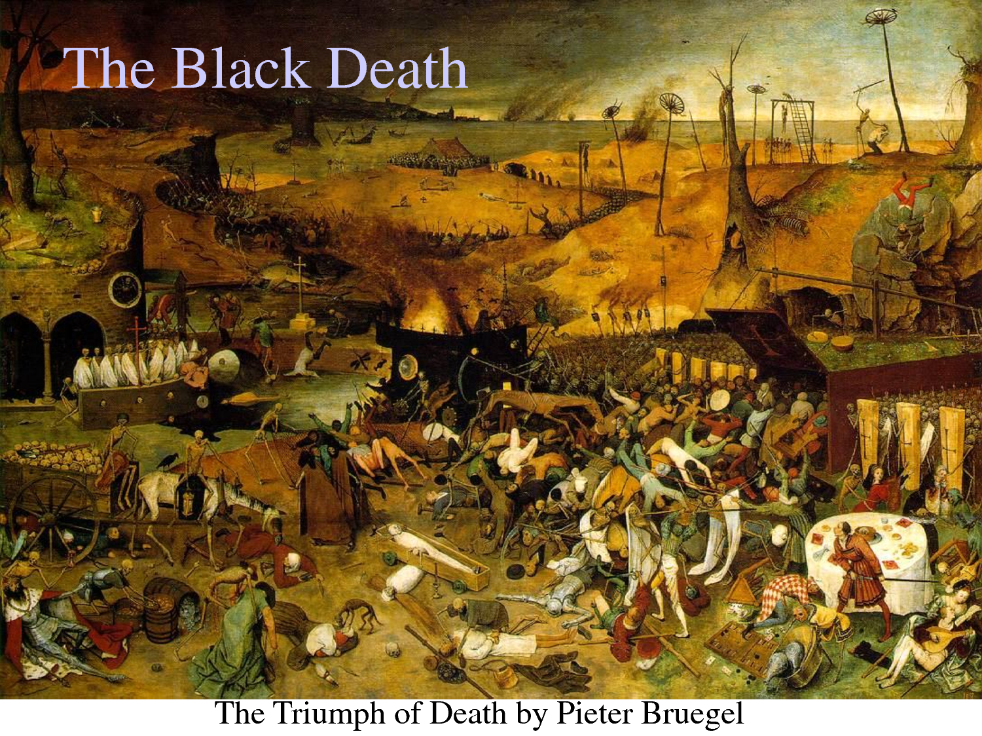
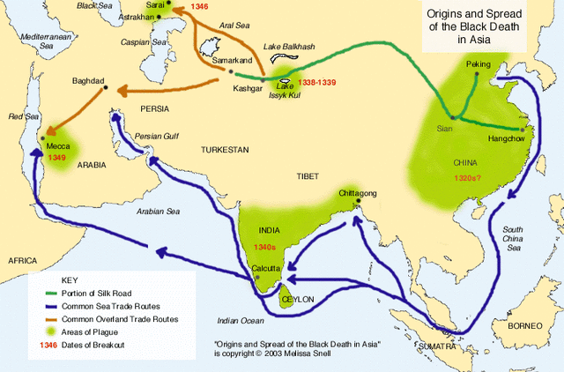
The Spread of Disease
long-distance trading led to spread of disease
most lethal junctures: when an unfamiliar disease arrives
in a new culture

Slide 46
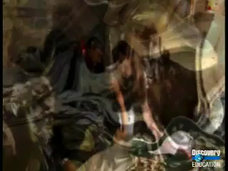
Bubonic Plague Movie
https://youtu.be/hE0boPjgOjg

Slide 47
Changes and Continuities

Slide 48
Continuities
  dominance of India in trade
  importance of the Silk Road and maritime trade routes
  Constantinople as western trade hub
  as classical societies began to decline, importance of trade opportunities and, possibly, even promise of cultural exchange remained vivid enough that people would actively seek replacements

Slide 49
Changes
  move from barter to coins as system of exchange
  greater interaction between civilizations – direct links between Rome and China
  cultural diffusion through trade – spread of religion, architecture, disease
  rise of merchant class in many areas

